Slide 1

A Reactive Online Optimization Based Whole Body Control for Quadruped Locomotion Over Challenging Terrain
[CE554] Mechanical Design of Civil Robot
Team 2
20185570 - Hong Seung woo
20183633 – Choe JongHun
September 19, 2018
Notes:
첫 페이지

Slide 2
Table of Contents
Research Topic
Literature Review
Research Plan
Future Work
Notes:
목차

Slide 3
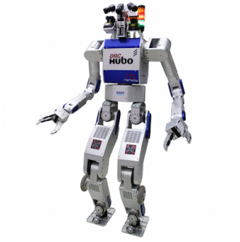
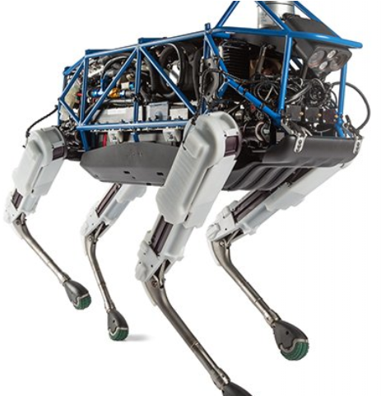








1. Research Topic
$$q, \dot{q}$$
High-level controller
$$x_{ref},{\dot{x}}_{ref},{\ddot{x}}_{ref}$$
$$q, \dot{q}$$
Low-level controller
$$q_{ref},{\dot{q}}_{ref},{\ddot{q}}_{ref}$$
Plant
$${\ddot{q}}_{des}$$
$$τ_{des}$$
$${F_{e}}_{des}$$
Position control robot
Torque
control robot
$$F_{e}$$
control robot
Notes:
통상적인 로봇 컨트롤 프레임워크에 대한 전반적인 설명

Slide 4
1. Research Topic
Highly compliant
Robustness against disturbance
Energy efficient
Robot Control Framework
Notes:
통상적인 로봇 컨트롤 프레임워크에 대한 전반적인 설명

Slide 5
1. Research Topic
High-level controller
Foot placement (CP) based reference generation
Highly compliant
Robustness against disturbance
Energy efficient
Full body inverse dynamics
w/ full optimization variables
Low-level controller
Torque control
quadrupedal robot
Plant

Slide 6
2. Literature Review
Aghili F (2005) A unified approach for inverse and direct dynamics of constrained multibody systems based on linear projection operator: Applications to control and simulation. IEEE Transactions on Robotics 21(5): 834–849.
Bouyarmane, K., Vaillant, J., Keith, F., & Kheddar, A. (2012). Exploring humanoid robots locomotion capabilities in virtual disaster response scenarios. In 12th IEEE-RAS International Conference on Humanoid Robots (Humanoids) (pp. 337–342), Osaka, Japan.
De Lasa, M., Mordatch, I., & Hertzmann, A. (2010). Featurebased locomotion controllers. ACM Transactions on Graphics, 29(4), 131:1–131:10.
Khatib O (1987) A unified approach for motion and force control of robot manipulators: The operational space formulation. IEEE Journal of Robotics and Automation 3(1): 43–53.
Herzog, A., Righetti, L., Grimminger, F., Pastor, P., & Schaal, S. (2014). Balancing experiments on a torque-controlled humanoid with hierarchical inverse dynamics. In IEEE/RSJ International Conference on Intelligent Robots and Systems (IROS), Chicago.
Hutter, M., Sommer, H., Gehring, C., Hoepflinger, M., Bloesch, M., & Siegwart, R. (2014). Quadrupedal locomotion using hierarchical operational space control. The International Journal of Robotics Research, 33(8), 1047–1062.
Feng, S., Whitman, E., Xinjilefu, X., & Atkeson, C. G. (2015). Optimization‐based full body control for the DARPA Robotics Challenge. Journal of Field Robotics, 32(2), 293-312.
Mistry M, Buchli J and Schaal S (2010) Inverse dynamics control of floating base systems using orthogonal decomposition. In: Proceedings of International conference on robotics and automation (ICRA), Anchorage, AK, 3–8 May 2010, pp. 3406–3412.
Sentis L (2007) Synthesis and control of whole-body behaviors in humanoid systems. PhD Thesis, Stanford University.
Raibert, M. H. (1986). Legged robots that balance. MIT press.
Vukobratović, M., & Borovac, B. (2004). Zero-moment point—thirty five years of its life. International journal of humanoid robotics, 1(01), 157-173.
Pratt, J., Carff, J., Drakunov, S., & Goswami, A. (2006, December). Capture point: A step toward humanoid push recovery. In Humanoid Robots, 2006 6th IEEE-RAS International Conference on (pp. 200-207). IEEE.
Rebula, J., Canas, F., Pratt, J., & Goswami, A. (2007, November). Learning capture points for humanoid push recovery. In Humanoid Robots, 2007 7th IEEE-RAS International Conference on (pp. 65-72). IEEE.

Slide 7
3. Research Plan

Slide 8
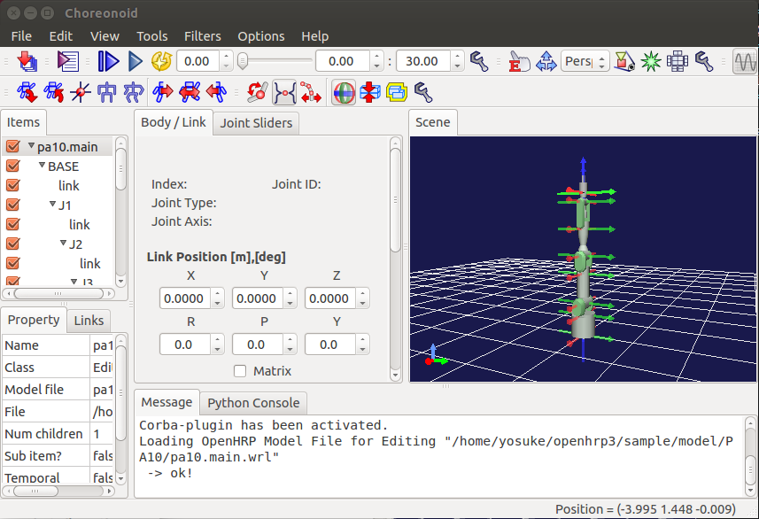
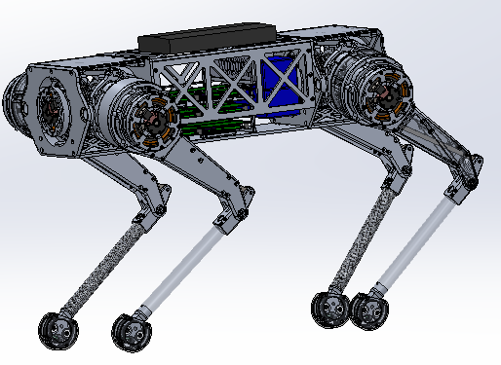
4. Future Work
Select appropriate Quadratic Programming solver
Choreonoid simulator install & tutorial
Do RESEARCH!!
Test on full-body simulator
(Test on real quadrupedal robot)

Slide 9


