Slide 1
CE554 Progress Report
Team 00
2018.09.03

Slide 2
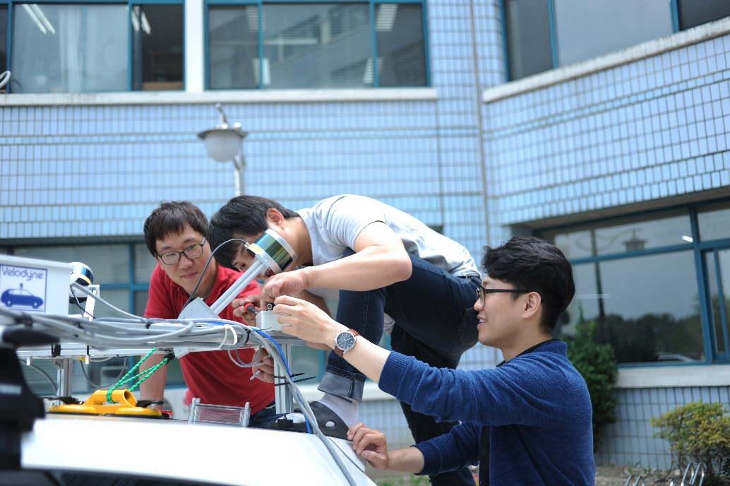
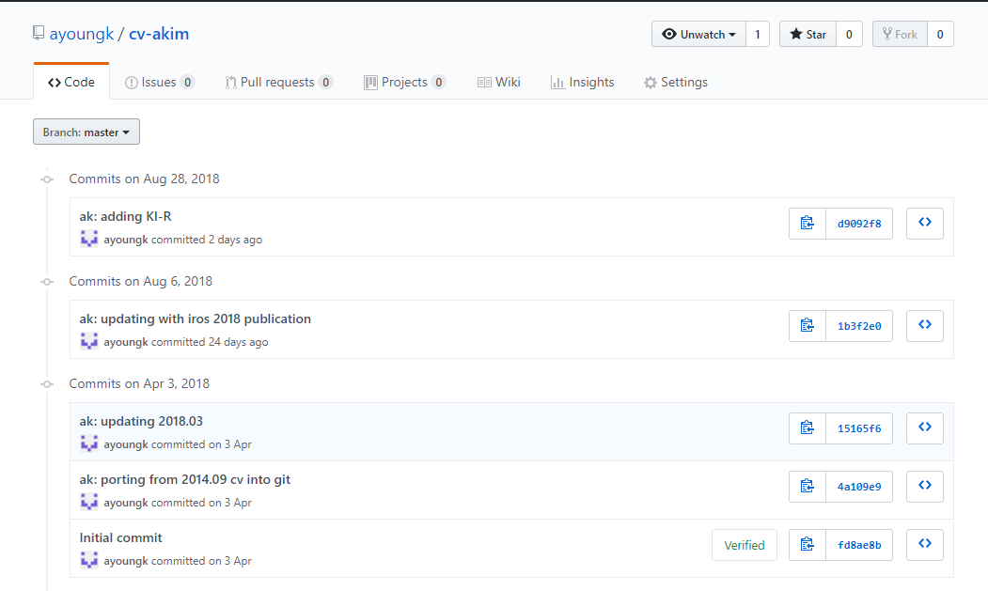
On-going Process
This week we performed
Experiment
Collected data
Mostly coded
First XX module completed

Slide 3

Potential Issue to Discuss
Robot does not move
We tried A and B but C is not working somehow
Camera works but limited view

