Slide 1
CE554 Progress Report
Team 02
2018.10.29

Slide 2
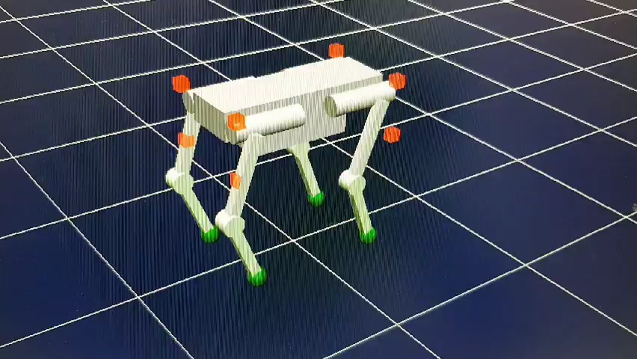
On-going Process
This week we performed
Preparing Preliminary PPT
Discussion
Organizing presentation
Method of using about ‘Choreoniod’
Low level controller with ID

Slide 3
Potential Issue to Discuss
Applying controller only on HLC
Do we have enough time to apply controller on LLC, too?
Presentation Plan
Video candidates, and which results are needed?

