Slide 1
CE554 Progress Report
Team 02
2018.11.26

Slide 2
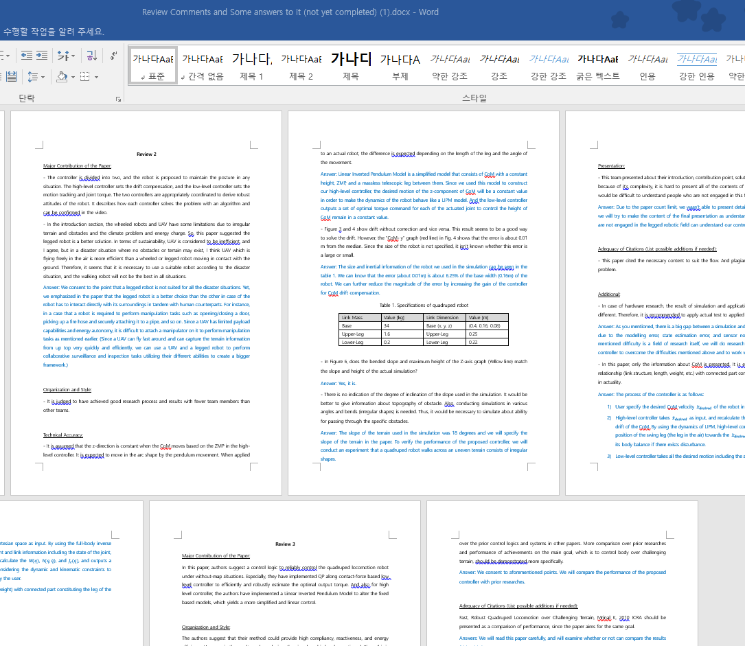
On-going Process
Write a Rebuttal
Collect reviews and write a rebuttal
Do Experiments
Push recovery
Slope
Uneven

Slide 3
Potential Issue to Discuss
Prepare final presentation
Final paper
Full rebuttal
Video organization
Propose standard of experiments
How much impact is needed for the push recovery task?
Various size of obstacles in case of the uneven terrain task?

