Slide 1
CE554 Progress Report
Team 02
2018.11.05

Slide 2
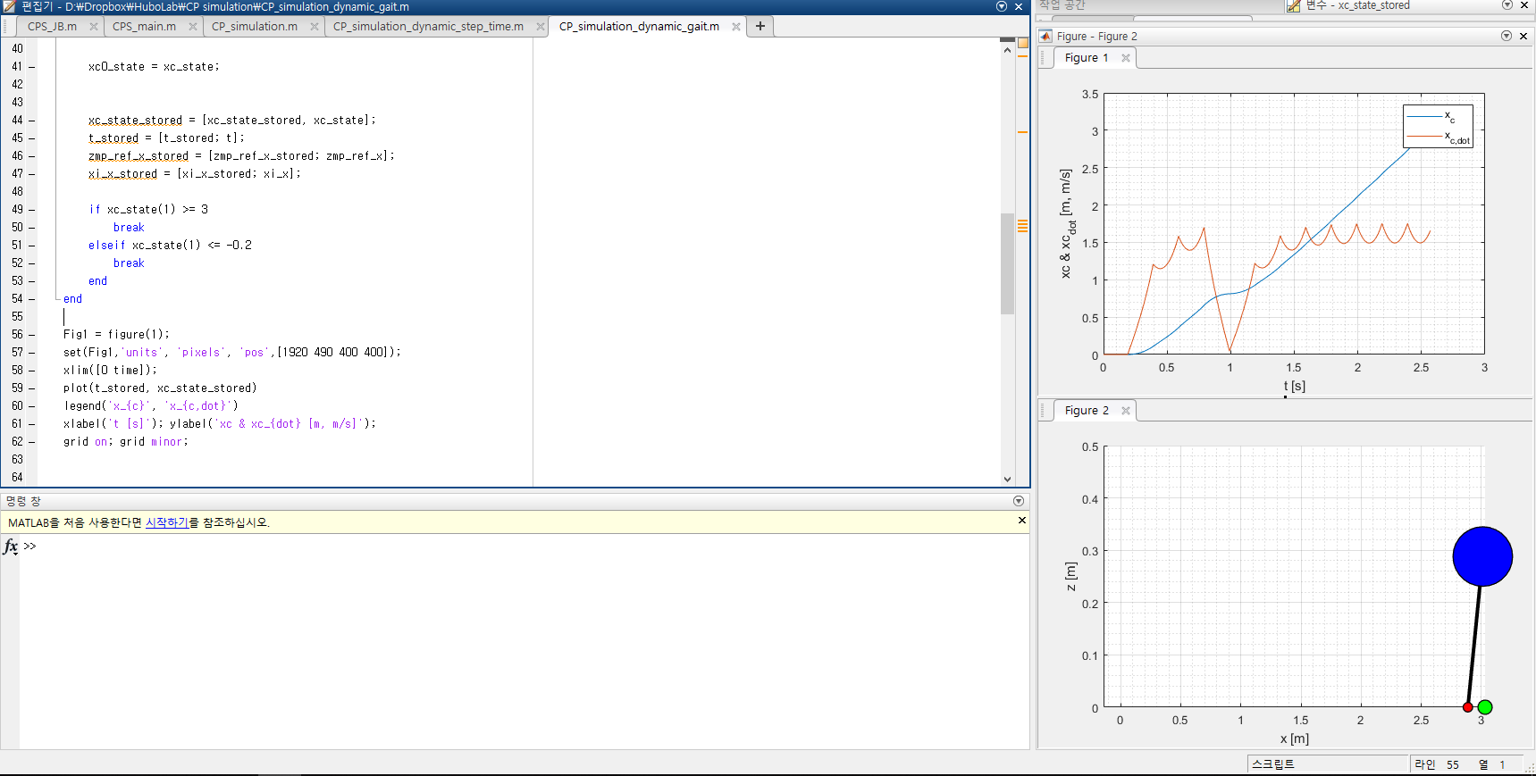
On-going Process
This week we performed
Preparing Preliminary PPT
Discussion
Our contributions
Design simulations for proving contributions
Low level controller with ID

Slide 3
Potential Issue to Discuss
What is the contribution points on HLC?
Not only use CoM position, but also pelvis position
Reduce noise, and computation time
Presentation Plan
Video candidates, and which results are needed?

