Slide 1
CE554 Progress Report
Team 02
2018.11.28

Slide 2
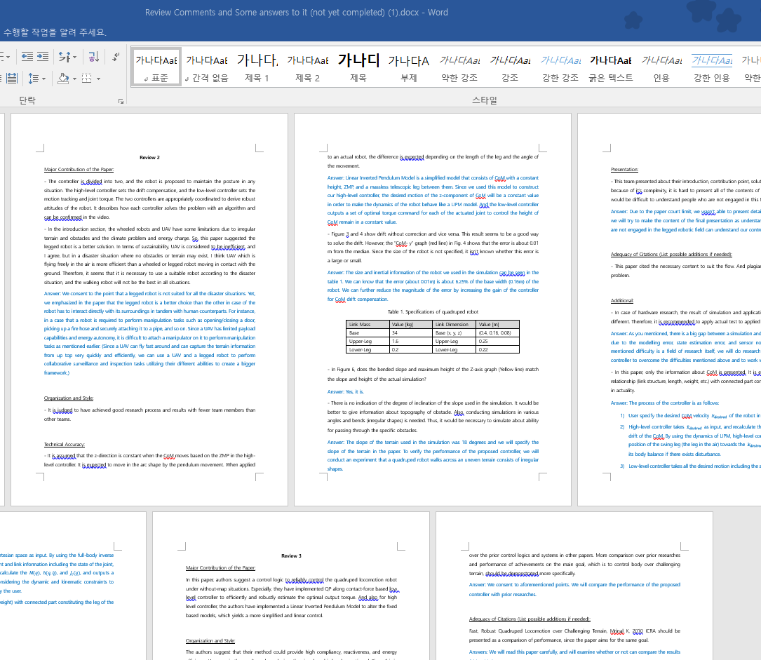
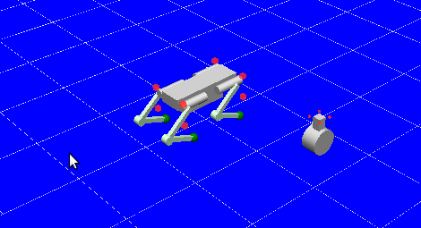
On-going Process
Write a Rebuttal
Collect reviews and write a rebuttal
Do Experiments
Push recovery
Uneven
Supplement of result and conclusion part

Slide 3
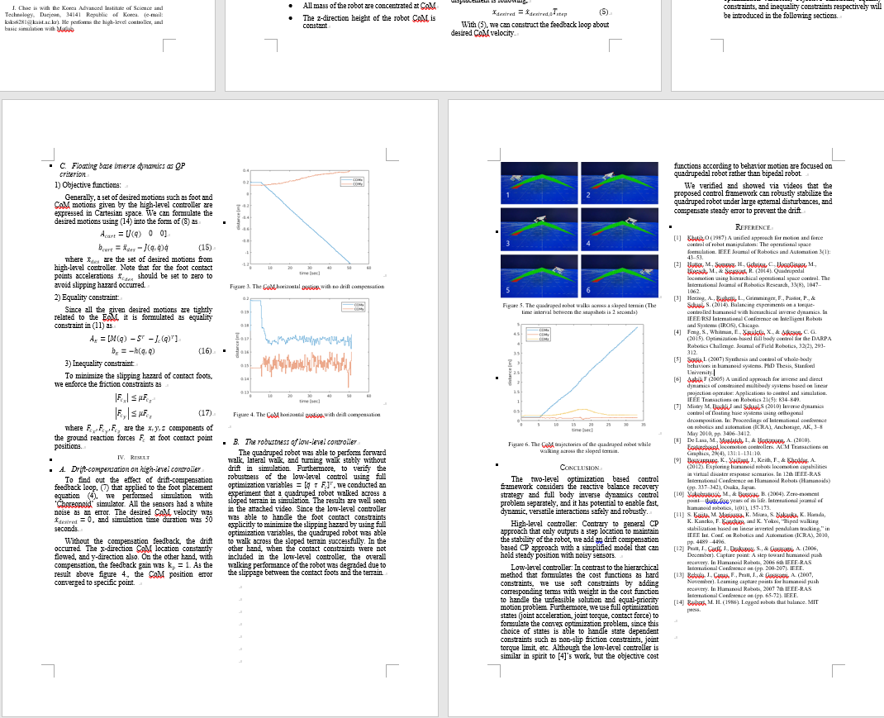
Potential Issue to Discuss
Possibility of excess
Current: full 5 pages
Plan: add result & conclusion for additional experiments
Push recovery
Uneven
6 pages may not enough!
How about 7~8 pages?

