Slide 1

A Reactive Online Optimization Based Whole Body Control for Quadruped Locomotion Over Challenging Terrain
[CE554] Mechanical Design of Civil Robot
Team 2
20185570 - Hong Seung woo
20183633 - Choe JongHun
November 21, 2018

Slide 2
Table of Contents
Reviews
Easy Issues
Common Issues

Slide 3
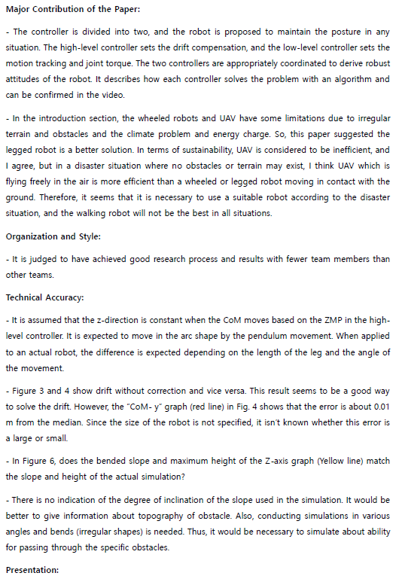
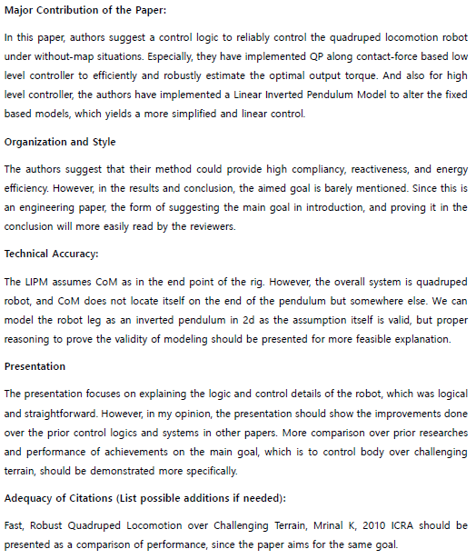
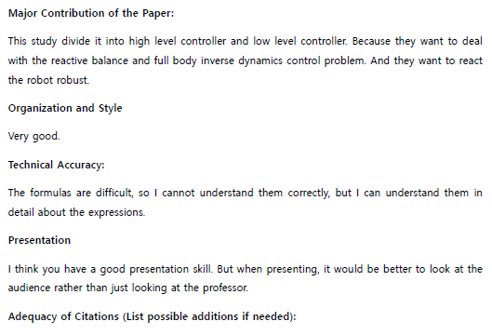
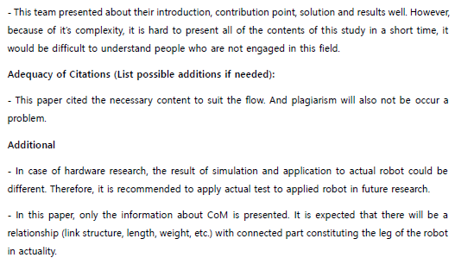
1. Reviews
Thanks for all the comments!!

Slide 4
1. Reviews
From the reviews, we could extract many comments.
Reviewers asked about…
Contents in introductions
Questions about the model that used in High-level controller
Questions about the quadruped robot that used in simulation
Minor typos
Figure organization
Experiment conditions
Requirements of additional experiments
Quantitative, and specific comparison with other researches

Slide 5
1. Reviews
We can divide these comments with 2 categories,
Easy issues
Common issues

Slide 6
2. Easy Issues
Easy issues
Questions about the model that used in High-level controller
Questions about the quadruped robot that used in simulation
Minor typos
Experiment conditions

Slide 7
2. Easy Issues
Easy issues
Questions about the model that used in High-level controller
Questions about the quadruped robot that used in simulation
Minor typos
Experiment conditions
Correct typos
Add information (Terrain / Robot condition)
We will answer the all the questions on rebuttal

Slide 8
3. Common Issues
Common issues
Contents in introductions
Figure organization
Requirements of additional experiments
Quantitative, and specific comparison with other researches
Lack of result and conclusion

Slide 9
3. Common Issues
Common issues
Contents in introductions
In the introduction section, the wheeled robots and UAV have some limitations due to irregular terrain and obstacles and the climate problem and energy charge. So, this paper suggested the legged robot is a better solution. In terms of sustainability, UAV is considered to be inefficient, and I agree, but in a disaster situation where no obstacles or terrain may exist, I think UAV which is flying freely in the air is more efficient than a wheeled or legged robot moving in contact with the ground. Therefore, it seems that it is necessary to use a suitable robot according to the disaster situation, and the walking robot will not be the best in all situations.
We agree that a legged robot is not suitable for all terrain conditions
We just emphasized that a legged robot can be a better choice when the robot should make direct interact with its surrounding.
Of course, there exist much terrains that a legged robot cannot reach.
We will modify introduction

Slide 10
3. Common Issues
Common issues
Figure organization
There are some figures that never mentioned
Reorganize figures
Make the figures more clearly
Check the missing legends
Add more information on figure’s captions

Slide 11
3. Common Issues
Common issues
Requirements of additional experiments
Quantitative, and specific comparison with other researches
There is no indication of the degree of inclination of the slope used in the simulation. It would be better to give information about topography of obstacle. Also, conducting simulations in various angles and bends (irregular shapes) is needed. Thus, it would be necessary to simulate about ability for passing through the specific obstacles.
The presentation focuses on explaining the logic and control details of the robot, which was logical and straightforward. However, in my opinion, the presentation should show the improvements done over the prior control logics and systems in other papers. More comparison over prior researches and performance of achievements on the main goal, which is to control body over challenging terrain, should be demonstrated more specifically.
Fast, Robust Quadruped Locomotion over Challenging Terrain, Mrinal K, 2010 ICRA should be presented as a comparison of performance, since the paper aims for the same goal.

Slide 12
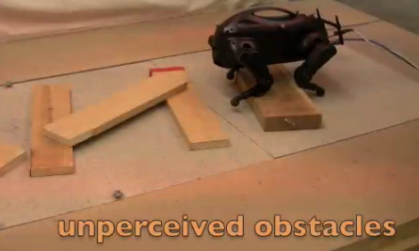
3. Common Issues
Uneven terrain:
[1] Fast, Robust Quadruped Locomotion over Challenging Terrain, Mrinal K, 2010 ICRA should be presented as a comparison of performance, since the paper aims for the same goal.
Size(length, width, height): 0.3[m] x 0.18[m] x 0.26[m]
Weight: 2.5 [kg]
Usable leg length: 13 [cm]
Perceived terrain: Obstacle height up to 76 [%] of the usable leg length
Unperceived terrain: Obstacle height up to 30 [%] of the usable leg length
Obstacle height up to 30 [%] of the usable leg length

Slide 13
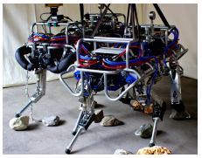
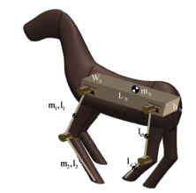

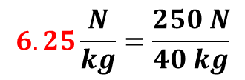
3. Common Issues
Push recovery:
[2] Barasuol, Victor, et al. "A reactive controller framework for quadrupedal locomotion on challenging terrain." ICRA. 2013.
Size(length, width, height): 1.0[m] x 0.5[m] x 0.98[m]
Weight: 70 [kg]
$$8.6\frac{N}{kg}=\frac{600 N}{70 kg}$$
Withstand 600 N push
[3] Khorram, Mahdi, and S. Ali A. Moosavian. "Push recovery of a quadruped robot on challenging terrains." Robotica 35.8 (2017): 1670-1689.
Size(length, width, height): 0.5[m] x 0.37[m] x 0.5[m]
Weight: 40 [kg]
$$6.25\frac{N}{kg}=\frac{250 N}{40 kg}$$
Withstand 250 N push
Withstand push force up to 8.6 [N/kg]

Slide 14
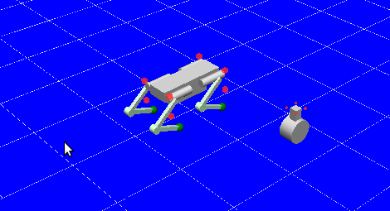
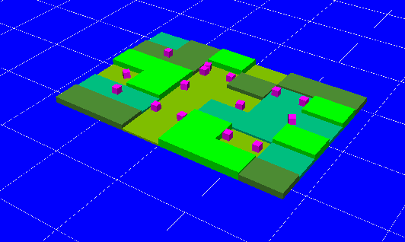
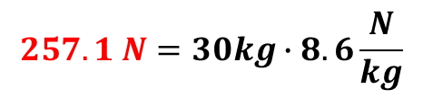

3. Common Issues
Comparison criteria:
Size(length, width, height): 0.4[m] x 0.16[m] x 0.53[m]
Usable leg length: 0.4[m]
$$12 cm=40cm∙0.3$$
Weight: 30 [kg]
$$257.1 N=30kg∙8.6\frac{N}{kg}$$
Withstand up to 260 N push
Uneven terrain
(Obstacle height: 12cm )
Push recovery
(Push force: up to 260 N)

Slide 15
3. Common Issues
Common issues
Lack of results and conclusions
The authors suggest that their method could provide high compliancy, reactiveness, and energy efficiency. However, in the results and conclusion, the aimed goal is barely mentioned. Since this is an engineering paper, the form of suggesting the main goal in introduction, and proving it in the conclusion will more easily read by the reviewers.
More result & conclusions are needed
Add result and conclusions
From additional experiments mentioned above
Experiment result: uneven terrain & push recovery
Comparisons will be included

Slide 16
Q & A

