Slide 1
CE554 Progress Report
Team 02
2018.10.08

Slide 2
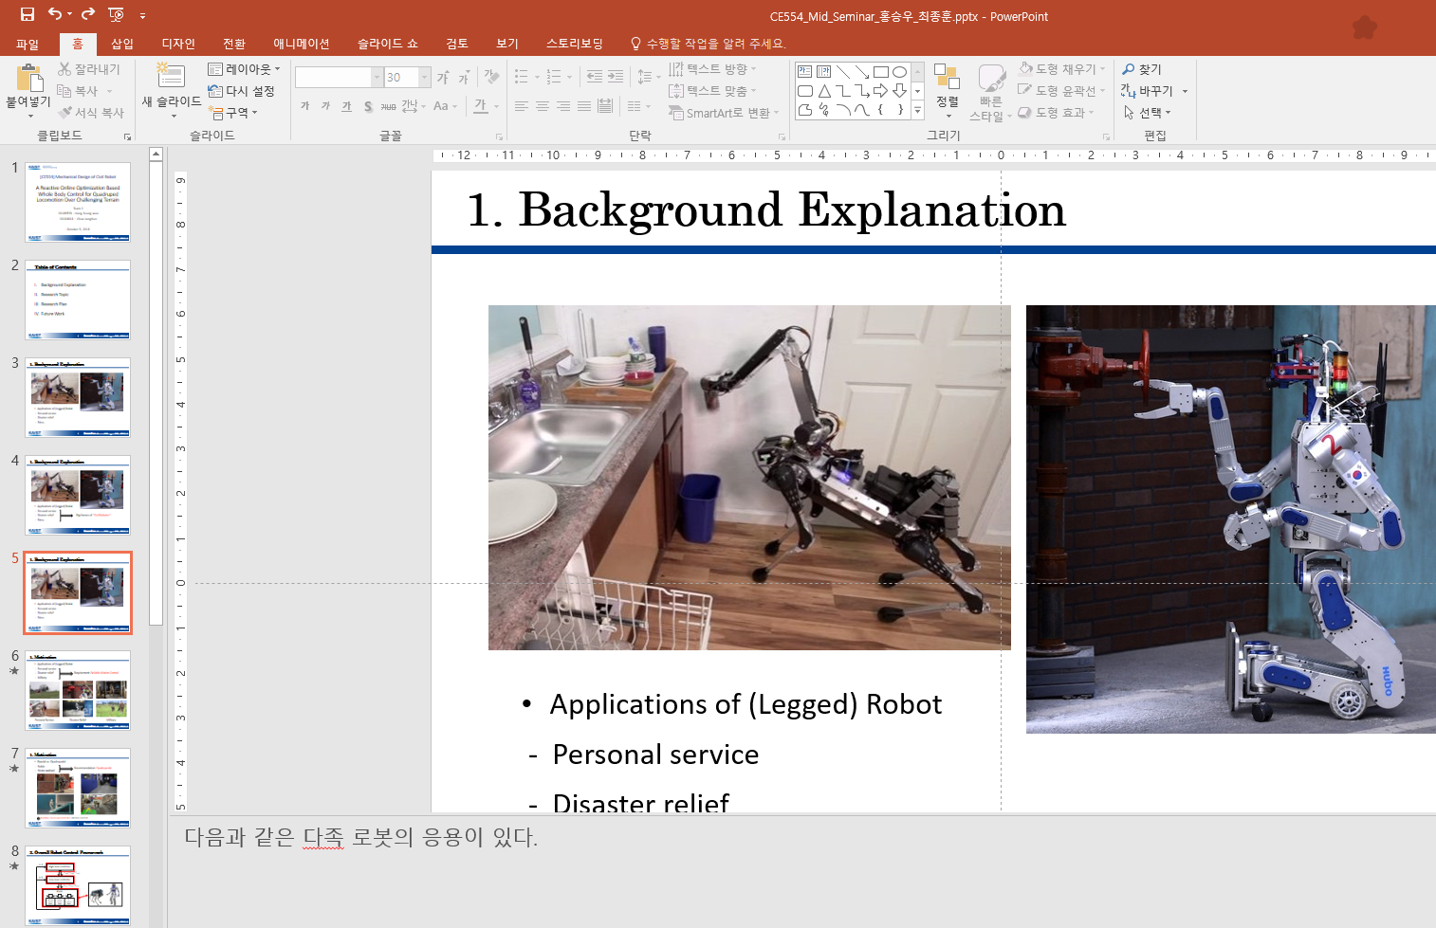
On-going Process
This week we performed
Preparing Mid-Seminar PPT
Discussion
Presentation
Using CP on High-level controller
4-legged robot proposed at IROS2018

Slide 3
Potential Issue to Discuss
Applying optimization also on HLC
Most of the algorithms applied optimization only on LLC. But Why?
Presentation Plan

