Slide 1
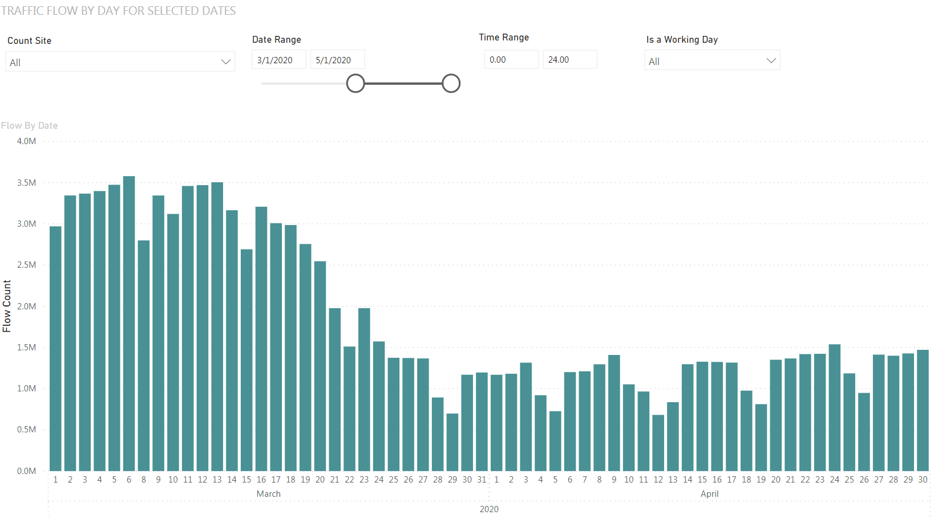
Social distancing
Lockdown

