Slide 1
Vuforia studio extentions
Steve Ghee

Slide 2
Important information
Vuforia Studio extension mechanism is
Undocumented
everything you learn/read here has been gathered and collated following many years of reverse engineering, experimentation, trial and error
there are many things that I do not know (have not needed to find out yet)
Unfinished
there are many gaps, there are things that don’t work
with imagination, many ‘gaps’ can be skipped
Unsupported
things break – product team do not support this, will not answer questions
debugging is manual (chrome debugger is your best friend)

Slide 3
agenda
Overview of Studio UX
Widget concepts
Anatomy of a widget
What are the important pieces
Widget 101
Something simple
Homework
-break
Widget 201

Slide 4
Overview
Widgets perform specific functions
Inputs can be static or dynamic
Dynamic inputs can be “bound” to suppliers of data (outputs of other widgets)
Same for outputs
data outputs can be bound to others
Widgets can also directly influence the scene (implicit output)
A well designed widget will
Do it’s specific task, and only that task
Will provide sufficient granularity in data inputs – enough to get the task done
(ideally) not offer too much flexibility i.e. simple to use
Fit in well with other widgets that already exist
Example
OCTO Finder widget will ‘identify’ items that meet some search criteria
It doesn’t try to list those items in some html display – there are widgets to do that
It doesn’t try to highlight those items – there’s a different widget for that
It is flexible as to what to include in the outputs so that other widget can ADD value

Slide 5
Overview
Today we will cover
Basic architecture of a widget
Design
Runtime
Data input and output
Handling changes to data
Interacting with other widgets
We will not cover
Javascript programming
Specific HTML or TML (Thing Markup) programming

Slide 6
Architecture
Vuforia Studio is an application builder – it declares a model which is ‘compiled’ into an experience = a web app
Vuforia View (experience “player”) hosts web apps
An experience is typically a web app (html, javascript)
TML = a series of extensions to the HTML declarative model to support 3D/AR
Think of an AR experience as a transparent HTML page that runs on top of a 3D page which sits on top of a video camera
Widgets provide 3 capabilities
A way to declare editor-based tools that help define some function or capability
a method to declare this functionality within the html page
At runtime, the code that is invoked when this (h)tml element is displayed
Vuforia Studio was built using AngularJS 1.x

Slide 7
Architecture
Experience Server
Project
Project
Project
Studio IDE
Vuforia View
Experience Project
View
View
Widget
Widget
View
Assets
code
Native services
e.g.Tracking, display

Slide 8
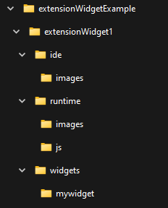
Components
Root
Index.js – manifest of that is needed
Ide
Assets used in the Studio editor e.g. icons
Widgets
Folder per widget
Contains design (declaration) for editor
Style sheet
Runtime
Assets for runtime – icons, models, code modules
Angular controller (js)

Slide 9
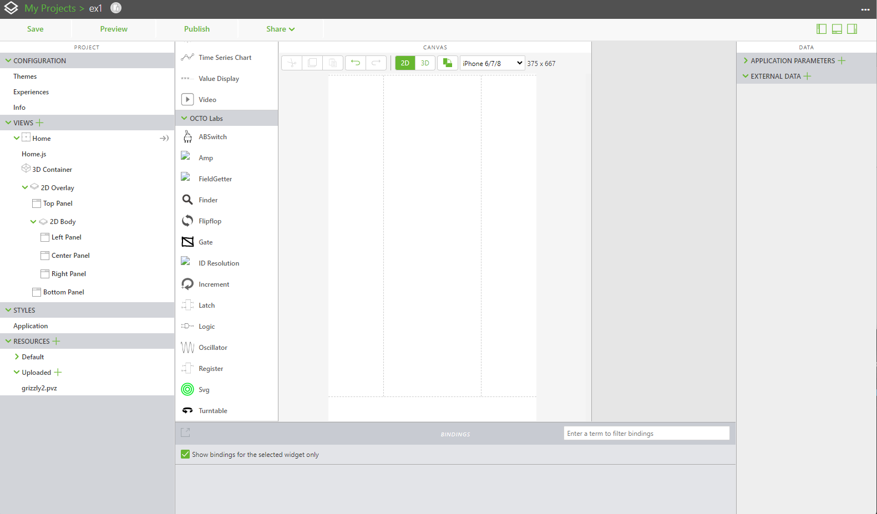
Anatomy
Widgets can be defined to be in specific categories
These map to which ‘template’ / View they are listed in
Category=AR is for widgets that specifically live in the AR visual space
Appear in the 3D window
Non-AR widgets appear in the 2D window
Widgets can be defined to be within a group
Many of the OCTO widgets appear in the “OCTO Labs” group
Groups can appear in multiple categories

Slide 10
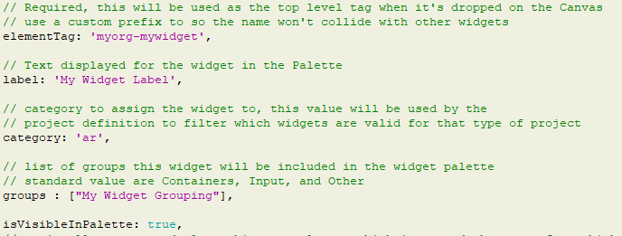
Widget.design.js
ElementTag
We are defining (declaring) a web page, so the element tag here is the name of the html element that your widget will use
Similar to <body> or <a> or <p>
Label
The name that appears in the widget display
Icon name must match label
Category
If its 3d centric, use “ar” otherwise leave blank
Groups
Describe where to fit in the toolbox
category
Group(s)
label

Slide 11
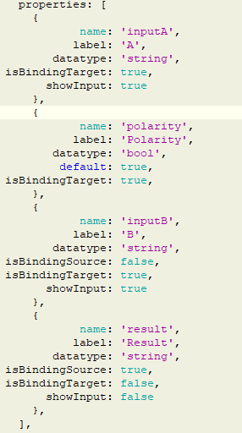
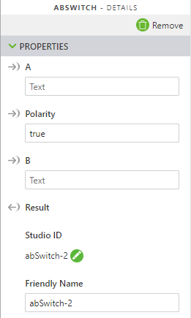
Widget.design.js
BindingTarget=true
Properties
An array of input/output values
Various types supported
String, Boolean, Number
Infotable (json array)
Select (choice)
Can be bindingTarget (input)
Can be bindingSource (output)
Can be both!
BindingSource=true

Slide 12
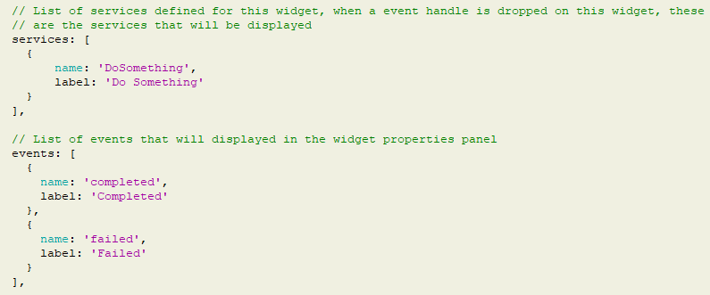
Widget.design.js
Services
These are capabilities (functions)
You trigger it via an event
Perform an operation, change state, change outputs
Events
Emitted when “something” happens
Can be bound to (input) triggers on other widgets

Slide 13
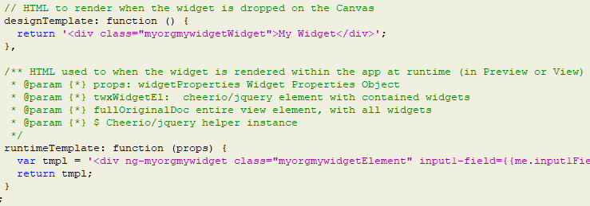
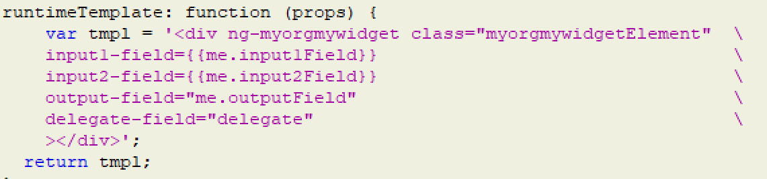
Widget.design.js
designTemplate
What appears in the editor canvas
Can include edit-time controls, display information etc.
runtimeTemplate
What appears at runtime
Can have visual presence (html)
Can drive TML etc.
Parameters are attributes
Semantics are important
xxx-field => xxxField
{{me.varName}} will track changes
“me.anotherVar” is two way

Slide 14

Widget.design.js
Dependencies
Declare stuff that is needed
Files
Any code, images, assets needed at runtime
Angular modules
Ids of the modules needed to operate
At runtime, invoke this…

Slide 15
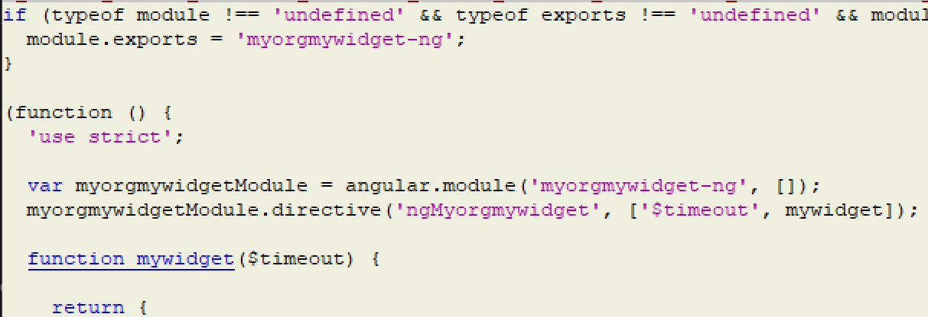
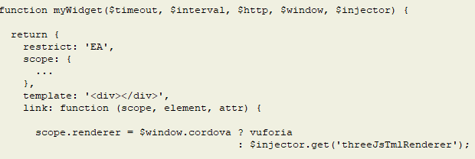
Myorgmywidget-ng.js
Request Other services
Angular controller
Instanced for each <div ng-controller
“listen” to changes in inputs
Process and apply changes to outputs
Important piece to get right
Declaration says
ng-myorgmywidget
Case doesn’t matter in html
Controller looks for ngMyorgmywidget
ng-xyz has the –x interpreted to be X (capital)
ng-xyz -> ngXyz
Take care when naming
Directive can request other angular services e.g. $timeout, $http, $window
Use $window to get tmlRenderer
Use $injector to get thingworx connector
Case is important here

Slide 16
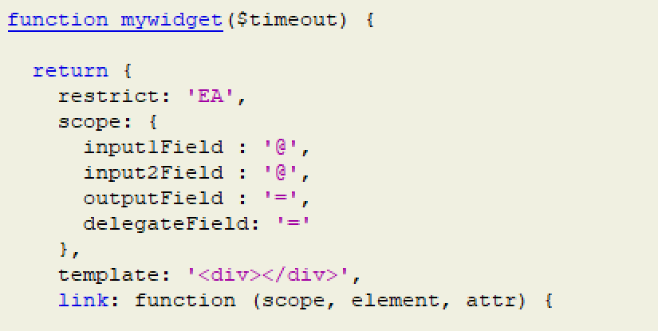
Myorgmywidget-ng.js
Angular controller
Attributes etc. are passed ‘scope
If declaration says xxx-something
Input (scope) is xxxSomething
Input-field1 -> inputField1
Field types
xxxField: ‘@’ declares this as an input
xxxField: ‘=‘ declares this as input/output
“Link” is called when a declaration is made in the html page
This is where you setup your services …

Slide 17
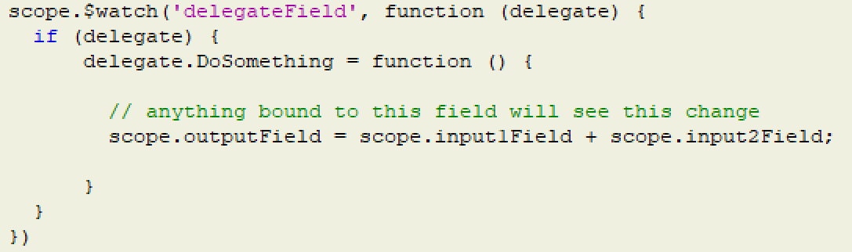
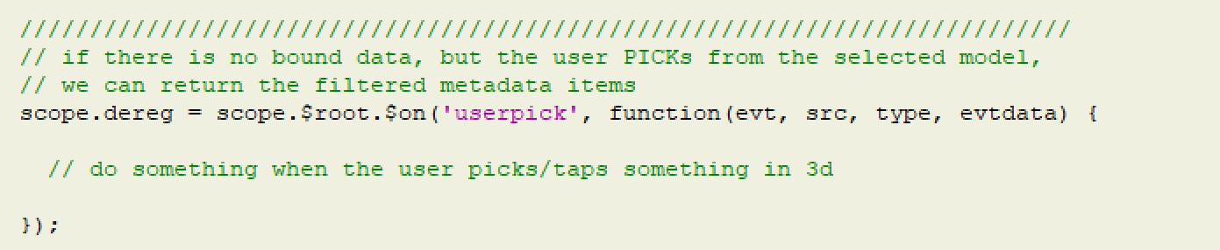
Myorgmywidget-ng.js
Widget definition
Setting up services
Use Angular $watch to observe changes
Delegate parameter accepts methods
Delegate.doSomething = function() …
doSomething matches the widget
Listen for events
Use Angular $on to listen for events
Return value is a function to unregister
Call this when view terminates
controller implementation

Slide 18
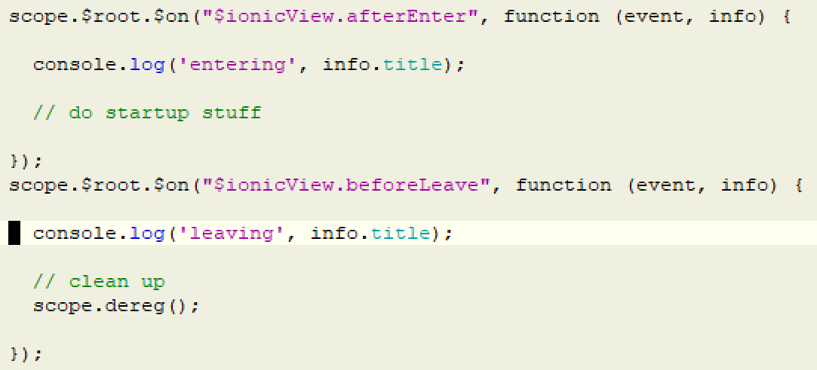
Myorgmywidget-ng.js
Lifecyle
Link function called on page initialisation
Use ionic events to react to page begin/end
ionicView.afterEnter
ionicView.beforeLeave
Remember to call deinit for event listeners
Widgets run in Angular digest loop
If you dont see data (outputs) changing, call
scope.$parent.$applyAsync()
to force the digest loop to re-evaluate

Slide 19
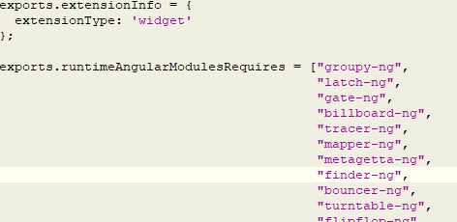
index.js
Exports
List of angular modules used

Slide 20
Things to watch out for
Naming / capitalisation is important
Check the ng-name / ngName is correct
Same for fields xxx-field / xxxField
Be sure to clean up (beforeLeave)
Very important for system events e.g. userpick ect.
Drag handlers in 3d editor don’t work
Workaround = Position by hand
There is no way, on drop, to identify what you were dropped on…
Workaround = manual named references (see ‘affects’ field in Billboard widget)

