Slide 1
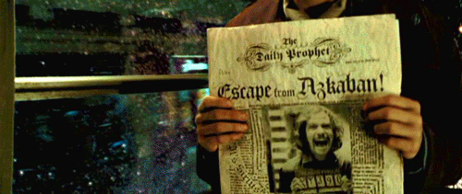
Journal

Slide 2
One machine generates N streams of telemetry …
Telemetry (machine)
machine
Data streams
time

Slide 3
At any time (t) we can look at the data stream :-
(like looking into a pipe with the water flowing towards you)
Telemetry (machine)
machine
Time = t
Data streams
time

Slide 4
And see the machine’s medical record as of “now”…
Temperature : 45 degrees
machine
Pressure : 21 Pa
Altitude : 210 m
Time = t

Slide 5
And of course we have all the history …
Telemetry (machine)
source
history
t-2
Think of it this way :
The machine / data source is constantly writing it’s autobiography
=> “What is happening to me right now”
And we can look back at previous pages to see what has happened in the past …
Data streams
time

Slide 6
So can see the machine’s medical record as of “then”…
Temperature : 47 degrees
machine
Pressure : 51 Pa
Altitude : 210 m
Time = t-2

Slide 7
and we can plot the information over time
47
Temperature :
51
Pressure :
Altitude :
210
Time = t-2
and interogate it…

Slide 8
A service event generates more telemetry
telemetry (machine)
machine
service
event
telemetry from
tools
user
app
Data streams
time

Slide 9
And we can have many sources of stream data
telemetry (machine)
machine
machine
machine
machine
service
event
service
event
telemetry from
tools
user
app
Data streams
sources
time
Notes:
Sources = machines, different users (technicians etc.) over time, different tools used in different service events, many apps

Slide 10
Using Jolt, we can generate (predict) future data
Telemetry (machine)
source
future
now
But this isn’t just simple extrapolation based on the immediate data streams …
Data streams
time

Slide 11
… it is driven from the many sources of data
machine
machine
machine
machine
Service
event
Service
event
Service
event
Data streams
… so we can predict events that could occur in the future…
sources
time
Notes:
Sources = machines, different users (technicians etc.) over time, different tools used in different service events, many apps

Slide 12
We can tap into other sources…
machine
service
event
routine
maintenance
schedule
Weather
Not ideal
weather
Data streams
and suggest the optimal time to take action
time

Slide 13
We can analyse and report …
Creates more (virtual) sources and more streams
aggregate
aggregate
machine
machine
machine
Service
event
machine
Service
event
Data streams
sources
time
Notes:
Sources = machines, different users (technicians etc.) over time, different tools used in different service events, many apps

Slide 14
… and we can predict on these streams too
aggregate
aggregate
machine
future
machine
machine
Service
event
machine
Service
event
now
Data streams
sources
time
Notes:
Sources = machines, different users (technicians etc.) over time, different tools used in different service events, many apps

Slide 15
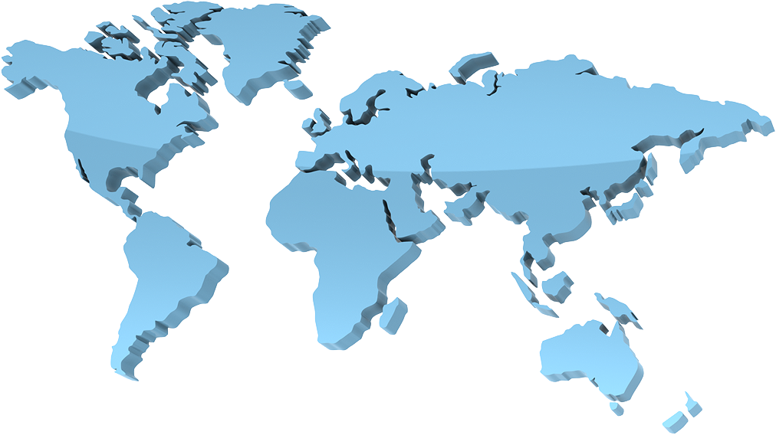
We can aggregate in many different ways…
aggregate
aggregate

Slide 16
But look at it from a different angle…

Slide 17
And …
Creates more (virtual) sources and more streams

Slide 18

Aggregate in a different way
aggregate

Slide 19
We can view the aggregate streams in the same way
Efficiency : 96.5%
aggregate
Last breakdown : Tuesday, CIC (Boston)
Overall energy used : 3460 kW
Time = t

Slide 20
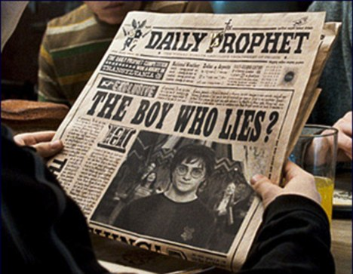
The records can contain all sorts of (dynamic) media
Based on your role
Text
Captions and blocks
Images
2d
3d
movies
Graphs & charts
Individual streams
Composite (aggregate) streams
Which is all presented in “magazine” form
Familiar layout paradigm
Broadsheet or tabloid form factors
Different pages showing different views e.g. news, page3, finance, sport
Each page can be laid out in different ways
Content on the page can be dynamic – real-time 3d, real-time telemetry

