Slide 1
Journal

Slide 2
One machine generates N streams of telemetry …
Telemetry (machine)
machine
Data streams
time

Slide 3
At any time (t) we can look at the data stream :-
(like looking into a pipe with the water flowing towards you)
Telemetry (machine)
machine
Time = t
Data streams
time

Slide 4
And see the machine’s medical record as of “now”…
Temperature : 45 degrees
machine
Pressure : 21 Pa
Altitude : 210 m
Time = t

Slide 5
And of course we have all the history …
Telemetry (machine)
source
history
t-2
Data streams
time

Slide 6
So can see the machine’s medical record as of “then”…
Temperature : 47 degrees
machine
Pressure : 51 Pa
Altitude : 210 m
Time = t-2

Slide 7
and we can plot the information over time
34
Temperature :
87
Pressure :
Altitude :
123
Time = t
and interogate it…

Slide 8
A service event generates more telemetry
telemetry (machine)
machine
service
event
telemetry from
tools
user
app
Data streams
time

Slide 9
And we can have many sources of stream data
telemetry (machine)
machine
machine
machine
machine
service
event
service
event
telemetry from
tools
user
app
Data streams
sources
time
Notes:
Sources = machines, different users (technicians etc.) over time, different tools used in different service events, many apps

Slide 10
At any time, we have historic and current (“now”) data
Telemetry (machine)
source
history
now
Think of it this way :
The machine / data source is constantly writing it’s autobiography
=> “What is happening to me right now”
And we can look back at previous pages to see what has happened in the past …
Data streams
time

Slide 11
So we can plot the information over time
And interegate it…
34
Temperature :
87
Pressure :
Altitude :
123
Time = t

Slide 12
Using Jolt, we can generate (predict) future data
Telemetry (machine)
source
future
now
Data streams
But this isn’t just simple extrapolation based on the immediate data streams …
time

Slide 13
… it is driven from the many sources of data
… so we can predict events that could occur in the future…
machine
machine
machine
machine
Service
event
Service
event
Service
event
Data streams
sources
time
Notes:
Sources = machines, different users (technicians etc.) over time, different tools used in different service events, many apps

Slide 14
We can tap into other sources…
machine
service
event
routine
maintenance
schedule
Weather
Not ideal
weather
Data streams
and suggest the optimal time to take action
time

Slide 15
We can analyse and report …
Creates more (virtual) sources and more streams
aggregate
aggregate
machine
machine
machine
Service
event
machine
Service
event
Data streams
sources
time
Notes:
Sources = machines, different users (technicians etc.) over time, different tools used in different service events, many apps

Slide 16
… and we can predict on these streams too
aggregate
aggregate
machine
future
machine
machine
Service
event
machine
Service
event
now
Data streams
sources
time
Notes:
Sources = machines, different users (technicians etc.) over time, different tools used in different service events, many apps

Slide 17
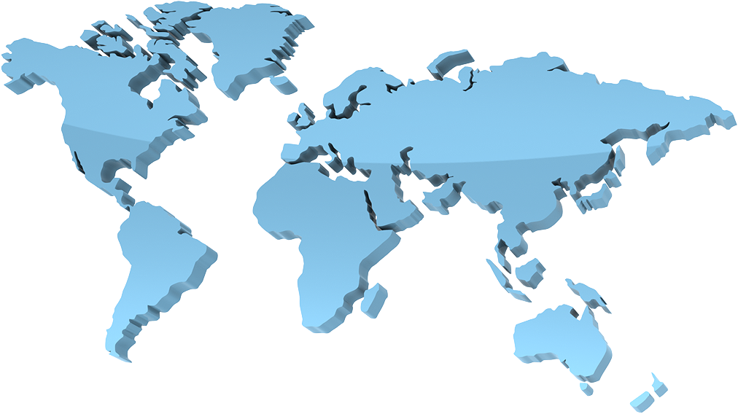
We can aggregate in many different ways…
aggregate
aggregate

Slide 18
But look at it from a different angle…

Slide 19
And …
Creates more (virtual) sources and more streams

Slide 20

Aggregate in a different way
aggregate

