Slide 1
The feasibility of a whole-cell model of the human platelet
Steve Haigh · Dash lab meeting · 21 May 2026

Slide 2
Quick recap
Framework choice
What I evaluated
What I did
Aiming to build a computer model of the platelet.
Has been done before in prokaryotes and yeast but not in other eukaryotic cells.
Lots of modelling done in platelets but not a whole-cell attempt.
Lots of options e.g., COPASI, V-Cell and others.
Landed on wcEcoli project from Covert lab – seemed capable of scaling to whole cell, plus code quality was excellent, something I could work with and expand.
Forked wcEcoli (i.e., took my own working copy).
Pruned all E.coli biology.
Used AI to build some tests in code to verify I didn’t remove too much.
Rebuilt cell contents and processes from the platelet literature.
Kept the simulation engine, state partitioning, listener / analysis framework
~5,000 lines of working code I didn't have to write.
Emailed Prof. Covert – “sounds fun, good luck”
Notes:
Why not COPASI or V-Cell?”→great single-pathway ODE tools, no copy-number accounting across compartments.
Cheat sheet
•COPASI — open-source biochemical pathway simulator; great for single-pathway ODE work.
•V-Cell — UConn cell modelling platform; spatial PDE-capable, domain-specific.
•SBML — Systems Biology Markup Language; XML interchange format.•BioModels — EBI repository of curated SBML models.
•wcEcoli — Covert Lab’s whole-cell E. coli model (Karr 2012 lineage; Macklin / SunScience2020).
•State partitioning — how a multi-process simulator divides shared molecule pools (e.g. ATP) be-tween competing processes each timestep.
•Mass balance — every atom of every species accounted for, with compartment-aware bookkeeping.

Slide 3
Method to build a calibrated model
Methodology
For each mechanism, a five-step process:
1. Anchor paper. E.g., Dolan & Diamond 2014 supplied the validation experiment (Fig. 4 Ca²⁺ transients ± extracellular Ca²⁺) and resting-state targets (100 nM cyt, 250 µM DTS).
2. Literature review for kinetics. Primary sources: deYoung-Keizer 1992 for IP3R, Caride 2007 for PMCA, Hoover & Lewis 2011 for SOCE, Mazet 2020 for the PI cycle...
3. Species enumeration. Every Ca²⁺-binding or -gating protein state, with a compartment tag (DTS, Cyt etc). ~50 species for the calcium pathway.
4. Copy numbers from Burkhart 2012 platelet proteomics.
5. Rate constants. Primary-source values, units normalised, every value carrying a citation comment in code.
Then: does the resting state hold? Do the timescales line up? Do the unit tests still pass?
Notes:
Every numerical value carries a primary-source citation comment in the code.
This is the discipline that catches transcription errors (segues into slide 8).
Step 5 is the key one. There are ~85 rate constants in this model; each is a small research project.
•Calibrated model — a model whose parameters are constrained by measurements rather than fitted to the validation experiment.
•Anchor paper — the single paper whose experiment you’ll validate against; defines targets upfront.•IP3R — inositol-1,4,5-trisphosphate receptor; Ca2+release channel on the DTS.•SERCA — sarco/endoplasmic-reticulum Ca2+ATPase; pumps Ca2+back into the DTS.
•PMCA — plasma-membrane Ca2+ATPase; pumps Ca2+out of the cell.
•SOCE — store-operated Ca2+entry; STIM1 / Orai1 mechanism that refills depleted stores from extracellular Ca2+.
•DTS — dense tubular system; platelet equivalent of ER, the intracellular Ca2+store.
•Burkhart 2012 — platelet proteomics dataset; absolute copy numbers for ~3,800 platelet proteins

Slide 4
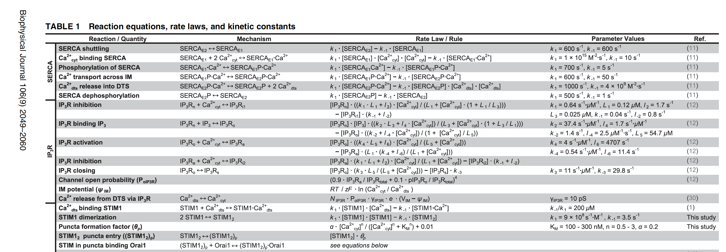
Build code from source data
Methodology
Start with the published data (usually PDF, sometimes CSV)
Just a small excerpt

Slide 5
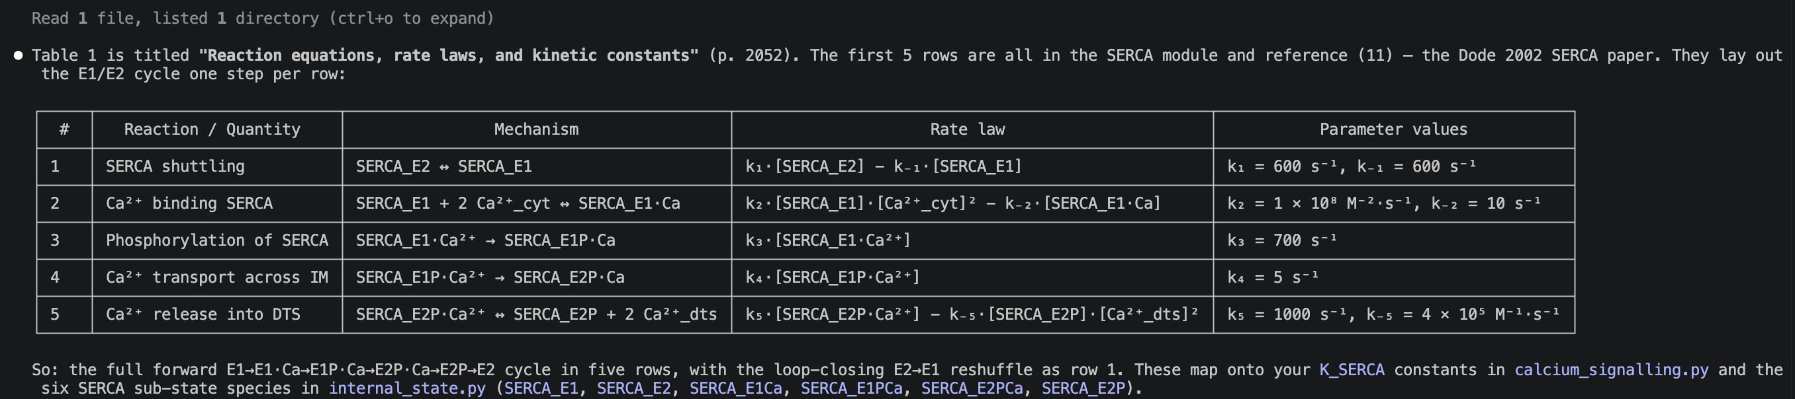
Build code from source data
Methodology
Ask AI to extract – get it to tell you what it’s doing to sanity check (but it is VERY good at this)
E.g. I asked “Please read Dolan and Diamond 2014 and tell me what the first 5 lines of table 1 show”
Simply not feasible to do this by hand at large scale, AI could process 100s of papers in a day. The only challenge is verification, but this is also amenable to AI assistance.
Notes:
Division of labour: AI does the rote PDF extraction; human do the sanity check.
•Headline claim: 100s of papers a day is reachable; the bottleneck is verification — and verification is also AI-amenable (see slide 8).
•Authorship of the model – primary source / wcEcoli / me, in that order
•PDF extraction — historically painful for tables and footnotes; modern multimodal LLMs are now reliable on well-formatted tables, less so on figures.
•Sanity check — the human step: does the extracted value match the paper’s text? Do the units make sense?

Slide 6
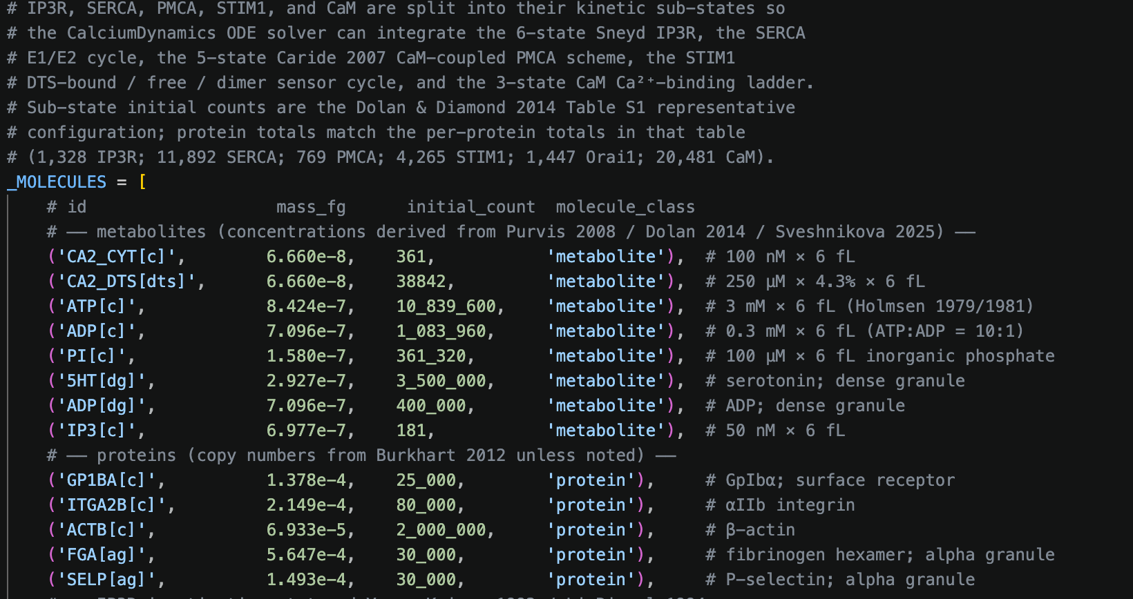
Build code from source data
Methodology
Then get AI to build the code, using the wcEcoli code as a template.
The code works well, the architecture is not perfect, needs some work to make it more usable
for future expansion but it’s an excellent start.
Notes:
“building the code” means: scaffolding new process modules off the wcEcoli template, wiring rate constants into the existing solver, writing unit tests for invariants.
works well, not perfect, will need refactoring before v. next
“Did the AI write code that worked first try?”→no, the back-and-forth is iterative; the AI is a fast scaffolder and a useful pair-programmer, not an oracle.

Slide 7





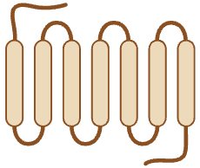
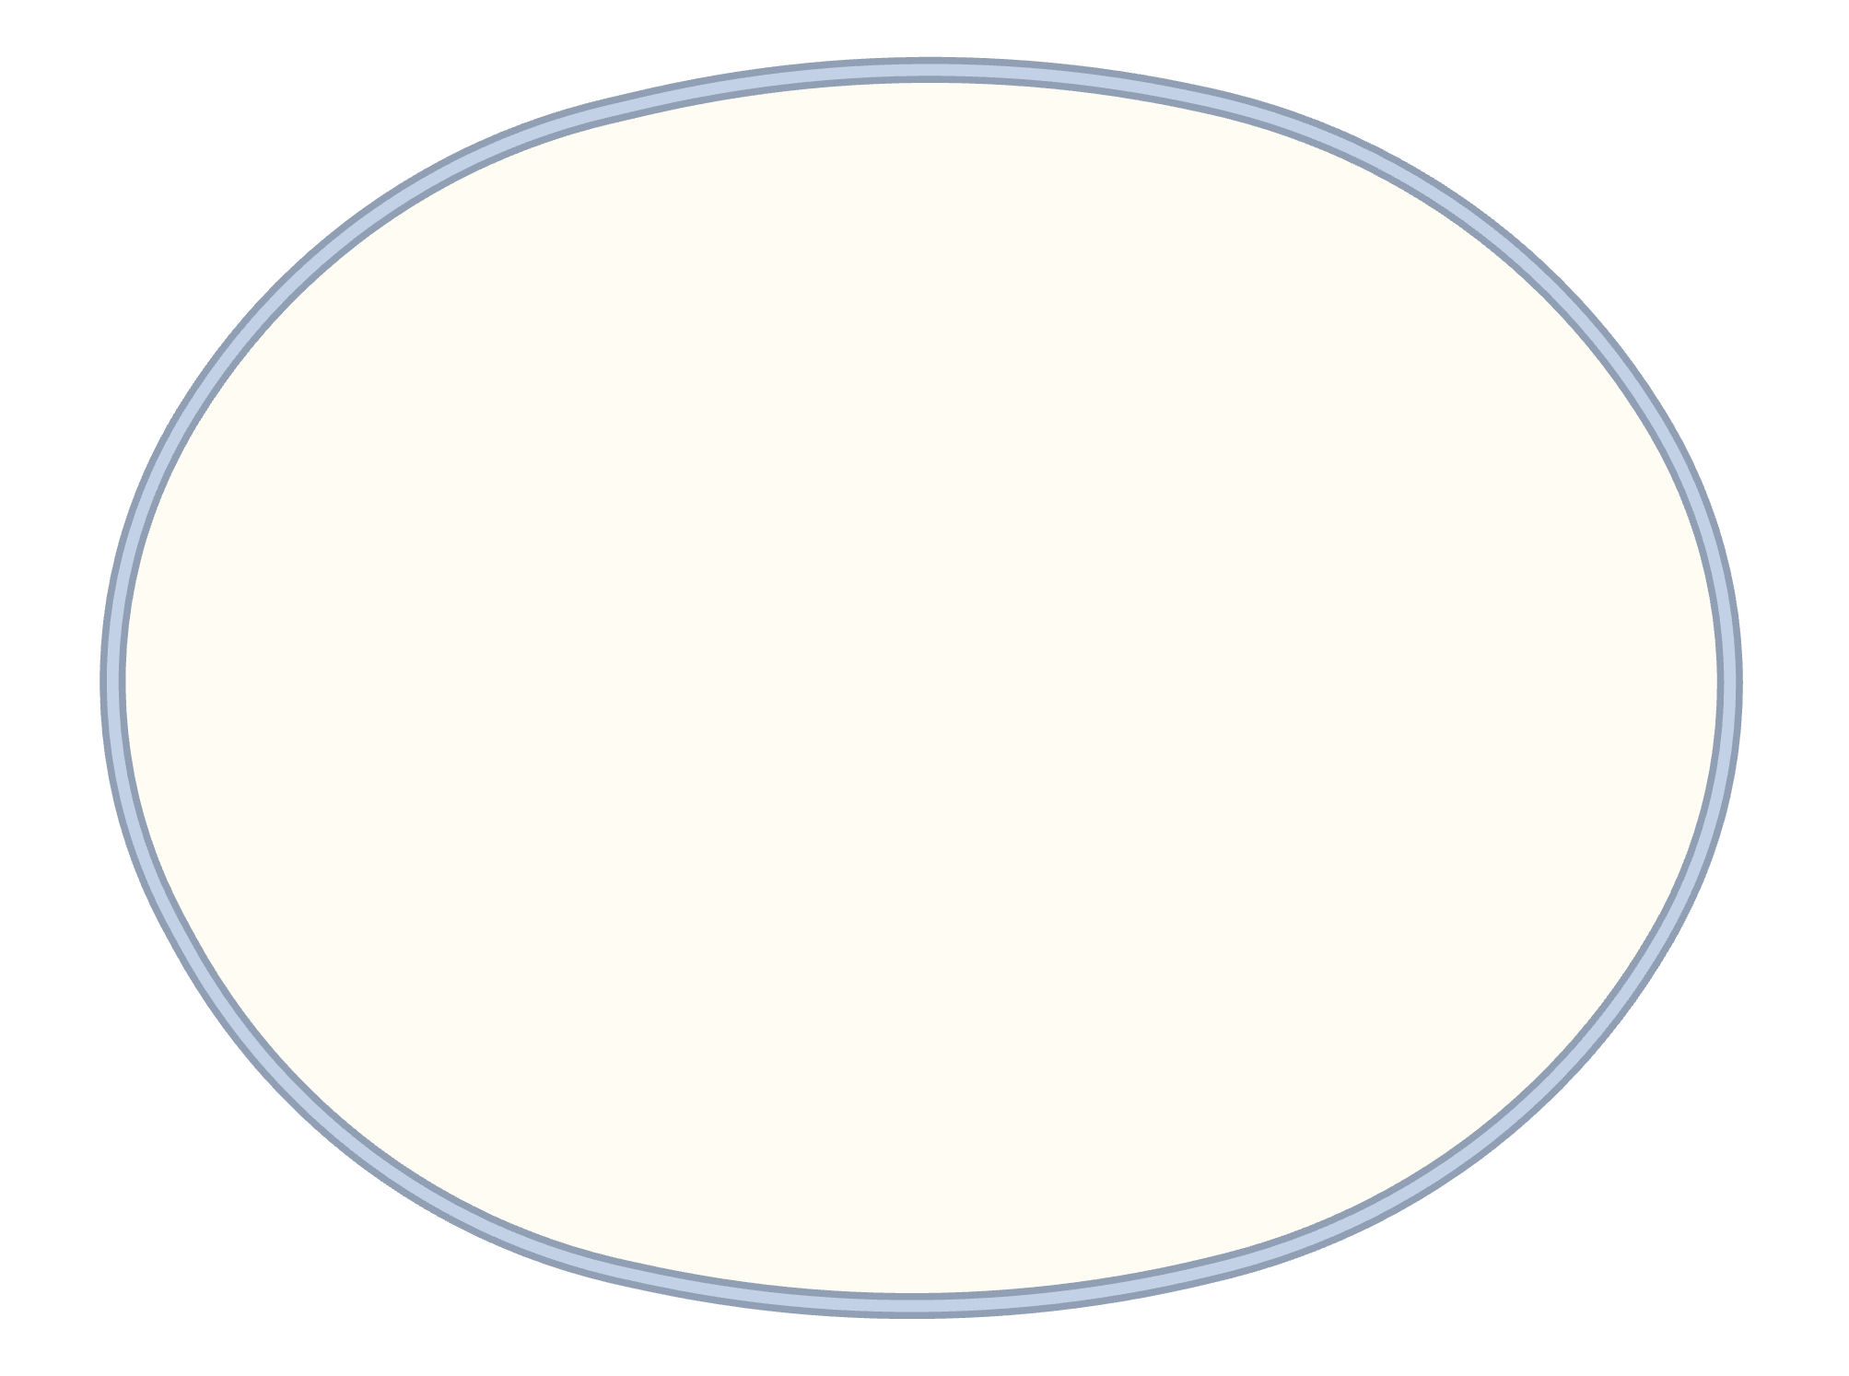
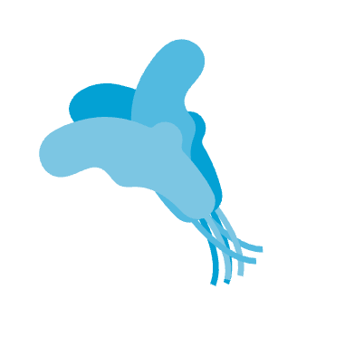

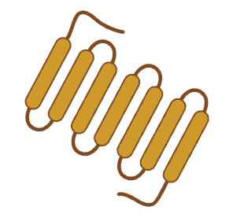
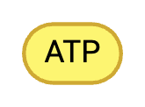
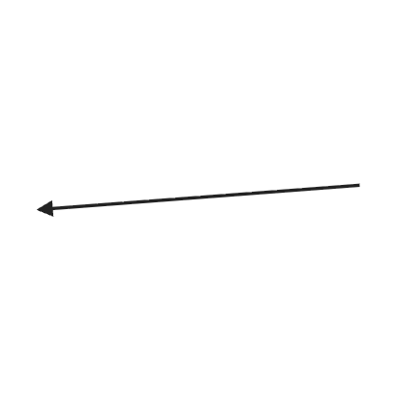


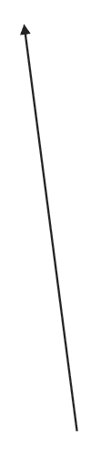

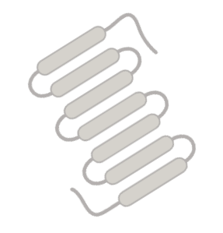

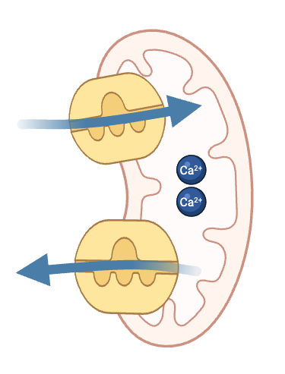









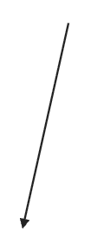

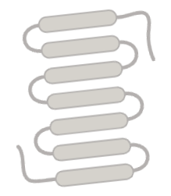

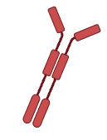





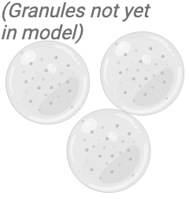


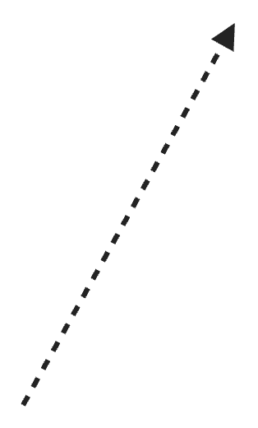
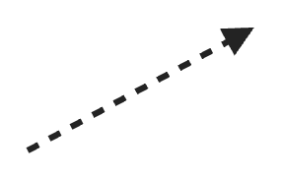






What did I build? (so far)
Result
ADP
Thrombin
P2X₁
Orai1
P2Y₁
PAR1/PAR4
P2Y₁₂
(not yet in model)
MCU
SCS
(PKC not yet in model)
NCLX
STIM₁
TXA₂R
(not yet in model)
IP₃R
Ca²⁺
Ca²⁺
Ca²⁺
Binding proteins:
CALR, HSP90B1, BiP, CREC
Ca²⁺
Ca²⁺
PMCA
SERCA
NCX
Binding proteins:
CaM + others
Notes:
•Agonist — a signal molecule that activates a platelet (thrombin, ADP, TXA2).•GPCR — G-protein-coupled receptor (PAR1/PAR4 for thrombin; P2Y1 and P2Y12 for ADP).
•Gαq — α-subunit of the heterotrimeric G-protein that activates PLCβ. G (P2Y12) is the inhibitory counterpart.
•PLCβ — phospholipase Cβ; cleaves PIP2→IP3+ DAG.
•IP3— inositol-1,4,5-trisphosphate; the second messenger that gates IP3R.
•NCX / NCLX / MCU — Na+/Ca2+exchanger (PM); Na+/Ca2+/Li+ exchanger (mitochondrial);mitochondrial Ca2+uniporter.
•CaM — calmodulin; cytosolic Ca2+sensor / buffer; activates PMCA at high Ca2+.
•CALR / BiP / HSP90B1 / CREC — major intra-DTS Ca2+-binding buffers.
•STIM1 / Orai1 — DTS Ca2+sensor + PM channel; the SOCE machinery.
•P2X1 — ATP-gated PM Ca2+channel; ionotropic, not GPCR.
•SCS / OCS — surface-connected (open canalicular) system; the platelet’s invaginated extracellular surface.
•TXA2R — thromboxane A2 receptor; not yet in model.
•PKC — protein kinase C; not yet in model.

Slide 8
Spotting Errors in the source
An aside
The Purvis 2008 k₃ story
Asked AI to check values it had extracted.
AI spotted that a value quoted in Purvis & Diamond 2008 (well known platelet modelling paper) was wrong – units were wrong and value was 100X too large.
AI found original study via references and verified for myself, AI was correct, there was a typo.
Very strong use-case for AI – tracking values and assertions across papers. It is also very useful for helping to review data – I got the AI to print the values it found, with reference to the primary source and the code so I could easily review.

Slide 9
Validation
Results
Criteria
Model state at 14 May
Compared output to existing models,
success criteria:
Resting cytosolic Ca²⁺ within 100 ± 10 nM band
Resting DTS Ca²⁺ in the literature range
IP₃-stimulated transient peak height in band
Transient duration matches shape of previous model(s)
Resting cyt Ca²⁺: 104 nM ✓
Resting DTS Ca²⁺: 235 µM ✓
Resting IP₃: 50 nM ✓
Resting Gαq-active: 100 of 5000 ✓
21 / 21 unit tests pass
Driven by physiological agonists — 1 nM thrombin, 10 µM ADP. No hand-fitted IP₃ forcing.
Notes:
Resting state targets — cytosolic Ca2+in 90–110 nM; DTS Ca2+in literature range (100–400 μM);IP3≈50 nM.
IP3-stimulated transient — the calcium spike following IP3release from the GPCR cascade.
Gαq-active — fraction of Gαq protein in its GTP-bound, active conformation; an upstream proxyfor receptor occupancy.•Unit test — automated invariant check (e.g. mass balance, positivity, sub-state sum)

Slide 10
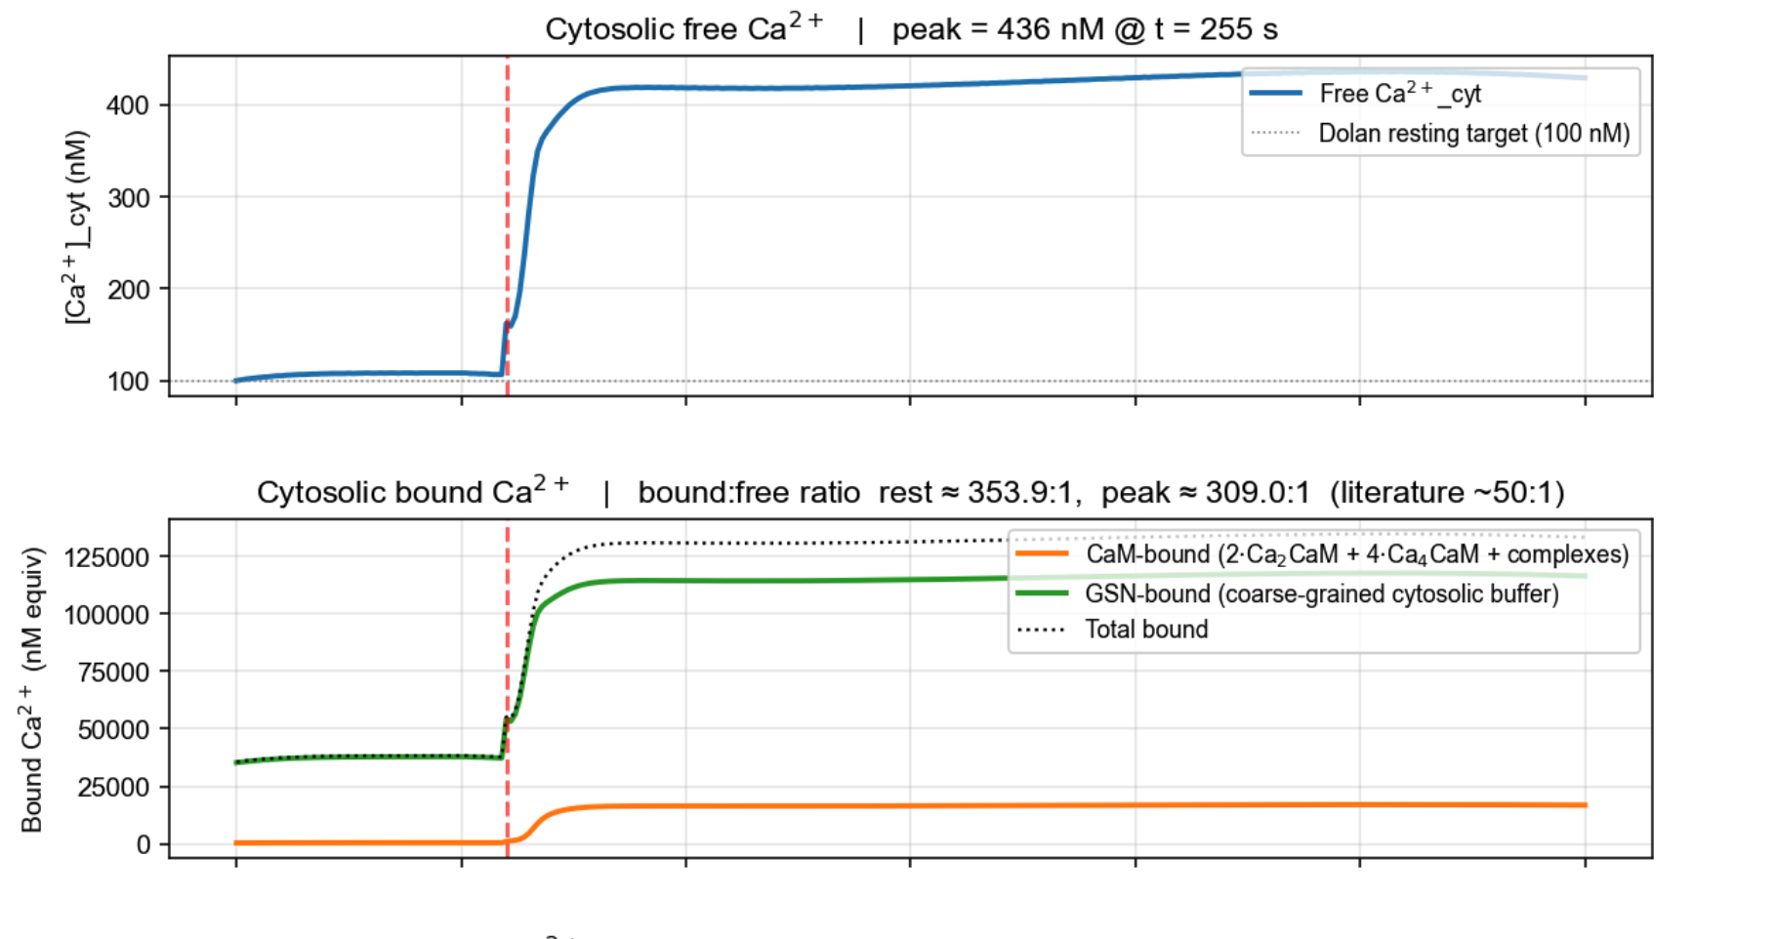
Model stimulated with ADP / Thrombin - Cytosolic Ca
Results

Slide 11
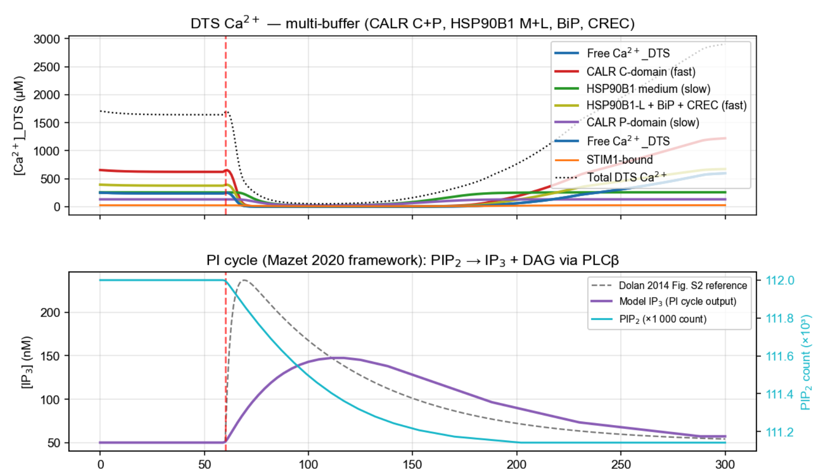
Model stimulated with ADP / Thrombin - DTS Ca
Results

Slide 12
Where it goes from here
Outlook
Near-term biology:
Granule release — the model currently stops at the Ca²⁺ peak
Implement P2Y₁₂, TXA₂R receptors and more, depending on time
Run experiments e.g. when P2Y₁₂ / Gᵢ are wired up add clopidogrel as an in-silico drug experiment.
Wider impact:
Platelet – CTC interactions. Calibrated platelet model could in principle be coupled to a tumour-cell model.
Methodology generalises to other single-cell calibration problems.
If we have well quanitified pathways no reason not to try and model them in a cancer cell.
Multiple cell-cell interactions – thrombus formation?
Blue sky goal:
I’d like to get to a point where a biologist with limited coding experience could build a model with AI help. Very long shot – a system where a user drops primary data and text instructions into an app and the model builds itself.

