Slide 1
The feasibility of a whole-cell model of the human platelet
Steve Haigh

Slide 2
Quick recap
What I evaluated
Aiming to build a computer model of the platelet.
Has been done before in prokaryotes and yeast but not in other eukaryotic cells.
Lots of modelling done in platelets but not a whole-cell attempt.
Lots of options e.g., COPASI, V-Cell and others.
Landed on wcEcoli project from Covert lab — capable of scaling to whole cell, code quality excellent, something I could work with and expand.
What I did
Forked wcEcoli (i.e., took my own working copy).
Pruned all E. coli biology.
Used AI to build tests to verify I didn’t remove too much.
Rebuilt cell contents and processes from the platelet literature.
Kept the simulation engine, state partitioning, listener / analysis framework.
~5,000 lines of working code I didn’t have to write.
Emailed Prof. Covert — “sounds fun, good luck”.
Notes:
Why not COPASI or V-Cell? — great single-pathway ODE tools, but no copy-number accounting across compartments.
Cheat sheet:
COPASI — open-source biochemical pathway simulator; great for single-pathway ODE work.
V-Cell — UConn cell modelling platform; spatial PDE-capable, domain-specific.
SBML — Systems Biology Markup Language; XML interchange format.
BioModels — EBI repository of curated SBML models.
wcEcoli — Covert Lab’s whole-cell E. coli model (Karr 2012 lineage; Macklin / Sun Science 2020).

Slide 3
Method to build a calibrated model
For each mechanism, a five-step process:
Anchor paper. E.g., Dolan & Diamond 2014 supplied the validation experiment (Fig. 4 Ca²⁺ transients ± extracellular Ca²⁺) and resting-state targets (100 nM cyt, 250 µM DTS).
Literature review for kinetics. Primary sources: deYoung–Keizer 1992 for IP₃R, Caride 2007 for PMCA, Hoover & Lewis 2011 for SOCE, Mazet 2020 for the PI cycle…
Species enumeration. Every Ca²⁺-binding or -gating protein state, with a compartment tag (DTS, Cyt etc.). ~50 species for the calcium pathway.
Copy numbers from Burkhart 2012 platelet proteomics.
Rate constants. Primary-source values, units normalised, every value carrying a citation comment in code.
Then: does the resting state hold? Do the timescales line up? Do the unit tests still pass?
Notes:
Every numerical value carries a primary-source citation comment in the code. This is the discipline that catches transcription errors (segues into slide 8).
Step 5 is the key one. There are ~85 rate constants in this model; each is a small research project.
Calibrated model — a model whose parameters are constrained by measurements rather than fitted to the validation experiment.
Anchor paper — the single paper whose experiment you’ll validate against; defines targets upfront.
IP₃R — inositol-1,4,5-trisphosphate receptor; Ca²⁺ release channel on the DTS.
SERCA — sarco/endoplasmic-reticulum Ca²⁺ ATPase; pumps Ca²⁺ back into the DTS.
PMCA — plasma-membrane Ca²⁺ ATPase; pumps Ca²⁺ out of the cell.
SOCE — store-operated Ca²⁺ entry; STIM1 / Orai1 mechanism that refills depleted stores from extracellular Ca²⁺.
DTS — dense tubular system; platelet equivalent of ER, the intracellular Ca²⁺ store.
Burkhart 2012 — platelet proteomics dataset; absolute copy numbers for ~3,800 platelet proteins.

Slide 4
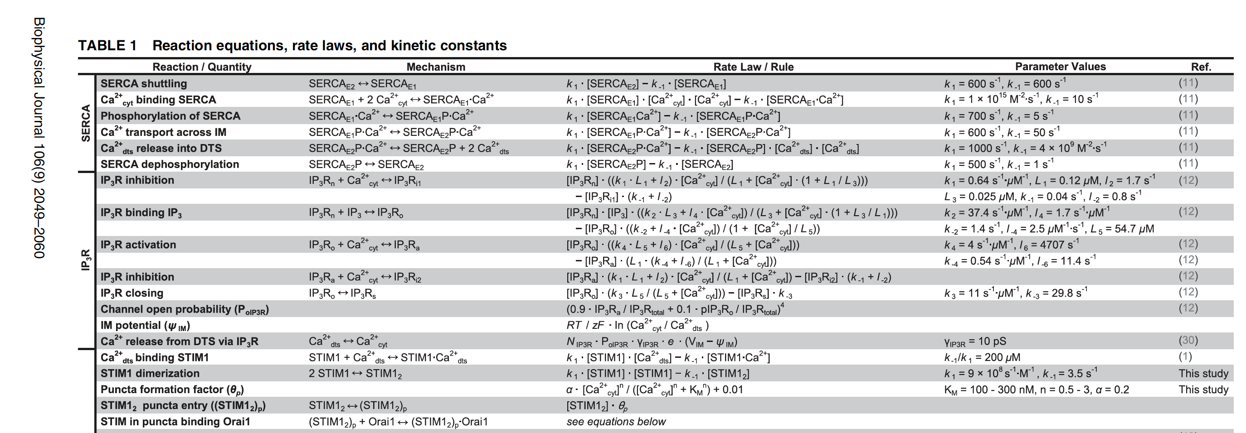
Build code from source data — start with the data
Start with the published data (usually PDF, sometimes CSV).
Just a small excerpt.

Slide 5
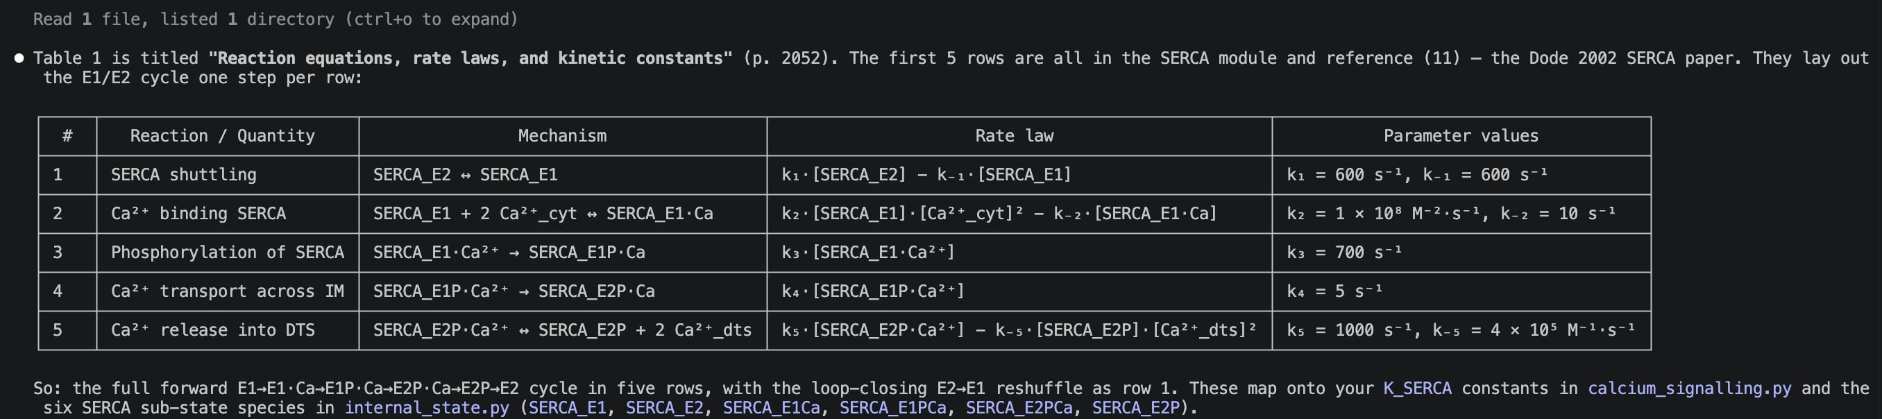
Build code from source data — AI extraction
Ask AI to extract — get it to tell you what it’s doing to sanity check (but it is very good at this).
E.g. I asked: “Please read Dolan and Diamond 2014 and tell me what the first 5 lines of table 1 show.”
Simply not feasible to do this by hand at large scale; AI could process 100s of papers in a day. The only challenge is verification, but this is also amenable to AI assistance.
Notes:
Division of labour: AI does the rote PDF extraction; humans do the sanity check.
Headline claim: 100s of papers a day is reachable; the bottleneck is verification — and verification is also AI-amenable (see slide 8).
Authorship of the model — primary source / wcEcoli / me, in that order.
PDF extraction — historically painful for tables and footnotes; modern multimodal LLMs are now reliable on well-formatted tables, less so on figures.
Sanity check — the human step: does the extracted value match the paper’s text? Do the units make sense?

Slide 6
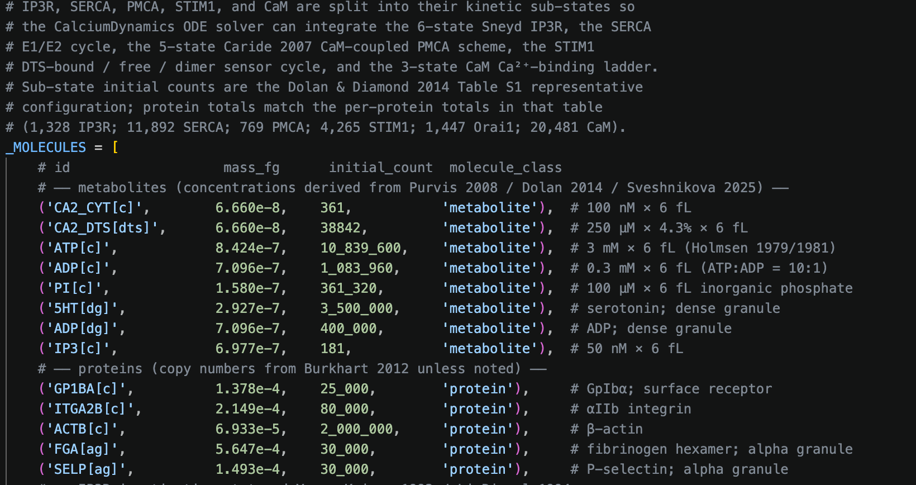
Build code from source data — AI writes the code
Then get AI to build the code, using the wcEcoli code as a template.
The code works well, the architecture is not perfect — needs some work to make it more usable for future expansion — but it’s an excellent start.
Notes:
“Building the code” means: scaffolding new process modules off the wcEcoli template, wiring rate constants into the existing solver, writing unit tests for invariants.
Works well, not perfect — will need refactoring before v.next.
“Did the AI write code that worked first try?” → no, the back-and-forth is iterative; the AI is a fast scaffolder and a useful pair-programmer, not an oracle.

Slide 7
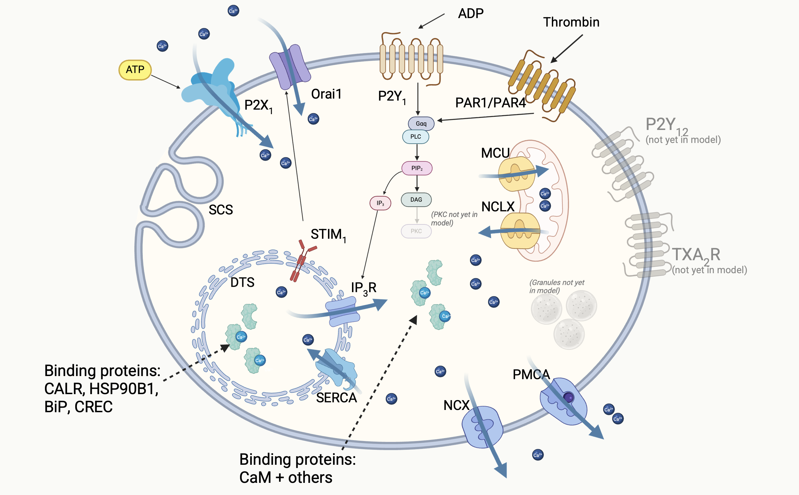
What did I build? (so far)
Notes:
Agonist — a signal molecule that activates a platelet (thrombin, ADP, TXA2).
GPCR — G-protein-coupled receptor (PAR1 / PAR4 for thrombin; P2Y1 and P2Y12 for ADP).
Gαq — α-subunit of the heterotrimeric G-protein that activates PLCβ. Gᵢ (P2Y12) is the inhibitory counterpart.
PLCβ — phospholipase Cβ; cleaves PIP₂ → IP₃ + DAG.
IP₃ — inositol-1,4,5-trisphosphate; the second messenger that gates IP₃R.
NCX / NCLX / MCU — Na⁺/Ca²⁺ exchanger (PM); Na⁺/Ca²⁺/Li⁺ exchanger (mitochondrial); mitochondrial Ca²⁺ uniporter.
CaM — calmodulin; cytosolic Ca²⁺ sensor / buffer; activates PMCA at high Ca²⁺.
CALR / BiP / HSP90B1 / CREC — major intra-DTS Ca²⁺-binding buffers.
STIM1 / Orai1 — DTS Ca²⁺ sensor + PM channel; the SOCE machinery.
P2X1 — ATP-gated PM Ca²⁺ channel; ionotropic, not GPCR.
SCS / OCS — surface-connected (open canalicular) system; the platelet’s invaginated extracellular surface.
TXA2R — thromboxane A2 receptor; not yet in model.
PKC — protein kinase C; not yet in model.

Slide 8
Spotting errors in the source
The Purvis 2008 k₃ story.
Asked AI to check values it had extracted.
AI spotted that a value quoted in Purvis & Diamond 2008 (a well-known platelet modelling paper) was wrong — units were wrong and value was 100× too large.
AI found the original study via the references and I verified for myself; AI was correct, there was a typo.
Very strong use-case for AI — tracking values and assertions across papers. Also very useful for helping to review data: I got the AI to print values it had found, with reference to the primary source and the code, so I could easily review.
Notes:
Resting-state targets — cytosolic Ca²⁺ in 90–110 nM; DTS Ca²⁺ in literature range (100–400 µM); IP₃ ≈ 50 nM.
IP₃-stimulated transient — the calcium spike following IP₃ release from the GPCR cascade.
Gαq-active — fraction of Gαq protein in its GTP-bound, active conformation; an upstream proxy for receptor occupancy.
Unit test — automated invariant check (e.g. mass balance, positivity, sub-state sum).

Slide 9
Validation
Criteria
Compared output to existing models. Success criteria:
Resting cytosolic Ca²⁺ within 100 ± 10 nM band
Resting DTS Ca²⁺ in the literature range
IP₃-stimulated transient peak height in band
Transient duration matches shape of previous model(s)
Model state at 14 May
Resting cyt Ca²⁺: 104 nM ✓
Resting DTS Ca²⁺: 235 µM ✓
Resting IP₃: 50 nM ✓
Resting Gαq-active: 100 of 5000 ✓
21 / 21 unit tests pass
Driven by physiological agonists — 1 nM thrombin, 10 µM ADP. No hand-fitted IP₃ forcing.

Slide 10
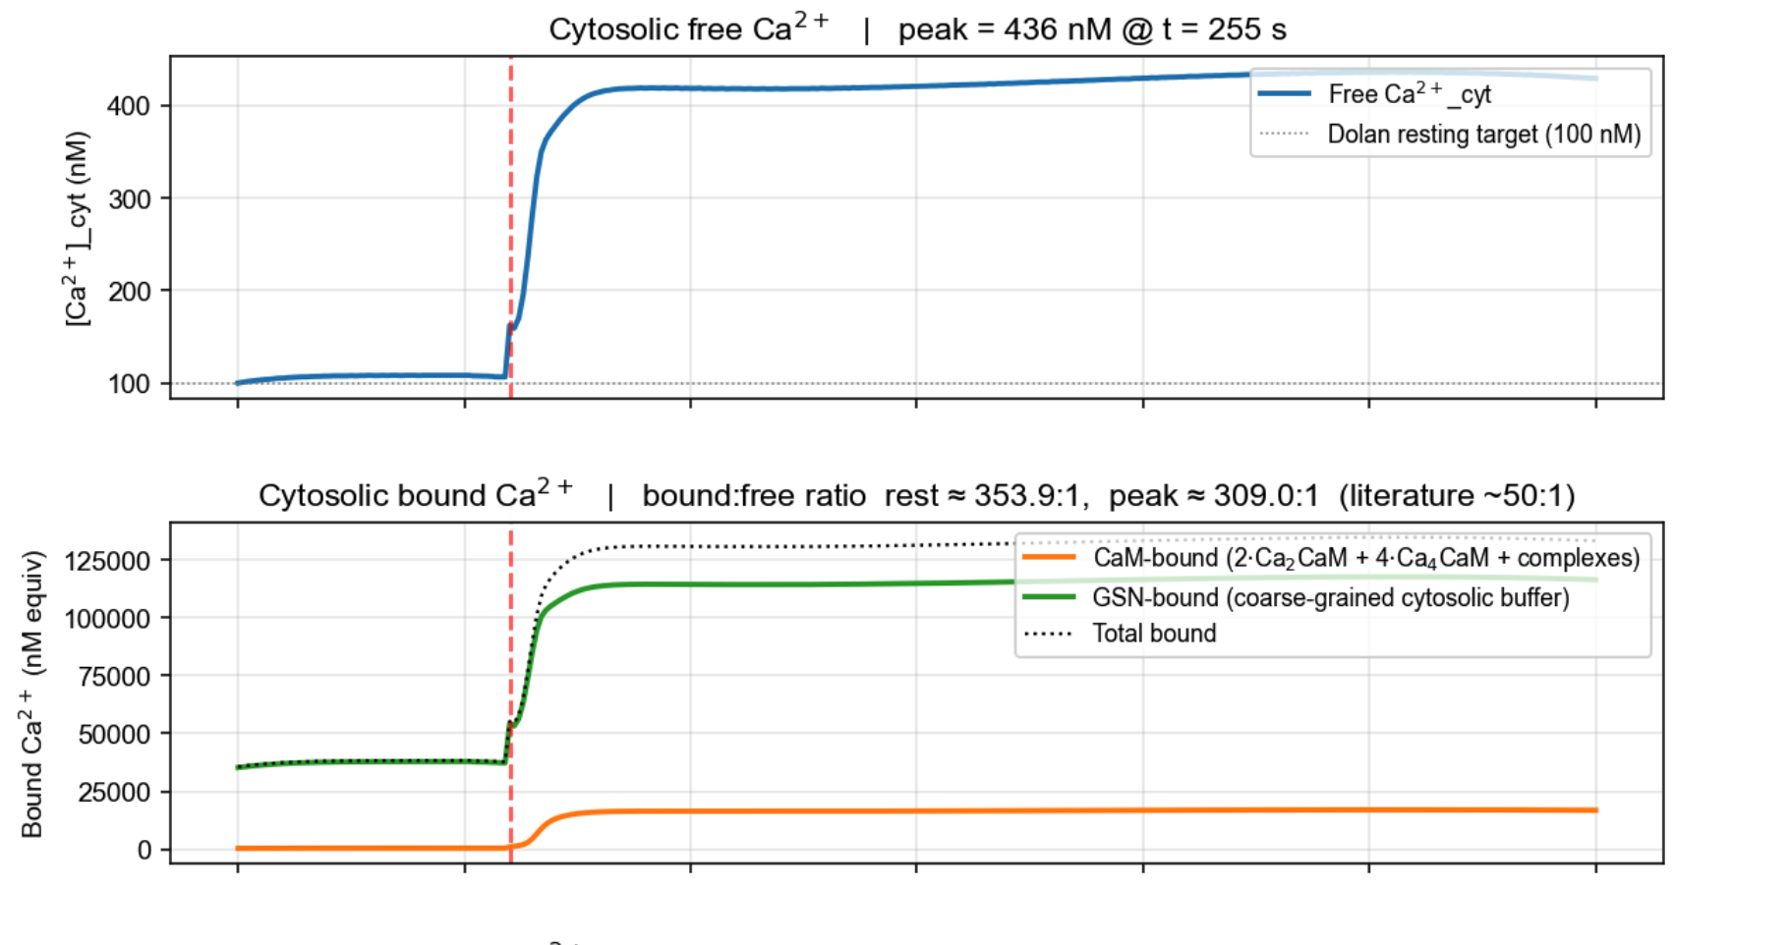
Model stimulated with ADP / thrombin — cytosolic Ca²⁺

Slide 11
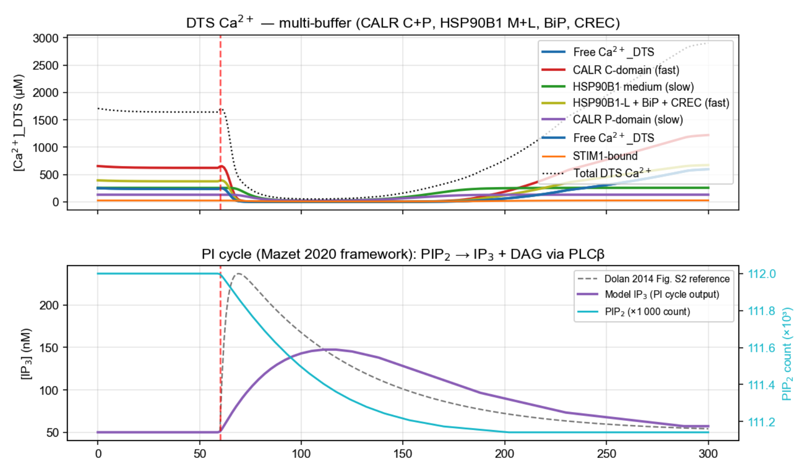
Model stimulated with ADP / thrombin — DTS Ca²⁺

Slide 12
Where it goes from here
Near-term biology
Granule release — the model currently stops at the Ca²⁺ peak.
Implement P2Y₁₂, TXA2R receptors and more, depending on time.
Run experiments e.g. when P2Y₁₂ / Gᵢ are wired up, add clopidogrel as an in silico drug experiment.
Wider impact
Platelet–CTC interactions. A calibrated platelet model could in principle be coupled to a tumour-cell model.
Methodology generalises to other single-cell calibration problems — if pathways are well-quantified, no reason not to try modelling them in a cancer cell.
Multiple cell–cell interactions — thrombus formation?
Blue sky goal
I’d like to get to a point where a biologist with limited coding experience could build a model with AI help. Very long shot: a system where a user drops primary data and text instructions into an app and the model builds itself.

