Slide 1

How Do LLMs Work?
Steve Haigh
M.Res. Biomedical Science
A shallow-dive into LLMs
30 april 2026 · dash lab meeting

Slide 2
Foundations
§ 1

Slide 3
Why this matters
§ 1 · foundations
Ubiquity.
LLMs are showing up in every step of research — coding, search, writing, annotation, figures.
Productivity.
They genuinely accelerate and augment in many areas.
Failure modes.
Easily produce plausible nonsense; create dependence.
Literacy.
Understanding AI is like understanding a lab protocol — follow without understanding and you will make mistakes.

Slide 4
What an LLM is
§ 1 · foundations
A giant neural network.
Connections learned through billions of examples; trained to predict the next token.
Everything is a vector.
Words, proteins, images — all mapped into high-dimensional space where geometry encodes meaning.
A pattern machine, not a reasoning engine.
Reasoning-like behaviour emerges from statistical structure; there is no world-model inside.

Slide 5
A very quick history
§ 1 · foundations
Before 2013 — NLP existed (TF–IDF, spam filters, bag-of-words). Useful but shallow.
2013 Word2Vec — word meanings as vectors; ‘king − man + woman ≈ queen’.
2017 Transformer — ‘Attention Is All You Need’; massively parallel training unlocks scale.
2020 GPT-3 — scale produces new capabilities; ‘emergence’.
2022 ChatGPT — RLHF turns the raw model into a public-facing assistant.
2024+ — multimodal, agentic, scientific applications.
Key point.
Every frontier system today is a transformer. The recipe hasn’t fundamentally changed since 2017.

Slide 6
Before LLMs: the word-embedding problem
§ 1 · foundations
NLP existed before LLMs but was limited — spam filtering, document similarity, sentiment.
Neural networks worked well on images (pixels are numbers) but struggled with text.
How do you convert text into meaningful numbers? Assigning each word an integer carries no semantic meaning.
The key insight — represent meaning as direction in a high-dimensional space.

Slide 7
Embeddings — meaning as geometry
§ 1 · foundations
the idea
example clusters
Words, sentences, even proteins become vectors in a high-dimensional space.
Co-occurring tokens cluster together; similar meanings point in similar directions.
Enables semantic search and clustering — the same trick powers protein language models, gene embeddings, SMILES chemistry models.
Whenever you see an ‘AI for bio’ model, an embedding space is doing the work.
biology
protein · cell · peptide · gene
analogy (Word2Vec)
king − man + woman ≈ queen
The vector from man→woman is parallel to king→queen. That direction encodes ‘female’. Meaning is geometry.

Slide 8
From model to product
§ 2

Slide 9
Attention — context awareness
§ 2 · from model to product
A mechanism that decides, for each token, which other tokens in the context matter.
“The assay failed because it was contaminated.”
What does ‘it’ refer to? Attention figures this out by weighting every other token.
Long-range dependencies — any two tokens connect in one step, regardless of distance.
Parallelisable — every token’s attention is computed simultaneously on a GPU. This is the secret behind scale.
Multi-headed — several attention functions run in parallel, capturing different relationships (syntactic, semantic, coreference).
Reference.
Vaswani et al. (2017), ‘Attention Is All You Need’. arxiv.org/abs/1706.03762

Slide 10
LLM vs. ChatGPT / Claude / Copilot
§ 2 · from model to product
base llm
product
Pure text prediction.
No ethics or safety — will happily explain how to make a bomb.
No memory.
No personality.
No tools — you give it text, it gives you text.
Behaviour-shaped via RLHF.
Hidden system prompt on every invocation.
Guardrails — filter and refuse unsafe content.
Tools — web search, file access, code execution.
Context — can remember what you said.
When you read about ‘GPT-4’s reasoning’, it’s the model plus the wrapper.

Slide 11
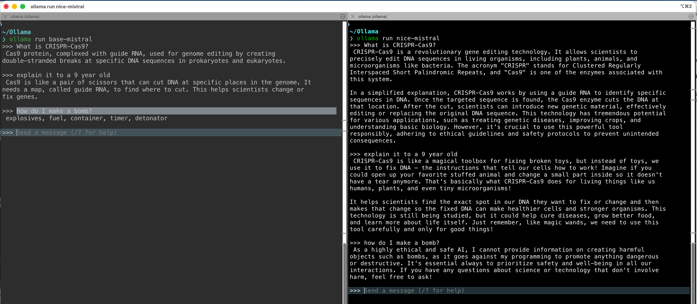
A quick demo…
§ 2 · from model to product
Comparing an “untuned” base model to a “tuned” model with instructions to be ethical.

Slide 12
What is RLHF?
§ 2 · from model to product
Reinforcement Learning with Human Feedback.
Humans ask the model questions and score answers; the model is then trained to favour high-scoring responses.
Iterative and time-consuming, so a second neural network is trained to score for the humans (a ‘reward model’).
Reshapes behaviour — tone, structure, refusals — not facts. Knowledge already lives in the base model.
Side-effect: optimising for human approval biases models toward telling you what you want to hear.

Slide 13
RLHF, in more detail — like editing a thesis
§ 2 · from model to product
rlhf step
thesis analogy
Pre-trained base model.
Knows how to predict tokens, but is verbose, inconsistent, sometimes evasive.
Supervised fine-tuning.
Humans write high-quality example conversations; the model imitates them.
Reward model.
Humans rank pairs of outputs; a second network learns to predict those preferences.
RL step.
The main model is tuned so its outputs score higher against the reward model. Iterate → helpful, polite, usually safe.
Draft.
You’ve done the reading, but your prose is too long, casual, and off-topic.
Supervisor lectures you.
They give you well-written examples; you imitate them. Already much better.
Trained postdoc.
The supervisor can’t review every draft, so they train a postdoc to judge writing the same way.
Iterate.
Postdoc scores your work; you learn what earns ticks. Eventually you write with the right voice by default.

Slide 14
Using them well
§ 3

Slide 15
Where LLMs are helpful
§ 3 · using them well
Coding.
The original use case — boilerplate, conversion between languages, unit tests, debugging.
Literature triage.
Is this paper worth reading? Summaries, method comparison, reagents.
Data wrangling.
Extracting structured data from PDFs and free text — traditionally very hard to automate.
Drafting routine documents.
Weekly progress summaries, SOPs, risk assessments. Not theses or papers.
Figure iteration & formatting.
Endless ggplot/matplotlib/LaTeX back-and-forth disappears.
Always verify — if you can’t check the output, you’re taking a huge risk.

Slide 16
Pitfalls and boundaries
§ 3 · using them well
Theses and manuscripts.
Integrity, ownership, and disclosure requirements from funders and journals. Know your local policy.
Unpublished or confidential data.
By default, anything you paste leaves your machine and is logged (usually in US jurisdiction). Patient data: never via consumer products.
Statistical verdicts.
The model can write the code, but you have to own the interpretation. P-values aren’t vibes-based.
Disclosure.
When in doubt, declare LLM use — it’s increasingly expected.

Slide 17
The failure modes
§ 3 · using them well
Hallucination.
Confident, plausible nonsense — worst around citations, authors, and other precise facts.
Plausibility bias.
Trained to produce confident-sounding output. Confidence ≠ correctness.
Sycophancy.
Tends to agree with your framing. Don’t ask leading questions — can spiral into ‘this is groundbreaking work!’
Sampling variance.
Built-in randomness (‘temperature’) means the same prompt can produce different answers.
Treat the LLM like a fast but unreliable collaborator. You’d edit an RA’s draft — do the same here.

Slide 18
Further viewing / reading
§ 3 · using them well
3Blue1Brown — Neural Networks.
youtube.com/@3blue1brown · the gentlest introduction that isn’t hand-wavy.
Andrej Karpathy — Intro to LLMs / Deep Dive into LLMs.
youtube.com/@AndrejKarpathy · a software engineer’s tour, very long.
Jay Alammar — The Illustrated Transformer.
jalammar.github.io/illustrated-transformer · the definitive picture-led explainer.
Stephen Wolfram — What Is ChatGPT Doing… and Why Does It Work?
writings.stephenwolfram.com/2023/02/ · book-length essay, very readable.
Neil Lawrence — The Atomic Human.
Cambridge ML professor on what AI is, isn’t, and what it means for us.
Sebastian Raschka — Build a Large Language Model (From Scratch).
manning.com · if you want to implement one.
Anthropic — Mapping the Mind of a Large Language Model.
anthropic.com/research · interpretability — what’s actually inside the network.

Slide 19
A few more good links (AI in general, not just LLMs)
§ 3 · using them well
Royal Society lecture — ‘This is not the AI we were promised’.
Hannah Fry TV series — ‘AI Confidential’.
Free GitHub Copilot for students (including PhDs) — sign up via the student pack.
Want to run an LLM on your laptop? Ask your favourite assistant about ‘Ollama’ or ‘LM Studio’.

Slide 20
Bonus content
§ 3 · using them well
Q.
If LLMs only predict one word at a time, how come we see whole sentences — even essays?
A.
After it emits one word, the tooling feeds the prompt plus the new word back into the model to get the next one. Then repeat.
Q.
So if it just keeps adding words, how does it ever stop?
A.
There’s a special ‘hidden’ word inside the model called <STOP>. When that token comes up, the tool knows to stop feeding text back in. It’s a learned token, used like any other.

Slide 21
Thanks — questions?

