Slide 1

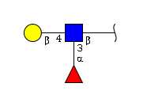
LacDiNAc
LacDiNAc & Lactosamine motif
All other motif sets

