Slide 1
Cross Platform Mobile Programming IF733
HTTP Requests
Andre Rusli

Slide 2
Agenda
Review
Connecting to a Backend
Using PHP and MySQL
Using Firebase

Slide 3
Review
1/4

Slide 4
Final Project
3-5 students per group
Requirements:
Novel ideas
At least one native feature
Running in Android or iOS
Use database and HTTP request
Topics:
Education
Environment
Sustainable cities and communities

Slide 5
Final Project Timeline
Week 10 (Lab.):
Github repo setup
Week 11 (Lab.):
Working prototype demo (local dynamic data, navigation, servable via browser)
CSIC submission (screen recording)
Week 15 (Class):
Final progress report (presentation)
Self and peer assessment

Slide 6
Presenting Loading Controller -when adding a new offer-
offers.service.ts
addOffer(offer: Place) {
this.getAllOffers()
.pipe(take(1))
.subscribe((offersArray) => {
this._offers.next(offersArray.concat(offer));
});
}
offers.service.ts
addOffer(offer: Place) {
return this.getAllOffers()
.pipe(take(1), delay(2000), tap(
(offersArray) => {
this._offers.next(offersArray.concat(offer));
}
));
}

Slide 7
Presenting Loading Controller -when adding a new offer-
new-offer.page.ts
new-offer.page.ts
saveOffer(f: NgForm) {
const offer: Place = {
id: f.value.id,
title: f.value.title,
description: f.value.description,
imgUrl: f.value.imgUrl,
price: +f.value.price,
};
this.offersSvc.addOffer(offer);
this.goBack();
}
saveOffer(f: NgForm) {
const offer: Place = {
id: f.value.id,
title: f.value.title,
description: f.value.description,
imgUrl: f.value.imgUrl,
price: +f.value.price,
};
this.loadingCtrl.create({
message: 'Creating a new place ...'
}).then(
(loadingElement) => {
loadingElement.present();
this.offersSvc.addOffer(offer).subscribe(() => {
loadingElement.dismiss();
this.goBack();
});
}
);
}

Slide 8
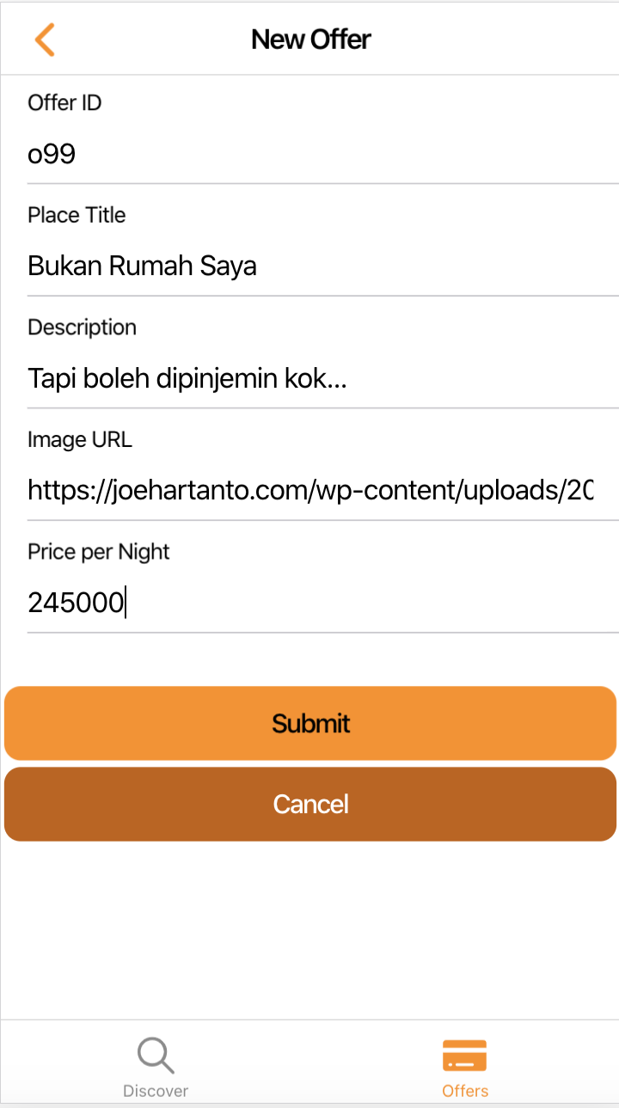
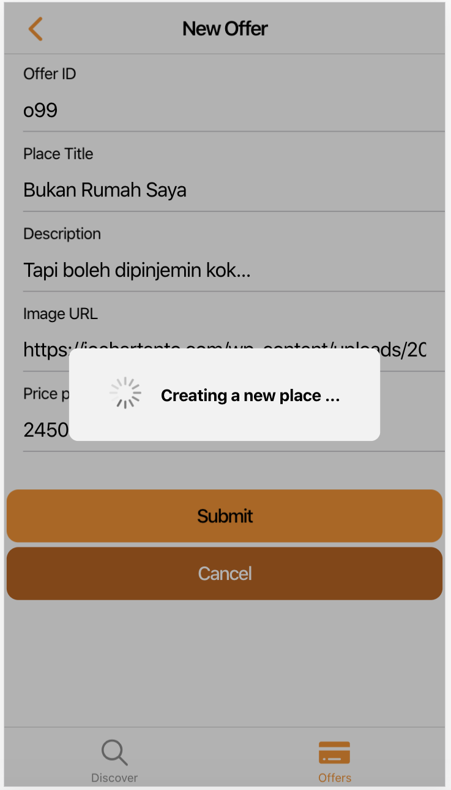
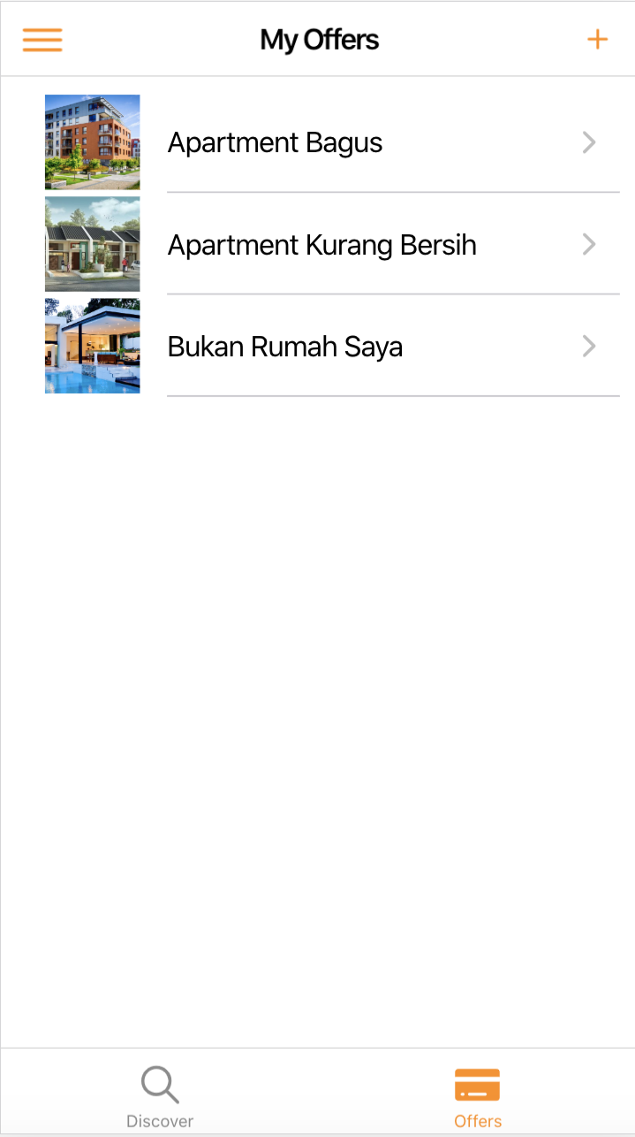

Slide 9
Connecting to a Backend
2/4

Slide 10
How to Connect
Store & Fetch
Data
Database (SQL, NoSQL)
Custom Backend
or
Managed Services (e.g. Firebase)
Server
(REST) API
Send Request
&
Receive Responses
Directly accessing database would be highly insecure
Ionic App

Slide 11
Using PHP and MySQL
3/4

Slide 12
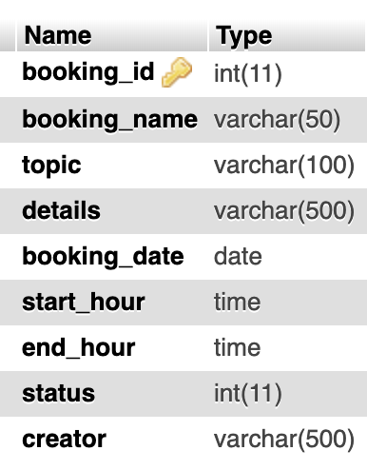
PHP MySQL
Fetching data from a MySQL DB
$conn = mysqli_connect($hostname, $username, $pswd, $dbname);
if ($conn->connect_error) {
die("Connection failed: " . $conn->connect_error);
}
else {
$sql = "SELECT * FROM bookings WHERE `status` = 1";
$result = $conn->query($sql);
$bookings = array();
if ($result->num_rows > 0) {
while($row = $result->fetch_assoc()) {
array_push($bookings,$row);
}
echo json_encode($bookings);
} else {
echo "0 results";
}
$conn->close();
}

Slide 13
PHP MySQL
Deleting data from a MySQL DB
$requestBody = json_decode(file_get_contents('php://input'), true);
$conn = mysqli_connect($hostname, $username, $pswd, $dbname); // Check connection
if ($conn->connect_error) {
die("Connection failed: " . $conn->connect_error);
}
else {
$booking_id = $requestBody['booking_id’];
$sql = "UPDATE bookings SET status = 0 WHERE booking_id = '$booking_id'";
if (mysqli_query($conn, $sql)) {
$status = true;
} else {
$status = false;
}
mysqli_close($conn);
echo json_encode($status);
}

Slide 14
PHP MySQL
Inserting data to a MySQL DB (1)
$conn = mysqli_connect($hostname, $username, $pswd, $dbname); // Check connection
if ($conn->connect_error) {
die("Connection failed: " . $conn->connect_error);
} else {
$input = file_get_contents('php://input');
$data = json_decode($input, true);
$message = array();
$booking_name = $data['booking_name'];
$topic = $data['topic'];
$details = $data['details'];
$booking_date = $data['booking_date'];
$start_hour = $data['start_hour'];
$end_hour = $data['end_hour'];
$creator = $data['creator'];

Slide 15
PHP MySQL
Inserting data to a MySQL DB (2)
$q = mysqli_query($conn, "INSERT INTO `bookings` (`booking_name`, `topic`,`details`, `booking_date`, `start_hour`, `end_hour`, `creator`) VALUES ('$booking_name','$topic','$details','$booking_date', '$start_hour', '$end_hour', '$creator')");
if ($q) {
$message['status'] = "success";
} else {
$message['status'] = "error";
}
mysqli_close($conn);
echo json_encode($message);
echo mysqli_error($con);
}

Slide 16
CORS Issue
if (isset($_SERVER['HTTP_ORIGIN'])) {
header('Access-Control-Allow-Origin: *');
header('Access-Control-Allow-Methods: POST, GET, PUT, DELETE, OPTIONS');
header('Access-Control-Allow-Headers: Origin, X-Requested-With, Content-Type, Accept');
}
if ($_SERVER['REQUEST_METHOD'] != "OPTIONS") {
...
}

Slide 17
Booking Service
export class BookingsService {
constructor(private http: HttpClient) { }
fetchBookings() {
return this.http.get('https://mobdevumn.com/api/fti_booking_app/get_bookings.php');
}
deleteBooking(id: string) {
return this.http.post('https://mobdevumn.com/api/fti_booking_app/delete_booking.php', { 'booking_id': id }).pipe(take(1));
}
insertBooking(newBooking: any) {
const b = {
'booking_name': newBooking.booking_name,
'topic': newBooking.topic,
'details': newBooking.details,
'booking_date': newBooking.booking_date,
'start_hour': newBooking.start_hour,
'end_hour': newBooking.end_hour,
'creator': newBooking.creator,
};
return this.http.post('https://mobdevumn.com/api/fti_booking_app/insert_booking.php', b).pipe(take(1));
}
}

Slide 18
Using the Service -get & delete-
this.bookingSvc.fetchBookings()
.subscribe((bookings) => {
console.log(bookings);
});
this.bookingSvc.deleteBooking(data.bookingId)
.subscribe(() => {
this.bookingSvc.fetchBookings()
.subscribe((bookings) => {
console.log(bookings);
});
console.log("DELETED");
});

Slide 19
Using the Service -insert-
this.bookingsSvc.insertBooking({
'booking_name': f.value.bookingName,
'topic': f.value.topic,
'details': f.value.details,
'booking_date': f.value.bookingDate,
'start_hour': f.value.startHour,
'end_hour': f.value.endHour,
'creator': f.value.creator,
})
.subscribe(
() => {
this.bookingsSvc.fetchBookings()
.subscribe((bookings) => {
console.log(bookings);
});
console.log("INSERTED");
this.closeModal();
}
);
}
Notes:
Try it yourself: Update

Slide 20
Using Firebase
4/4

Slide 21
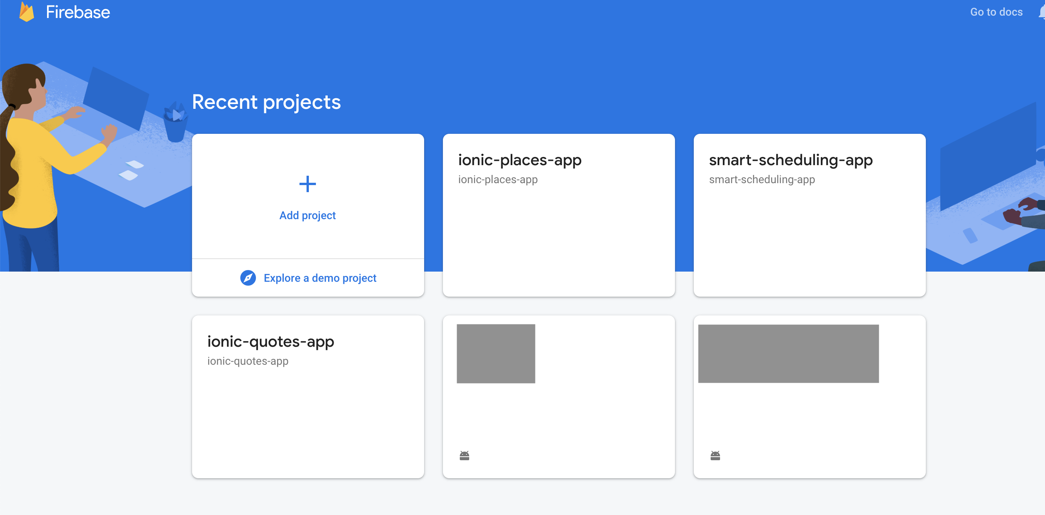
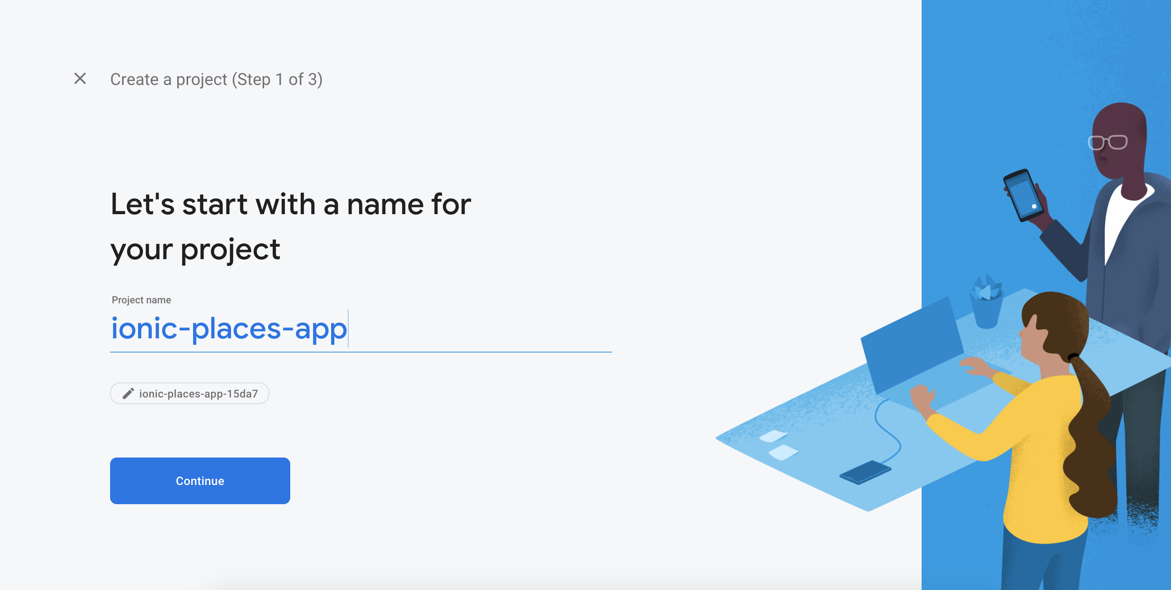
Firebase

Slide 22
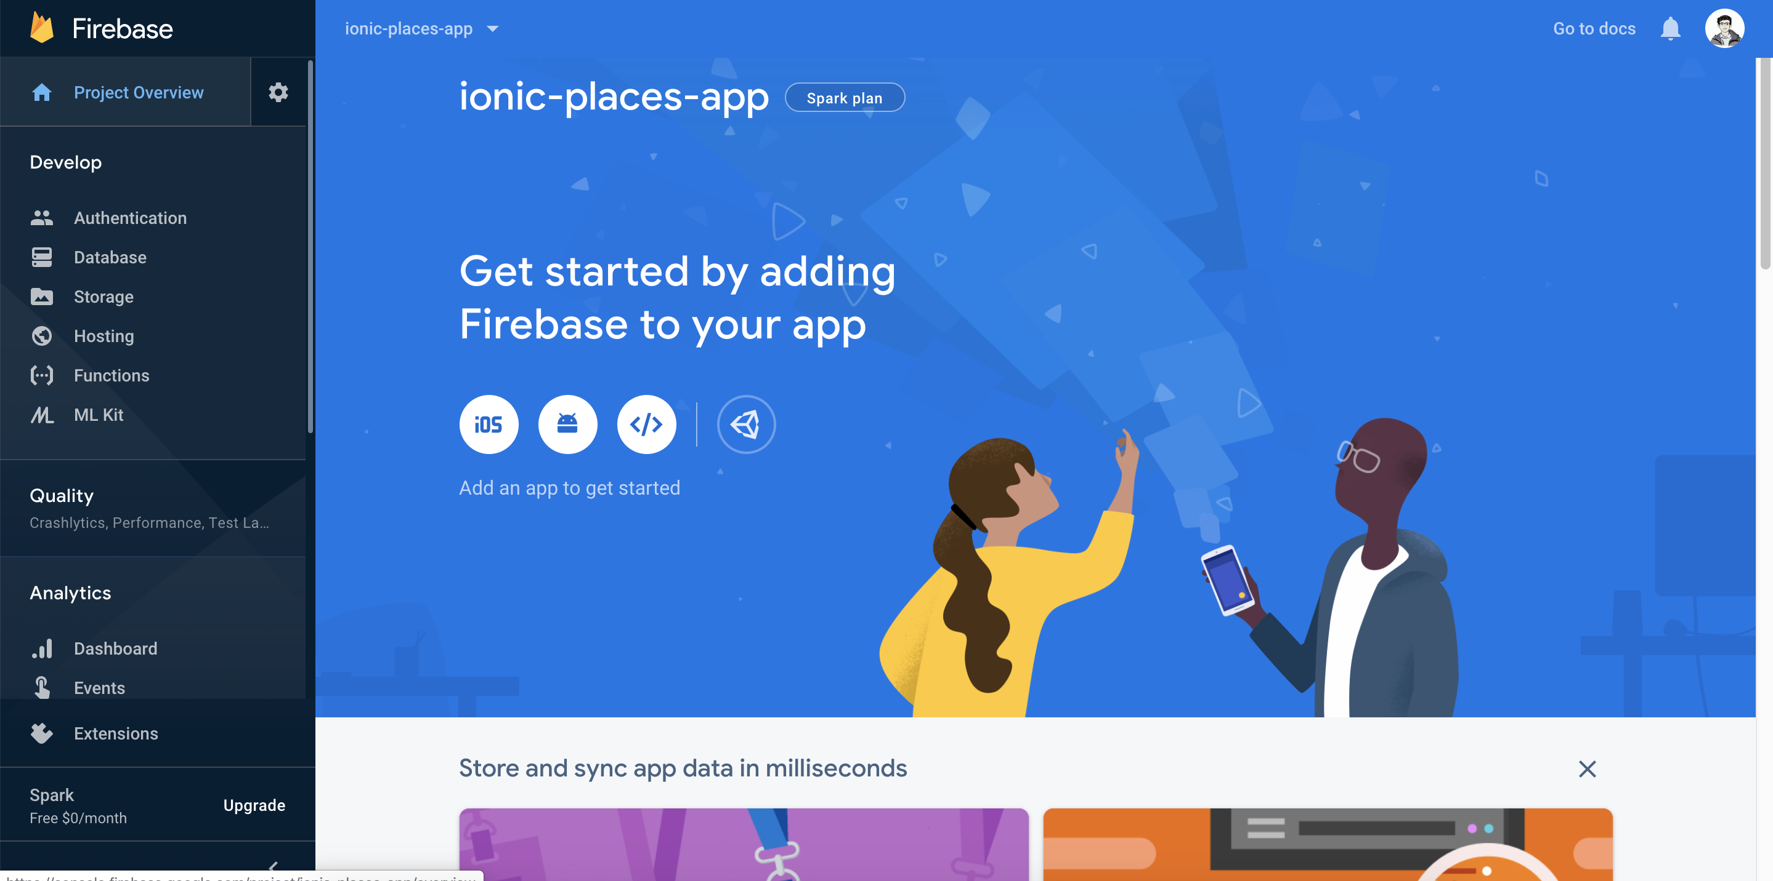
Firebase
Notes:
Authentication for user/account management
Database for the NoSQL database
Storage for storing images

Slide 23
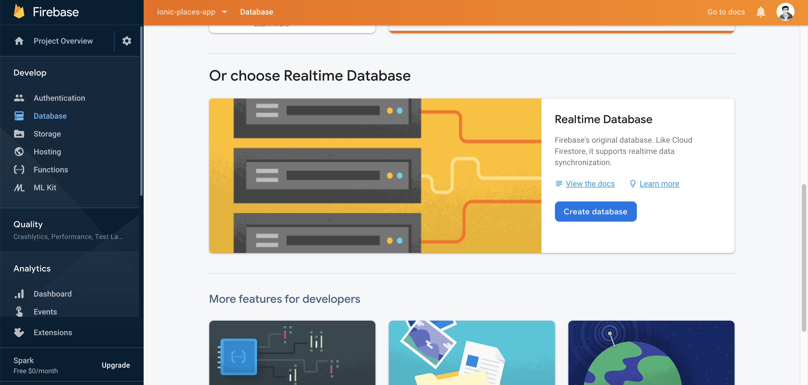
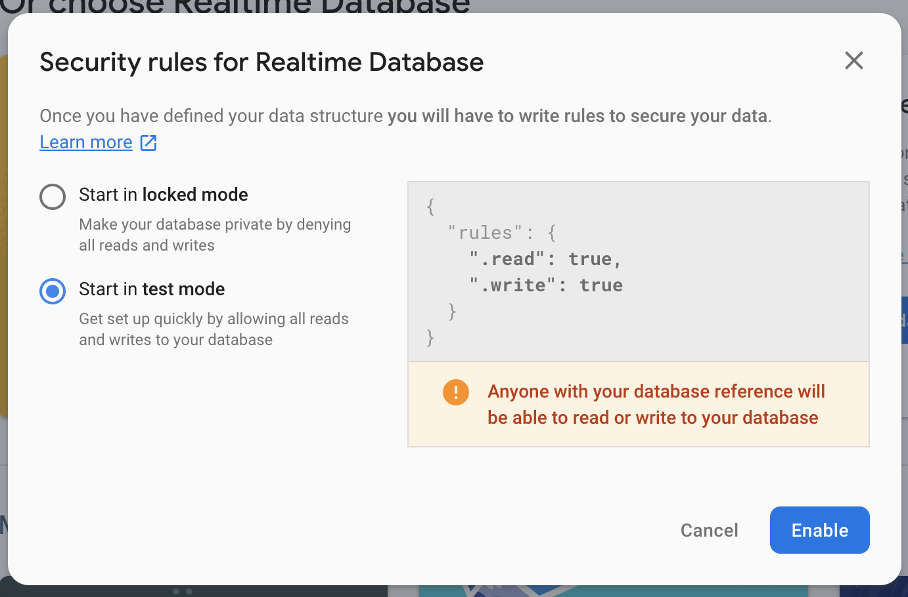
Firebase Realtime Database

Slide 24
Setting Up HTTP Module -insert HttpClientModule to app.module.ts-
import { RouteReuseStrategy } from '@angular/router';
import { HttpClientModule } from '@angular/common/http';
import { IonicModule, IonicRouteStrategy } from '@ionic/angular';
import { SplashScreen } from '@ionic-native/splash-screen/ngx';
import { StatusBar } from '@ionic-native/status-bar/ngx';
import { AppComponent } from './app.component';
import { AppRoutingModule } from './app-routing.module';
@NgModule({
declarations: [AppComponent],
entryComponents: [],
imports: [BrowserModule, HttpClientModule, IonicModule.forRoot(), AppRoutingModule],
providers: [
StatusBar,
SplashScreen,
{ provide: RouteReuseStrategy, useClass: IonicRouteStrategy }
],
bootstrap: [AppComponent]
})
export class AppModule { }

Slide 25
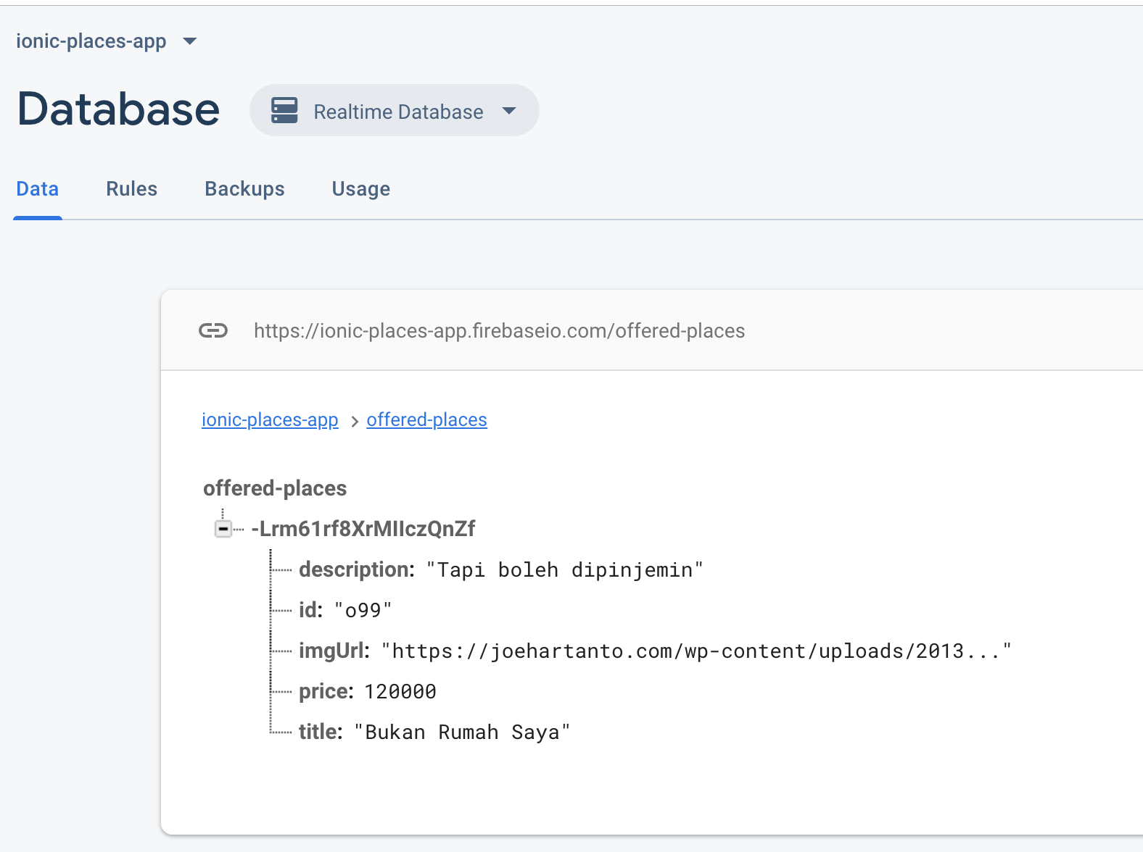
Sending Data via HTTP -Use HTTP Post to Firebase Realtime DB-
addOffer(offer: Place) {
return this.http
.post<{ name: string }>('https://ionic-places-app.firebaseio.com/offered-places.json', { ...offer })
.pipe(
switchMap(resp => {
console.log(resp);
return this.getAllOffers();
}),
take(1),
tap(
(offersArray) => {
this._offers.next(offersArray.concat(offer));
}
)
);
}
offers.service.ts
Notes:
No need to change anything from the new-offer.page.ts
switchMap return an observable, compared to map which returns non-observables.

Slide 26
Fetching Data via HTTP -Use HTTP Get to Fetch Data from Firebase Realtime DB-
fetchOffers() {
return this.http
.get<{ [key: string]: Place }>('https://ionic-places-app.firebaseio.com/offered-places.json')
.pipe(
map(resp => {
const offers = [];
for (const key in resp) {
if (resp.hasOwnProperty(key)) {
offers.push({
id: resp[key].id,
title: resp[key].title,
description: resp[key].description,
imgUrl: resp[key].imgUrl,
price: resp[key].price
});
}
}
return offers;
}),
tap(
(offers) => {
this._offers.next(offers);
}
)
);
}
offers.service.ts
offers.page.ts
ionViewWillEnter() {
this.offersSvc.fetchOffers().subscribe();
}
Notes:
Try it yourself: Delete and Update
Google: Angular/Ionic and Firebase Realtime Database

Slide 27
Questions?
Comments?

Slide 28
NEXT
Authentication

Slide 29
Thank you

