Slide 1
Cross Platform Mobile Programming
IF733
Location and Google Maps
Andre Rusli

Slide 2
Agenda
API Setup
Preparing our app
Adding the Google Maps SDK

Slide 3
API Setup
1/3
Notes:
https://developers.google.com/maps/documentation/javascript/tutorial

Slide 4
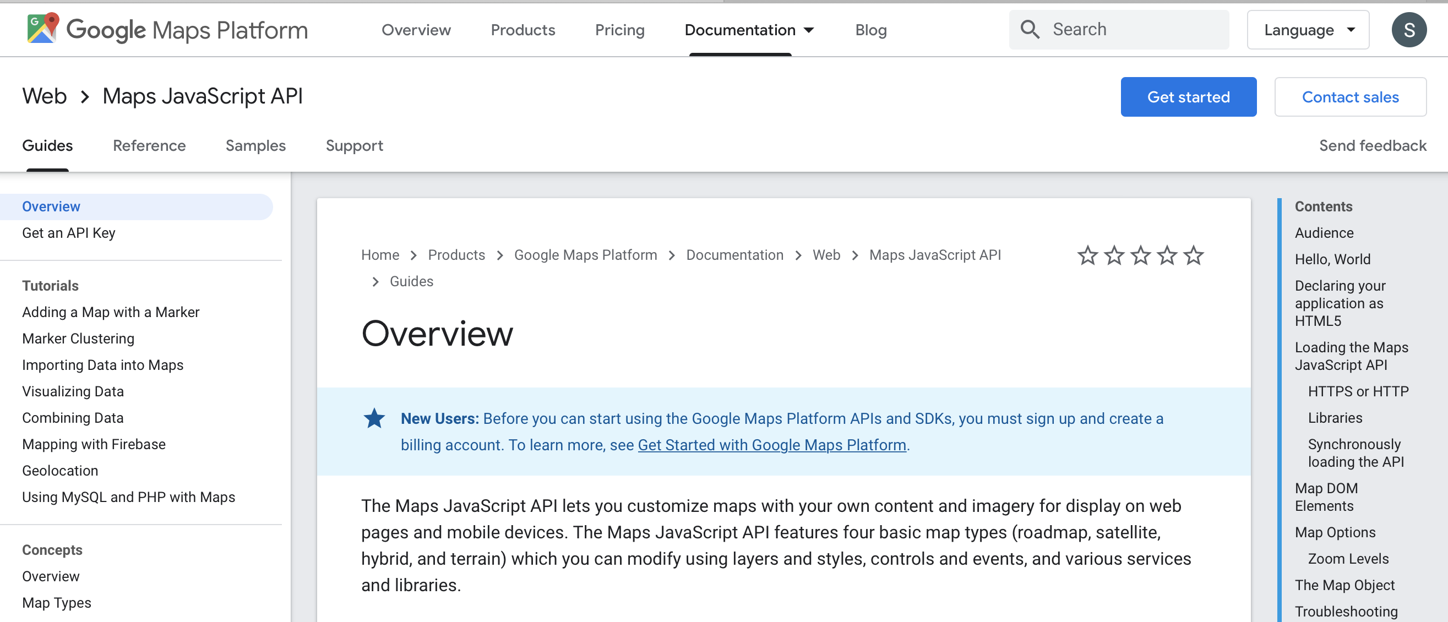
Account Preparation
Notes:
https://developers.google.com/maps/documentation/javascript/tutorial

Slide 5
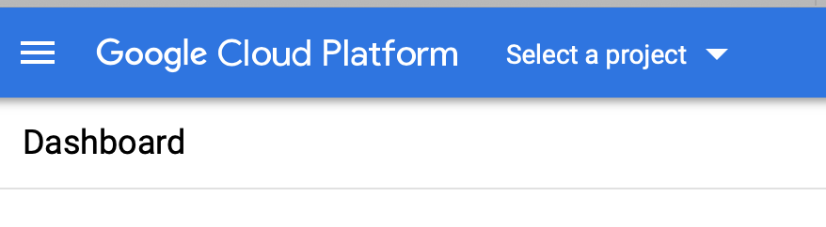
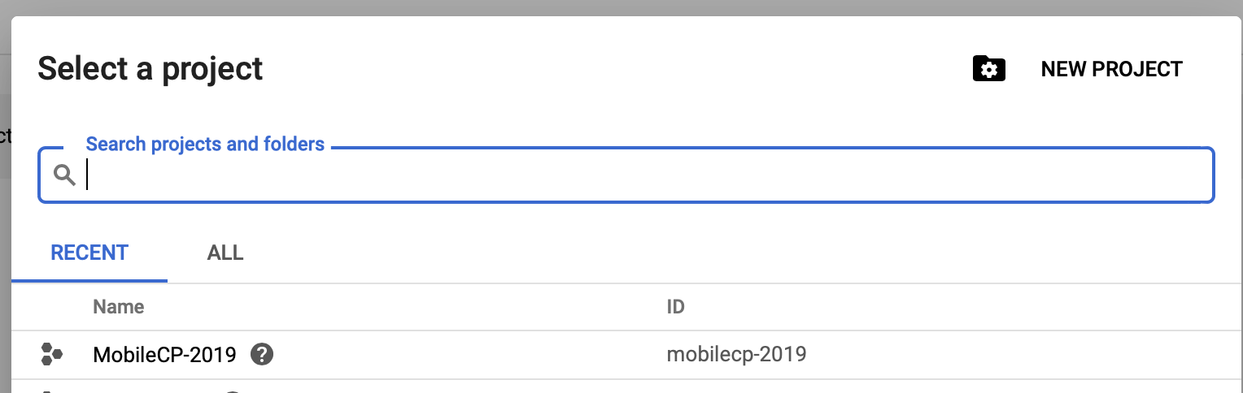
Create Project in GCP
Notes:
https://console.cloud.google.com

Slide 6
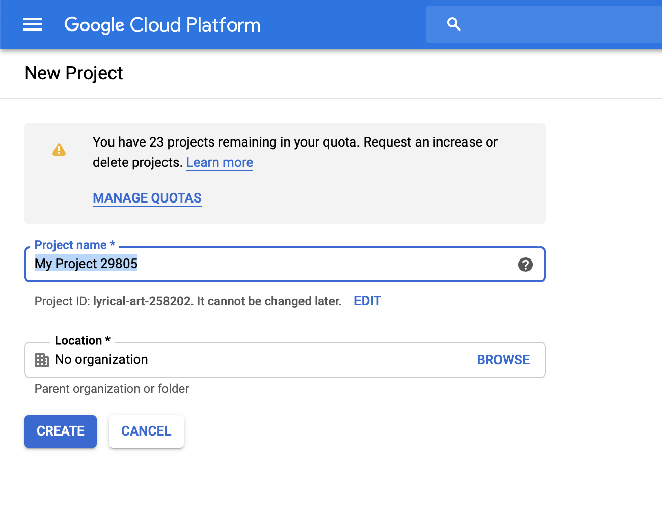
Create Project in GCP
Notes:
https://console.cloud.google.com

Slide 7
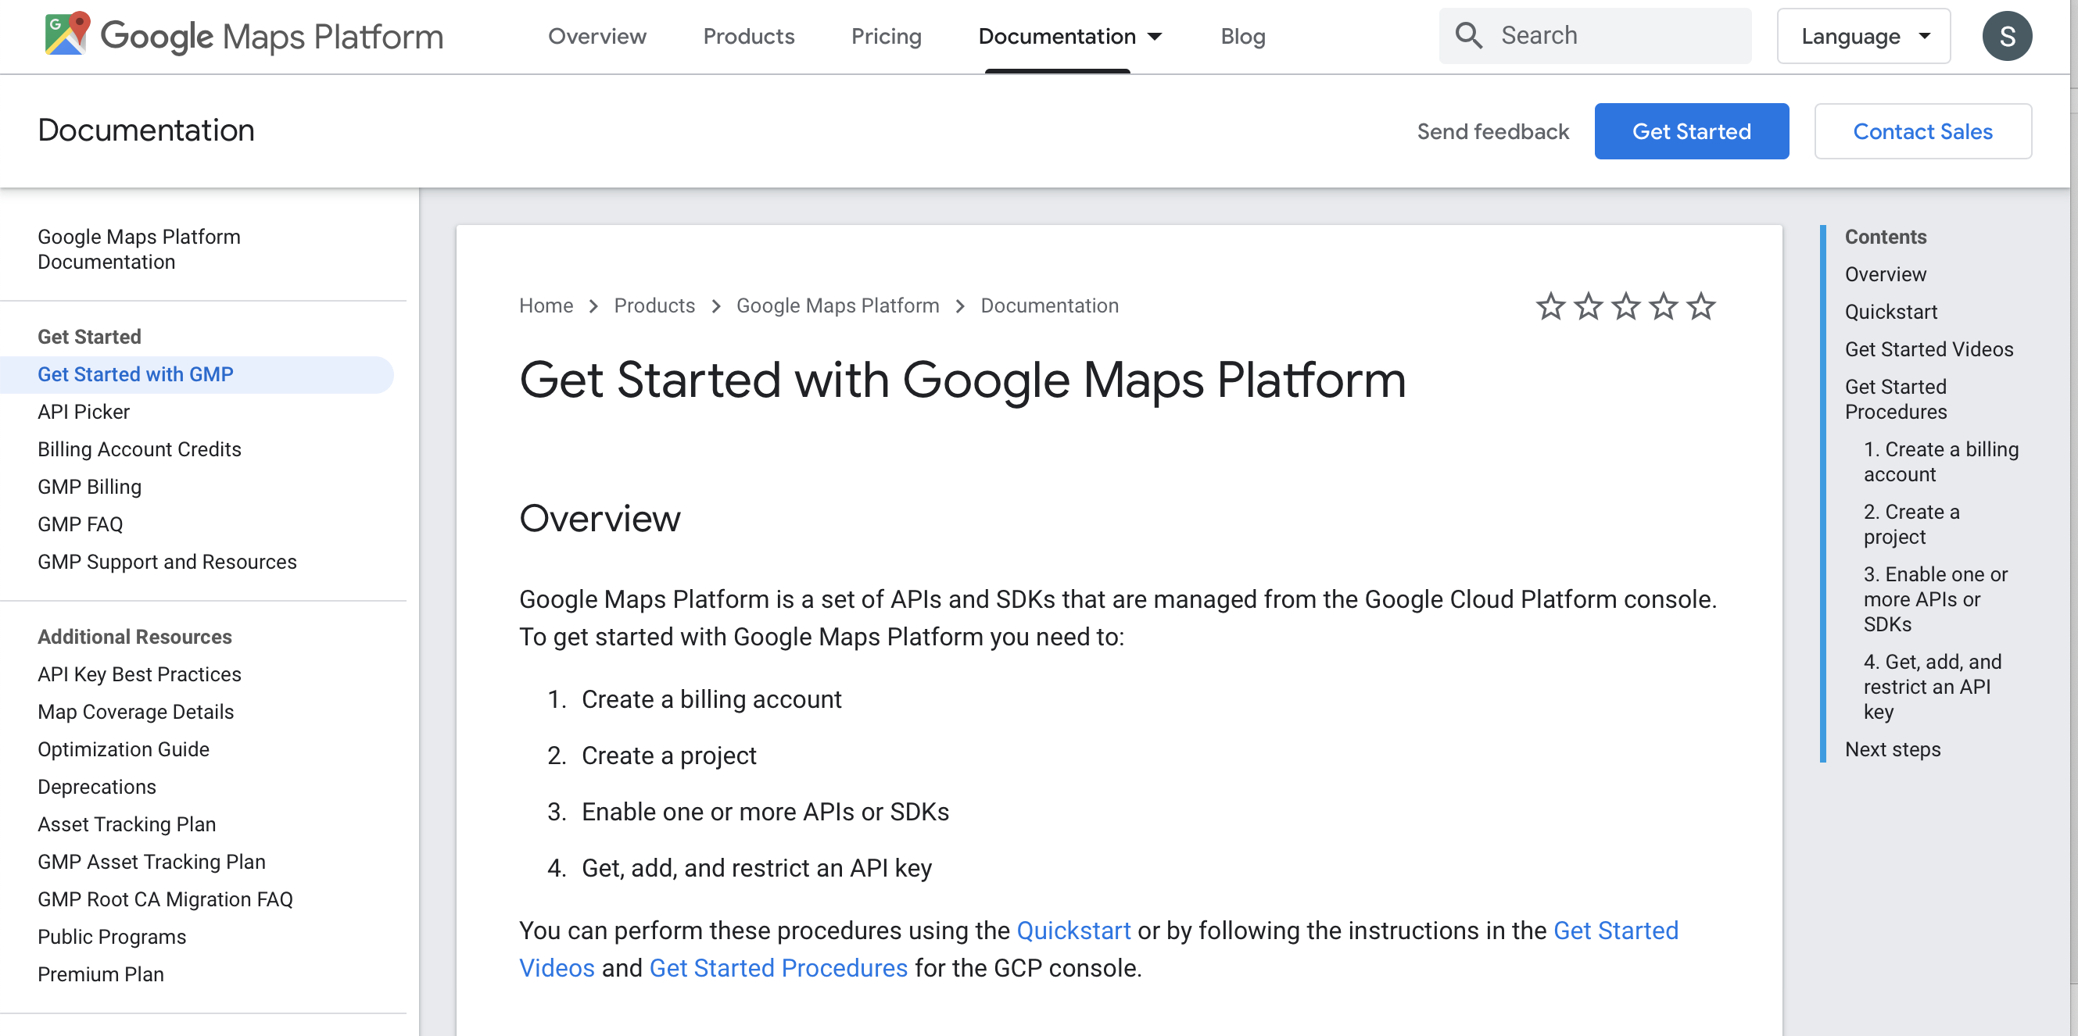
Account Preparation
Notes:
https://cloud.google.com/maps-platform/

Slide 8
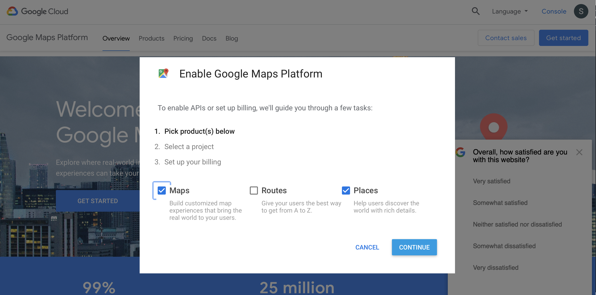
Enabling the Google Maps Platform
Notes:
Maps for the maps.
Places for the Geocoding, to convert coordinates to addresses.

Slide 9
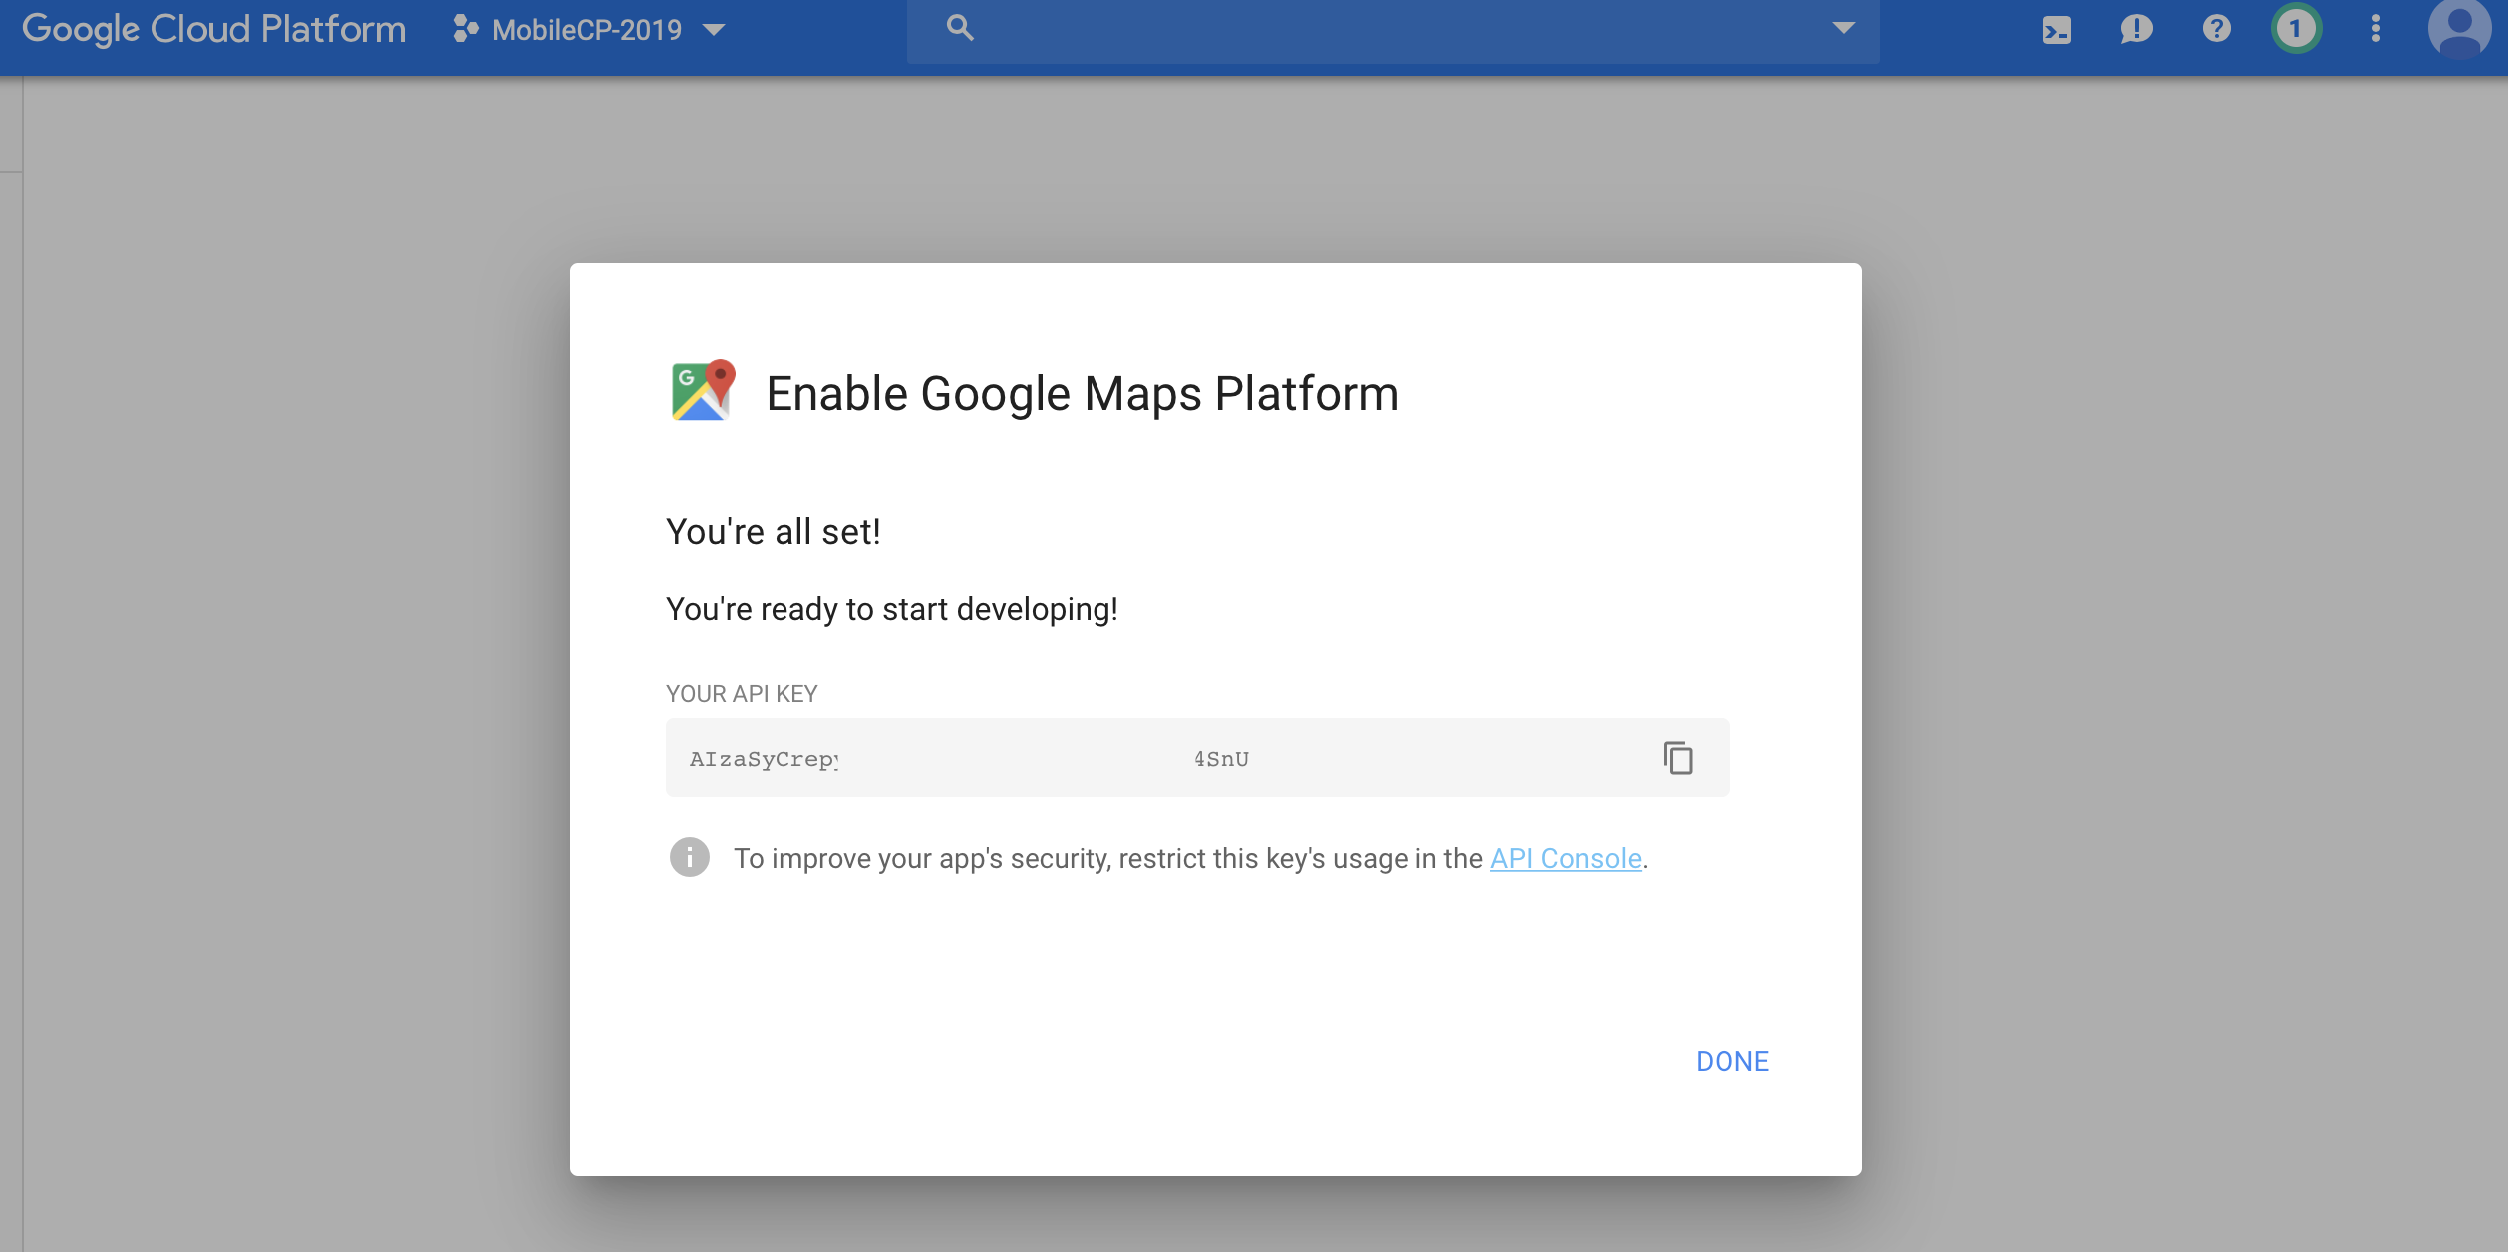
Getting the Maps API Key
Notes:
Maps for the maps.
Places for the Geocoding, to convert coordinates to addresses.
We can put the maps API Key to the environment.ts as we put our firebase API Key.

Slide 10
Preparing Our App
2/3
Notes:
https://developers.google.com/maps/documentation/javascript/tutorial

Slide 11
LocationPicker Component
> ionic generate component shared/pickers/location-picker
export class LocationPickerComponent implements OnInit {
constructor(private modalCtrl: ModalController) { }
ngOnInit() { }
async onPickLocation() {
const modal = await this.modalCtrl.create({
component: MapModalComponent
});
return await modal.present();
}
}
<div>
<ion-button color='primary' (click)='onPickLocation()'>
<ion-icon name='map' slot='start'></ion-icon>
<ion-label>Select Location</ion-label>
</ion-button>
</div>

Slide 12
MapModal Component
> ionic generate component shared/map-modal
<ion-header>
<ion-toolbar>
<ion-title>Pick Location</ion-title>
<ion-buttons slot='primary'>
<ion-button (click)='onCancel()'>Cancel</ion-button>
</ion-buttons>
</ion-toolbar>
</ion-header>
<ion-content>
<div class='map' #map></div>
</ion-content>
export class MapModalComponent implements OnInit {
constructor(private modalCtrl: ModalController) { }
ngOnInit() { }
onCancel() {
this.modalCtrl.dismiss();
}
}

Slide 13
Shared Module
> ionic generate component shared/shared.module.ts
import { NgModule } from '@angular/core';
import { LocationPickerComponent } from './pickers/location-picker/location-picker.component';
import { MapModalComponent } from './map-modal/map-modal.component';
import { CommonModule } from '@angular/common’;
import { IonicModule } from ’@ionic/angular’;
@NgModule({
declarations: [LocationPickerComponent, MapModalComponent],
imports: [CommonModule, IonicModule],
exports: [LocationPickerComponent, MapModalComponent],
entryComponents: [MapModalComponent]
})
export class SharedModule { }

Slide 14
Using the MapModal and LocationPicker
-in the HomePage-
home.module.ts
...
@NgModule({
imports: [
CommonModule,
SharedModule,
FormsModule,
IonicModule,
...
home.page.html
<ion-content>
<app-location-picker></app-location-picker>
<ion-button expand="block" color="danger" fill="outline" (click)="onLogout()">
Logout
</ion-button>
</ion-content>

Slide 15
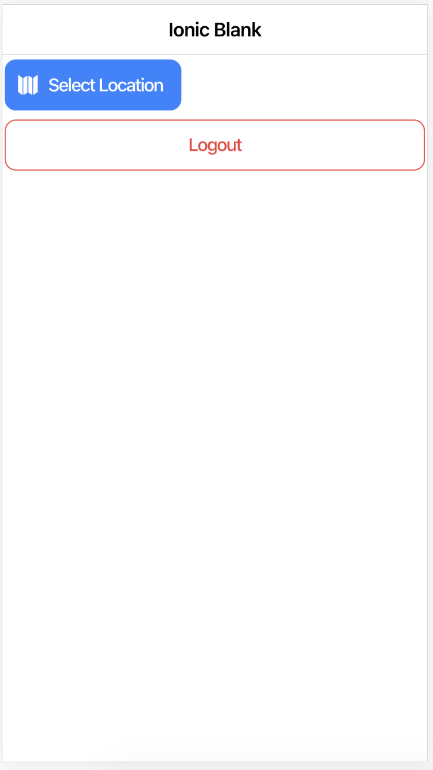
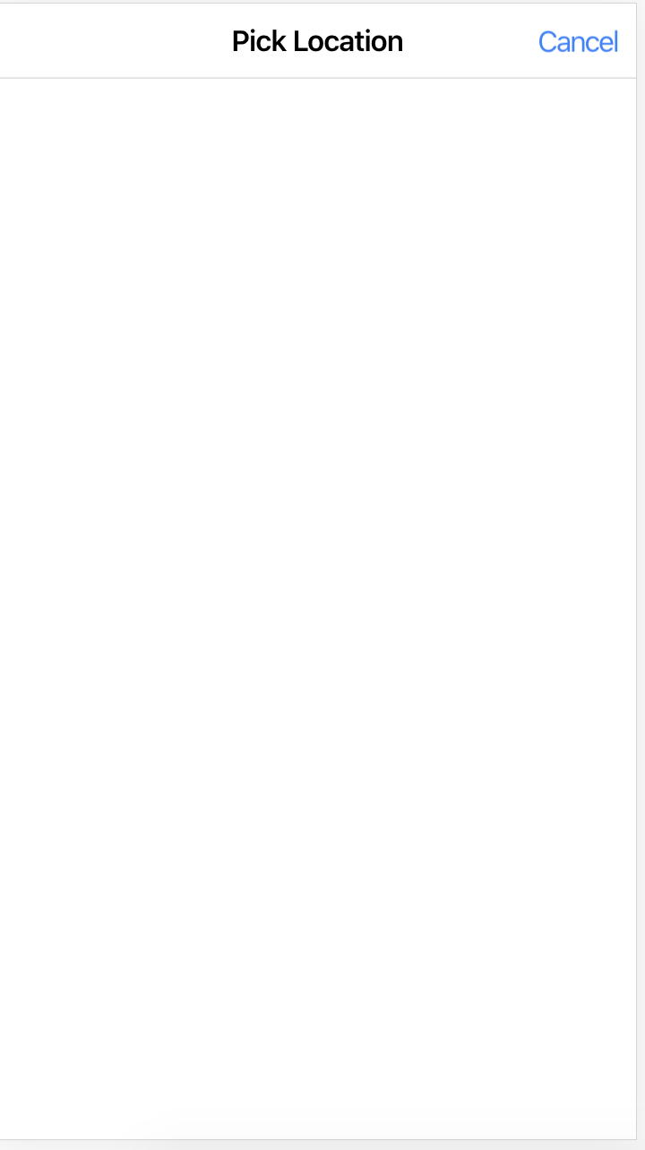

Slide 16
Google Maps SDK
3/3

Slide 17
Method #1
Notes:
https://angular-maps.com/guides/getting-started/
https://www.youtube.com/watch?v=lApggVS0icc

Slide 18
Using Angular Google Maps
> npm install @agm/core
shared.module.ts
import { AgmCoreModule } from '@agm/core';
import { environment } from 'src/environments/environment';
@NgModule({
declarations: [LocationPickerComponent, MapModalComponent],
imports: [
CommonModule,
IonicModule,
AgmCoreModule.forRoot({
apiKey: `${environment.mapsAPIKey}`,
}),
],
exports: [LocationPickerComponent, MapModalComponent],
entryComponents: [MapModalComponent]
})
Notes:
https://angular-maps.com/guides/getting-started/
https://www.youtube.com/watch?v=lApggVS0icc

Slide 19
Using Angular Google Maps
> npm install @agm/core
map-modal.component.html
<ion-content>
<agm-map [latitude]="lat" [longitude]="lng" (mapClick)="onChooseLocation($event)">
<agm-marker [latitude]="lat" [longitude]="lng"></agm-marker>
</agm-map>
</ion-content>
map-modal.component.scss
map-modal.component.ts
agm-map {
height: 300px;
}
export class MapModalComponent implements OnInit {
lat = 51.678418;
lng = 7.809007;
constructor(private modalCtrl: ModalController) { }
onChooseLocation(event: any) {
this.lat = event.coords.lat;
this.lng = event.coords.lng;
}
Notes:
https://angular-maps.com/guides/getting-started/
https://www.youtube.com/watch?v=lApggVS0icc

Slide 20
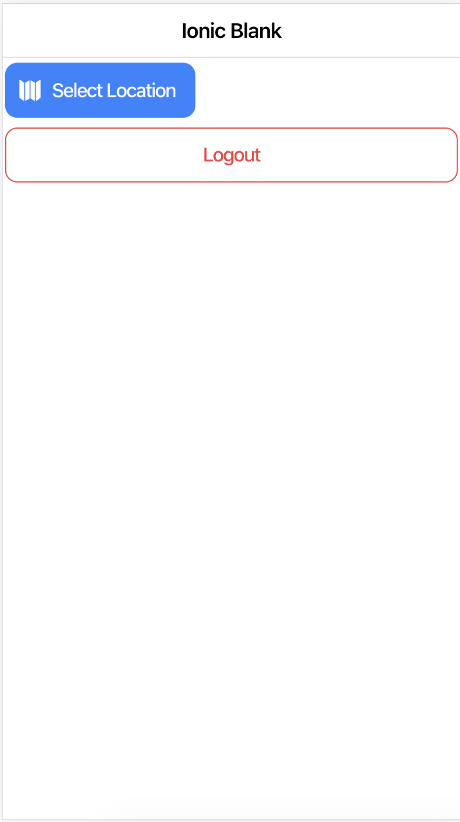
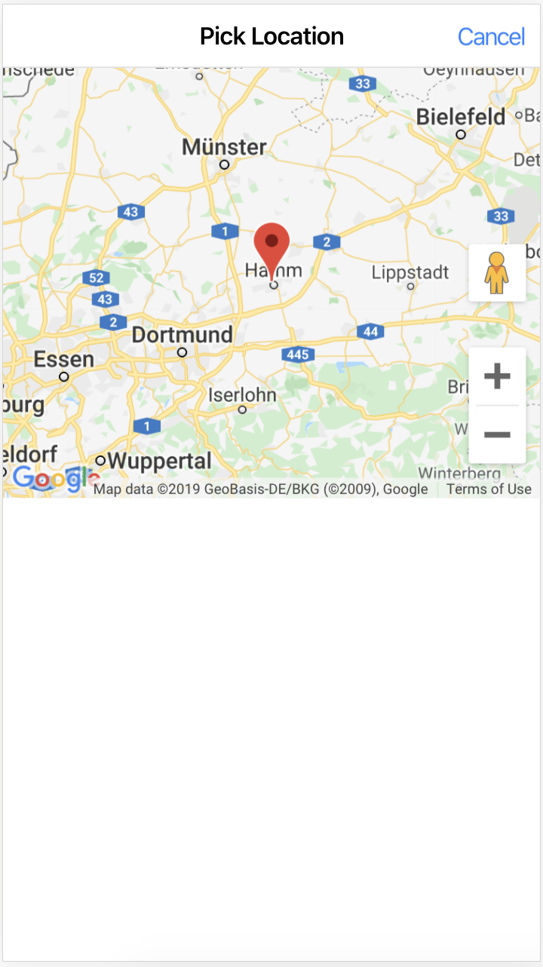
Using Angular Google Maps
> npm install @agm/core
Notes:
https://angular-maps.com/guides/getting-started/
https://www.youtube.com/watch?v=lApggVS0icc

Slide 21
Method #2
Notes:
https://angular-maps.com/guides/getting-started/
https://www.youtube.com/watch?v=lApggVS0icc

Slide 22
Google Maps Javascript SDK
private getGoogleMaps(): Promise<any> {
const win = window as any;
const googleModule = win.google;
if (googleModule && googleModule.maps) {
return Promise.resolve(googleModule.maps);
}
return new Promise((resolve, reject) => {
const script = document.createElement('script');
script.src = `https://maps.googleapis.com/maps/api/js?key=${environment.mapsAPIKey}&callback=initMap`;
script.async = true;
script.defer = true;
document.body.appendChild(script);
script.onload = () => {
const loadedGoogleModule = win.google;
if (loadedGoogleModule && loadedGoogleModule.maps) {
resolve(loadedGoogleModule.maps);
} else {
reject('Google maps SDK is not available');
}
};
});
}
map-modal.component.ts
Notes:
https://developers.google.com/maps/documentation/javascript/tutorial

Slide 23
Google Maps Javascript SDK
map-modal.component.ts
export class MapModalComponent implements OnInit, AfterViewInit {
ngAfterViewInit() {
this.getGoogleMaps().then((googleMaps) => {
const mapElement = this.mapElementRef.nativeElement;
const map = new googleMaps.Map(mapElement, {
center: { lat: this.lat, lng: this.lng },
zoom: 16,
});
googleMaps.event.addListenerOnce(map, 'idle', () => {
this.renderer.addClass(mapElement, 'visible');
});
}).catch(err => {
console.log(err);
});
}
Notes:
https://developers.google.com/maps/documentation/javascript/tutorial

Slide 24
Adding Marker and Click Listener
map-modal.component.ts
ngAfterViewInit() {
this.getGoogleMaps().then((googleMaps) => {
const mapElement = this.mapElementRef.nativeElement;
const map = new googleMaps.Map(mapElement, {
center: { lat: this.lat, lng: this.lng },
zoom: 16,
});
googleMaps.event.addListenerOnce(map, 'idle', () => {
this.renderer.addClass(mapElement, 'visible');
});
const marker = new googleMaps.Marker({ position: { lat: this.lat, lng: this.lng }, map });
console.log(marker);
map.addListener('click', event => {
const selectedCoords = {
lat: event.latLng.lat(),
lng: event.latLng.lng(),
};
this.modalCtrl.dismiss(selectedCoords);
});
}).catch(err => {
console.log(err);
});
}
Notes:
https://developers.google.com/maps/documentation/javascript/tutorial

Slide 25
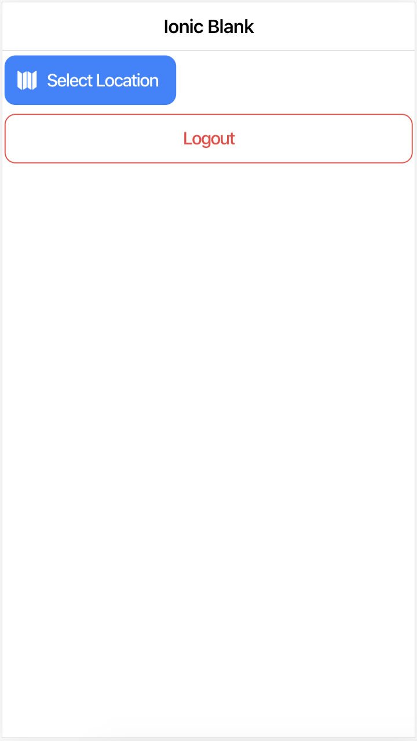
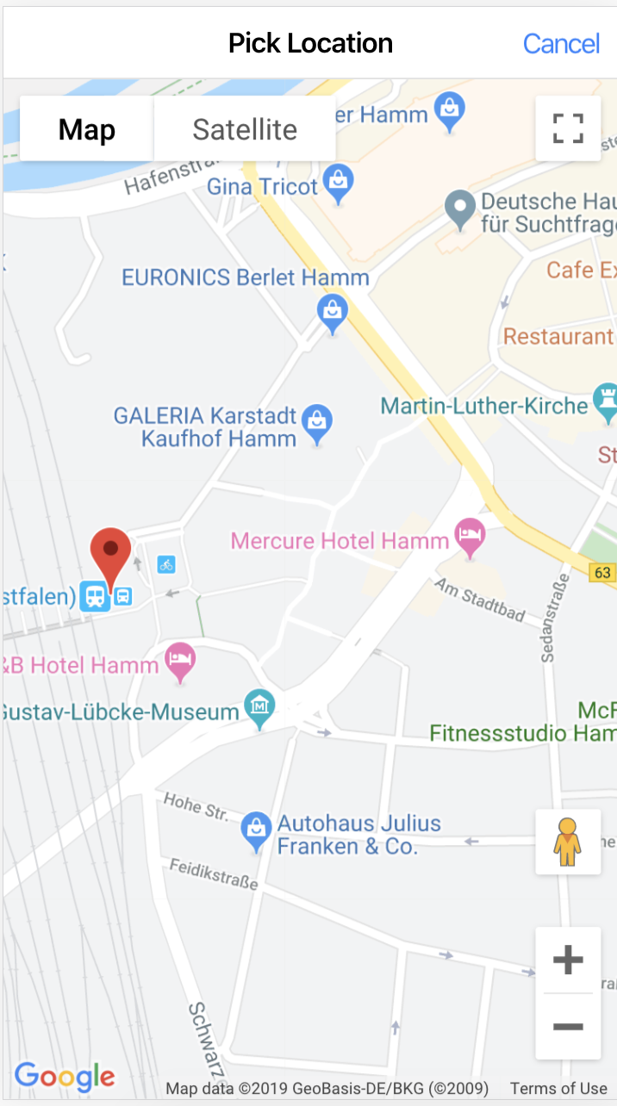
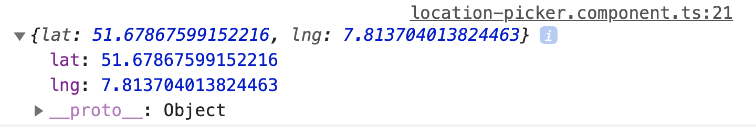
Adding Marker and Click Listener
location-picker.component.ts
async onPickLocation() {
const modal = await this.modalCtrl.create({
component: MapModalComponent
});
modal.onDidDismiss().then((modalData) => {
console.log(modalData.data);
});
return await modal.present();
}
Notes:
https://developers.google.com/maps/documentation/javascript/tutorial

Slide 26
Questions?
Comments?

Slide 27
Thank you

