Slide 1

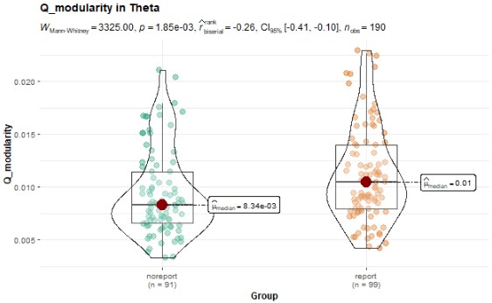
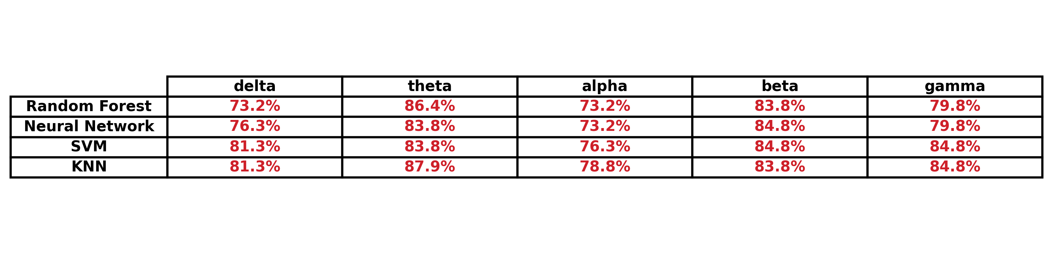
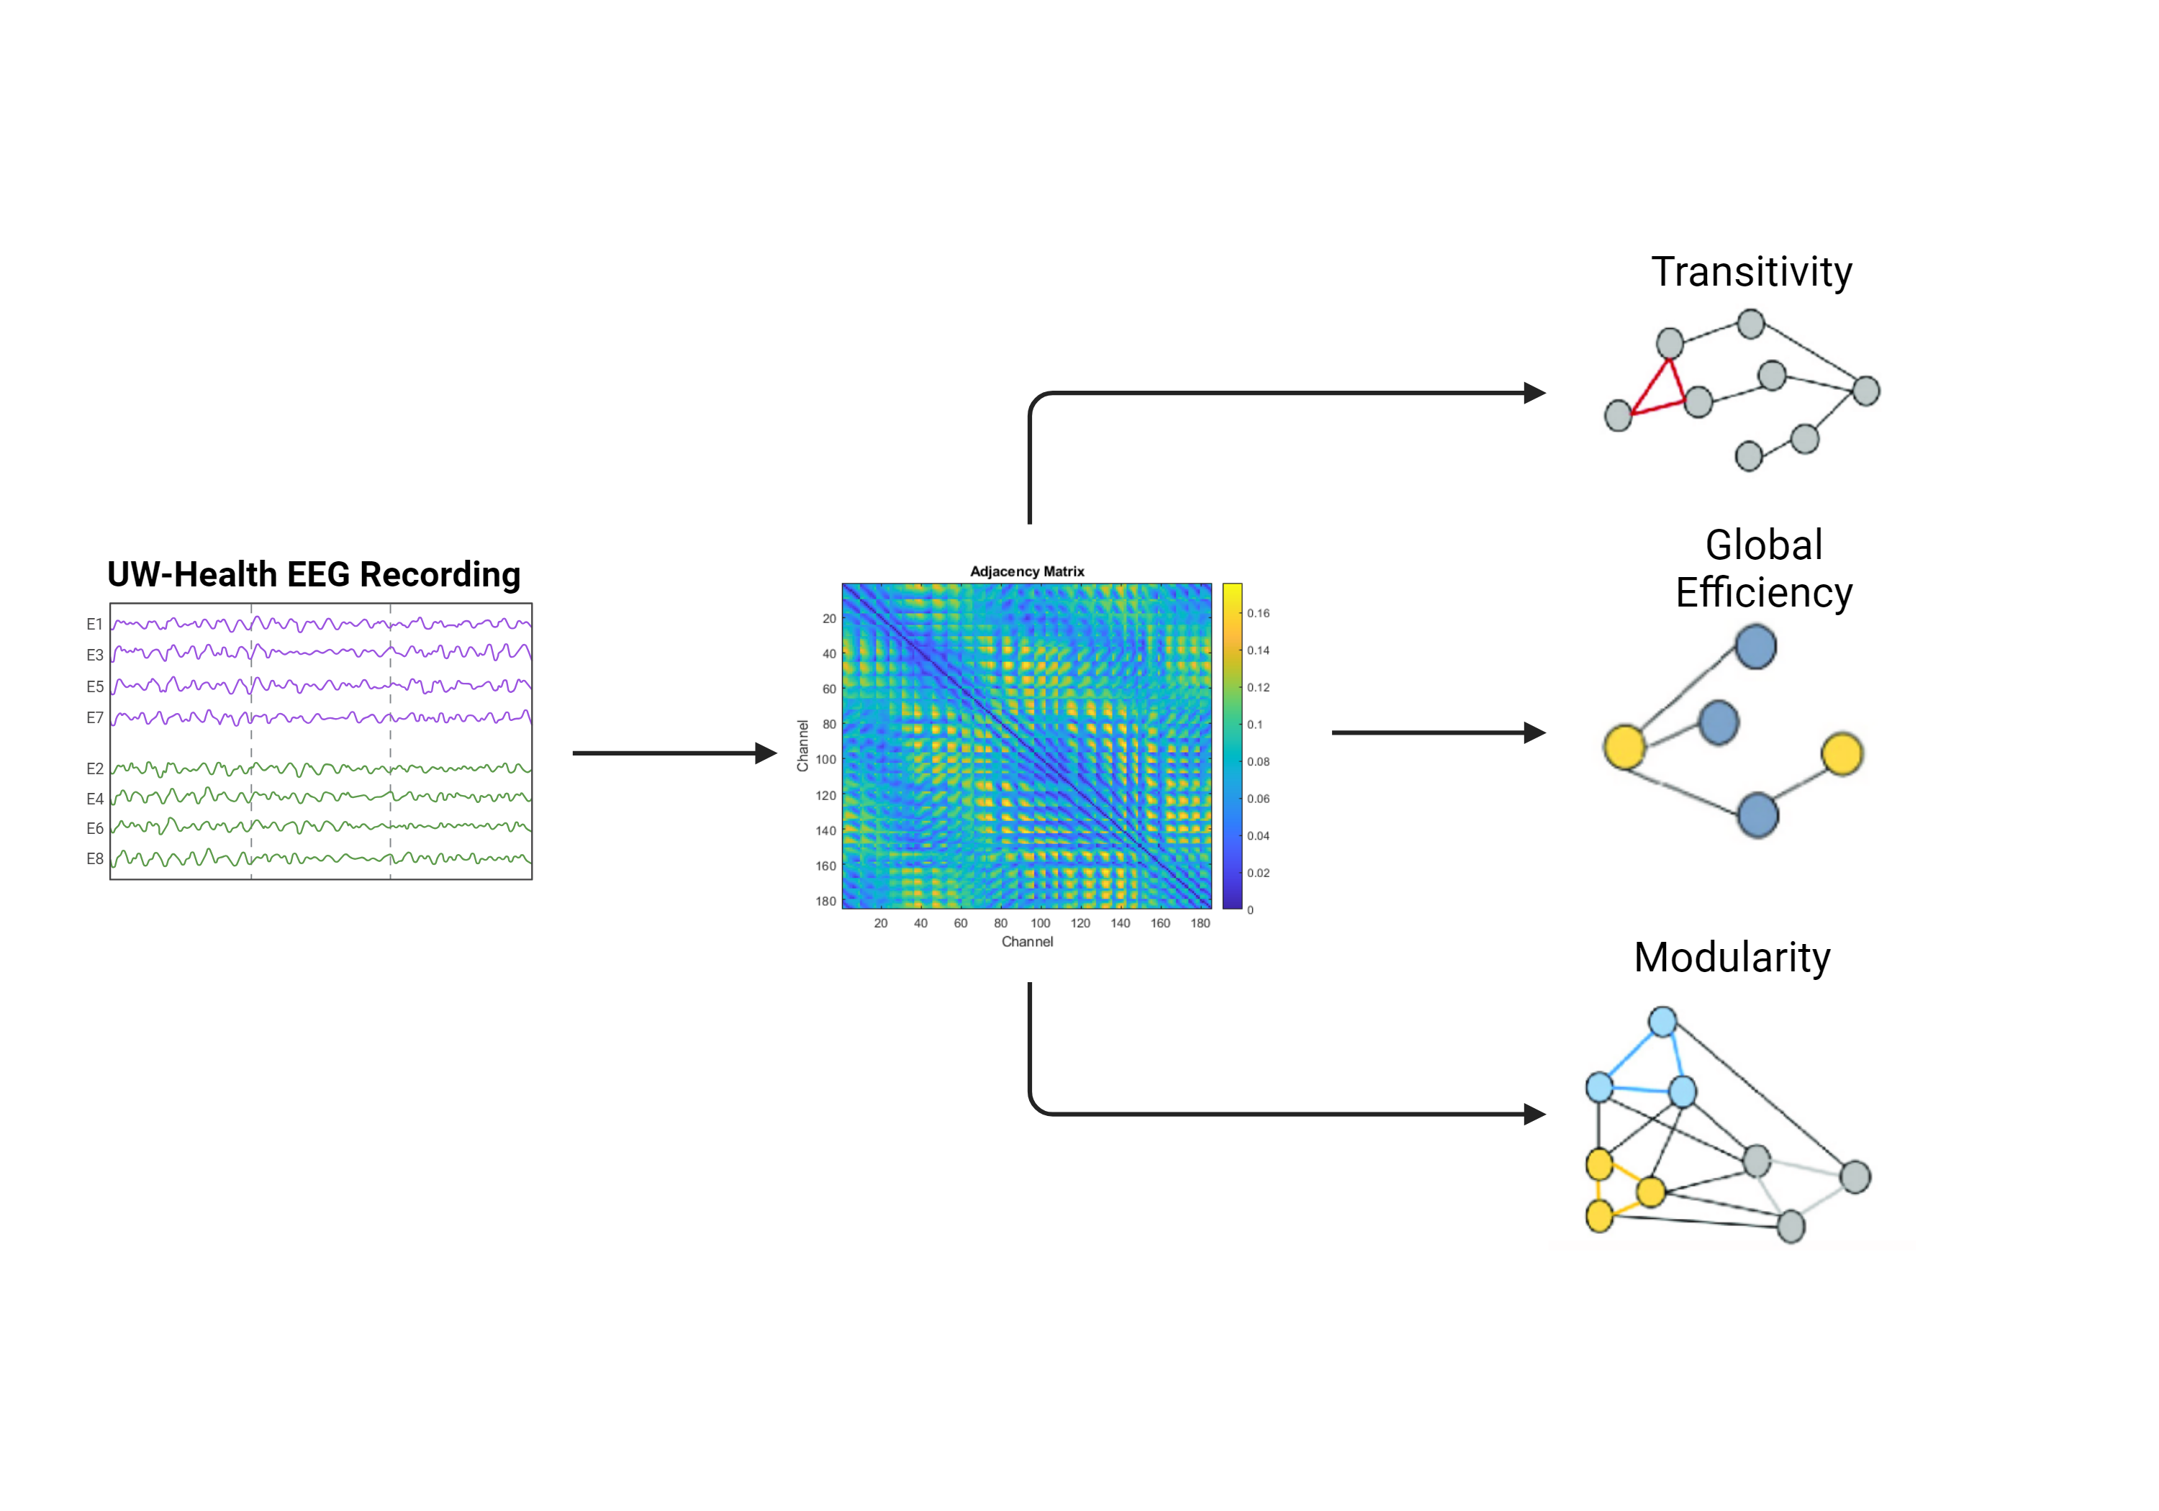
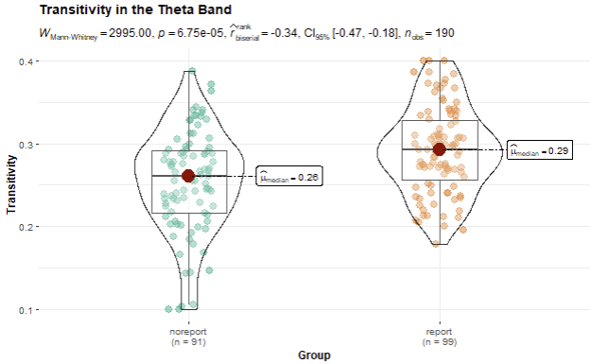
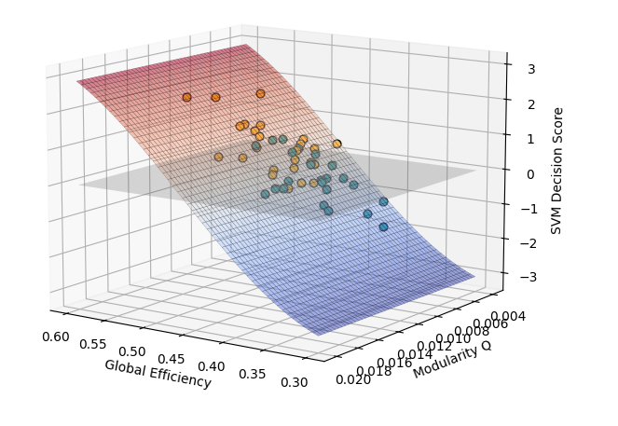
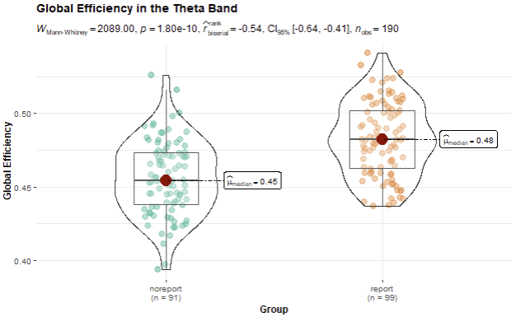
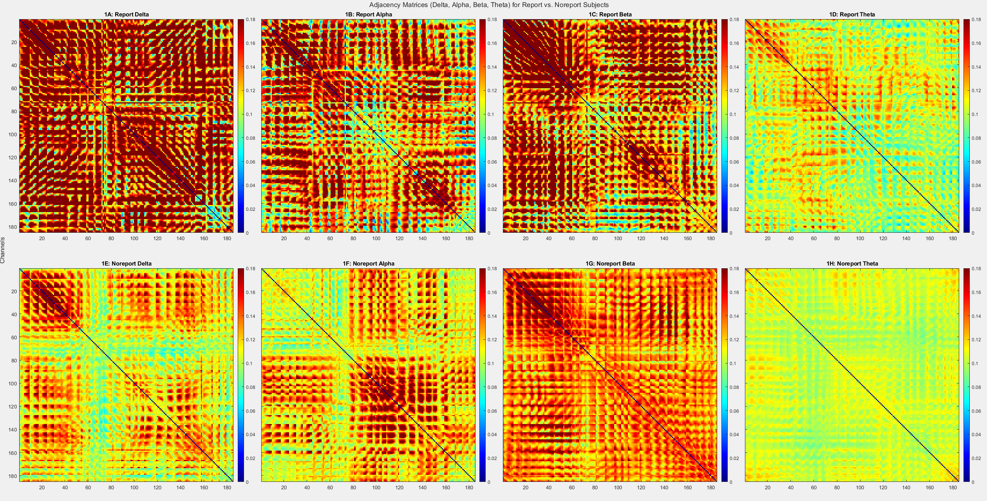

Graph Topology Predicts Consciousness
Steven Edward Haworth^{1,2}, Santiago Philibert Rosas¹, Mariel Kalkach-Aparicio^{1,}, Giulio Tononi³, Aaron F. Struck^{1†}
1 Department of Neurology, University of Wisconsin, Madison, WI, USA, 2 Department of Statistics, University of Wisconsin, Madison, WI, USA
3 Department of Psychiatry, University of Wisconsin, Madison, WI, USA
† Mentor, Affiliations represent current and/or at the time of the study
Introduction
Sleep provides a unique opportunity to investigate consciousness, as the brain naturally alternates between aware and unaware states without external intervention. High-density EEG (HD-EEG) offers the temporal resolution needed to track these shifts, capturing large-scale neural dynamics across sleep stages.1 By transforming EEG signals into functional brain networks, researchers can apply graph-theoretical tools to quantify network properties such as Global Efficiency, Transitivity, and Modularity—metrics that reflect integration, local clustering, and community structure, respectively.2 These measures have been proposed as potential biomarkers for altered states of consciousness, yet their utility in sleep remains underexplored. Emerging evidence suggests that dreaming may be associated with specific topological patterns in EEG-derived networks.3 In this study, we use a serial awakening protocol and HD-EEG to examine whether graph-theoretical features can reliably distinguish between conscious and sleep states. An overview of our data preprocessing is illustrated below.
Q Modularity
Predictive Modeling
Theta band connectivity yielded the highest classification performance overall. Among all models, KNN consistently outperformed others, achieving the top accuracy across multiple frequency bands. These results highlight theta-band topology and KNN as robust markers of sleep consciousness.
Discussion
This 3D plot shows an SVM decision surface separating conscious and unconscious states based on Global Efficiency and Modularity Q. Data points above or below this plane reflect the SVM’s confidence in class membership, and the presence of misclassifications illustrates the model's generalization behavior on test data. However, SVMs do not account for subject-specific variability in feature importance.
Transitivity
Graphical Representation
We computed adjacency matrices using lagged coherence, calculated as the square of the imaginary part of the cross-spectral density normalized by individual power spectra—across 2-second sliding windows with 50% overlap. For subjects with multiple awakenings, we averaged matrices to form a representative network, then computed measures such as Global Efficiency, Transitivity, and Modularity to better the understand network structure and local nodal influence.
Conclusion
This study demonstrates that graph-theoretical measures derived from high-density EEG can reasonably discriminate conscious from unconscious states during sleep. The serial awakening paradigm, validated by statistical tests and machine learning identified up to 50 network metrics. The most influential being Global Efficiency, Modularity Q, and Transitivity. Among all classifiers tested, K-Nearest Neighbors (KNN) and Support Vector Machines (SVM) showed the most reliable and consistent performance, with accuracies approaching 90%. These findings highlight the value of balancing accuracy with reliability when selecting machine learning tools for neuroscience research Future work may incorporate subject-level uncertainty using Bayesian modeling to personalize predictions.
Global Efficiency
Acknowledgements
I would like extend a huge thank you to Dr. Giulio Tononi for providing access to the HD-EEG dataset. I am also grateful to Dr. Klevest Gjini, Dr. Aaron F Struck, and Atakan Selte for their mentorship and guidance throughout this project.

