Slide 1


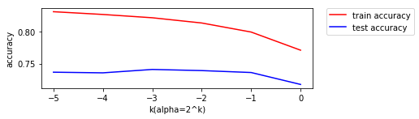
Naïve Bayes
Advantages: easy and fast
Disadvantages: ignore interactions between features

Slide 2
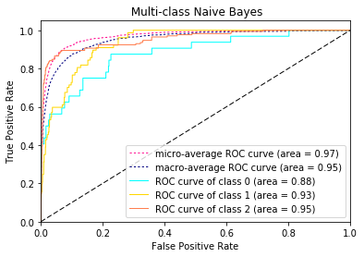
Results of Naïve Bayes
 | Accuracy | F-score(micro) | F-score(macro)
Train | 0.797994 | 0.800257 | 0.740366
Test | 0.746606 | 0.745852 | 0.653087
We have 20 classes, the areas of ROC curves are around 0.88 to 0.99.

