Slide 1


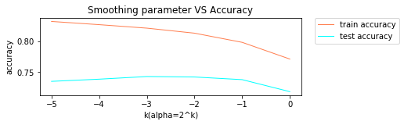
Naïve Bayes
Advantages: easy and fast
Disadvantages: ignore interactions between features
Notes:
Tunig smoothing parameter alpha to achieve better model. According to this figure, we choose alpha=0.5 to build model for further classification.

Slide 2
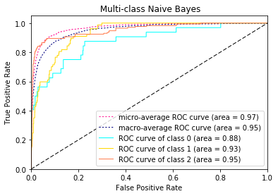
Results of Naïve Bayes
 | Accuracy | F-score(micro) | F-score(macro)
Train | 0.797994 | 0.800257 | 0.740366
Test | 0.746606 | 0.745852 | 0.653087
There are 20 classes and the areas of ROC curves are around 0.88 to 0.99.
Notes:
There are 20 classes and the areas of ROC curves are around 0.88 to 0.99. It suggests each class is classified well. This figure only shows ROC curves of first three classes, since it is difficult to distinguish 20 curves together.

