Slide 1
CS412 Project: What’s Cooking
All-Eatable

Slide 2
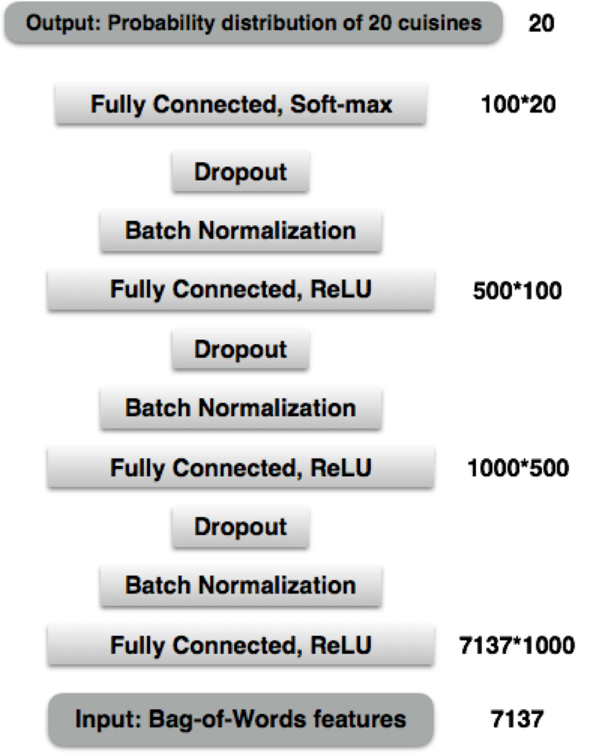

Neural Network
4th hidden Layer
3rd hidden Layer
2nd hidden Layer
1st hidden Layer

Slide 3
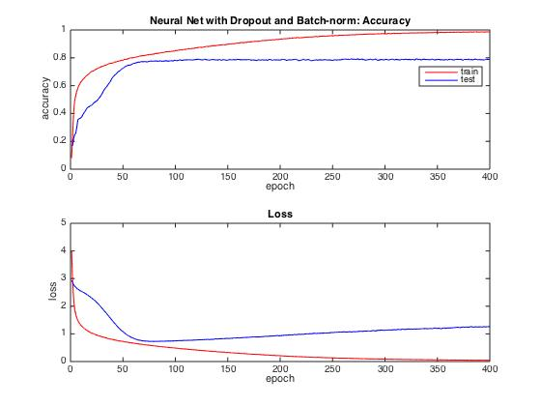
Results of Neural Net
Batch-norm with Dropout
 | Accuracy | Loss
Train | 0.987010 | 0.043150
Test | 0.789090 | 1.269093

Slide 4
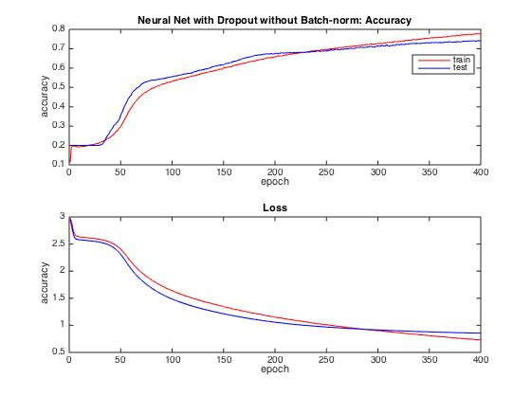
Results of Neural Net
No Batch-norm but with Dropout
 | Accuracy | Loss
Train | 0.780003 | 0.726374
Test | 0.741327 | 0.855012

Slide 5
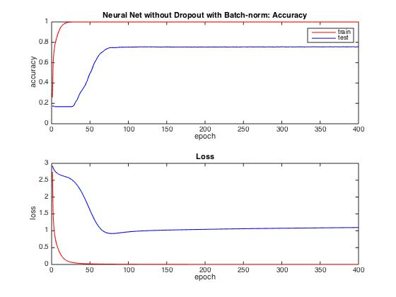
Results of Neural Net
Batch-norm without Dropout
 | Accuracy | Loss
Train | 0.999609 | 0.001691
Test | 0.754651 | 1.096316

Slide 6
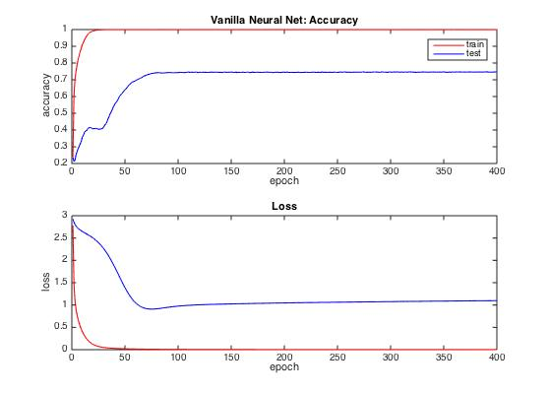
Results of Neural Net
No Batch-norm no Dropout
 | Accuracy | Loss
Train | 0.999497 | 0.001732
Test | 0.746858 | 1.097635

Slide 7
Comparison on the effects of Batch-norm and Dropout
Batch Normalization | Dropout | Train Accuracy | Test Accuracy
Yes | Yes | 0.987010 | 0.789090
No | Yes | 0.780003 | 0.741327
Yes | No | 0.999609 | 0.754651
No | No | 0.999497 | 0.746858
Batch-norm:
faster convergence
Dropout:
reduce over-fitting

