Slide 1
Analyzing Lending Club Loan Data: To default, or not, this is the question.
Xiaohan Liu, Weixin Liu, Xinyu Xu, Xuan Yin, Haiyang He
CS 412: Introduction to Machine Learning
Nov 29th 2016

Slide 2
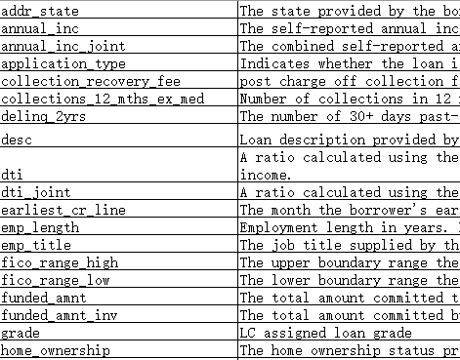

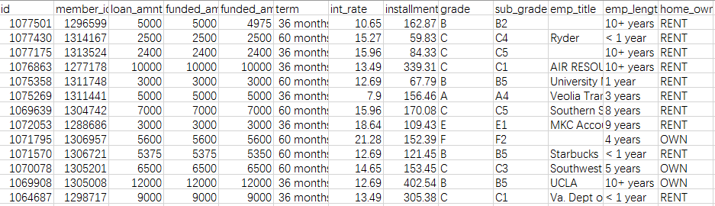

Introduction
Project description
Research Goal:
Will the loan taker default?
Y/N
Prioritize on default case recall,
F-score and overall accuracy.
Notes:
The raw data is from Kaggle.com. The information includes more than 880K individual loan applicant’s background information. Loan status information is the y-label.
Our main goal is to answer this question with a simple Y/N to a new borrower given information. Since a loan default will cause both principal and uncollected interests losses, we want to focus on a as high as possible default case recall rate. We utilized multiple machine learning techniques to predict those destined to default loans and pick out the best performing model.

Slide 3
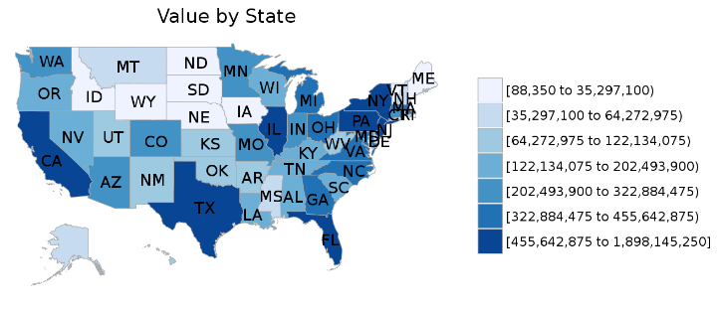
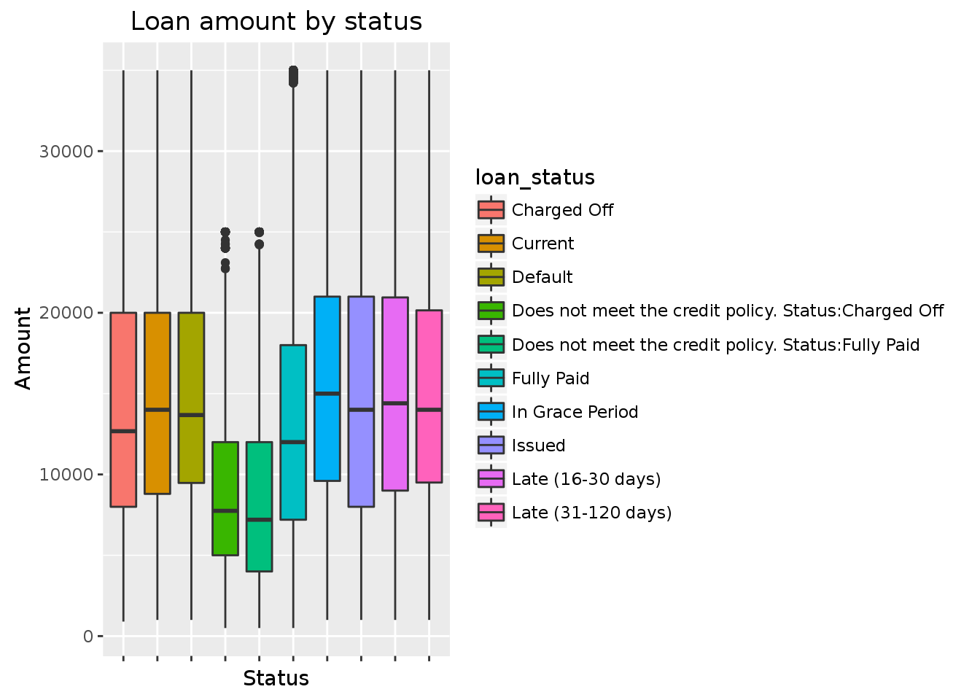
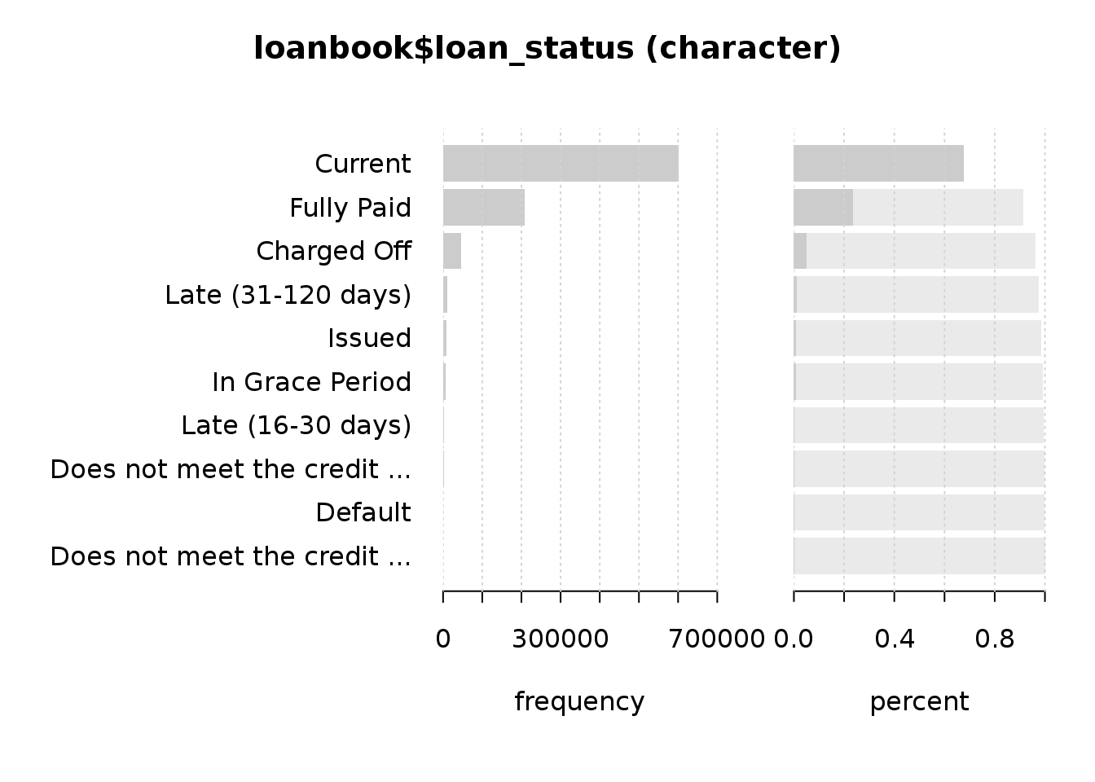
Introduction
Data representation
Notes:
Here are some graphs describing out data distribution in terms of some features.
For loan status, which separate our data into several classes, the data is distributed as described in the figure. We summarized these status and categorize them into two classes.
The last figure shows the loan amount distribution

Slide 4
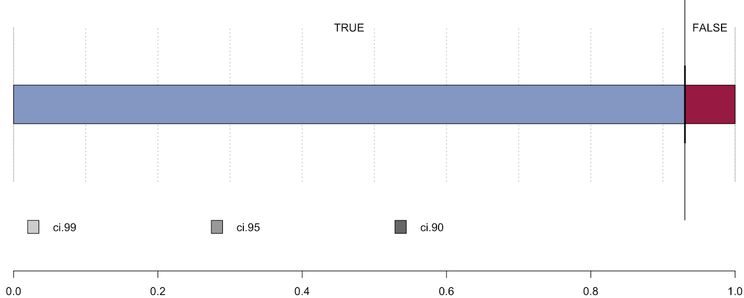
Data Pre-processing
Original input size is 887,379 × 74:
Define Y labels and reconstruct the input matrix. (878,983 × 74)
Feature selection, removing the redundant and irrelevant. (878,983 × 36)
Converting “description” to string length. (878,983 × 36)
Remove joint applicants and rows with NA values.(877,860 × 35)
Screen out features with high collinearity/multicollinearity. (877,860 × 32)
Normalize all numeric. (Optional) Expand categorical to design matrix. (877,860 × 141)
Notes:
To accommodate our research goal, we redefine the Y label, loan_status binarily. The original “Paid off”, “current”, etc. 4 categories are re-labled as TRUE, the original “Defualt”, “charged off” etc. 5 categories are combined and relabled as FALSE. The category “just issued” is dropped. And we rearrange the input matrix by numeric first, then categorical, and Y to the very last.
We first delete all the goal-irrelevant and redundant features. For example, information for administrative purpose like member_id and issuded_date, next_due_time etc. are dropped. And we also delete columns like grade, since all the information is contained in subgrade. Secondly, the features have the same values across all cases are dropped, like policy_code and paymnt plan. Thirdly, we remove all the features contain more than 50% NA in them.
There is an interesting feature called description, which asks the application to fill in whatever they wanna say and it is optionally required. As a result, some left blank while some wrote a 200 words essay. We first wanna to use tf-idf (term frequency and inverse document frequency) to deeply dig it, nevertheless, due to the limitation of computation power, we settled with counting the string length of the description instead of ignoring it, which turned out to be worthwhile.
Remove the joint applicant (500+) to simplify situation, and further delete all rows with NA values and elements like 999 and 9999 in small numerical values columns which stand for NA essentially.
Among all the numeric we delete the highly correlated features (cov > 0.95) and multicollinearity associated with VIF>50(variance inflation factor). So, it is an extremely conservative truncation.
Normalize all numeric data as 0 to 1.
To better accommodate logistic regression and boosting, we expand all the categorical to design matrix of each sublevel with dummy variable 0 or 1.

Slide 5
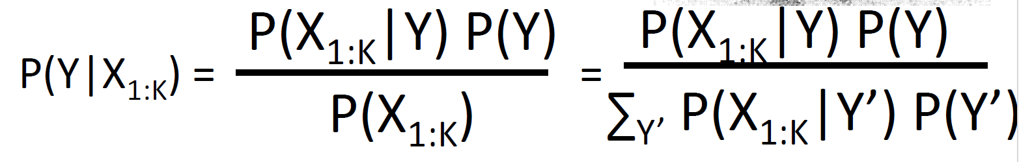
Naïve Bayes
Why Naïve Bayes classifier?
Straightforward and fast, just “count”.
R-packages
Library(MASS) # for Naïve Bayes
Library(caret) # for feature selection
Library(klaR) # for classification
Disadvantages of Naïve Bayes classifier
Overconfidence issue.
Assumption doesn’t cope with this data well.
 | Reference: False | Reference: True
Prediction: Negative | 6366 | 16845
Prediction: Positive | 5511 | 133864
 | Reference: False | Reference: True
Precision | 0.254 | 0.959
Recall | 0.524 | 0.759
F-score | 0.342 | 0.847
Overall accuracy is 0.862
Courtesy of Prof. Ziebart
Notes:
Now the data is ready.
We first tried some classic classification algorithms. Naive Bayes (NB) algorithm makes the 'naive' conditional independence assumption , is a simple and effective algorithm.
Since it ignores the interactions between variables, some of the information in the data is ignored. This makes it an inherently high bias model, which makes it hard to accurately represent many complex situations. ; it has a high approximation error but as a result it also does not overfit. (A model with high variance attempts to model all of the data including the noise in the data).
On the other hand, since the interactions are not modeled, less training data is needed. This is why the NB classifier is known to perform well both with small data sets and with missing data.
The results are shown in the table, the classifier performs well on the positive class but badly on the negative class, which might because of the high bias of the model.

Slide 6
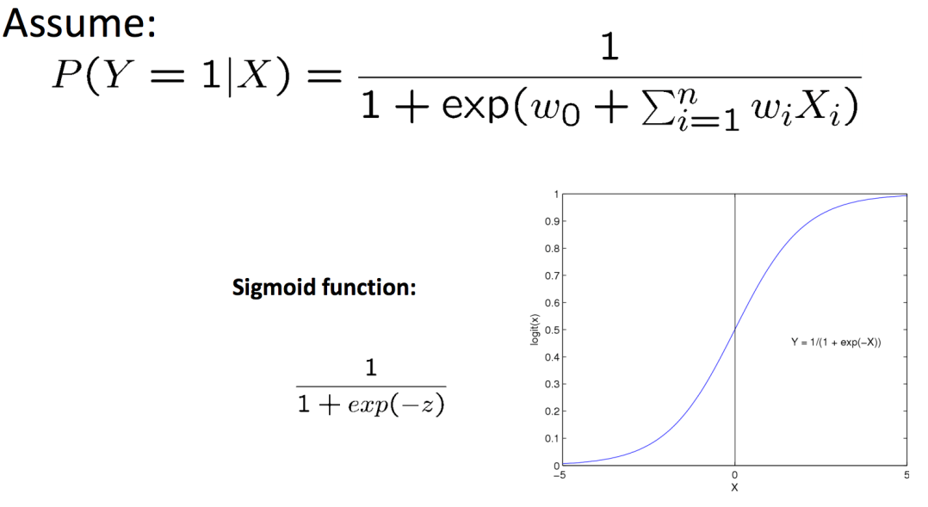
Logistic regression
Why Logistic Regression?
Nice probabilistic interpretation.
Easy to incorporate new data.
Lots of regularization methods. (We used LASSO)
R-packages
Library(glmnet) # for logistic regression and regularization
Library(caret) # for feature selection
Library(ROCR) # for ROC curve
Preliminary results (cut-off = 0.5)
 | Reference: False | Reference: True
Prediction: Negative | 646 | 5181
Prediction: Positive | 11707 | 158038
 | Reference: False | Reference: True
Precision | 0.111 | 0.931
Recall | 0.052 | 0.968
F-score | 0.071 | 0.949
L1 regularization (LASSO) here.
Overall accuracy is 0.904
Courtesy of Prof. Ziebart

Slide 7
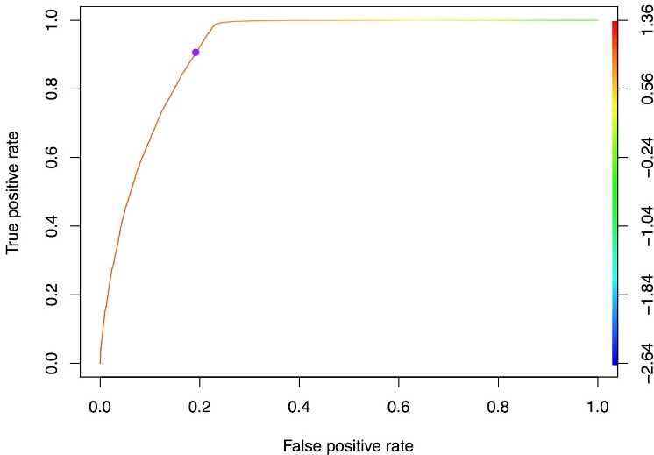
Logistic regression
ROC curve
Optimized results (cut-off = 0.924)
Closest point to (0,1), tpr = 0.906 while fpr = 0.192.
Optimal cut-off value is 0.924
AUC = 0.919
We used L1 regularization (LASSO) here.
 | Reference: False | Reference: True
Prediction: Negative | 10066 | 15306
Prediction: Positive | 2390 | 147810
 | Reference: False | Reference: True
Precision | 0.397 | 0.984
Recall | 0.808 | 0.906
F-score | 0.532 | 0.943
L1 regularization (LASSO) here.
Overall accuracy is 0.899

Slide 8
Model-Based Boosting
Top Challenge in Statistical Research:
Little Idea about the True Data Generating Process
E.g., in logistic regression
Function form: why not logistic with nonlinear functions of features?
Variables: which feature to be included?
Solution: Component-Wise Gradient Boosting
Prediction Accuracy Optimization and Functional Form and Variable Selection at the Same Time.
Notes:
The top challenge in statistical research is, we have little idea about the true data generating process.
For example, in logistic regression, we are not sure features enter into the model in the form of linear combination. It is entierly plausible that some nonlinear functions of features enter into the model. We are even not sure which feature should be included into the model.
The classical techniques for model building and variable selection, such as stepwise selection, are know to be unreliable or even biased.
The solution we considered here is component-wise gradient boosting. It optimizes the prediction accuracy and select the functional form and variables at the same time. The resulting prediction rule is mathematically equivalent to General Additive Model, easy to interpret.

Slide 9
Model-Based Boosting
Specific Implementation
Base model is logistic regression.
Each continuous feature --> logistic with penalized spline.
All discrete features --> logistic with ridge regression.
Gradient descend to minimize the negative binomial likelihood.
In each step, the gradient of the model that minimizes the objective among all models in that step is chosen.
Optimal stop to avoid overfitting: 5-fold Cross Validation
R-package: mboost
Disadvantage: High Computational Cost
Notes:
8G memory PC cannot even allocate the gradient of full sample!

Slide 10
Model-Based Boosting
5-fold Cross Validation Results Comparison (Selected Results)
 | Reference: False | Reference: True
Prediction: Negative | 4415.4 | 5768.6
Prediction: Positive | 1162.8 | 68653.2
Cutoff Prob | 0.800
Precision (False) | 0.925
Recall (False) | 0.714
F-Score (False) | 0.806
Accuracy | 0.976
 | Cutoff Prob = 0.5 |  | Cutoff Prob = 0.924
 | Logistic | Boosting | Logistic | Boosting
Precision (False) | 0.111 | 0.988 | 0.397 | 0.434
Recall (False) | 0.052 | 0.546 | 0.808 | 0.792
F-score (False) | 0.071 | 0.703 | 0.532 | 0.560
Accuracy | 0.904 | 0.968 | 0.899 | 0.913
Notes:
In either case, boosting has higher accuracy than logistic.
Since we focus on the detection of loan default to prevent loss, we pay attention to the false side statistics.
When cutoff probability is 0.5, Boosting outperforms logistic in all the statistics.
When cutoff probability is 0.924, Boosting generally has better performance except in Recall, 0.016 lower.
Precision: When it predicts no, how often is it correct?
Recall: When it's actually no, how often does it predict no?
F-score: Weighted average of precision and recall.

Slide 11
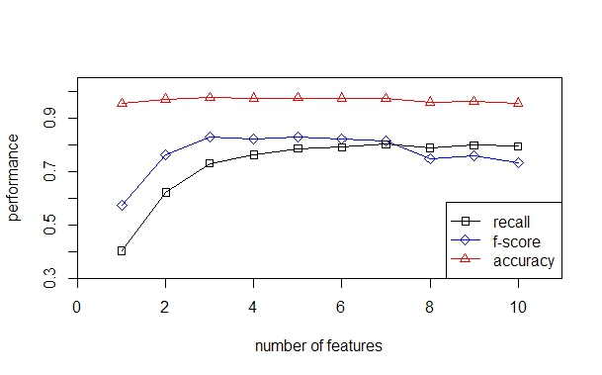
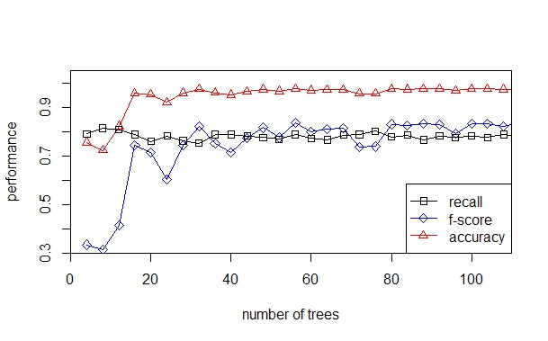
Random Forest
Why we use Random Forest
Efficient on big data.
No overfitting concerns.
Relatively immune to imbalanced data.
Parameters tuning
# of trees
# of features each tree
Notes:
Decision tree is non-parametric, easy to interpret, fast and scalable.
The main disadvantage of Decision Tree is that they easily overfit, so we use random forest to average out and don’t need to care about pruning, and generates good performance on classification.
RF grows many classification trees, in each tree:
Bootstrapping data reduce correlation
Select a few features reduce correlation
Grow trees to the largest extent possible increase strength
In the original paper on random forests, it was shown that the forest error rate depends on two things:
Correlation between trees and the strength of each tree.
Increasing the correlation increases the forest error rate.
Increasing the strength of the individual trees decreases the forest error rate.
Using more trees to form the forest can reduce the correlation. From the result we can know 100 trees are enough.
Increasing selected features will increasing the correlation, which increases the error. However, using too few features will make each tree too weak, which also increases the error.
Choose 5(sqrt(32)) has the best performance

Slide 12
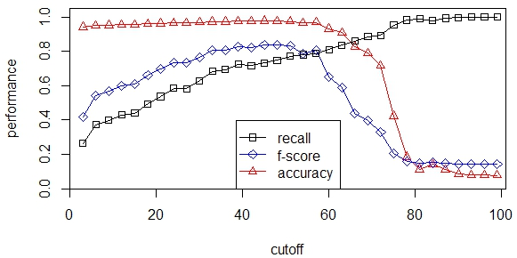
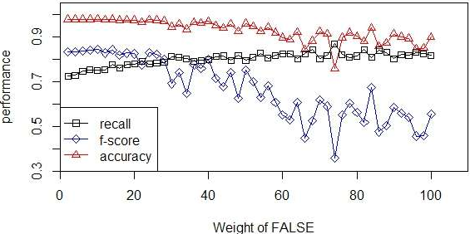
Random Forest
Balancing Prediction Error
Optimized Result
 | Reference: False | Reference: True
Prediction: Negative | 9408.6 | 1026.2
Prediction: Positive | 2808.6 | 162328.2
 | Reference: False | Reference: True
Precision | 0.902 | 0.983
Recall | 0.770 | 0.994
F-score | 0.831 | 0.988
Overall accuracy is 0.978
Notes:
Still, we wanna mitigate the influences of the imbalanced sample. We first tried to tune the cutoff, meaning how many P-voting trees are needed in 100 trees for a positive prediction. And it looks like the default 50-50 has the best overall performance. So, we can say in practice, RF is indeed relatively immune to sample imbalance. We then took a 3% random sample trying to increase the weight of False class, looks promising, but due to the limit of time and CPU, we cannot explore further.
Here are the Optimized result from RF, as you could see, it renders the best performance among all the models especially the overall accuracy and recall and F-score for false class.
Explore the best cutoff to maximize the recall of FALSE class while keeping almost the same accuracy and F-score
X-axis – how many trees is needed for TRUE class to win in the voting
The default value (50 vs 50) has the best f-score

Slide 13
Intermodel Performance Comparison
 | NB classifier | LR | LR-Boosting | RF classifier
False Recall | 0.524 | 0.808 | 0.714 | 0.770
F-score | 0.342 | 0.532 | 0.806 | 0.831
Accuracy | 0.342 | 0.899 | 0.976 | 0.978
Q: LR vs. RF?
A: Choose all
Methods | Pro | Con
NB | Light and quick, easy interpreting | Assumption hard to accommodate
LR | Lots of regularizations, probabilistic outputs, online integrating new inputs | Mediocre performance
LR-Boosting | More flexible functional form, a synthesis of prediction accuracy and functional forms and variables selection | High computation cost
RF | Efficient on big data, non-parametric, top-notch performance | Memory-intense
Better data is king
Notes:
Performane wise, RF is the overall the best by a big margin on F-score and accuracy. But LR/LR-boosting tends to edge out slightly in terms of False recall.
No doubt that this project helps to ascend our understanding on those classic ML models towards the next level. And during work, we come up with some our own feelings on the pros and cons on each different methods.
(念)
To go back to the particular question of logistic regression and boosting vs. random forest, here are some of our thoughts.:
both are fast and scalable, random forests tend to beat out logistic regression in terms of accuracy and F-score given imbalanced sample, but logistic regression can be updated online and gives you useful probabilities.
Since our clients are sadly ourselves, so we could totally narrow it down to a direct comparison on one facet. Or we should take a lesson from the Netflix Prize and Middle Earth, just use an ensemble method to choose them all.
Final thought, when data is huge, the performance gap of different algorithms is not that dramatic and it comes down to the speed and easiness.
Better data usually beats better algorithm, and good feature design gets you a long way.

Slide 14
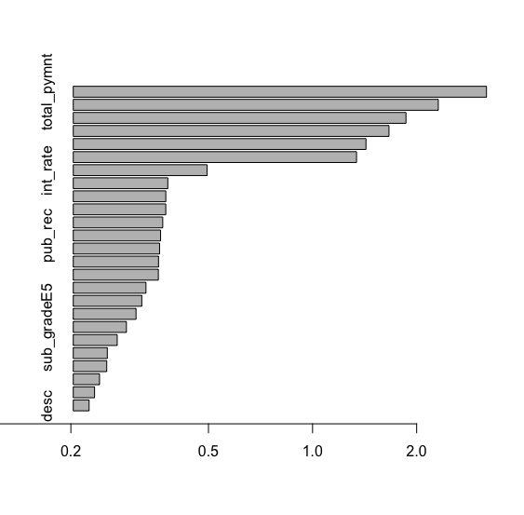
Feature Importance
Notes:
MeanDecreaseAccuracy means the total decrease in accuracy from splitting on the variable, averaged over all trees
Here we can check the relative importance of those features. The left is all 32 features from RF, the right is the top 25 out of 141 features from logistic regression. Definitely, the loan amount, payment, interest rate are vital. But two models suggest different weights on other not that important features like term and purpose. However, there is one thing in common, the not mandatorily required description seems to be more influential to the prediction than the length of employment and a slew of others.

Slide 15

Fin
Thank you very much for your attention!

