Slide 1
cs412 project
All-Eatable
What’s Cooking: Predicting Cuisines With Recipes’ Ingredients
He Huang, Ye Liu, Lichao Sun
Zhu Wang, Congying Xia, Fan Zhu
Apr 27, 2017

Slide 2
A Famous Saying…
“There exists no problem in the universe that delicacies cannot solve”

Slide 3

Project Description
Kaggle (https://www.kaggle.com/c/whats-cooking)
Goal
use recipe ingredients to predict the cuisine
Data
39774 recipes and 20 kinds of cuisines
Recipe id
Category of cuisine
List of ingredients of each recipe
Notes:
Our project is about a competition named \What's Cooking? on Kaggle1
https://www.kaggle.com/c/whats-cooking

Slide 4
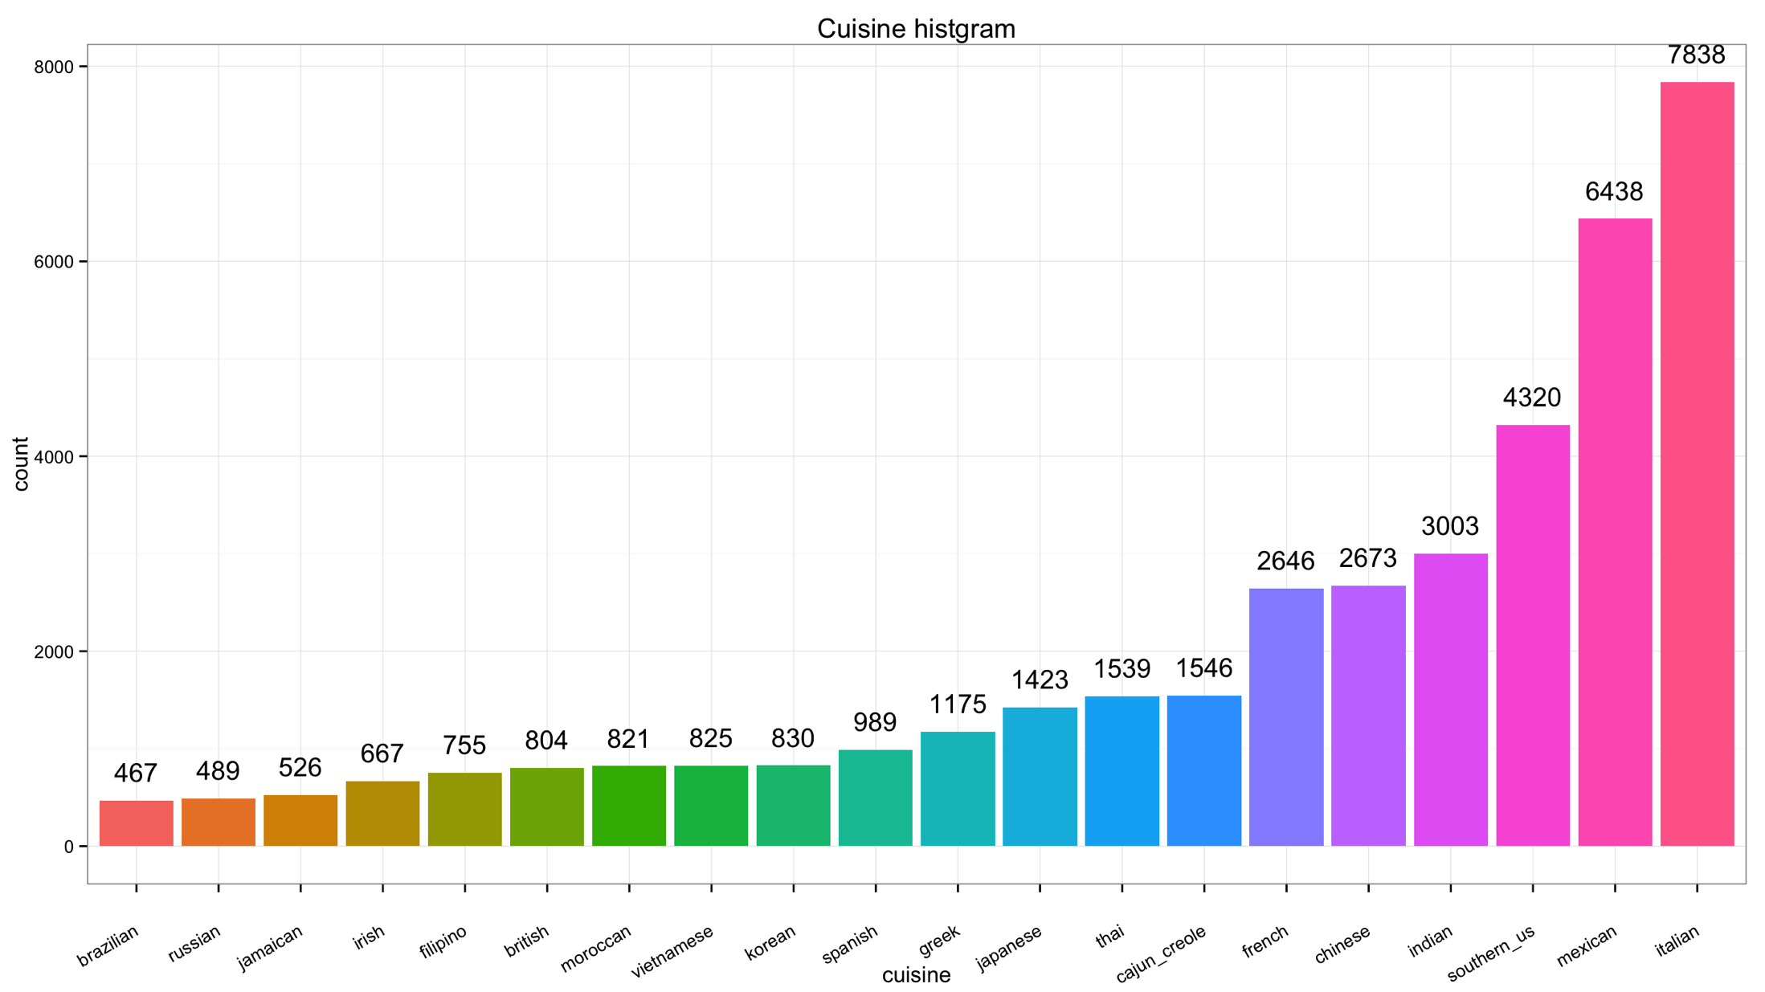
Introduction
Italian (7838)
Mexican (6438)
Southern_US (4320)
Indian (3003)
Chinese (2673)
French (2646)
Notes:
Top 3 cuisine

Slide 5
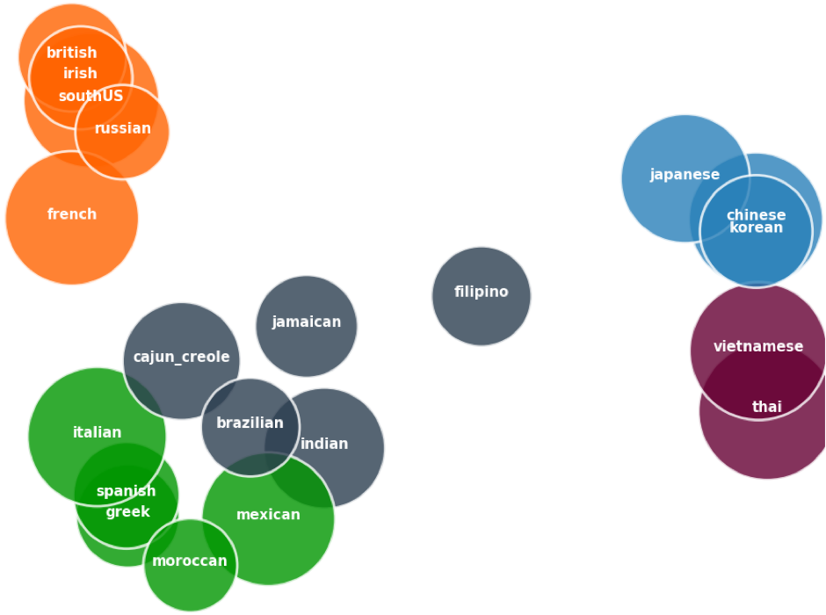
Introdution
Using PCA and K-means Clusters to visualize data
Notes:
TF-IDF : each term in gradients and cuisine as documents
PCA: reduced to 2-Dimensentions
K-means cluster: k = 5
Size of bubbles: Jaccard Similarity(one vs. the other cuisines in its cluster)

Slide 6
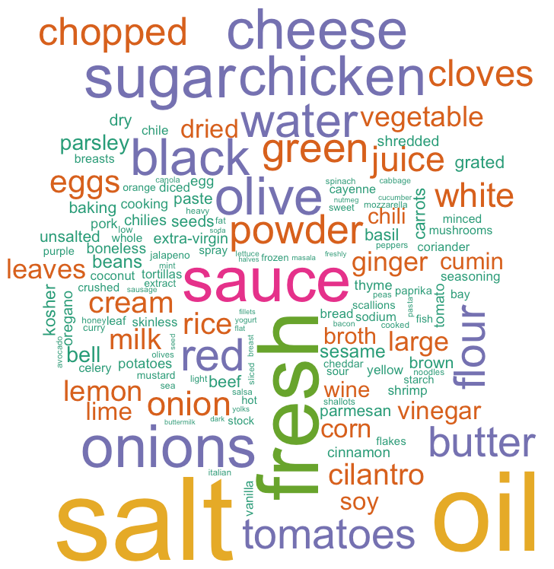
Introduction
Ingredients frequency more than 1000

Slide 7
Data preprocessing
Remove stop-words & special characters
Stemming
Bag-of-Words
TF-IDF

Slide 8
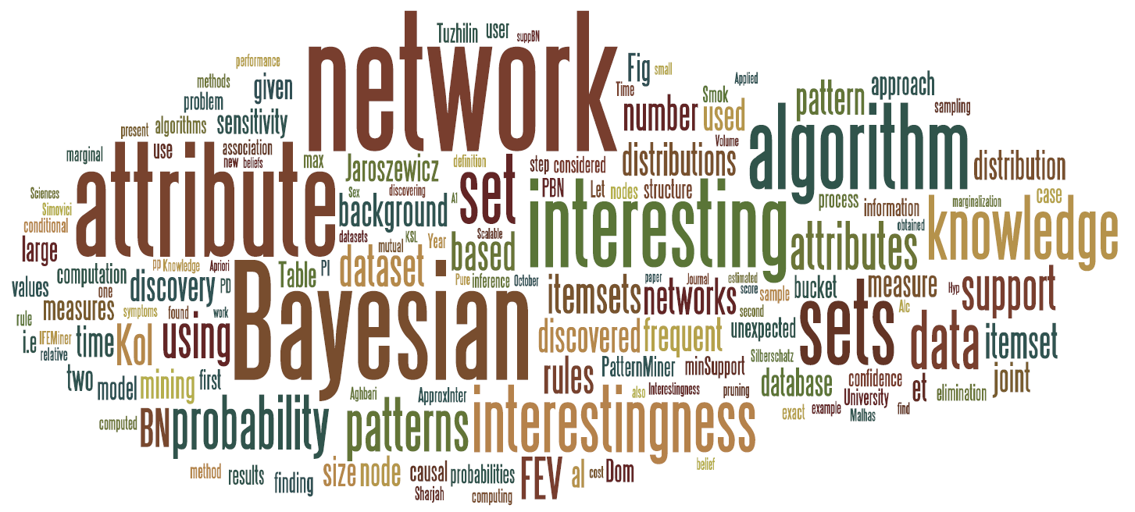
Machine Learning Algorithms
Random Forest
Naïve Bayes
SVM
LDA
Neural Network

Slide 9
Random Forest
Number of trees
Higher number of trees
Better performance
Lower speed
Max_features
Sqrt -> sqrt(n_features)
Log2 -> log2(n_features)
None -> n_features
Notes:
More than 200 trees don’t help
Log2 better

Slide 10
Random Forest
Min samples per leaf
The minimum number of samples
required to split an internal node
max_depth
The maximum depth of the tree.
If None, then nodes are expanded until all leaves are pure or until all leaves contain less than min_samples_split sample

Slide 11
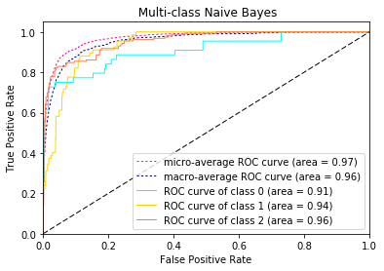
Naïve Bayes
 | Accuracy | F-score(micro) | F-score(macro)
Train | 0.826601 | 0.826601 | 0.788229
Test | 0.762946 | 0.762946 | 0.685015
Using 5-fold cross-validation to tune smoothing parameter alpha, we got alpha=0.125 to build model.
There are 20 classes and the areas of ROC curves are around 0.89 to 0.99.
Notes:
There are 20 classes and the areas of ROC curves are around 0.89 to 0.99. It suggests each classifiers will perform well at some cutoffs. This figure only shows ROC curves of first three classes, since it is difficult to distinguish 20 curves together.

Slide 12
Linear SVM
max_iter
The maximum number of iterations to be run
Max_Iter | Train | Test
5 | 0.874827153 | 0.751194368
10 | 0.904431175 | 0.758109127
100 | 0.933312382 | 0.764018104
1000 | 0.933123821 | 0.764395273

Slide 13
Linear SVM
C: Penalty parameter C of the error term.
C | Train | Test
0.5 | 0.9221873 | 0.7738245
1 | 0.9331238 | 0.7643952
2 | 0.9403834 | 0.7523259
Loss: ‘hinge’ or ‘squared_hinge’
loss | Train | Test
hinge | 0.9085167 | 0.7725672
Squared hinge | 0.9331238 | 0.7643953

Slide 14
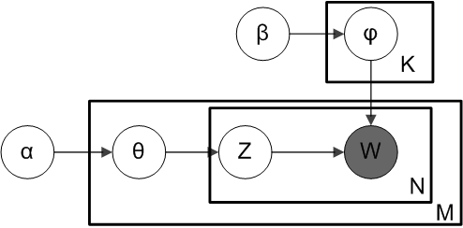
Latent Dirichlet Allocation (LDA)

Slide 15
LDA
Most probable words in four of the topics:
prob
Topic 0 | Topic 5 | Topic 9 | Topic 14
Sour cream | salt | salt | butter
Chili powder | All-purpose flour | Garlic cloves | salt
salsa | Baking powder | Cooking spray | eggs
Black beans | sugar | Olive oil | sugar
Flour tortillas | Large eggs | Chopped onion | milk

Slide 16
LDA
Most probable words in four of the topics:
prob
Topic 0 | Topic 5 | Topic 9 | Topic 14
Sour cream | salt | salt | butter
Chili powder | All-purpose flour | Garlic cloves | salt
salsa | Baking powder | Cooking spray | eggs
Black beans | sugar | Olive oil | sugar
Flour tortillas | Large eggs | Chopped onion | milk
Tortillas dishes

Slide 17
LDA
Most probable words in four of the topics:
prob
Topic 0 | Topic 5 | Topic 9 | Topic 14
Sour cream | salt | salt | butter
Chili powder | All-purpose flour | Garlic cloves | salt
salsa | Baking powder | Cooking spray | eggs
Black beans | sugar | Olive oil | sugar
Flour tortillas | Large eggs | Chopped onion | milk
cakes

Slide 18
LDA
Most probable words in four of the topics:
prob
Topic 0 | Topic 5 | Topic 9 | Topic 14
Sour cream | salt | salt | butter
Chili powder | All-purpose flour | Garlic cloves | salt
salsa | Baking powder | Cooking spray | eggs
Black beans | sugar | Olive oil | sugar
Flour tortillas | Large eggs | Chopped onion | milk
vegetables

Slide 19
LDA
Most probable words in four of the topics:
prob
Topic 0 | Topic 5 | Topic 9 | Topic 14
Sour cream | salt | salt | butter
Chili powder | All-purpose flour | Garlic cloves | salt
salsa | Baking powder | Cooking spray | eggs
Black beans | sugar | Olive oil | sugar
Flour tortillas | Large eggs | Chopped onion | milk
desserts

Slide 20
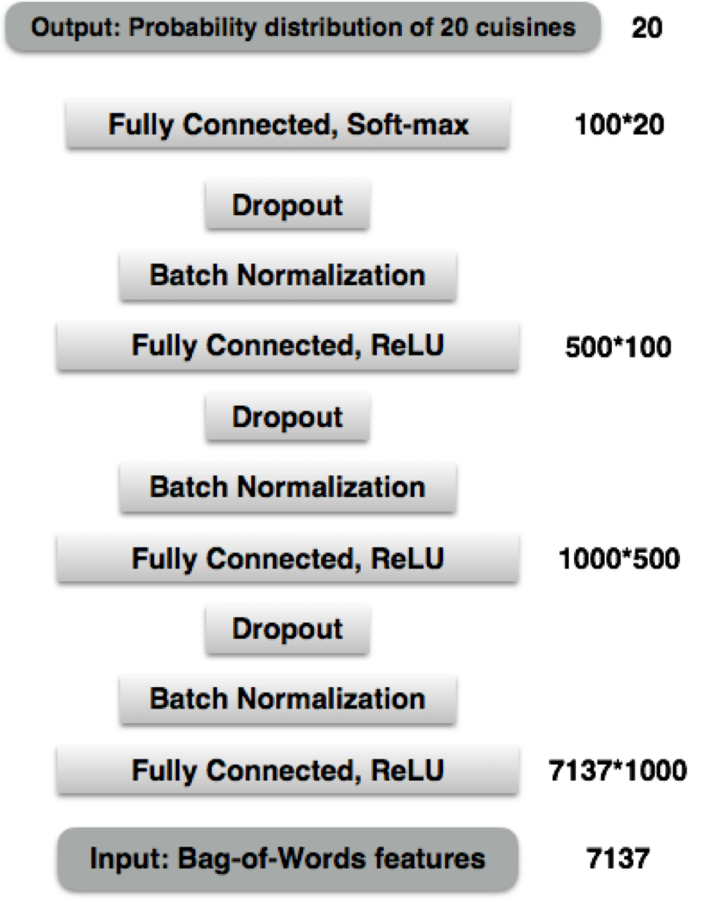

Neural Network
3rd hidden Layer
2nd hidden Layer
1st hidden Layer

Slide 21
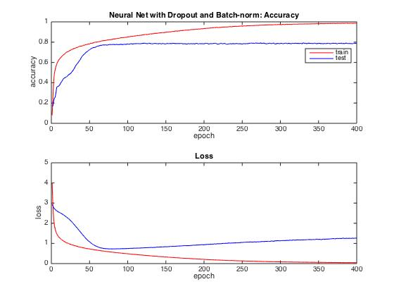
Results of Neural Network
Batch-norm with Dropout
 | Accuracy | Loss
Train | 0.987010 | 0.043150
Test | 0.789090 | 1.269093
Notes:
Accuracy
Train 0.98701 Test 0.78909
Loss
Train 0.04315 Test 1.269093

Slide 22
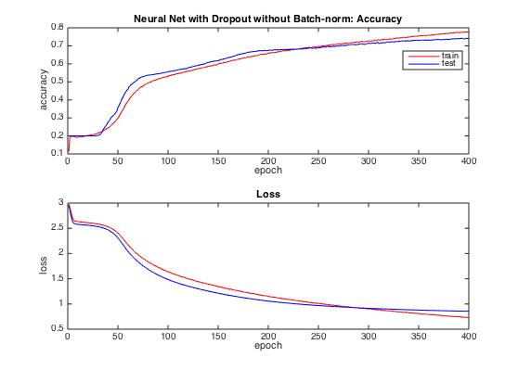
Results of Neural Network
No Batch-norm but with Dropout
 | Accuracy | Loss
Train | 0.780003 | 0.726374
Test | 0.741327 | 0.855012
Notes:
Accuracy
Train 0.98701 Test 0.78909
Loss
Train 0.04315 Test 1.269093

Slide 23
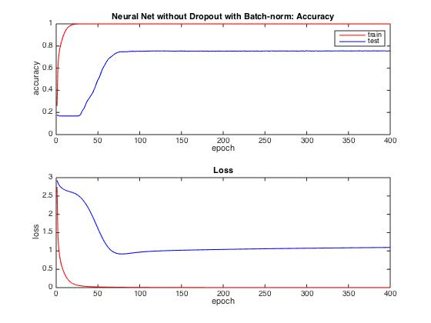
Results of Neural Network
Batch-norm without Dropout
 | Accuracy | Loss
Train | 0.999609 | 0.001691
Test | 0.754651 | 1.096316
Notes:
Accuracy
Train 0.98701 Test 0.78909
Loss
Train 0.04315 Test 1.269093

Slide 24
Comparison on the effects of Batch-norm and Dropout
Batch Normalization | Dropout | Train Accuracy | Test Accuracy
Yes | Yes | 0.987010 | 0.789090
No | Yes | 0.780003 | 0.741327
Yes | No | 0.999609 | 0.754651
No | No | 0.999497 | 0.746858

Slide 25
Comparison on the effects of Batch-norm and Dropout
Batch Normalization | Dropout | Train Accuracy | Test Accuracy
Yes | Yes | 0.987010 | 0.789090
No | Yes | 0.780003 | 0.741327
Yes | No | 0.999609 | 0.754651
No | No | 0.999497 | 0.746858
Batch-norm:
faster convergence
Dropout:
reduce over-fitting

Slide 26
Comparison

Slide 27
Last words
“a man is what he eats as much as what he reads”.
So,
eat, and be happy.

Slide 28
The universe is nothing but food
Thank you

