Slide 1


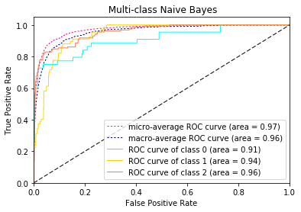
Naïve Bayes
 | Accuracy | F-score(micro) | F-score(macro)
Train | 0.826601 | 0.826601 | 0.788229
Test | 0.762946 | 0.762946 | 0.685015
Using 5-fold cross-validation to tune smoothing parameter alpha, we got alpha=0.125 to build model.
There are 20 classes and the areas of ROC curves are around 0.89 to 0.99.
Notes:
There are 20 classes and the areas of ROC curves are around 0.89 to 0.99. It suggests each classifiers will perform well at some cutoffs. This figure only shows ROC curves of first three classes, since it is difficult to distinguish 20 curves together.

