Slide 1
Using Data Analysis to Address Important Social Questions

Slide 2
and now
Experiments …

Slide 3

Recall regression assumptions
E(health|BMI) = β₁ +β₂ BMI + Ɛ
${Health}_{i}= {\hat{β}}_{1}+{{\hat{β}}_{2}BMI}_{i}$ + $e_{i}$
Regression Assumptions:
Mean of the random error term is equal to zero
Error terms are normally distributed
Variance of the error term, σ^{2,} is the same for all X:
heteroskedasticity
i.e…. Assumptions 1-3 written as Ɛ _{i} ~ N (0, σ² )
4. Zero correlation between error terms for X_{i} and X_{j}
5. Error term & the explanatory variable(s) are uncorrelated: Cov(Ɛ_{i} ,X_{i} ) = 0:
endogeneity
6. Regression model correctly specified (e.g. as a linear relationship)
OLS estimators are BLUE – Best Linear Unbiased Estimators
Notes:
Properties of OLS under Assumptions
OLS estimators are linear functions of the data
OLS estimators are unbiased: the mean value of the sampling distribution is equal to the population value of the parameter
OLS estimators are efficient: they have the smallest variance of all possible linear estimators of the population regression parameters
In short OLS estimators are BLUE – Best Linear Unbiased Estimators.
OLS estimators are Normally Distributed

Slide 4

Instrument Variables
E(health|BMI) = β₁ +β₂ BMI + Ɛ
${Health}_{i}= {\hat{β}}_{1}+{{\hat{β}}_{2}BMI}_{i}$ + $e_{i}$
Recall our linear model assumptions:
We discussed heteroskedasticity and how to account for it in Stata: vce(robust)
4. Zero correlation between error terms for X_{i} and X_{j}
5. Error term & the explanatory variable(s) are uncorrelated: Cov(Ɛ_{i} ,X_{i} ) = 0:
endogeneity
Instrumental variable (IV) methods deal with the endogeneity of a
regressor within a regression framework.
An instrument is a variable that affects the endogenous variable, but not the outcome other than through its effect on the endogenous variable (exclusion restriction) .
Reasons for IV: omitted variable bias; reverse causality, and; measurement error.

Slide 5
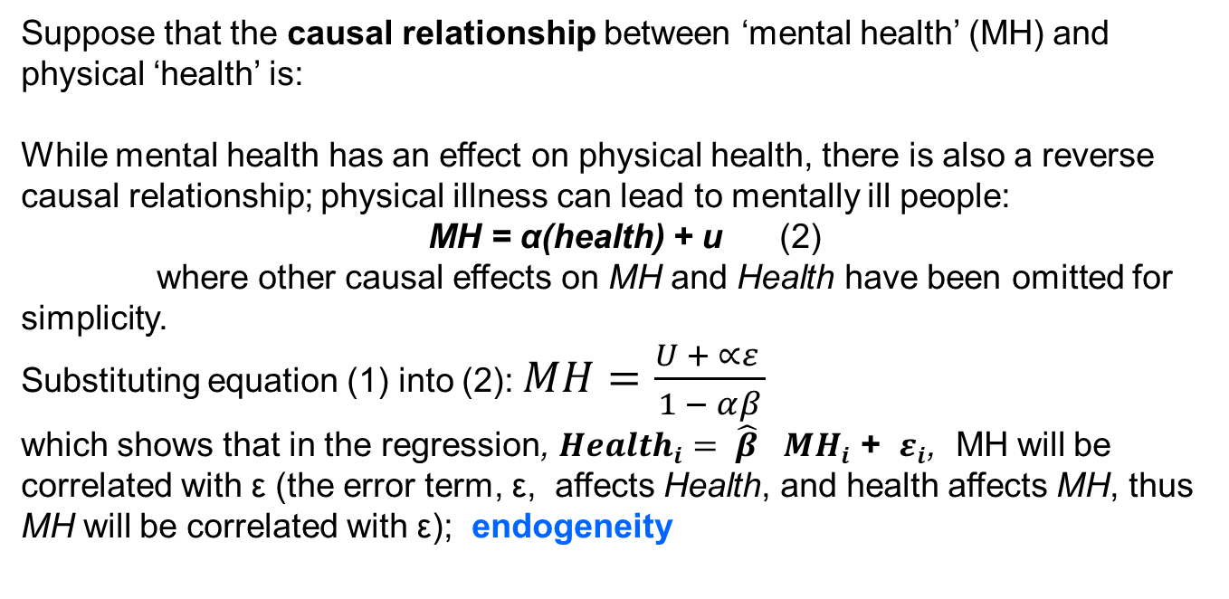

Reverse Causality
Suppose that the causal relationship between ‘mental health’ (MH) and physical ‘health’ is:
While mental health has an effect on physical health, there is also a reverse causal relationship; physical illness can lead to mentally ill people:
MH = α(health) + u (2)
where other causal effects on MH and Health have been omitted for simplicity.
Substituting equation (1) into (2): $MH=\frac{U + ∝ε }{1 − αβ}$
which shows that in the regression, ${Health}_{i}= {{\hat{β}}_{}MH}_{i}$ + $ε_{i}$, MH will be correlated with ε (the error term, ε, affects Health, and health affects MH, thus MH will be correlated with ε); endogeneity
${Health}_{i}= {βMH}_{i}$ + $ε_{i}$ (1)
How can we deal within reverse causality?
Notes:
How can we deal within reverse causality?
Leads and lags?
But information from past mental health feeds to current mental health
And, we cannot predict the future (leads)
Deal with reverse causality via the design of the (natural) experiment.
A picture of overweight and obesity in Australia, Summary - Australian Institute of Health and Welfare (aihw.gov.au)
Overweight and obesity, 2017-18 financial year | Australian Bureau of Statistics (abs.gov.au)
Key statistics
67% of adults were overweight or obese, an increase from 63% in 2014-15.
A greater proportion of men were overweight or obese than women (75% compared with 60%).
25% of children were overweight or obese.
national-obesity-strategy-2022-2032-at-a-glance-summary-with-a-logic-framework_0.pdf (health.gov.au)
Overweight and obesity have significant financial impacts. In 2018, obesity cost the Australian community $11.8 billion and if nothing is done, may cost an estimated $87.7 billion by 2032.
The Gross Domestic Product (GDP) in Australia was worth 1723.83 billion US dollars in 2023, according to official data from the World Bank. The GDP value of Australia represents 1.63 percent of the world economy. source: World Bank

Slide 6



Measurement Error
Data contains errors.
e.g. If we are interested in:
but we do not observe W, but instead observe some x, which is
related to W :
where u represents measurement error (noise).
Substituting one equation into the other gives:
which evidences that in the regression y = βx + v, x will be correlated
with v (u affects x, and v = ε - u β , thus x will be correlated with v).
$$Y_{i}=βW_{i}+ε$$
$$x_{i}=W_{i}+u$$
$$Y_{i}=βx_{i}−βu+ε= βx+v$$

Slide 7
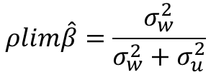
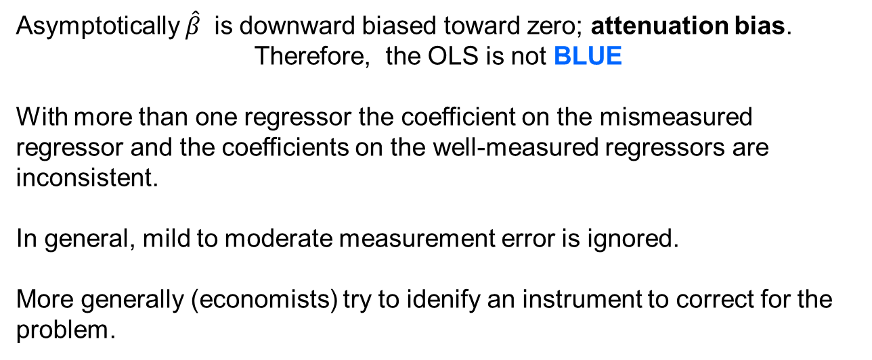
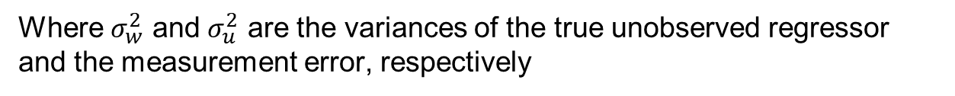
Measurement Error
With a single mismeasured regressor an OLS estimate converges to:
$$ρlim\hat{β}=\frac{σ_{w}^{2}}{σ_{w}^{2}+σ_{u}^{2}}$$
Where $σ_{w}^{2}$ and $σ_{u}^{2}$ are the variances of the true unobserved regressor and the measurement error, respectively
Asymptotically $\hat{β}$ is downward biased toward zero; attenuation bias.
Therefore, the OLS is not BLUE
With more than one regressor the coefficient on the mismeasured regressor and the coefficients on the well-measured regressors are inconsistent.
In general, mild to moderate measurement error is ignored.
More generally (economists) try to idenify an instrument to correct for the problem.

Slide 8
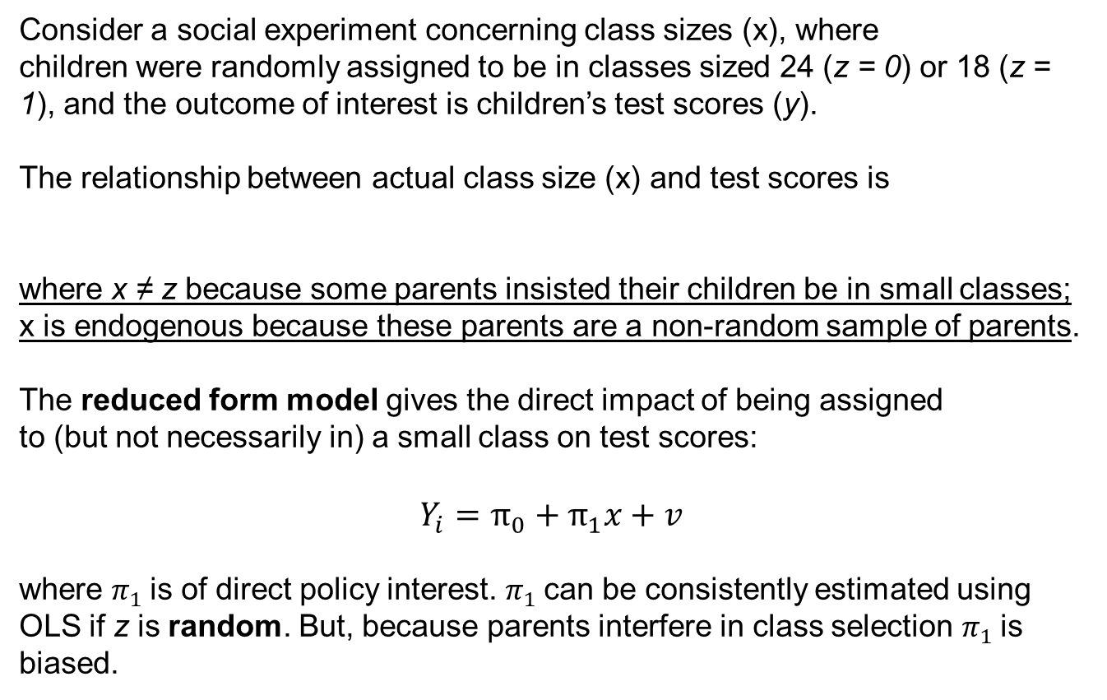

IV Example 1
Consider a social experiment concerning class sizes (x), where
children were randomly assigned to be in classes sized 24 (z = 0) or 18 (z = 1), and the outcome of interest is children’s test scores (y).
The relationship between actual class size (x) and test scores is
where x ≠ z because some parents insisted their children be in small classes; x is endogenous because these parents are a non-random sample of parents.
The reduced form model gives the direct impact of being assigned
to (but not necessarily in) a small class on test scores:
$$Y_{i}=π_{0}+π_{1}x+v$$
where $π_{1}$is of direct policy interest. $π_{1}$can be consistently estimated using OLS if z is random. But, because parents interfere in class selection $π_{1}$is biased.
$$Y_{i}=β_{0}+β_{1}x+ε$$
Notes:
24 (z = 0) or 18 (z = 1): z could be considered the identifier of the experimentally-treated, z=1 if a child complied and was assigned to a class-size of 24
Those who didn’t are the control group.
Non-compliers/never takers: where x ≠ z because some parents insisted their children be in small classes; x is endogenous because these parents are a non-random sample of parents

Slide 9
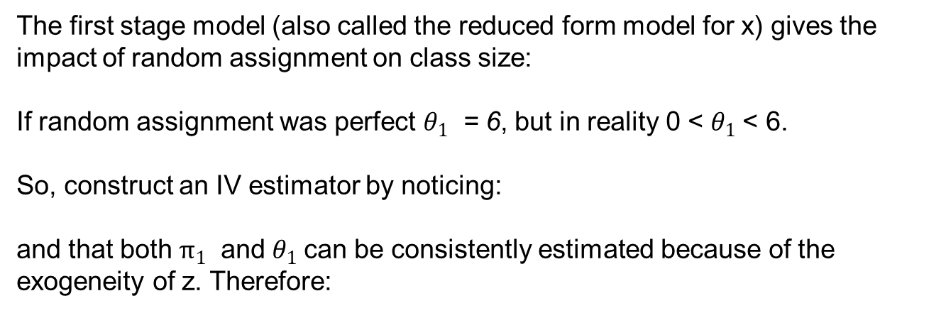


IV Example 1
The first stage model (also called the reduced form model for x) gives the impact of random assignment on class size:
If random assignment was perfect $θ_{1}$ = 6, but in reality 0 < $θ_{1}$< 6.
So, construct an IV estimator by noticing:
and that both $π_{1}$ and $θ_{1}$can be consistently estimated because of the exogeneity of z. Therefore:
$$x= θ_{0}+θ_{1}z+u$$
$$π_{1}= {\frac{dy}{dx}∗\frac{dx}{dz}=β_{1} ∗θ}_{1}$$
$$β_{1}^{IV}{={\frac{\hat{π_{1}}}{\hat{θ_{1}}}=\frac{effect of instrument on outcome}{effect of instrument on endogenous variable}}_{}}_{}$$
where $\hat{π_{1}}$ and $\hat{θ_{1}}$ come from OLS estimation of the reduced form and
first stage models, respectively. This procedure is called Indirect Least Squares.
Notes:
24-18: $θ_{1}$ = 6, but in reality: 0 < $θ_{1}$< 6

Slide 10

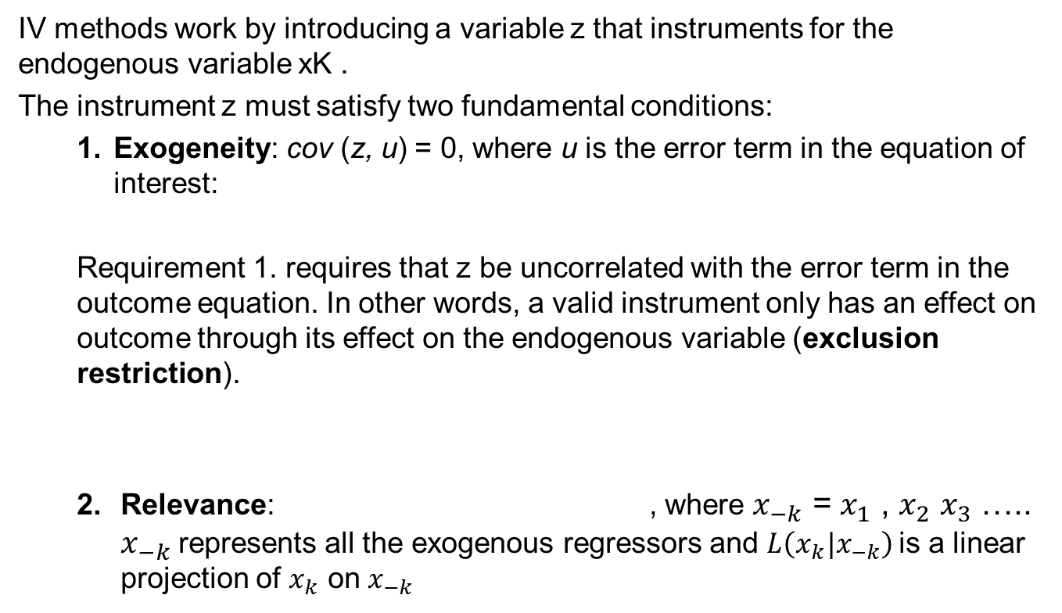
Instrument (IV) Requirements
IV methods work by introducing a variable z that instruments for the endogenous variable xK .
The instrument z must satisfy two fundamental conditions:
Exogeneity: cov (z, u) = 0, where u is the error term in the equation of interest:
Requirement 1. requires that z be uncorrelated with the error term in the outcome equation. In other words, a valid instrument only has an effect on outcome through its effect on the endogenous variable (exclusion restriction).
Relevance: , where $x_{−k}$ = $x_{1}$ , $x_{2}$ $x_{3}$ ….. $x_{−k}$represents all the exogenous regressors and $L\left(x_{k}|x_{−k}\right)$is a linear projection of $x_{k}$ on $x_{−k}$
Cov $\left[z,x_{K}| L\left(x_{k}|x_{−k}\right)\right]$ ≠ 0

Slide 11



Instrument (IV) Requirements
IV methods work by introducing a variable z that instruments for the endogenous variable xK .
The instrument z must satisfy two fundamental conditions:
Relevance: , where $x_{−k}$ = $x_{1}$ , $x_{2}$ $x_{3}$ ….. $x_{−k}$represents all the exogenous regressors and $L\left(x_{k}|x_{−k}\right)$is a linear projection of $x_{k}$ on $x_{−k}$
Cov $\left[z,x_{K}| L\left(x_{k}|x_{−k}\right)\right]$ ≠ 0
Requirement 2 requires that z have some explanatory power for $x_{k}$beyond what is obtained from a linear combination of the exogenous regressors.
An equivalent condition is that $θ_{1}≠$ 0 in the first stage model
where E (v, $x_{1}$ , $x_{2}$ $x_{3}$ ….. $x_{−k}$, z) = 0 and E (${U|x}_{1}$ , $x_{2}$ $x_{3}$ ….. $x_{−k}$, z) = 0.
Requirement 2 is often stated as requiring that z be correlated with $x_{k}$,
but this not strong enough. z must explain $x_{k}$, in addition to the explanatory power of $x_{1}$ , $x_{2}$ $x_{3}$ ….. $x_{−k}$, i.e. it must be partially correlated.

Slide 12
IV Example
Consider a situation where the Government decides on a policy to lock down a City or State because of a viral influenza (COVID) outbreak in 2020; business and social interaction cease. What are the implications for the mental health and wellbeing of those affected?
In ex post press conferences, politicians cite a positive effect of their lockdown policy on overall wellbeing, their policy benefitted the people. Is this the case?
A quick look at mental health & deaths in the HILDA panel data do not appear to support the politician’s claims:
Discontinuity?

Slide 13
IV Example
To test the politician’s claim we decide to uncover the underlying causation effect of the lockdowns on life satisfaction (LS) via an endogenous variable mental health (MH). MH is endogenous because all mental health changes may not necessarily arise from the lockdown; e.g. some could emerge from job loss. We decide to use an IV method: Regression Discontinuity Design (RDD).
So, we need an instrument where we can clearly identify those who were directly affected by the lockdown in 2020 (treated group) and those who were not (control group.
Identification; the IV: The survey responses from (control group) individuals answering the mental health and life satisfaction questions in 2020 HILDA Survey before the beginning of the 1 April 2020 lockdowns (231 days) would not have captured the lockdown effect (d=0), because they didn’t know the lockdowns were coming. The COVID Lockdown affected responses from individuals who answered after 1 April 2020 are the treated group (d=1).
Our instrument appears to satisfy the exclusion restriction because it does not to have a direct effect on the DV (Life Satisfaction) while it does have an effect on the endogenous IV (Mental Health).

Slide 14



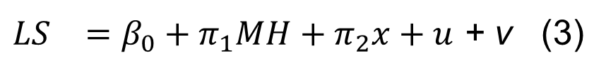
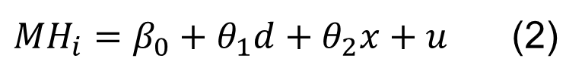
IV Example
$$OLS$$
$${LS}_{}=β_{0}+β_{1}d+β_{2}MH+β_{3}x+ε \left(1\right)$$
$$First Stage:Reduced Form$$
${MH}_{i}=β_{0}+θ_{1}d+θ_{2}x+u$ (2)
$$Second Stage:Structural Form$$
${LS}_{}=β_{0}+π_{1}MH+π_{2}x+u$ + v (3)
Victorian State HILDA Data: 2019 to 2020; one year either side of the 2020 Lockdowns.
Notes:
The control variable x s are female and age.

Slide 15
IV Example
Stata: xi i.age
ivreg2 lifesat female _Iage_* (mental_health=covic), cluster(persnr)
first savefirst savefprefix(first)
Marginal effects; Standard errors in parentheses
+ p<0.10, * p<0.05, ** p<0.01
F-stat requirements per Lee et. al., 2022.
Interpret
Notes:
When a model is standardized, the coefficients of the regression equation are interpreted in terms of standard deviations rather than the original units of the variables. This means that the coefficients indicate the change in the dependent variable (Y) for a one standard deviation change in the predictor (X).
For instance, if you have a standardized regression coefficient (also known as a beta coefficient) of 0.5 for a variable, it implies that a one standard deviation increase in this predictor variable leads to a 0.5 standard deviation increase in the outcome variable.
Was there a specific regression result you had in mind? We can unpack it together!

Slide 16
IV Tests using IVREG2 in Stata
First Stage F-Statistic (note: Lee et al., 2021)
Test of excluded instruments:
Underidentification tests
Weak identification test
Weak-instrument-robust inference
Weak Instrument Tests
Underidentification
Identification Tests
Test of endogeneity
Stata Example:
use istat_v6.dta, clear
ivreg2 lifesat female _Iage_* (mental_health=covic), cluster(`cluster') first savefirst savefprefix(first) endog(mental_health)
Notes:
Ivregress
lifesat Coef. Std. Err. z P>z [95% Conf. Interval]
mental_health -.013729 .0063093 -2.18 0.030 -.0260951 -.0013629
Non-linear models not covered

Slide 17
Self-Completion tasks
IV1: Using the 2019 to 2020 panel data, run a OLS regression including the variables from the dataset that you consider have an effect on the dependent variable, Life Satisfaction; include the COVID dummy (covic). Report the: effect(s), standard errors, sample size, level of explanation for and interpret the results in terms of the research question.
IV1: Repeat then above using IVREG2. Incorporate the causal evidence from this analysis in a letter to the Government that reveals the effect of the COVID Lockdowns on Victoria (hhstate==2).
Notes:
To team or not to team?

Slide 18
Other IV Methods
Two Staged Least Squares (2SLS)
Stata: ivregress 2sls lifesat i.age (mental_health=covic), vce(robust) first
estat endogenous
Non-Linear Models (not covered)
Bivariate Probit Model
Difference-in- Difference models
Notes:
Ivregress
lifesat Coef. Std. Err. z P>z [95% Conf. Interval]
mental_health -.013729 .0063093 -2.18 0.030 -.0260951 -.0013629
Non-linear models not covered

Slide 19
Alternative: Difference in Difference Models
If you want, I can go through, in detail, how to design a ‘causation’ analysis’ using a natural experiment as the exogenous shock.
Items covered would include:
How to identify a natural experiment;
How to select the sample frames for intensive and extensive regression continuity analysis;
How to prepare the data for analysis;
STATA IV command selection; RDD versus Fuzzy RDD;
Selecting tests that support validity of the analysis;
How to interpret results;
How to report results;
Other items of interest…..

Slide 20
References:
ABS (2016). Technical Paper Socio-Economic Indexes for Areas (SEIFA). 2033.0.55.001. Australian Bureau of Statistics, Canberra, Australia
ACARA (2020) National Report on Schooling in Australia. The Australian Curriculum, Assessment and Reporting Authority. Australian Government. Sydney, Australia. http://www.acara.edu.au/reporting/nrosia2009, accessed 23 November 2020.
Anderson, M. L. (2008). Multiple inference and gender differences in the effects of early intervention: a re-evaluation of the abecedarian, Perry preschool, and early training projects. Journal of the American Statistics Association, 103 (484), 1481–1495
Anderson, D. (2014) In School and Out of Trouble? The Minimum Dropout Age and Juvenile Crime, Review of Economics and Statistics, 96, 318-31.
Artega, I., Humpage, S. Reynolds, A.J. & Temple, J.A. (2014). One year of preschool or two: Is it important for adult outcomes? Economics of Education Review, 40, 221-237.
Autor, D., Figlio, D., Karbownik, K., Roth, J, & Wasserman, M. (2019). Family disadvantage and the gender gap in behavioral and educational outcomes American Economic Journal: Applied Economics, 11 (3) 338-381.
Baum, C.F., Schaffer, M.E. & Stillman, S. (2007). Enhanced routines for instrumental variables/generalised method of moments estimation & testing. The Stat Journal 7(4), 465-506.
Baum, C., Schaffer, M., & Stillman, S. (2022). IVREG2: Stata module for extended instrumental variables/2SLS and GMM estimation.
Beatton, T. & Sandi, M. (2023). Why doesn’t free Prep do less to reduce crime among the most disadvantaged? BEST Working Paper. Behavioural Economics Society & Technology Research Centre, Queensland University of Technology
Beatton, Tony; Kidd, Michael ; Niu, Anthony; Vella, F. (2023). Age of Starting School, Academic Performance, and the Impact of non-compliance: An experiment within an experiment, evidence from Australia. AASLE 2017 Conference, IZA Working Paper dp14168/2021; forthcoming Economic Record/2023.
Beatton, T., Kidd, M. P. & Sandi, M. (2019). Age in Cohort, School Indiscipline and Crime: Regression-Discontinuity Estimates for Queensland. August 13, 2018. Life Course Centre Working Paper Series. The University of Queensland.
Beatton, T., Kidd, M. P. and Machin, S. & Sarkar, D. (2018). Larrikin Youth: New Evidence on Crime and Schooling. Labour Economics Volume 52, June 2018, Pages 149-159.
Beatton, T., & Kidd, M. P. & Machin, S. (2018). "Gender crime convergence over twenty years: Evidence from Australia," European Economic Review, Elsevier, vol. 109(C), pages 275-288.
Black, S.E., Devereux, P.J. & Salvanes, K.G. (2011). TOO YOUNG TO LEAVE THE NEST? THE EFFECTS OF SCHOOL STARTING AGE. The Review of Economics and Statistics, 93(2): 455–467.
Brutti, Z. & Montolio, D. (2021). Preventing criminal minds: Early education access and adult offending behavior. Journal of Economic Behavior and Organization, 191, 97–126
Crawford, C., Dearden, L. & Greaves, E. (2014). The drivers of month-of-birth differences in children’s cognitive and non-cognitive skills. Journal of the Royal Statistical Society Statistics in Society Series A 177(4) 829-860.
DoE (2009). A Flying Start for Queensland Children. Queensland Government Education White Paper. Department of Education, Queensland Government, Australia.
https://cabinet.qld.gov.au/documents/2010/Feb/Flying%20Start%20for%20Children%20Discussion%20Paper/Attachments/discussion%20paper%20flying%20start.pdf

Slide 21
References:
Drange, N. Havnes, T. & Sandsør, A.M.J. (2016). Kindergarten for all: Long run effects of a universal intervention. Economics of Education Review, 53, 164-181.
Imbens, G. and Lemieux, T. (2008) Regression Discontinuity Designs: A Guide to Practice. Journal of Econometrics, 142, 615-635.
Gramlich, E.M. (1986). Evaluation of Education Projects: the Case of the Perry Preschool Program. Economics of Education Review, 5(1), 17-21.
Garcia, J.L. Heckman, J.J. & Ziff, A.L. (2019). Early Childhood education & crime. Infant Ment Health J. 2019 Jan; 40(1): 141–151.
Heckman, J.J. & Karapakula, G. (2019). INTERGENERATIONAL AND INTRAGENERATIONAL EXTERNALITIES OF THE PERRY PRESCHOOL PROJECT. Working Paper 25889, NBER.
Jacob, B. and Lefgren, L. (2003) Are Idle Hands the Devil’s Workshop? Incapacitation, Concentration and Juvenile Crime, American Economic Review, 93, 1560-77.
Landersø, R., Nielsen, H. S., & Simonsen, M. (2017). School starting age and the crime‐age profile. The Economic Journal, 127(602), 1096-1118.
Lee, D. S., McCrary, J., Moreira, M. J., and Porter, J. (2021) ‘Valid T-Ratio Inference for IV’, National Bureau of Economic Research, Working Paper 29124.
Lochner, L. and Moretti, E. (2004) The Effect of Education on Crime: Evidence from Prison Inmates, Arrests and Self-Reports, American Economic Review, 94, 155-89.
Luallen, J. (2006) School’s Out… Forever: A Study of Juvenile Crime, At-Risk Youths and Teacher Strikes, Journal of Urban Economics, 59, 75-103.
Kling, J.R. Liebman, J. B. & Katz, L.F. (2007). Experimental analysis of neighborhood effects. Econometrica, 75 (1), 83–119.
Machin, S., Marie, O. and Vujic, S. (2011) The Crime Reducing Effect of Education, Economic Journal, 121, 463-84.
Morgan, H. (2019). Does High-Quality Preschool Benefit Children? What the Research Shows. Education Sciences 9(19). doi:10.3390/educsci9010019
OECD (2012), Equity and Quality in Education: Supporting Disadvantaged Students and Schools, OECD Publishing. http://dx.doi.org/10.1787/9789264130852-en
Oreopoulos, P. (2009) Would More Compulsory Schooling Help Disadvantaged Youth? Evidence From Recent Changes to School- Leaving Laws, in Gruber, J. (ed.) The Problems of Disadvantaged Youth: An Economic Perspective, National Bureau of Economic Research. University of Chicago Press.
Pianta, R., La Paro, K. M., and Hamre, B. K. (2008). Classroom Assessment Scoring System: Manual Pre-K. Baltimore: Paul. H. Brookes.
Reynolds, A.J., Temple, J.A. & Ou, S-R (2010). Preschool education, educational attainment, and crime prevention: Contributions of cognitive and non-cognitive skills. Children & Youth Services Review, 32, 1054-1063.
Rodríguez-Planas, N, (2012). Longer-term impacts of mentoring, educational services, and learning incentives: evidence from a randomized trial in the United States. American. Economic. Journal: Applied Economics. 4 (4), 121–139.
Rotger, G.P. & Galster, G.C. (2019). Neighborhood peer effects on youth crime: natural experiment evidence. Journal of Economic Geography, 19(3), 655-676.
Tayler, C., Ishimine, K., Cloney, D., Cleveland, G., & Thorpe, K. (2013). The quality of early childhood education and care services in Australia. Australasian Journal of Early Childhood, 38(2), 13-21
Temple & Reynolds, 2007). Benefits and costs of investments in preschool education: Evidence from the Child–Parent Centers and related programs. Economics of Education Review 26, 126–144.
Thorpe, K., Potia, A., Beatton, T., Rankin, P., & Staton, S. (2020). Educational Outcomes of Queensland’s Investment in Early Childhood Education and Care 2007- 2020, Queensland Government Final Report. University of Queensland, Queensland Australia.
Vincent, C. G., Sprague, J. R., CHiXapkaid, M., Tobin, T. J., & Gau, J. M. (2015). Effectiveness of schoolwide positive behavior interventions and supports in reducing racially inequitable disciplinary exclusion. In D. J. Losen (Ed.), Closing the school discipline gap: Equitable remedies for excessive exclusion (pp. 207–221). New York: Teachers College Press.
Warren, D., O’Connor, M., Smart, D. & Edwards, B. (2016). A Critical Review of the Early Childhood Literature. Australian Institute of Family Studies. Australian Government.

Slide 22
End of Session

Slide 23

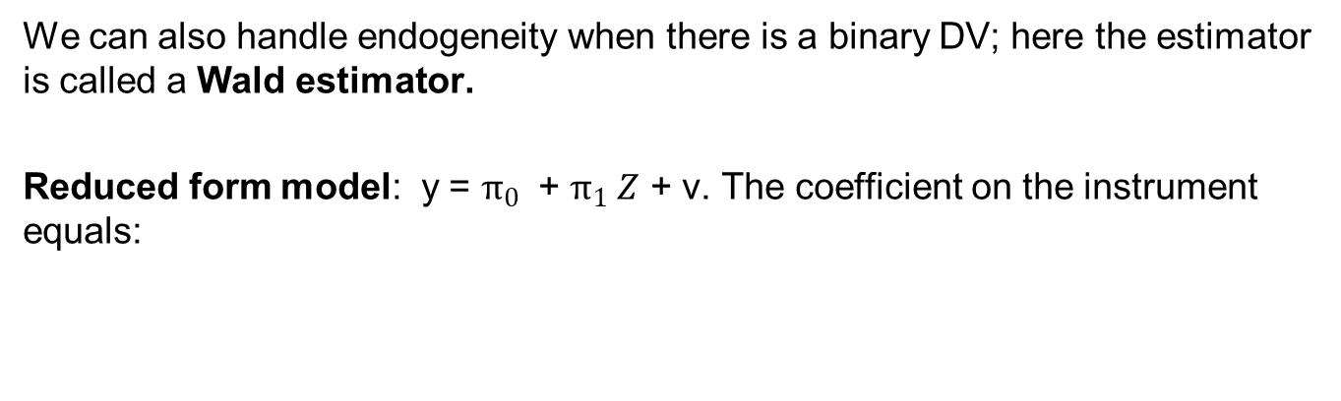


Wald Estimator
We can also handle endogeneity when there is a binary DV; here the estimator is called a Wald estimator.
Reduced form model: y = $π_{0}$ + $π_{1} Z$ + v. The coefficient on the instrument equals:
$$π_{1}={\hat{E}\left(y|z=1\right)−\hat{E}\left(y|z=0\right)}_{}$$
where the expectations are estimated by sample means.
Similarly, the first stage model:
The coefficient on the instrument equals:
$$d= θ_{0}+θ_{1}z+u$$
$$θ_{1}={\hat{E}\left(dy|z=1\right)−\hat{E}\left(d|z=0\right)}_{}$$
where d is the endogenous binary variable.

Slide 24
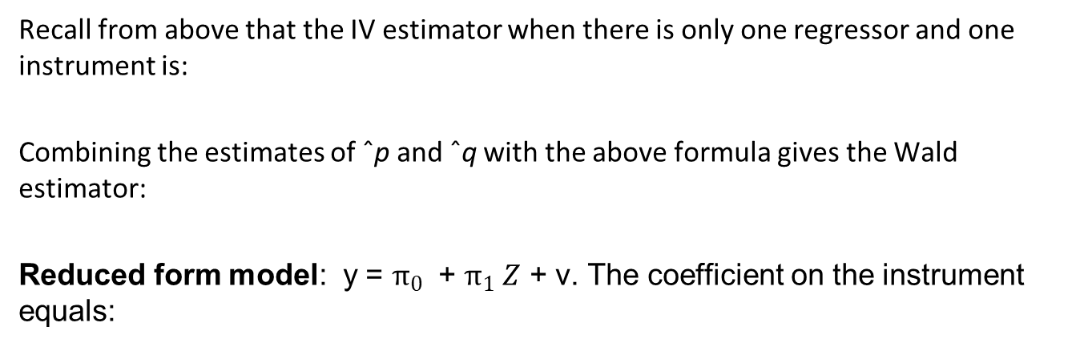
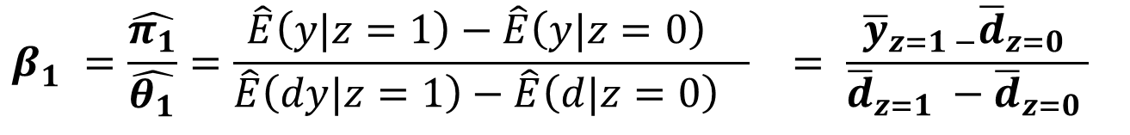

Wald Estimator
Recall from above that the IV estimator when there is only one regressor and one instrument is:
Combining the estimates of ˆp and ˆq with the above formula gives the Wald estimator:
Reduced form model: y = $π_{0}$ + $π_{1} Z$ + v. The coefficient on the instrument equals:
$$d= θ_{0}+θ_{1}z+u$$
where the expectations are estimated by sample means.
$$β_{1}^{}{={\frac{\hat{π_{1}}}{\hat{θ_{1}}}=\frac{{\hat{E}\left(y|z=1\right)−\hat{E}\left(y|z=0\right)}_{}}{{\hat{E}\left(dy|z=1\right)−\hat{E}\left(d|z=0\right)}_{}}}_{}= \frac{{\overline{y}}_{z=1 −}{\overline{d}}_{z=0 }}{{\overline{d}}_{z=1} −{\overline{d}}_{z=0 }}}_{}$$
The Wald (1940) estimator was originally developed for a bivariate regression with mismeasured regressors.

