Slide 1


ARC Training Centre for Behavioural
Insights for Technology Adoption
From Unstructured Text to Knowledge Graphs
Agentic semantic automation workflows for research
ARC BITA Geek Seminar – 4 August 2026
Tim Nguyen
letu.nguyen@qut.edu.au

Slide 2
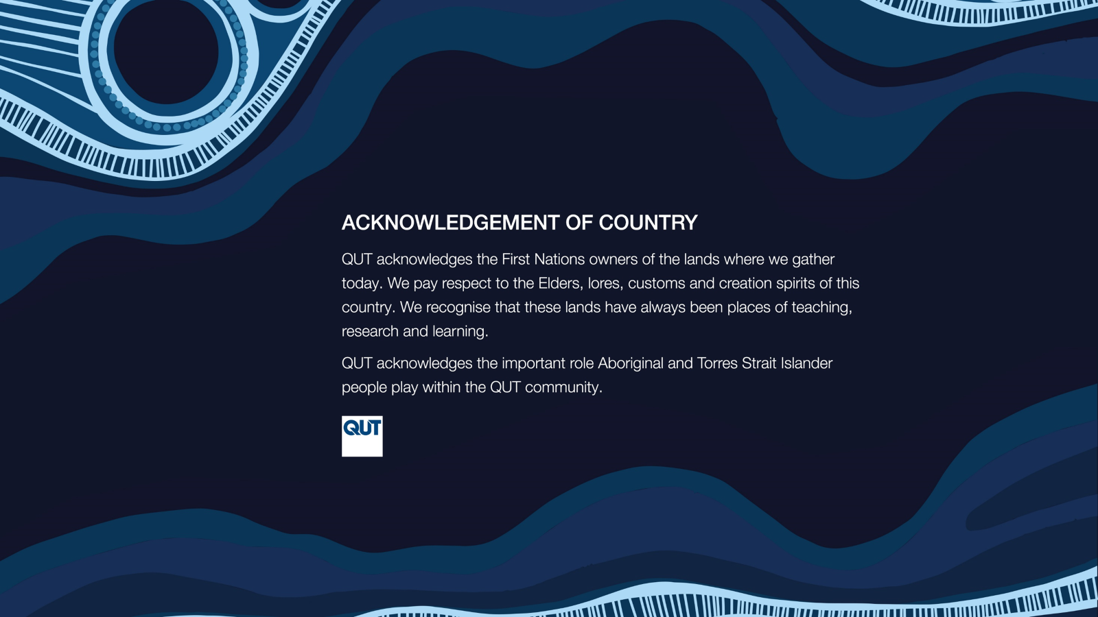
Acknowledgement to Country
I acknowledge the Turrbal and Yugara as the First Nations owners of the lands where QUT now stands (Meanjin).
I pay respect to their Elders, lores, customs and creation spirits, and recognise that these lands have always been places of teaching, research and learning.
I acknowledge the important role Aboriginal and Torres Strait Islander people play within the QUT and broader community.
Notes:
Meanjin - meaning ‘place shaped as a spike’

Slide 3
The research problem / motivation
Valuable information is trapped in narrative sources
Many research collections consist of narrative documents rather than analysis-ready tables.
Information about people, events, institutions, locations and relationships is distributed across multiple passages or documents.
The appropriate unit of analysis may change across research questions.
Manual coding is slow, costly and difficult to reproduce at scale.
A single-purpose dataset often cannot be reused for a different question.
Notes:
Closing statement: We need a method that preserves the meaning and provenance of narrative material while transforming it into structured, queryable research data.
Suggested visual → Show three stages: Narrative documents → fragmented information → researchable representation
A few faded archival pages could be used as an illustrative background, while keeping the discussion general.

Slide 4
Semantic Automation
Schema
Identify research-relevant entities, events, attributes and relationships.
Define Graph Entities and Relationships
AI agent orchestration
Prompt Engineering
Network graph
Convert them into structured and machine-readable records.
Applying Predefined Schema to AI Agent Models
Build knowledge graph
Notes:
Semantic automation uses language models, schemas, tools and validation processes to:
identify research-relevant entities, events, attributes and relationships;
convert them into structured and machine-readable records;
preserve links to supporting source evidence;
coordinate multiple specialised processing steps; and
enable subsequent querying, graph analysis and interactive inquiry.
Could also consider a diagram like the one below, or you can just talk about/discuss it without a diagram:
Source documents
↓
Ingestion, OCR and preprocessing
↓
Retrieval and context assembly
↓
Schema-guided entity and event extraction
↓
Entity resolution and relationship extraction
↓
Validation, guardrails and human review
↓
Structured database / knowledge graph
↓
Search, analysis, visualisation and interactive inquiry

Slide 5
Human Review Supports Every Stage
Agent Orchestration
Text Extraction
Automated Data Validation
Schema-Guided Analysis
Knowledge Graph Generation
Entity Resolution
Notes:
Text Extraction: extracting text from documents by extracting text or running OCR on scanned-image documents.
Schema guided Analysis: transfer research identification into structural schema. Defining AI agent to deliver the result based on predefined schema
Entity Resolution: Identify and consolidate duplicated entity records.
Automated Data Validation: it validates data for formatting errors , inconsistencies, missing values, and typographical issues
Knowledge Graph Generation Progress: define relationships between schema objects and transform validated data into logical network of connected entities.
Note: Human review supports every stage by checking ambiguous cases, validating outputs, and correcting errors.

Slide 6
Schema
Object type | Example fields
Person | canonical ID, name variants, role, approximate dates
Proceeding or event | date, type, location, participants
Institution | name, jurisdiction, period
Document | source ID, page, passage or text span
Relationship | source node, relation type (e.g. AFFILIATED_WITH, MENTIONED_IN), target node, evidence, confidence
Schema is a blueprint or structure for organising data → converts research questions into extraction rules
A research schema should specify:
entities: what kinds of objects exist.
attributes: what should be recorded about each object.
relationships: how objects may be connected;
data types: strings, dates, lists, categories and numeric values.
constraints: required fields and permitted values.
provenance: where each extracted claim from.
uncertainty: confidence, ambiguity and validation status.
Notes:
For a lightly historical example, relationship types might include:
PARTICIPATED_IN
TESTIFIED_IN
RELATED_TO
AFFILIATED_WITH
OCCURRED_AT
CHARGED_WITH
RECEIVED_SANCTION
MENTIONED_IN
The important point is not the precise labels, but that the graph relationships are defined within the schema before extraction begins.

Slide 7
Schema example (with data type specification)
personal_information = {
full_name: str,
age: int,
email: str,
address: str,
phone_number: str,
}
personal_information = {
full_name: str,
age: {
approx_age: int,
desc: str,
},
email: list[str],
address: str,
phone_number: str,
}

Slide 8
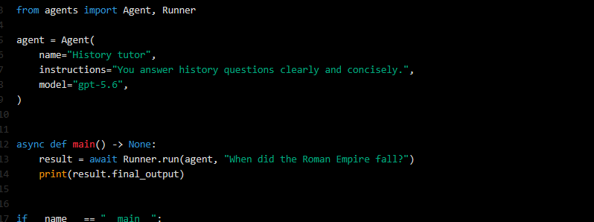
OpenAI agent SDK
Model
Instructions
Predefined schema
Complex reasoning and ambiguous documents.
Fast extraction and classification.
Cost and process-volume requirements.
Agent role and objectives.
Research topics and target fields.
Field definitions and extraction rules.
Handling of missing or uncertain information.
Boundaries on what agent must not infer.
Field and nested objects.
Data types.
Requirements and optional values.
Structured, machine-readable output.
Agent tools
File or vector search –retrieve document passages.
Web search – obtain permitted external information.
MCP

Slide 9
Instructions & Prompting
Good
You are an analyst expert, your job is to detect all information detail following by the schema and field definitions along with it below:
Fullname:
It refers to name of the person being mentione in the source text.
You have to follow this structure of full name:
middle name + given name + surname
Given name + surname.
If you can’t detect the person’s name, please return “Unknown”.
v.s.
Bad
You are an analyst expert, your job is to detect all information detail following by the schema and field definitions along with it below:
Fullname: it refers to name of the person being mentioned.

Slide 10
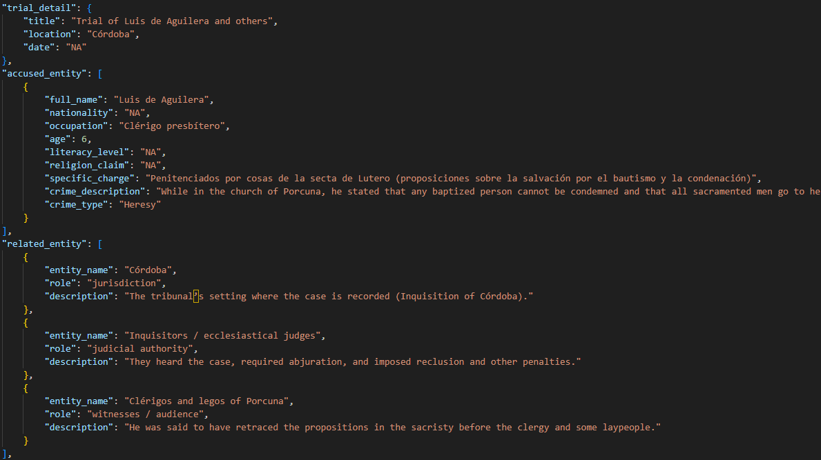

Slide 11
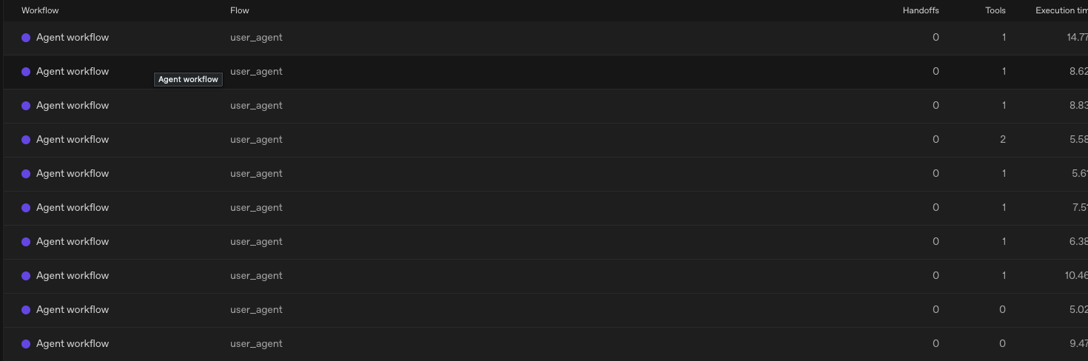
Agent tracing #1 – Handoffs, tool calls, metadata

Slide 12
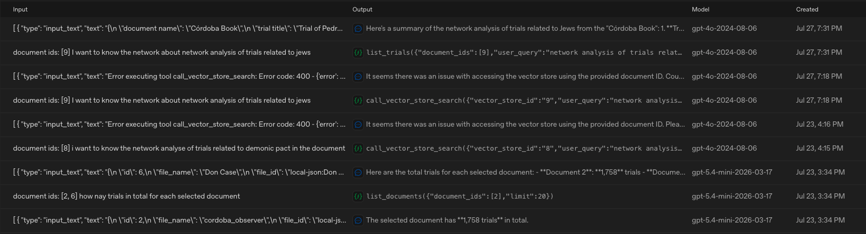
Agent tracing #2 – Input/Output Monitoring

Slide 13
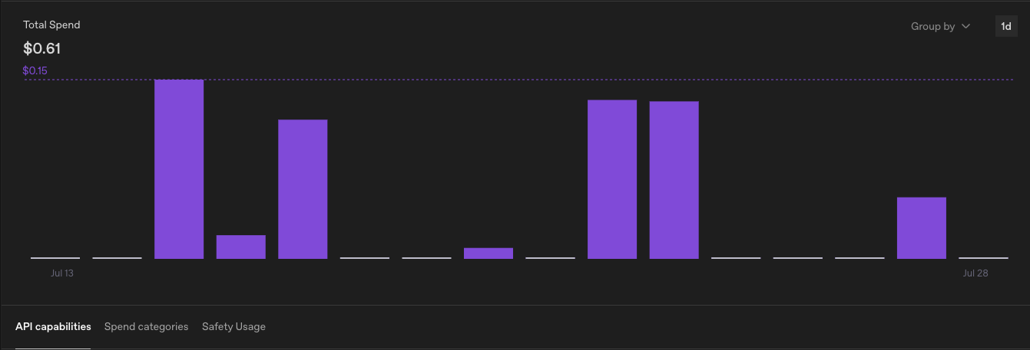
Cost Tracking
Notes:
Compared to cost/time for a human RA, very attractive here with LLMs..

Slide 14
Network Graph
Graph Schema Definition
Define nodes/edges, for example:
Graph Generation Tools
Create custom tools.
Use tool software such as Gephi Layout software.
nodes = people, papers/documents, events
edges = AFFILIATED_WITH, MENTIONED_IN

Slide 15
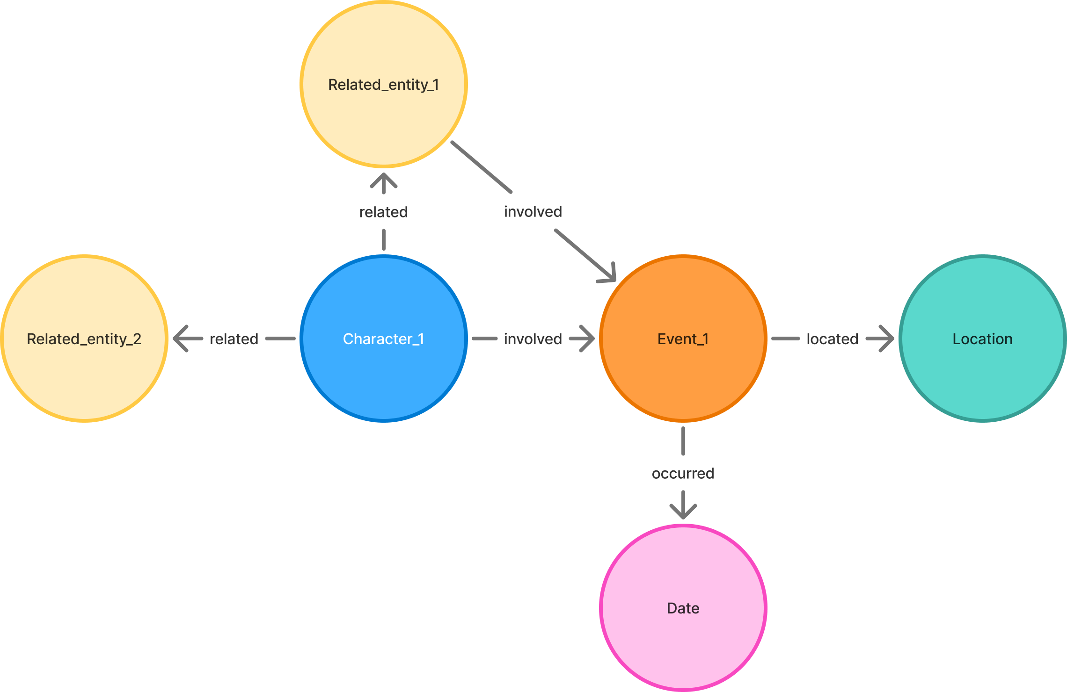
Define Relationship Progression
personal_information = {
full_name: str,
age: int,
email: str,
address: str,
phone_number: str,
}

Slide 16
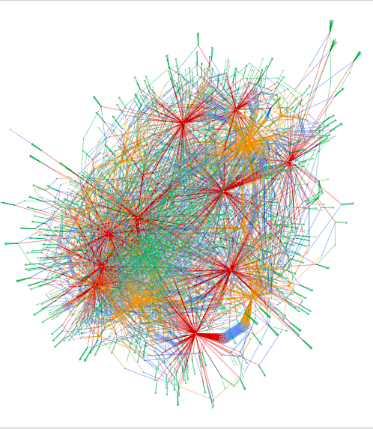
Network Analysis
Clustering-area detection.
Who or what is most central/important?
Can also consider e.g., subgraph/community detection, centrality measures, clustering coefficient
Filtering by given options.
E.g., topics/themes, crime type, etc.

