Slide 1

Model Report
19 Jan 2022 19:58:11

Slide 2
Purpose
Model Report
2
/ 67

Slide 3
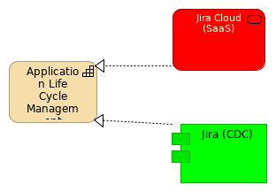
Views
Application Life Cycle Management
No viewpoint
Elements
Element
Type
Application Life Cycle Management
Capability
Jira (CDC)
Application Component
Jira Cloud (SaaS)
Application Service
Model Report
3
/ 67

Slide 4
Current State Landscape
No viewpoint
Model Report
4
/ 67

Slide 5
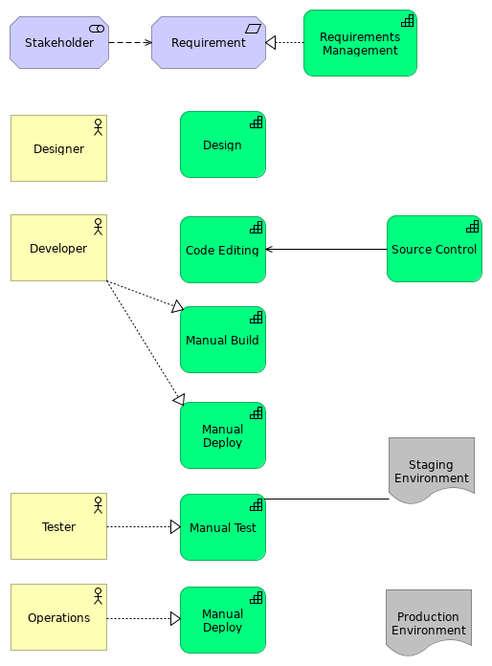
Model Report
5
/ 67

Slide 6
Elements
Element
Type
Code Editing
Capability
Design
Capability
Designer
Business Actor
Developer
Business Actor
Manual Build
Capability
Manual Deploy
Capability
Manual Deploy
Capability
Manual Test
Capability
Operations
Business Actor
Production Environment
Deliverable
Requirement
Requirement
Requirements Management
Capability
Source Control
Capability
Staging Environment
Deliverable
Stakeholder
Stakeholder
Tester
Business Actor
Model Report
6
/ 67

Slide 7
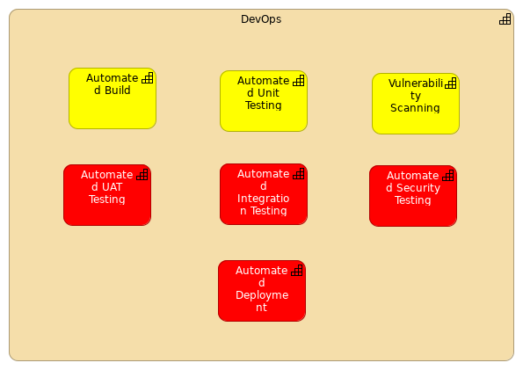
DevOps
No viewpoint
Elements
Element
Type
Automated Build
Capability
Automated Deployment
Capability
Automated Integration Testing
Capability
Automated Security Testing
Capability
Automated UAT Testing
Capability
Automated Unit Testing
Capability
DevOps
Capability
Vulnerability Scanning
Capability
Model Report
7
/ 67

Slide 8
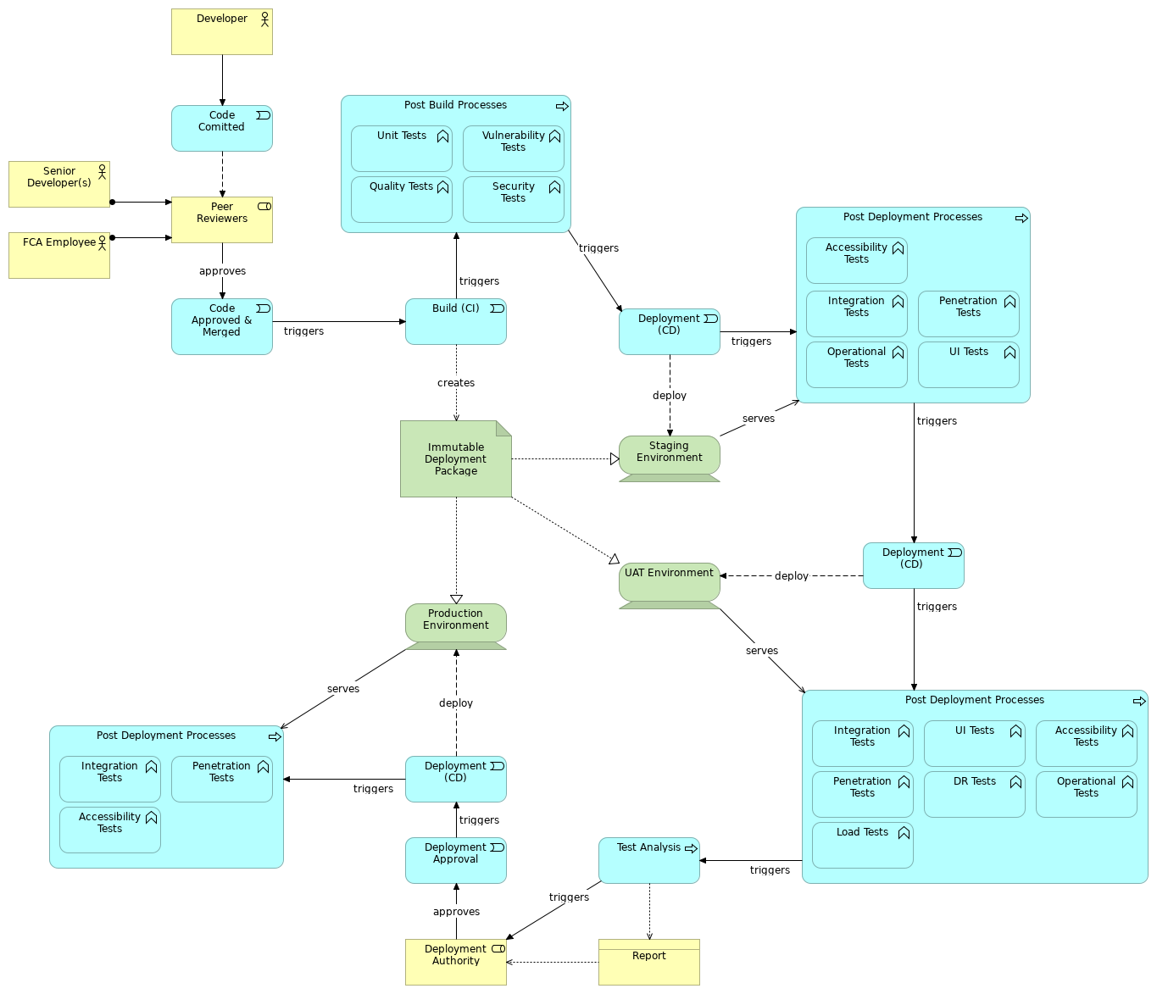
Lifecycle
Requirements Realization viewpoint
Elements
Element
Type
Accessibility Tests
Application Function
Accessibility Tests
Application Function
Accessibility Tests
Application Function
Build (CI)
Application Event
Code Approved & Merged
Application Event
Code Comitted
Application Event
Deployment (CD)
Application Event
Deployment (CD)
Application Event
Deployment (CD)
Application Event
Deployment Approval
Application Event
Deployment Authority
Business Role
Developer
Business Actor
Model Report
8
/ 67

Slide 9
Element
Type
DR Tests
Application Function
FCA Employee
Business Actor
Immutable Deployment Package
Artifact
Integration Tests
Application Function
Integration Tests
Application Function
Integration Tests
Application Function
Load Tests
Application Function
Operational Tests
Application Function
Operational Tests
Application Function
Peer Reviewers
Business Role
Penetration Tests
Application Function
Penetration Tests
Application Function
Penetration Tests
Application Function
Post Build Processes
Application Process
Post Deployment Processes
Application Process
Post Deployment Processes
Application Process
Post Deployment Processes
Application Process
Production Environment
Device
Quality Tests
Application Function
Report
Business Object
Security Tests
Application Function
Senior Developer(s)
Business Actor
Staging Environment
Device
Test Analysis
Application Process
UAT Environment
Device
UI Tests
Application Function
UI Tests
Application Function
Unit Tests
Application Function
Vulnerability Tests
Application Function
Model Report
9
/ 67

Slide 10
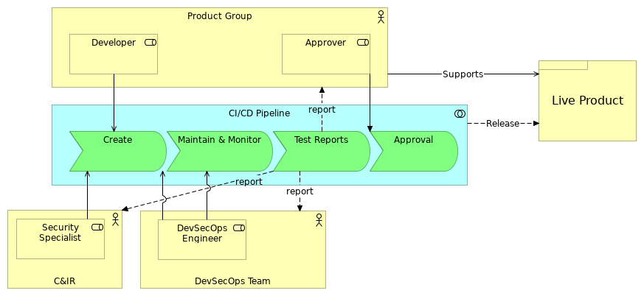
People & Processes
No viewpoint
Elements
Element
Type
Approval
Application Event
Approver
Business Role
C&IR
Business Actor
CI/CD Pipeline
Application Collaboration
Create
Application Event
Developer
Business Role
DevSecOps Engineer
Business Role
DevSecOps Team
Business Actor
Live Product
Product
Maintain & Monitor
Application Event
Product Group
Business Actor
Security Specialist
Business Role
Test Reports
Application Event
Model Report
10
/ 67

Slide 11
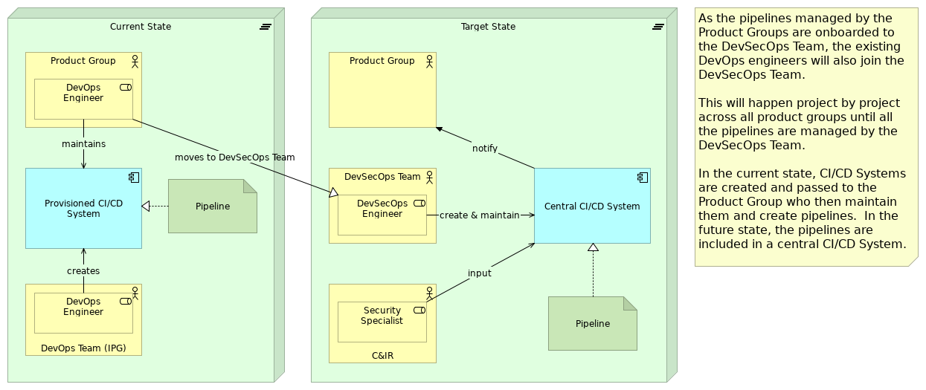
People Transitions
Implementation and Migration viewpoint
Elements
Element
Type
C&IR
Business Actor
Central CI/CD System
Application Component
Current State
Plateau
DevOps Engineer
Business Role
DevOps Team (IPG)
Business Actor
DevSecOps Engineer
Business Role
DevSecOps Team
Business Actor
Pipeline
Artifact
Pipeline
Artifact
Product Group
Business Actor
Provisioned CI/CD System
Application Component
Security Specialist
Business Role
Target State
Plateau
Model Report
11
/ 67

Slide 12
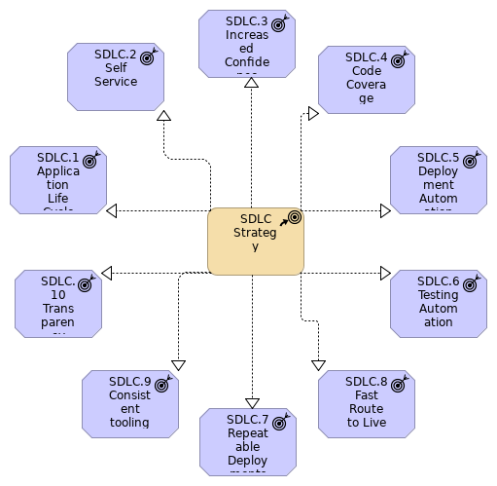
SDLC Outcomes
Strategy viewpoint
Elements
Element
Type
SDLC Strategy
Course of Action
SDLC.1 Application Life Cycle
Outcome
SDLC.10 Transparency
Outcome
SDLC.2 Self Service
Outcome
SDLC.3 Increased Confidence
Outcome
SDLC.4 Code Coverage
Outcome
SDLC.5 Deployment Automation
Outcome
SDLC.6 Testing Automation
Outcome
Model Report
12
/ 67

Slide 13
Element
Type
SDLC.7 Repeatable Deployments
Outcome
SDLC.8 Fast Route to Live
Outcome
SDLC.9 Consistent tooling
Outcome
Model Report
13
/ 67

Slide 14
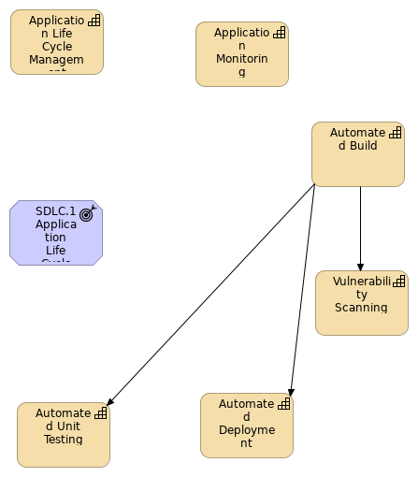
SDLC.1 Application Life Cycle
No viewpoint
Elements
Element
Type
Application Life Cycle Management
Capability
Application Monitoring
Capability
Automated Build
Capability
Automated Deployment
Capability
Automated Unit Testing
Capability
SDLC.1 Application Life Cycle
Outcome
Vulnerability Scanning
Capability
Model Report
14
/ 67

Slide 15
Model Report
15
/ 67

Slide 16
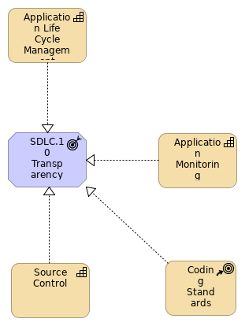
SDLC.10 Transparency
No viewpoint
Elements
Element
Type
Application Life Cycle Management
Capability
Application Monitoring
Capability
Coding Standards
Course of Action
SDLC.10 Transparency
Outcome
Source Control
Capability
Model Report
16
/ 67

Slide 17
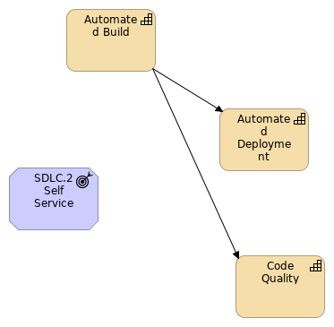
SDLC.2 Self Service
No viewpoint
Elements
Element
Type
Automated Build
Capability
Automated Deployment
Capability
Code Quality
Capability
SDLC.2 Self Service
Outcome
Model Report
17
/ 67

Slide 18
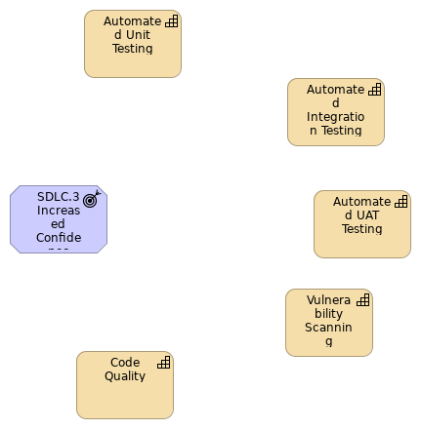
SDLC.3 Increased Confidence
No viewpoint
Elements
Element
Type
Automated Integration Testing
Capability
Automated UAT Testing
Capability
Automated Unit Testing
Capability
Code Quality
Capability
SDLC.3 Increased Confidence
Outcome
Vulnerability Scanning
Capability
Model Report
18
/ 67

Slide 19
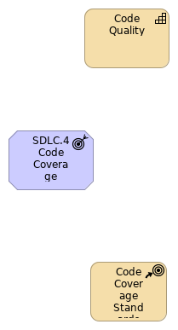
SDLC.4 Code Coverage
No viewpoint
Elements
Element
Type
Code Coverage Standards
Course of Action
Code Quality
Capability
SDLC.4 Code Coverage
Outcome
Model Report
19
/ 67

Slide 20
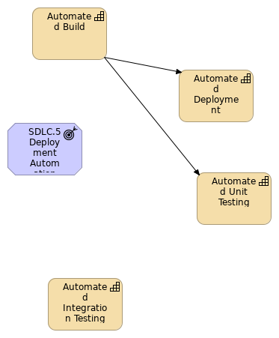
SDLC.5 Deployment Automation
No viewpoint
Elements
Element
Type
Automated Build
Capability
Automated Deployment
Capability
Automated Integration Testing
Capability
Automated Unit Testing
Capability
SDLC.5 Deployment Automation
Outcome
Model Report
20
/ 67

Slide 21
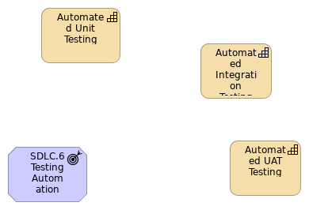
SDLC.6 Testing Automation
No viewpoint
Elements
Element
Type
Automated Integration Testing
Capability
Automated UAT Testing
Capability
Automated Unit Testing
Capability
SDLC.6 Testing Automation
Outcome
Model Report
21
/ 67

Slide 22
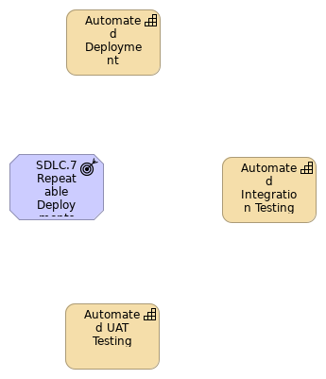
SDLC.7 Repeatable Deployments
No viewpoint
Elements
Element
Type
Automated Deployment
Capability
Automated Integration Testing
Capability
Automated UAT Testing
Capability
SDLC.7 Repeatable Deployments
Outcome
Model Report
22
/ 67

Slide 23
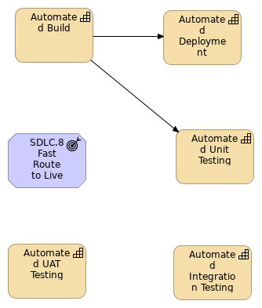
SDLC.8 Fast Route to Live
No viewpoint
Elements
Element
Type
Automated Build
Capability
Automated Deployment
Capability
Automated Integration Testing
Capability
Automated UAT Testing
Capability
Automated Unit Testing
Capability
SDLC.8 Fast Route to Live
Outcome
Model Report
23
/ 67

Slide 24
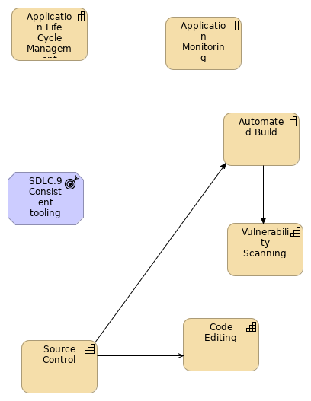
SDLC.9 Consistent tooling
No viewpoint
Elements
Element
Type
Application Life Cycle Management
Capability
Application Monitoring
Capability
Automated Build
Capability
Code Editing
Capability
SDLC.9 Consistent tooling
Outcome
Source Control
Capability
Vulnerability Scanning
Capability
Model Report
24
/ 67

Slide 25
Model Report
25
/ 67

Slide 26
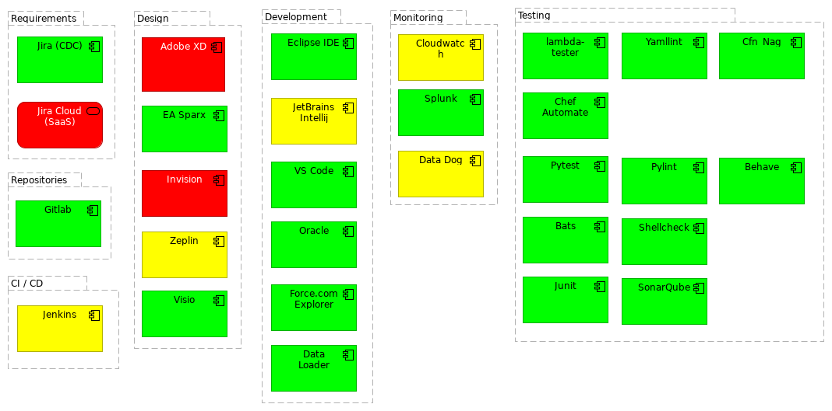
Target State Capability Map - Tooling
No viewpoint
Elements
Element
Type
Adobe XD
Application Component
Bats
Application Component
Behave
Application Component
Cfn_Nag
Application Component
Chef Automate
Application Component
CI / CD
Grouping
Cloudwatch
Application Component
Data Dog
Application Component
Data Loader
Application Component
Design
Grouping
Development
Grouping
EA Sparx
Application Component
Eclipse IDE
Application Component
Force.com Explorer
Application Component
Gitlab
Application Component
Invision
Application Component
Jenkins
Application Component
JetBrains Intellij
Application Component
Jira (CDC)
Application Component
Jira Cloud (SaaS)
Application Service
Junit
Application Component
lambda-tester
Application Component
Monitoring
Grouping
Oracle
Application Component
Model Report
26
/ 67

Slide 27
Element
Type
Pylint
Application Component
Pytest
Application Component
Repositories
Grouping
Requirements
Grouping
Shellcheck
Application Component
SonarQube
Application Component
Splunk
Application Component
Testing
Grouping
Visio
Application Component
VS Code
Application Component
Yamllint
Application Component
Zeplin
Application Component
Model Report
27
/ 67

Slide 28
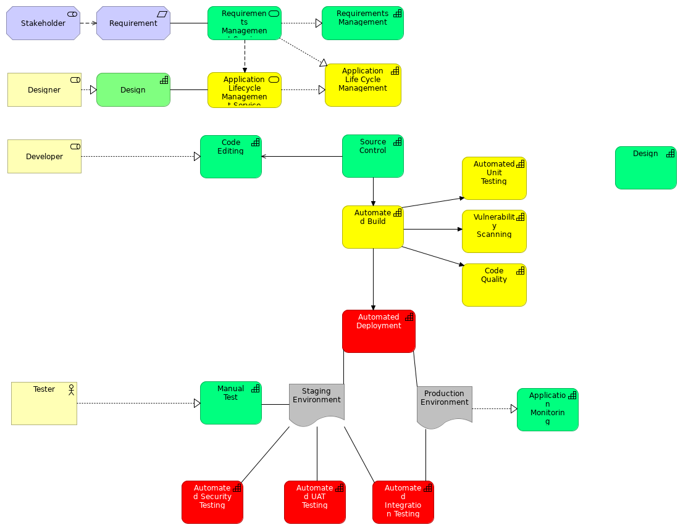
Target State Landscape
No viewpoint
Elements
Element
Type
Application Life Cycle Management
Capability
Application Lifecycle Management Service
Application Service
Application Monitoring
Capability
Automated Build
Capability
Automated Deployment
Capability
Automated Integration Testing
Capability
Automated Security Testing
Capability
Automated UAT Testing
Capability
Automated Unit Testing
Capability
Code Editing
Capability
Code Quality
Capability
Design
Capability
Designer
Business Role
Developer
Business Role
Manual Test
Capability
Model Report
28
/ 67

Slide 29
Element
Type
Production Environment
Deliverable
Requirement
Requirement
Requirements Management
Capability
Requirements Management Service
Application Service
Source Control
Capability
Staging Environment
Deliverable
Stakeholder
Stakeholder
Tester
Business Actor
Vulnerability Scanning
Capability
Model Report
29
/ 67

Slide 30
Strategy Layer
Application Life Cycle Management
Type
Capability
Application Monitoring
Type
Capability
Approve
Type
Value Stream
Automated Build
Type
Capability
Automated Deployment
Type
Capability
Automated Integration Testing
Type
Capability
Automated Security Testing
Type
Capability
Automated UAT Testing
Type
Capability
Automated Unit Testing
Type
Capability
Code Coverage Standards
Type
Course of Action
Code Editing
Type
Capability
Code Quality
Type
Capability
Coding Standards
Type
Course of Action
Create
Type
Value Stream
Model Report
30
/ 67

Slide 31
Create (copy)
Type
Value Stream
Design
Type
Capability
DevOps
Type
Capability
Maintain & Monitor
Type
Value Stream
Manual Build
Type
Capability
Manual Deploy
Type
Capability
Manual Deploy
Type
Capability
Manual Test
Type
Capability
Requirements Management
Type
Capability
SDLC Strategy
Type
Course of Action
Source Control
Type
Capability
Test Reports
Type
Value Stream
Vulnerability Scanning
Type
Capability
Model Report
31
/ 67

Slide 32
Business Layer
Approver
Type
Business Role
Business Function
Type
Business Function
Business Process
Type
Business Process
C&IR
Type
Business Actor
Deployment Authority
Type
Business Role
Designer
Type
Business Actor
Designer
Type
Business Role
Developer
Type
Business Role
Developer
Type
Business Actor
DevOps
Type
Business Service
DevOps (CDC)
Type
Business Service
DevOps (EUC)
Type
Business Service
DevOps Engineer
Type
Business Role
DevOps Team (IPG)
Type
Business Actor
Model Report
32
/ 67

Slide 33
DevSecOps Engineer
Type
Business Role
DevSecOps Engineer
Type
Business Role
DevSecOps Team
Type
Business Actor
FCA Employee
Type
Business Actor
To verify the code changes and to ensure test quality
Live Product
Type
Product
Operations
Type
Business Actor
Peer Reviewers
Type
Business Role
Product Group
Type
Business Actor
Report
Type
Business Object
Security Specialist
Type
Business Role
Senior Developer(s)
Type
Business Actor
Stakeholder
Type
Business Actor
Tester
Type
Business Actor
Model Report
33
/ 67

Slide 34
Application Layer
Accessibility Tests
Type
Application Function
UAT
Accessibility Tests
Type
Application Function
Staging
Accessibility Tests
Type
Application Function
Production
Adobe XD
Type
Application Component
Application Lifecycle Management Service
Type
Application Service
Approval
Type
Application Event
Bats
Type
Application Component
Behave
Type
Application Component
Build (CI)
Type
Application Event
Central CI/CD System
Type
Application Component
Cfn_Nag
Type
Application Component
Chef Automate
Type
Application Component
Model Report
34
/ 67

Slide 35
CI/CD Pipeline
Type
Application Collaboration
CI/CD Pipeline
Type
Application Service
Cloudwatch
Type
Application Component
Code Approved & Merged
Type
Application Event
Code Comitted
Type
Application Event
Create
Type
Application Event
Data Dog
Type
Application Component
Data Loader
Type
Application Component
FCAType
Development Tool
Deployment (CD)
Type
Application Event
Deployment to staging environment
Deployment (CD)
Type
Application Event
Deployment to Production environment
Deployment (CD)
Type
Application Event
Deployment to UAT environment
Deployment Approval
Type
Application Event
DR Tests
Type
Application Function
Model Report
35
/ 67

Slide 36
UAT
DR Tests
Type
Application Function
EA Sparx
Type
Application Component
Eclipse IDE
Type
Application Component
Force.com Explorer
Type
Application Component
drill down
EAID_6B076B3F_3CE8_48c5_9872_6DC839C5AD7A
Gitlab
Type
Application Component
Integration Tests
Type
Application Function
Production
Integration Tests
Type
Application Function
UAT
Integration Tests
Type
Application Function
Staging
Invision
Type
Application Component
Jenkins
Type
Application Component
JetBrains Intellij
Type
Application Component
Jira (CDC)
Type
Application Component
Model Report
36
/ 67

Slide 37
This is the CDC instance of Jira. Approval given to migrate to the SaaS version (Jira Cloud) in July 2019
Jira Cloud (SaaS)
Type
Application Service
Junit
Type
Application Component
lambda-tester
Type
Application Component
Load Tests
Type
Application Function
Load Tests
Type
Application Function
UAT
Maintain & Monitor
Type
Application Event
Monitoring
Type
Application Process
Monitoring
Type
Application Service
Operational Tests
Type
Application Function
UAT
Operational Tests
Type
Application Function
Staging
Oracle
Type
Application Component
Penetration Tests
Type
Application Function
Model Report
37
/ 67

Slide 38
Staging
Penetration Tests
Type
Application Function
Production
Penetration Tests
Type
Application Function
UAT
Post Build Processes
Type
Application Process
Post Deployment Processes
Type
Application Process
Production
Post Deployment Processes
Type
Application Process
UAT
Post Deployment Processes
Type
Application Process
Staging
Provisioned CI/CD System
Type
Application Component
Pylint
Type
Application Component
Pytest
Type
Application Component
Quality Tests
Type
Application Function
Requirements Management Service
Type
Application Service
Model Report
38
/ 67

Slide 39
Security Tests
Type
Application Function
Shellcheck
Type
Application Component
SonarQube
Type
Application Component
Splunk
Type
Application Component
Test Analysis
Type
Application Process
Test Reports
Type
Application Event
UI Tests
Type
Application Function
Staging
UI Tests
Type
Application Function
UAT
Unit Tests
Type
Application Function
Usage Analysis
Type
Application Function
Visio
Type
Application Component
VS Code
Type
Application Component
Vulnerability Tests
Type
Application Function
Model Report
39
/ 67

Slide 40
Yamllint
Type
Application Component
Zeplin
Type
Application Component
Model Report
40
/ 67

Slide 41
Technology & Physical Layer
Code
Type
Artifact
Design
Type
Artifact
Immutable Deployment Package
Type
Artifact
Pipeline
Type
Artifact
Pipeline
Type
Artifact
Production Environment
Type
Device
Staging Environment
Type
Device
UAT Environment
Type
Device
Model Report
41
/ 67

Slide 42
Motivation
IPG
Type
Stakeholder
Requirement
Type
Requirement
Requirement
Type
Requirement
Requirement
Type
Requirement
Requirement
Type
Requirement
SDLC.1 Application Life Cycle
Type
Outcome
drill down
EAID_545C6720_6B18_4707_A7BF_344E46C3F6F7
Defined application life cycle that everyone understands and subscribes to, from concept to design to development to testing to live
SDLC.10 Transparency
Type
Outcome
drill down
EAID_786039EF_C844_4a88_B42B_FE8EDD48A646
The status of projects is available to all. Also information regarding the performance and usage of applications and adherence to coding standards.
SDLC.2 Self Service
Type
Outcome
Self Service to reduce dependencies on specialist IT staff. Being able to update project status, commit code to source control, trigger a new build and deployment to staging environments.
SDLC.3 Increased Confidence
Type
Outcome
Increased confidence in software/systems delivered. This is delivered by increasing the amount of automated testing that is run every time the code is built and deployed, along with checks for code quality.
SDLC.4 Code Coverage
Type
Outcome
Model Report
42
/ 67

Slide 43
Increased code coverage through unit testing
SDLC.5 Deployment Automation
Type
Outcome
Automation of deployments preferably through 1-click
SDLC.6 Testing Automation
Type
Outcome
Automation of testing during the compilation phase of the life cycle to ensure that changes have not broken existing functionality
SDLC.7 Repeatable Deployments
Type
Outcome
Repeatable deployments through environments for easy promote forward and roll back
SDLC.8 Fast Route to Live
Type
Outcome
Faster route to live giving regular deployments and increased visibility to stakeholders
SDLC.9 Consistent tooling
Type
Outcome
Consistent tooling to promote re-use across the FCA reducing support and maintenance costs
Stakeholder
Type
Stakeholder
Stakeholder
Type
Stakeholder
Model Report
43
/ 67

Slide 44
Implementation and Migration
Current State
Type
Plateau
Production Environment
Type
Deliverable
Report
Type
Deliverable
Staging Environment
Type
Deliverable
Target State
Type
Plateau
Work Package
Type
Work Package
Model Report
44
/ 67

Slide 45
Other
CI / CD
Type
Grouping
Design
Type
Grouping
Development
Type
Grouping
Monitoring
Type
Grouping
Repositories
Type
Grouping
Requirements
Type
Grouping
Testing
Type
Grouping
Model Report
45
/ 67

Slide 46
Relations
Association relation
Type
Association relation
Source
Manual Test
Target
Staging Environment
Realization relation
Type
Realization relation
Source
Source Control
Target
SDLC.10 Transparency
Realization relation
Type
Realization relation
Source
Jira Cloud (SaaS)
Target
Application Life Cycle Management
Realization relation
Type
Realization relation
Source
SDLC Strategy
Target
SDLC.8 Fast Route to Live
Realization relation
Type
Realization relation
Source
Developer
Target
Create
Composition relation
Type
Composition relation
Source
Target State
Target
Central CI/CD System
Composition relation
Type
Composition relation
Source
Post Deployment Processes
Target
Integration Tests
Composition relation
Type
Composition relation
Source
Post Deployment Processes
Target
Penetration Tests
Composition relation
Type
Composition relation
Model Report
46
/ 67

Slide 47
Source
Current State
Target
Central CI/CD System
Realization relation
Type
Realization relation
Source
SDLC Strategy
Target
SDLC.10 Transparency
Assignment relation
Type
Assignment relation
Source
CI/CD Pipeline
Target
Approval
Assignment relation
Type
Assignment relation
Source
Product Group
Target
Work Package
Realization relation
Type
Realization relation
Source
Immutable Deployment Package
Target
Staging Environment
Realization relation
Type
Realization relation
Source
Work Package
Target
CI/CD Pipeline
Realization relation
Type
Realization relation
Source
Usage Analysis
Target
Monitoring
Serving relation
Type
Serving relation
Source
CI/CD Pipeline
Target
Developer
Access relation
Type
Access relation
Source
Developer
Target
Code
Model Report
47
/ 67

Slide 48
Realization relation
Type
Realization relation
Source
Operations
Target
Manual Deploy
Composition relation
Type
Composition relation
Source
Target State
Target
Pipeline
Realization relation
Type
Realization relation
Source
Immutable Deployment Package
Target
Production Environment
Serving relation
Type
Serving relation
Source
Deployment (CD)
Target
DevSecOps Team
Composition relation
Type
Composition relation
Source
Post Deployment Processes
Target
Accessibility Tests
Composition relation
Type
Composition relation
Source
Current State
Target
DevOps Team (IPG)
Realization relation
Type
Realization relation
Source
Application Monitoring
Target
SDLC.10 Transparency
Composition relation
Type
Composition relation
Source
Post Build Processes
Target
Vulnerability Tests
Composition relation
Type
Composition relation
Source
Post Deployment Processes
Target
Accessibility Tests
Model Report
48
/ 67

Slide 49
Realization relation
Type
Realization relation
Source
Approver
Target
Approve
Realization relation
Type
Realization relation
Source
Designer
Target
Design
Assignment relation
Type
Assignment relation
Source
DevOps Team (IPG)
Target
DevOps Engineer
Serving relation
Type
Serving relation
Source
DevSecOps Engineer
Target
Create
Association relation
Type
Association relation
Source
Automated Deployment
Target
Production Environment
Association relation
Type
Association relation
Source
Design
Target
Application Lifecycle Management Service
Serving relation
Type
Serving relation
Source
CI/CD Pipeline
Target
Product Group
Realization relation
Type
Realization relation
Source
Developer
Target
Manual Build
Realization relation
Type
Realization relation
Source
Code
Model Report
49
/ 67

Slide 50
Target
Code Comitted
Composition relation
Type
Composition relation
Source
Post Deployment Processes
Target
Accessibility Tests
Composition relation
Type
Composition relation
Source
Post Deployment Processes
Target
Penetration Tests
Influence relation
Type
Influence relation
Source
Stakeholder
Target
Requirement
Serving relation
Type
Serving relation
Source
Build (CI)
Target
DevSecOps Team
Realization relation
Type
Realization relation
Source
Jira (CDC)
Target
Application Life Cycle Management
Association relation
Type
Association relation
Source
Staging Environment
Target
Automated Security Testing
Realization relation
Type
Realization relation
Source
SDLC Strategy
Target
SDLC.5 Deployment Automation
Realization relation
Type
Realization relation
Source
SDLC Strategy
Target
SDLC.3 Increased Confidence
Realization relation
Type
Realization relation
Model Report
50
/ 67

Slide 51
Source
SDLC Strategy
Target
SDLC.1 Application Life Cycle
Composition relation
Type
Composition relation
Source
Current State
Target
DevSecOps Team
Composition relation
Type
Composition relation
Source
Post Deployment Processes
Target
Integration Tests
Composition relation
Type
Composition relation
Source
Post Deployment Processes
Target
DR Tests
Realization relation
Type
Realization relation
Source
SDLC Strategy
Target
SDLC.4 Code Coverage
Serving relation
Type
Serving relation
Source
Product Group
Target
CI/CD Pipeline
Composition relation
Type
Composition relation
Source
Post Build Processes
Target
Unit Tests
Triggering relation
Type
Triggering relation
Source
Approver
Target
CI/CD Pipeline
Realization relation
Type
Realization relation
Source
Work Package
Target
Build (CI)
Model Report
51
/ 67

Slide 52
Serving relation
Type
Serving relation
Source
CI/CD Pipeline
Target
DevSecOps Team
Composition relation
Type
Composition relation
Source
Post Deployment Processes
Target
DR Tests
Serving relation
Type
Serving relation
Source
Source Control
Target
Code Editing
Association relation
Type
Association relation
Source
Test Reports
Target
DevSecOps Team
Influence relation
Type
Influence relation
Source
Requirements Management
Target
Stakeholder
Realization relation
Type
Realization relation
Source
Work Package
Target
Developer
Serving relation
Type
Serving relation
Source
Deployment (CD)
Target
DevSecOps Team
Assignment relation
Type
Assignment relation
Source
FCA Employee
Target
Peer Reviewers
Assignment relation
Type
Assignment relation
Source
C&IR
Target
Security Specialist
Model Report
52
/ 67

Slide 53
Assignment relation
Type
Assignment relation
Source
DevSecOps Team
Target
DevSecOps Engineer
Composition relation
Type
Composition relation
Source
Current State
Target
Product Group
Association relation
Type
Association relation
Source
Test Reports
Target
Product Group
Composition relation
Type
Composition relation
Source
Post Deployment Processes
Target
Operational Tests
Access relation
Type
Access relation
Source
Deployment Authority
Target
Report
Association relation
Type
Association relation
Source
Test Analysis
Target
Report
Composition relation
Type
Composition relation
Source
Post Deployment Processes
Target
UI Tests
Composition relation
Type
Composition relation
Source
Current State
Target
Pipeline
Flow relation
Type
Flow relation
Source
Code Comitted
Model Report
53
/ 67

Slide 54
Target
Peer Reviewers
Realization relation
Type
Realization relation
Source
Product Group
Target
Requirement
Assignment relation
Type
Assignment relation
Source
CI/CD Pipeline
Target
Test Reports
Assignment relation
Type
Assignment relation
Source
CI/CD Pipeline
Target
Maintain & Monitor
Composition relation
Type
Composition relation
Source
Post Build Processes
Target
Security Tests
Serving relation
Type
Serving relation
Source
Developer
Target
Create
Realization relation
Type
Realization relation
Source
Requirements Management Service
Target
Application Life Cycle Management
Assignment relation
Type
Assignment relation
Source
DevSecOps Team
Target
DevOps Engineer
Realization relation
Type
Realization relation
Source
CI/CD Pipeline
Target
Test Reports
Realization relation
Type
Realization relation
Model Report
54
/ 67

Slide 55
Source
CI/CD Pipeline
Target
Approve
Realization relation
Type
Realization relation
Source
Application Life Cycle Management
Target
SDLC.10 Transparency
Realization relation
Type
Realization relation
Source
Immutable Deployment Package
Target
UAT Environment
Realization relation
Type
Realization relation
Source
Pipeline
Target
Provisioned CI/CD System
Association relation
Type
Association relation
Source
Automated Deployment
Target
Staging Environment
Realization relation
Type
Realization relation
Source
SDLC Strategy
Target
SDLC.9 Consistent tooling
Influence relation
Type
Influence relation
Source
Stakeholder
Target
Requirement
Realization relation
Type
Realization relation
Source
Tester
Target
Manual Test
Realization relation
Type
Realization relation
Source
CI/CD Pipeline
Target
Create
Model Report
55
/ 67

Slide 56
Association relation
Type
Association relation
Source
Production Environment
Target
Automated Integration Testing
Access relation
Type
Access relation
Source
Application Lifecycle Management Service
Target
Design
Realization relation
Type
Realization relation
Source
Immutable Deployment Package
Target
Deployment (CD)
Composition relation
Type
Composition relation
Source
Post Deployment Processes
Target
Load Tests
Assignment relation
Type
Assignment relation
Source
Senior Developer(s)
Target
Peer Reviewers
Realization relation
Type
Realization relation
Source
Coding Standards
Target
SDLC.10 Transparency
Composition relation
Type
Composition relation
Source
Current State
Target
Provisioned CI/CD System
Realization relation
Type
Realization relation
Source
Developer
Target
Manual Deploy
Assignment relation
Type
Assignment relation
Source
DevSecOps Team
Target
DevSecOps Engineer
Model Report
56
/ 67

Slide 57
Realization relation
Type
Realization relation
Source
Production Environment
Target
Application Monitoring
Realization relation
Type
Realization relation
Source
Work Package
Target
Approver
Realization relation
Type
Realization relation
Source
Pipeline
Target
Central CI/CD System
Realization relation
Type
Realization relation
Source
DevSecOps Engineer
Target
Create
Triggering relation
Type
Triggering relation
Source
Automated Build
Target
Vulnerability Scanning
Serving relation
Type
Serving relation
Source
DevSecOps Engineer
Target
CI/CD Pipeline
Triggering relation
Type
Triggering relation
Source
Developer
Target
Code Comitted
Realization relation
Type
Realization relation
Source
Security Specialist
Target
Create
Flow relation
Type
Flow relation
Source
Production Environment
Model Report
57
/ 67

Slide 58
Target
Monitoring
Serving relation
Type
Serving relation
Source
DevSecOps Engineer
Target
Maintain & Monitor
Serving relation
Type
Serving relation
Source
Security Specialist
Target
Create
Assignment relation
Type
Assignment relation
Source
Approver
Target
Work Package
Triggering relation
Type
Triggering relation
Source
Automated Build
Target
Automated Unit Testing
Realization relation
Type
Realization relation
Source
DevSecOps Engineer
Target
Maintain & Monitor
Composition relation
Type
Composition relation
Source
Target State
Target
C&IR
Association relation
Type
Association relation
Source
Requirement
Target
Requirements Management Service
Assignment relation
Type
Assignment relation
Source
Product Group
Target
Approver
Realization relation
Type
Realization relation
Model Report
58
/ 67

Slide 59
Source
Application Lifecycle Management Service
Target
Application Life Cycle Management
Composition relation
Type
Composition relation
Source
Post Deployment Processes
Target
UI Tests
Association relation
Type
Association relation
Source
Staging Environment
Target
Automated UAT Testing
Composition relation
Type
Composition relation
Source
Post Deployment Processes
Target
Integration Tests
Realization relation
Type
Realization relation
Source
SDLC Strategy
Target
SDLC.6 Testing Automation
Triggering relation
Type
Triggering relation
Source
Source Control
Target
Automated Build
Realization relation
Type
Realization relation
Source
Report
Target
Deployment Authority
Realization relation
Type
Realization relation
Source
Requirements Management
Target
Requirement
Realization relation
Type
Realization relation
Source
CI/CD Pipeline
Target
Maintain & Monitor
Model Report
59
/ 67

Slide 60
Triggering relation
Type
Triggering relation
Source
Approver
Target
Approval
Assignment relation
Type
Assignment relation
Source
Product Group
Target
Developer
Realization relation
Type
Realization relation
Source
Code
Target
Code Approved & Merged
Triggering relation
Type
Triggering relation
Source
Automated Build
Target
Automated Deployment
Realization relation
Type
Realization relation
Source
Developer
Target
Code Editing
Realization relation
Type
Realization relation
Source
SDLC Strategy
Target
SDLC.7 Repeatable Deployments
Assignment relation
Type
Assignment relation
Source
CI/CD Pipeline
Target
Create
Composition relation
Type
Composition relation
Source
Post Build Processes
Target
Quality Tests
Triggering relation
Type
Triggering relation
Source
Automated Build
Target
Code Quality
Model Report
60
/ 67

Slide 61
Composition relation
Type
Composition relation
Source
Target State
Target
Provisioned CI/CD System
Composition relation
Type
Composition relation
Source
Target State
Target
Product Group
Serving relation
Type
Serving relation
Source
Deployment (CD)
Target
DevSecOps Team
Composition relation
Type
Composition relation
Source
Post Deployment Processes
Target
Operational Tests
Flow relation
Type
Flow relation
Source
Requirements Management Service
Target
Application Lifecycle Management Service
Access relation
Type
Access relation
Source
Test Analysis
Target
Report
Triggering relation
Type
Triggering relation
Source
Product Group
Target
CI/CD Pipeline
Composition relation
Type
Composition relation
Source
Post Deployment Processes
Target
Penetration Tests
Serving relation
Type
Serving relation
Source
DevSecOps Team
Model Report
61
/ 67

Slide 62
Target
Build (CI)
Realization relation
Type
Realization relation
Source
SDLC Strategy
Target
SDLC.2 Self Service
Access relation
Type
Access relation
Source
Designer
Target
Design
Access relation
Type
Access relation
Source
Peer Reviewers
Target
Code
Assignment relation
Type
Assignment relation
Source
Product Group
Target
DevOps Engineer
Influence relation
Type
Influence relation
Source
Stakeholder
Target
Requirement
Composition relation
Type
Composition relation
Source
Target State
Target
DevSecOps Team
Association relation
Type
Association relation
Source
Staging Environment
Target
Automated Integration Testing
Realization relation
Type
Realization relation
Source
Requirements Management Service
Target
Requirements Management
Composition relation
Type
Composition relation
Model Report
62
/ 67

Slide 63
Source
Post Deployment Processes
Target
Load Tests
Serving relation
Type
Serving relation
Source
Test Analysis
Target
Deployment Authority
Access relation
Type
Access relation
Source
Designer
Target
Design
approves
Type
Triggering relation
Source
Deployment Authority
Target
Deployment Approval
approves
Type
Triggering relation
Source
Peer Reviewers
Target
Code Approved & Merged
create & maintain
Type
Serving relation
Source
DevSecOps Engineer
Target
Central CI/CD System
creates
Type
Serving relation
Source
DevOps Engineer
Target
Provisioned CI/CD System
creates
Type
Access relation
Source
Build (CI)
Target
Immutable Deployment Package
deploy
Type
Flow relation
Source
Deployment (CD)
Target
UAT Environment
Model Report
63
/ 67

Slide 64
deploy
Type
Flow relation
Source
Deployment (CD)
Target
Production Environment
deploy
Type
Flow relation
Source
Deployment (CD)
Target
Staging Environment
edit
Type
Access relation
Source
DevSecOps Team
Target
Pipeline
input
Type
Access relation
Source
Security Specialist
Target
Pipeline
input
Type
Serving relation
Source
Security Specialist
Target
Central CI/CD System
maintains
Type
Access relation
Source
Product Group
Target
Pipeline
maintains
Type
Serving relation
Source
DevOps Engineer
Target
Provisioned CI/CD System
moves to DevSecOps Team
Type
Specialization relation
Source
DevOps Engineer
Target
DevSecOps Engineer
notifies
Type
Realization relation
Source
Pipeline
Target
Product Group
Model Report
64
/ 67

Slide 65
notify
Type
Triggering relation
Source
Central CI/CD System
Target
Product Group
Release
Type
Flow relation
Source
CI/CD Pipeline
Target
Live Product
report
Type
Flow relation
Source
Test Reports
Target
C&IR
report
Type
Flow relation
Source
Test Reports
Target
Product Group
report
Type
Flow relation
Source
Test Reports
Target
DevSecOps Team
serves
Type
Serving relation
Source
UAT Environment
Target
Post Deployment Processes
serves
Type
Serving relation
Source
Staging Environment
Target
Post Deployment Processes
serves
Type
Serving relation
Source
Production Environment
Target
Post Deployment Processes
Supports
Type
Serving relation
Source
Product Group
Model Report
65
/ 67

Slide 66
Target
Live Product
triggers
Type
Triggering relation
Source
Test Analysis
Target
Deployment Authority
triggers
Type
Triggering relation
Source
Deployment (CD)
Target
Post Deployment Processes
triggers
Type
Triggering relation
Source
Post Build Processes
Target
Deployment (CD)
triggers
Type
Triggering relation
Source
Post Deployment Processes
Target
Deployment (CD)
triggers
Type
Triggering relation
Source
Build (CI)
Target
Post Build Processes
triggers
Type
Triggering relation
Source
Post Deployment Processes
Target
Test Analysis
triggers
Type
Triggering relation
Source
Code Approved & Merged
Target
Build (CI)
triggers
Type
Triggering relation
Source
Deployment Approval
Target
Deployment (CD)
triggers
Type
Triggering relation
Model Report
66
/ 67

Slide 67
Source
Deployment (CD)
Target
Post Deployment Processes
triggers
Type
Triggering relation
Source
Deployment (CD)
Target
Post Deployment Processes
Model Report
67
/ 67

