Slide 1
Python-based Simulation of the Helper Node in Wireless Mesh Network
Project work – Actual Topics
Student: Zuo Xiang
Supervisor: Dipl.-Inf. Frank Wilhelm
Professor: Prof. Dr.-Ing. Dr. h.c. Frank H.P. Fitzek
Dresden, 26.02.2016
Institut für Nachrichtentechnik Deutsche Telekom Chair of Communication Networks

Slide 2
Structure
1. Motivation
2. Scenario and Method
3. Simulation Results
4. Summary and Outlooks

Slide 3

Motivation
N4
N3
N3
N6
N2
N2
N1
N5

Slide 4
Scenario
Helper
e_1
e_2
e_2
= e_1
Sender
Receiver
e_3

Slide 5
Method
RLNC
RLNC
RLNC(Random Linear Networkcoding)
Parmaters: input data: random data using /dev/urandom symbols = 100 symbol size = 1500 Bytes number of generation = 1
Coder & Decoder: full vector, binary systematic coding number of rounds: 50

Slide 6

Scenario
Helper
e_1
e_2 = e_1
Sender
Receiver
e_3

Slide 7
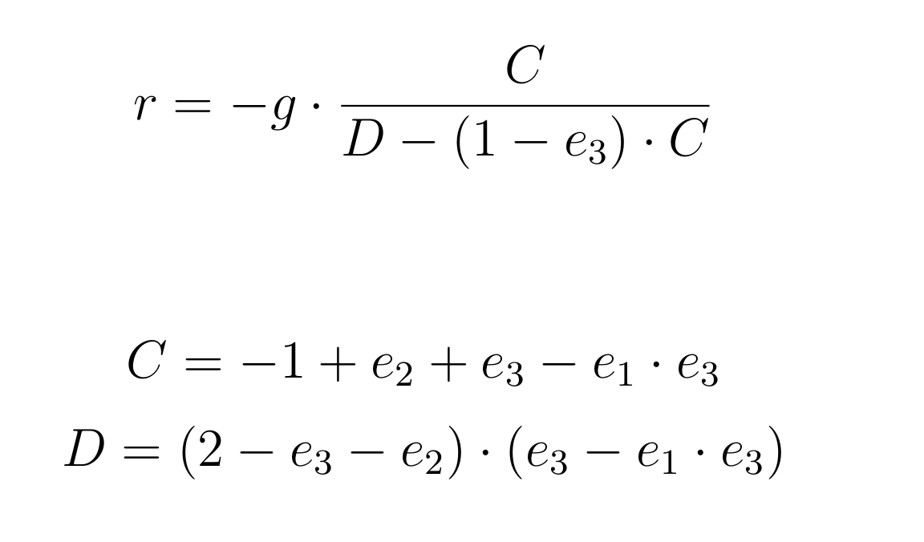
Method
PlayNCool
Opportunistic Network Coding for Local Optimization of Routing in Wireless Mesh Networks
r: the number of transmission from the sender before the helper starts transmitting. g: geration size

Slide 8
Scenario
Helper
e_1
e_2 = e_1
Sender
Receiver
e_3
alternating

Slide 9
Simulation Device
OS: Manjaro Linux 15.12 X86_64
Kernel: 4.1.18
CPU: Intel Core i7-4550U CPU @ 3GHz
RAM: 8GB
Python version: 2.7.11
Kodo-python version: 9.0.1

Slide 10
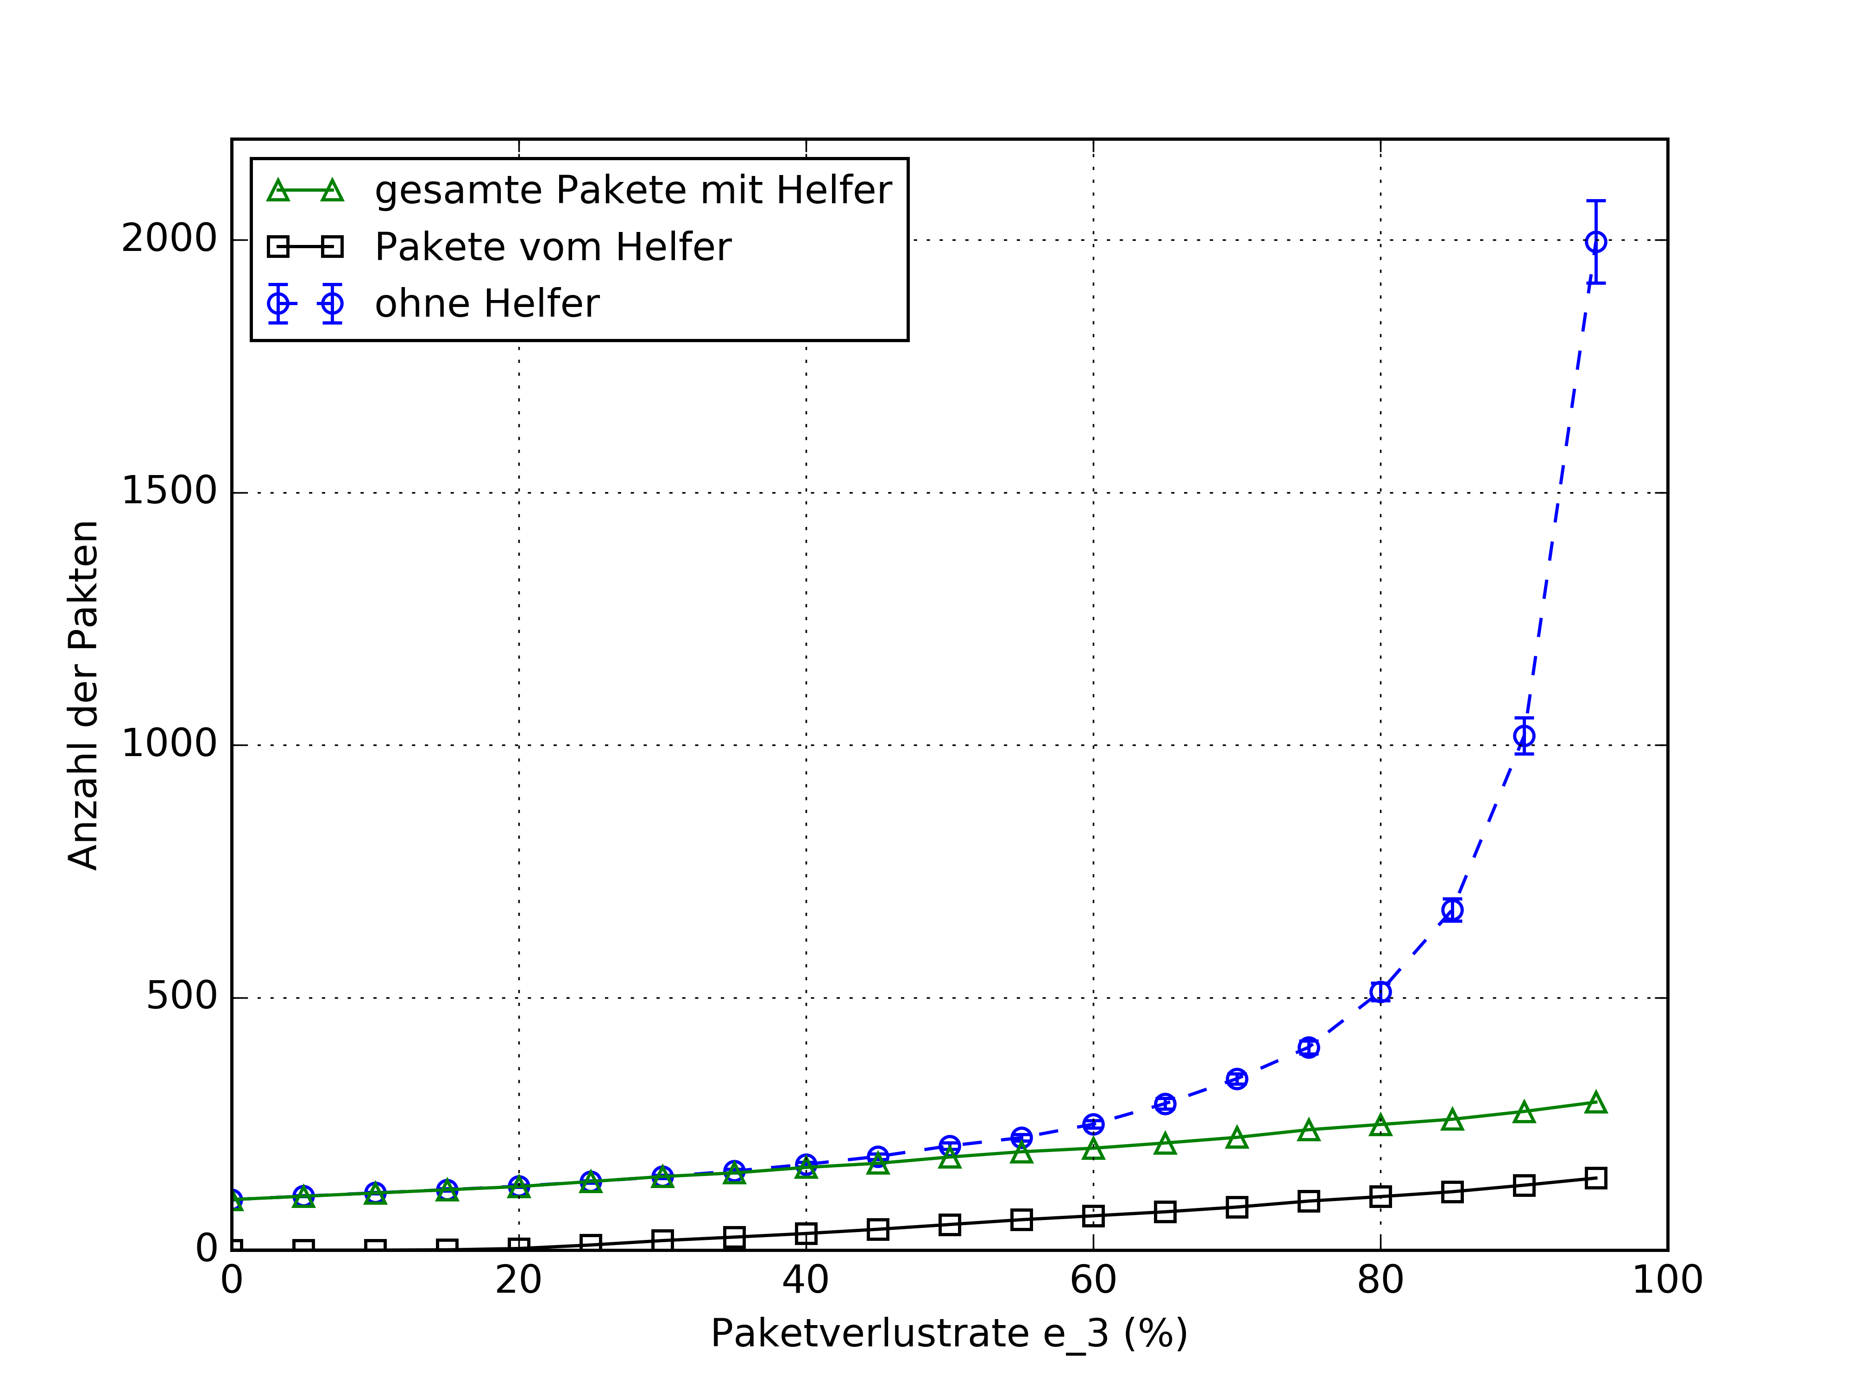
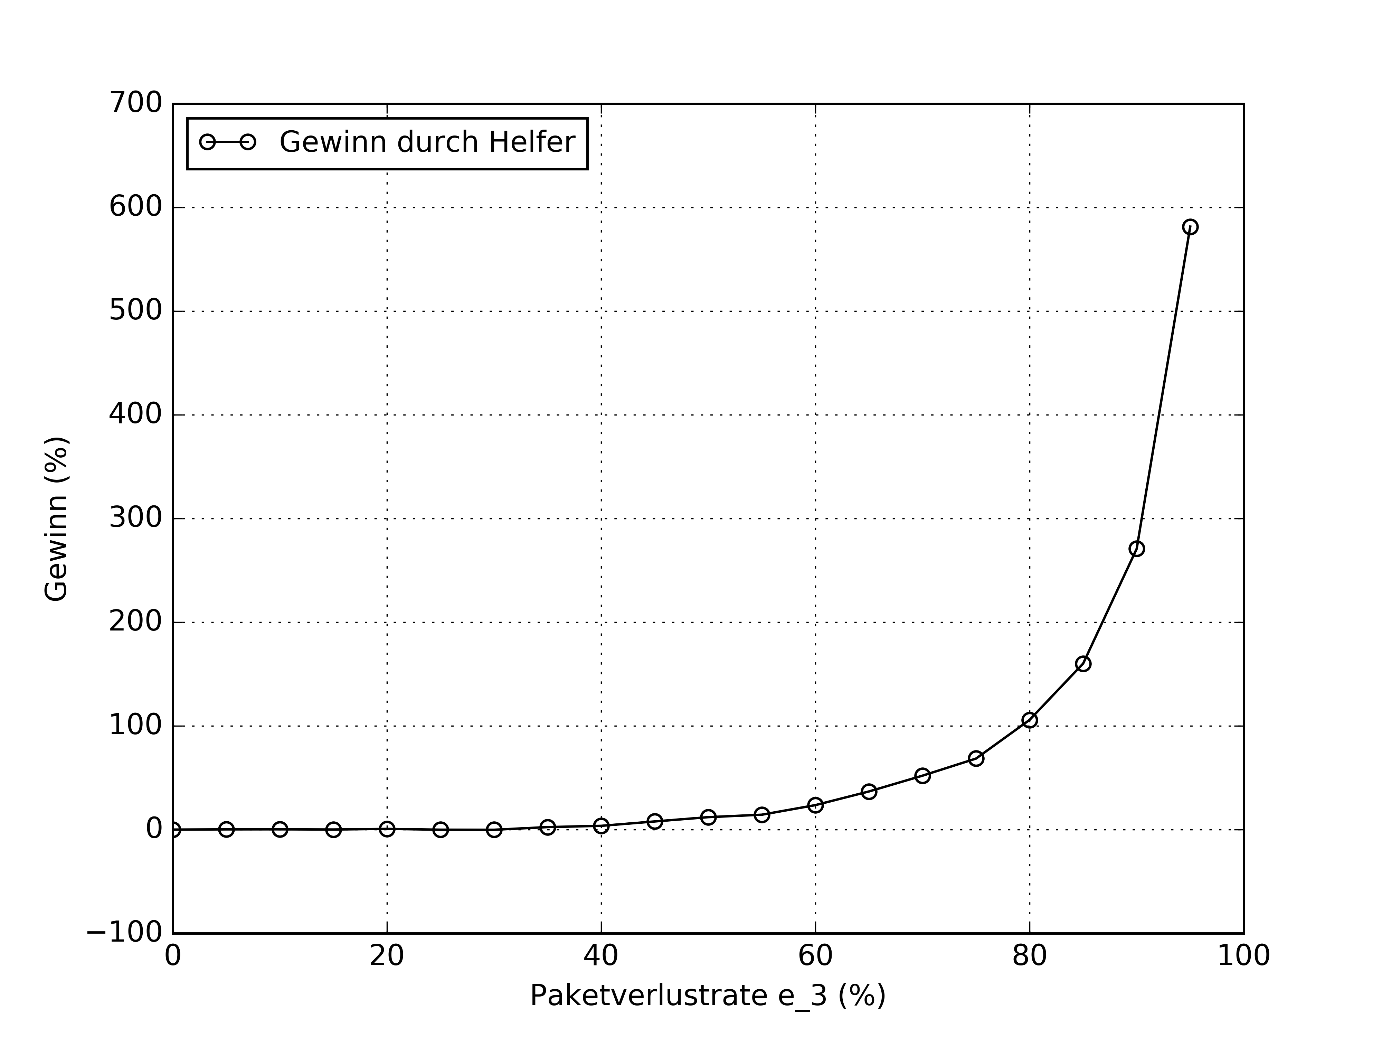
Simulation Results
Fig1 Results with e_2 = 30%
(a) average
(b) gain

Slide 11
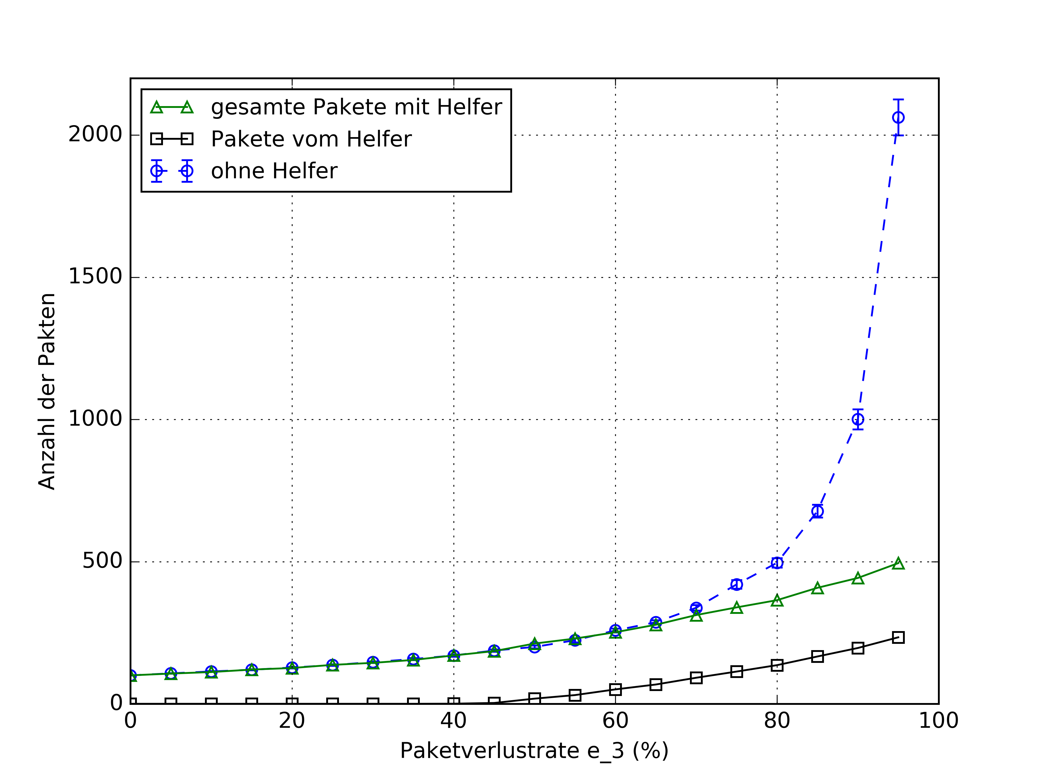
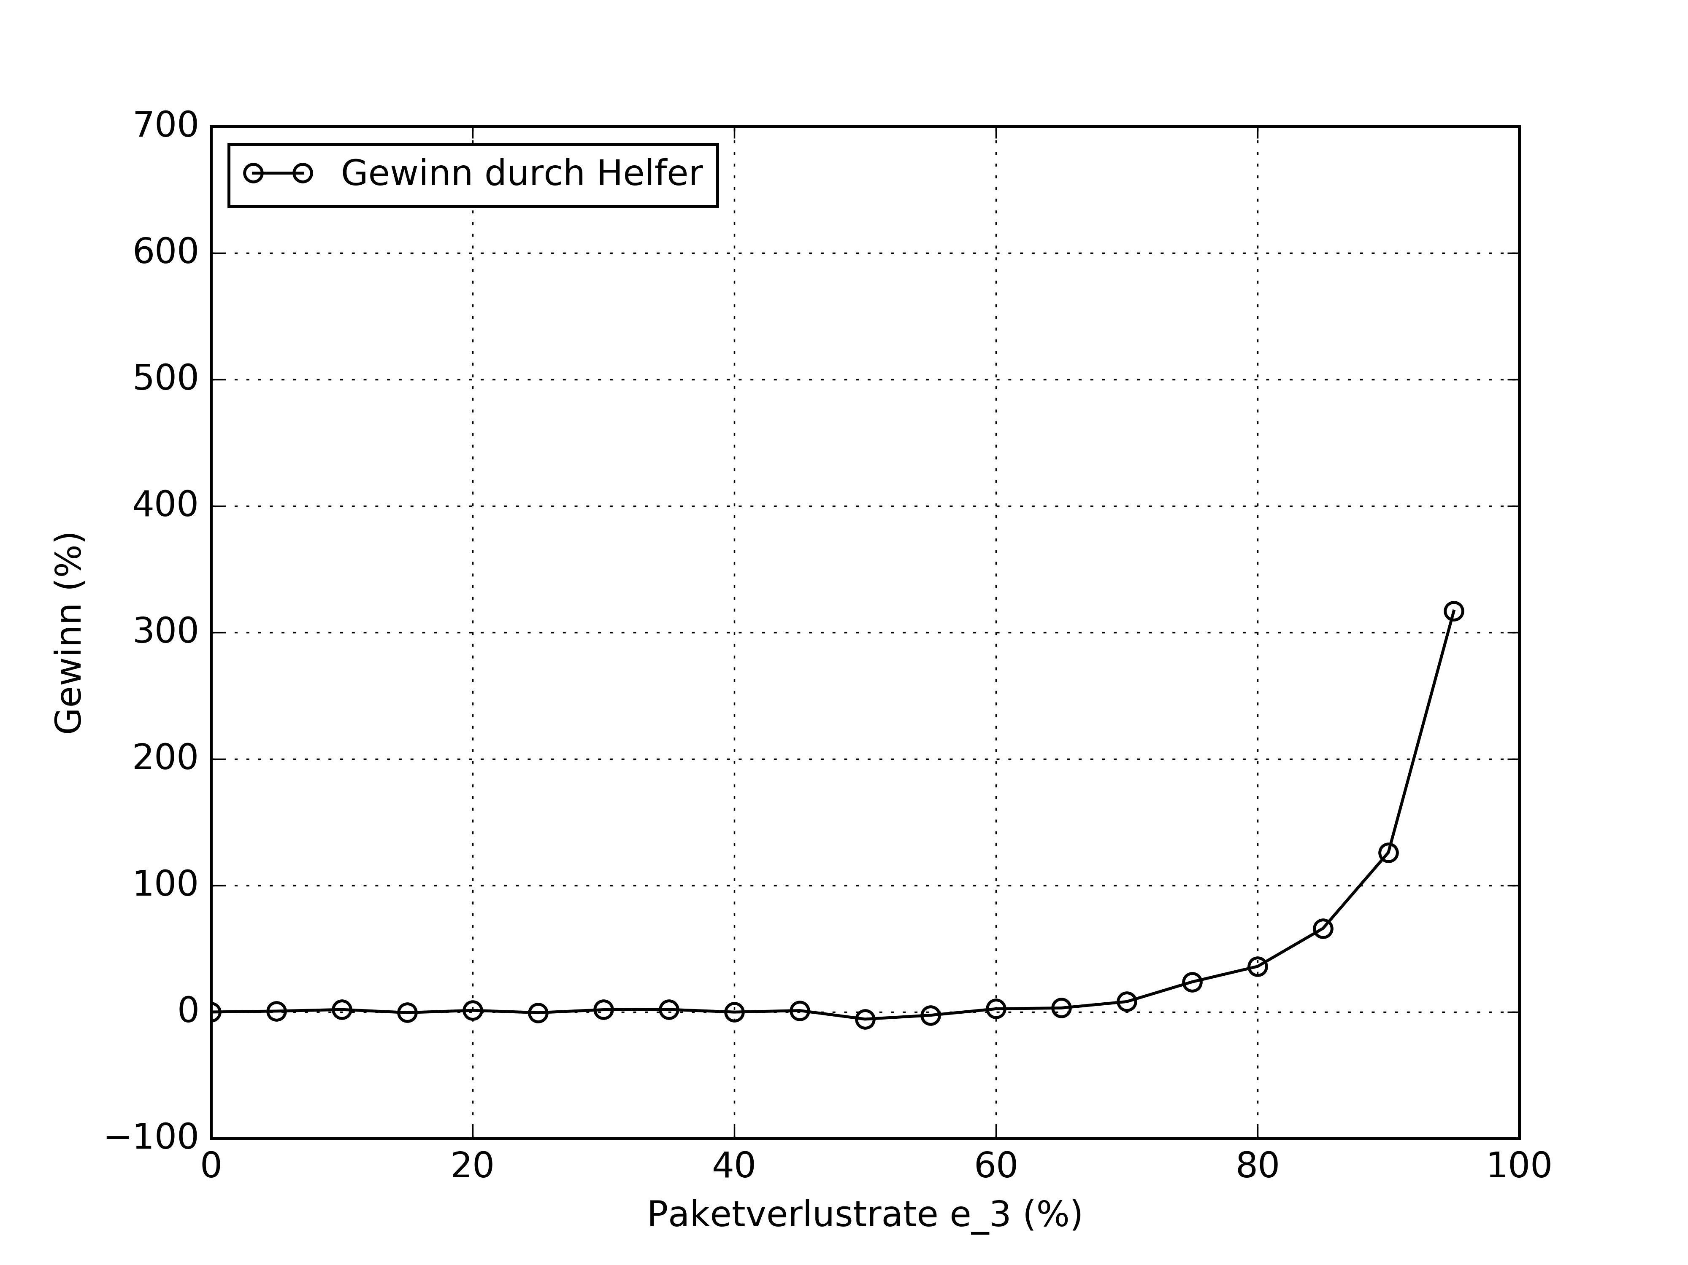
Simulation Results
Fig2 Results with e_2 = 60%
(a) average
(b) gain

Slide 12
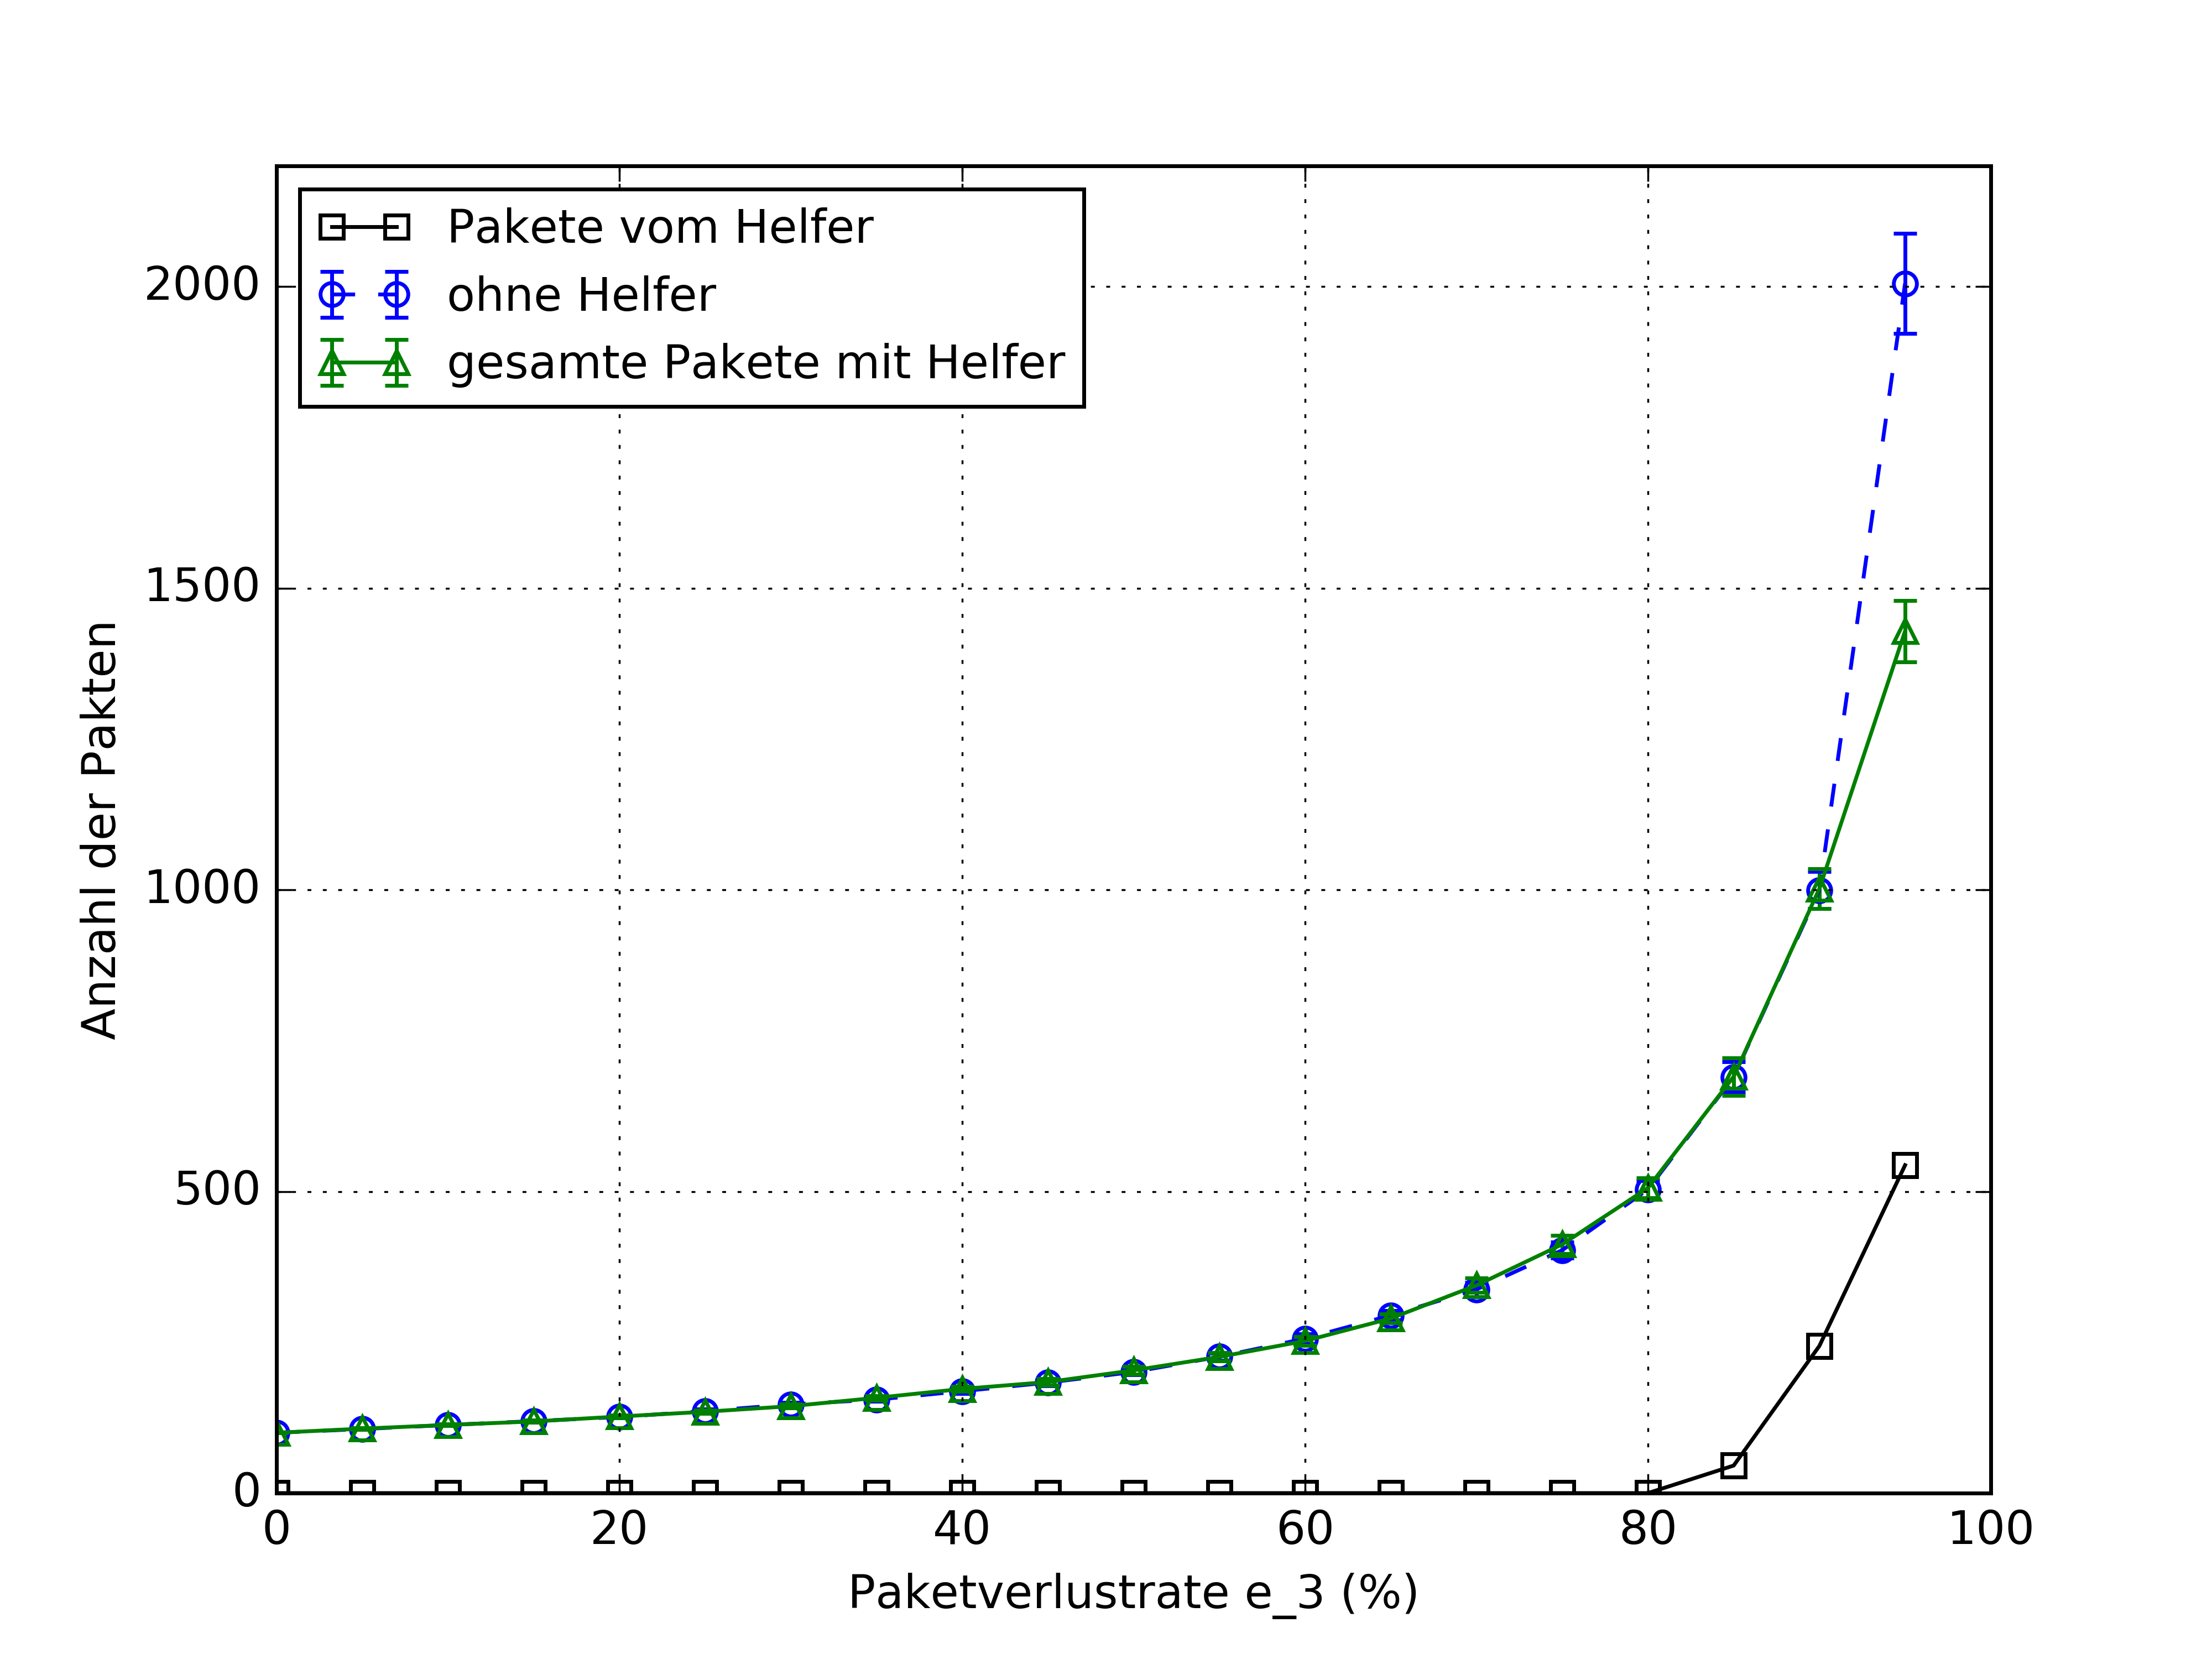
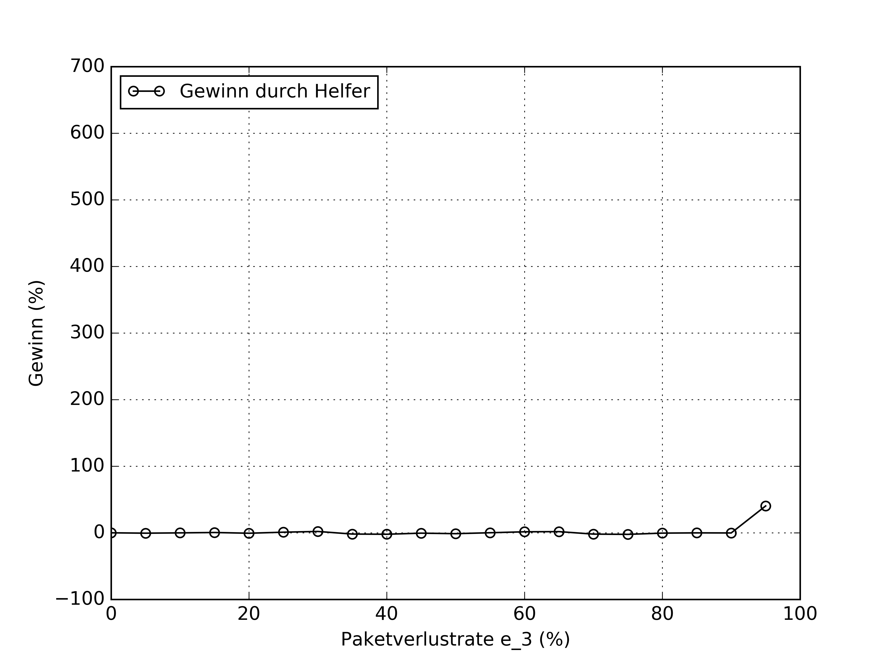
Simulation Results
Fig3 Results with e_2 = 90%

Slide 13
Summary and Outlooks
Summary and Outlooks
In this Scenario, the number of transmissions can be obviously reduced by using a helper node, if the packet loss rate between the sender and receiver is relatively worse than that between the sender and helper.
• Asymmetric packet loss rate of the helper node
• Transmission several generations of packets

Slide 14
List of references
[1] Peyman Pahlevani, Daniel E Lucani, Morten V Pedersen und Frank HP
Fitzek. „Playncool: opportunistic network coding for local optimization
of routing in wireless mesh networks“. In: Globecom Workshops (GC
Wkshps), 2013 IEEE. IEEE. 2013, S. 812–817
[2] Tracey Ho, Muriel Médard, Ralf Koetter, David R Karger, Michelle Effros,
Jun Shi und Ben Leong. „A random linear network coding approach to
multicast“. In: Information Theory, IEEE Transactions on 52.10 (2006),
S. 4413–4430
[3] Introduction to Kodo. Steinwurf. url: http://steinwurf.com/kodo/
[4] Github Repository of Kodo-Python. Steinwurf. url: https://github.
com/steinwurf/kodo-python
[5] Homepage of matplotlib. url: http://matplotlib.org/

Slide 15
Thank you very much for your attention.
Ich bedanke mich für Ihre Aufmerksamkeit.

