Slide 1

Hadoop Vectored IO: your data just got faster!
Steve Loughran
stevel@cloudera.com
github: steveloughran

Slide 2
Steve Loughran
Long-standing open source developer
Hadoop Committer
Cloud Connectors (s3a, abfs…)
PB of data goes through my code every day
I get to care when it doesn't or just takes too long!
Mountain Biking (+climbing)

Slide 3
Problem: reading large data from cloud storage is slow
More time waiting for queries.
Longer cluster lifespans or more VMs
Bigger bills from AWS, Microsoft, Google.
Worst case: ETL jobs take so long they can't keep up
Vectored IO transforms ORC and Parquet read times in cloud
Notes:
Who uses orc in cloud store?
Who uses parquet in cloud store?
Are there any orc/parquet devs here?

Slide 4
seek() is a concept from Hard Disks: its time is done
HDDs: seeking was a physical operation
SSDs: block-by-block reads; you can read > 1 block in parallel.
Cloud storage: S3, Azure, GCS: latency of GET requests
Prefetching? Great for sequential IO
ORC/Parquet reads are considered "random IO", but there is nothing random about it
If the format readers can pass their "read plan" to the filesystem client, it can optimise data retrieval
Notes:
With prefetching we make lot of unnecessary get requests and data gets discarded.
SSD reads block by block thus sequential, we can think of parallelizing.

Slide 5
What do you mean
"random" IO?

Slide 6
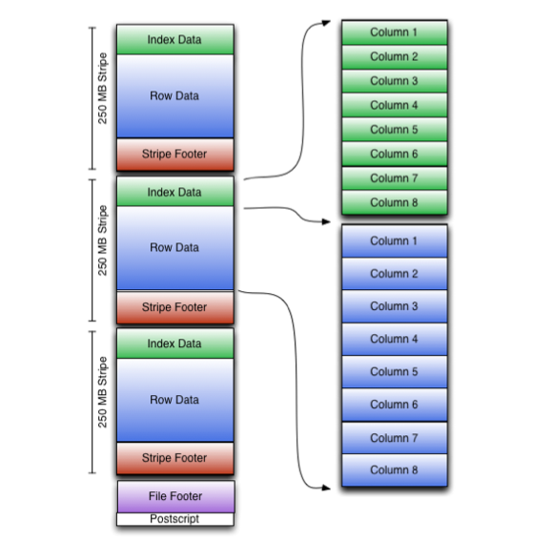
ORC
Fixed length postscript bytes contain offset of footer
Footer includes schemas, stripe info
Index data in stripes include column ranges, encryption, compression
Column stripes of hundreds of MB
Columns can be read with this data
Predicate pushdown can dynamically skip columns if index data shows it is not needed.

Slide 7
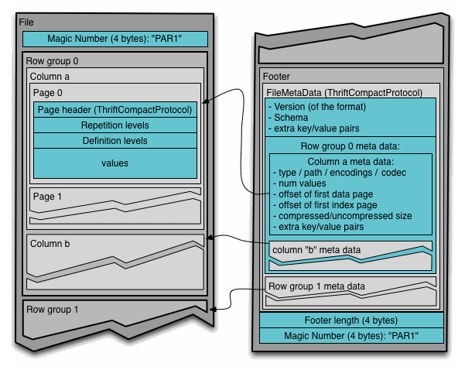
Parquet
Thrift-based columnar format
256+ MB Row Groups
Fixed 8 byte postscript includes pointer to real footer
Footer has schema + metadata of every column in every row group
Query engines process subset of columns within row groups
Notes:
Backwards seek() of footer read switches s3a/gs to random IO mode

Slide 8
Columnar formats need Hadoop Vectored IO
Inspired from readv()/writev() from Linux.
Scatter/Gather API where callers request 1+ file range.
Each range mapped to a CompletableFuture
Default implementation: sort ranges + sequential
readFully(offset, range) into buffers
Object store optimizations.
Works great everywhere; radical benefit in object stores

Slide 9
New method in PositionedReadable interface:
public interface PositionedReadable {
readVectored(
List<? extends FileRange> ranges,
IntFunction<ByteBuffer> allocator)
throws IOException
}
default implementation: available everywhere
Notes:
It takes a list of file ranges and a method to allocate byte buffers and fills the data in each allocated buffer which can be accessed by client from each file range.
Any FileSystem already implementing this interface will automatically have the base implementation of Vectored IO. Thanks to Java 8 default methods

Slide 10
Advantages
Asynchronous: Clients can perform other operations while waiting for data for specific ranges.
Parallel Processing of results: Clients can process ranges independently/Out of Order
Efficient: A single vectored read call will replace multiple reads.
Performant: Optimizations like range merging, parallel data fetching, bytebuffer pooling and java direct buffer IO.

Slide 11
Implementations
Default implementation:
Blocking readFully() calls for each range.
Same performance as the classic API.
Local/Checksum FileSystem:
Java NIO Async Channel API
Reads directly into on-heap or off-heap ByteBuffers
Parallel read with zero-kernel-copy, DMA, memory-mapped SSD...
Notes:
This should improve you local IO for example running spark apps locally.

Slide 12
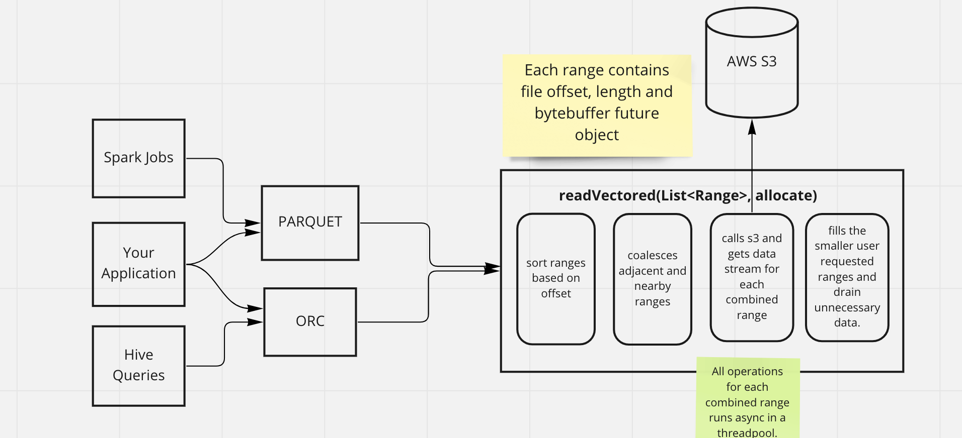
S3A: parallelized GETs
Notes:
S3A implementation sort the ranges based on start file offset then coalesces adjacent and "nearby" ranges and then fetches each combined range in separate HTTP GET requests,
and then populate the buffers for each user requested ranges.
Complete operation for each combined range is executed in parallel using a thread pool.

Slide 13
S3A parallel GET requests
Multiple GET requests issued into common thread pool.
Set in fs.s3a.vectored.active.ranged.reads; default = 4
Results returned as soon as their data is received
If/when S3 supports multiple ranges in GET, could be done in a single request.

Slide 14
How to use?
Path p = path("s3a://bucket/table1/file.orc");
FileSystem fs = FileSystem(p.getUri(), conf);
List<FileRange> ranges = new ArrayList<>();
ranges.add(createFileRange(8 * 1024, 100));
ranges.add(createFileRange(14 * 1024, 100));
ranges.add(createFileRange(10 * 1024, 100));
ranges.add(createFileRange(2 * 1024 - 101, 100));
ranges.add(createFileRange(40 * 1024, 1024));
ByteBufferPool pool = new ElasticByteBufferPool();
ExecutorService dataProcessor = Executors.newFixedThreadPool(5);

Slide 15
// open file
try (FSDataInputStream in = fs.open(p)) {
// initiate vectored read
in.readVectored(ranges, size -> pool.getBuffer(false, size));
// process results in worker pool
for (FileRange range : ranges)
dataProcessor.submit(() ->
range.getData().thenAccept(buffer -> {
/* process */
pool.putBuffer(buffer);
countDownLatch.countDown();
}));
countDown.await();
}

Slide 16
Is it faster? Oh yes*.
Java Microbench benchmark for local storage is 7x faster.
Hive queries with ORC data in S3.
TPCH ⇒ 10-20% reduced execution time.
TPCDS ⇒ 20-40% reduced execution time.
Synthetic ETL benchmark ⇒ 50-70% reduced execution time.
* your results may vary. No improvements for CSV or Avro
Notes:
Improvement in query execution time. And the best thing about this no code change required in hive, spark anywhere. Just upgrade the hadoop and orc/parquet.

Slide 17
Java Microbench Harness
Native IO implementation of vectored IO API in RawLocal and Checksum filesystem
JMH benchmark to compare the performance across
FS: [Raw, Checksum file system].
Buffers: [Direct, Heap]
read: [seek() + read(), Vectored, java async file channel read]
see: org.apache.hadoop.benchmark.VectoredReadBenchmark

Slide 18
JMH benchmarks result
Benchmark buffer fileSystem Score Error
syncRead (array) checksum 12627.855 ± 439.369
syncRead (array) raw 1783.479 ± 161.927
asyncFileChanArray direct N/A 1448.505 ± 140.251
asyncFileChanArray array N/A 705.741 ± 10.574
asyncRead direct checksum 1690.764 ± 306.537
asyncRead direct raw 1562.085 ± 242.231
asyncRead array checksum 888.708 ± 13.691
asyncRead array raw 810.721 ± 13.284
(microseconds per operation)
=7x faster
Notes:
The current code ( traditional read api) is by far the slowest and using the Java native async file channel is the fastest.
Reading in raw fs is almost at par java native async file channel. This was expected as the vectored read implementation of raw fs uses java async channel to read data.
For checksum fs vectored read is almost 7X faster than traditional sync read.

Slide 19
JMH benchmarks result observations.
The current code (traditional read API) is by far the slowest and using the Java native async file channel is the fastest.
Reading in raw FS is almost at par java native async file channel. This was expected as the vectored read implementation of raw fs uses java async channel to read data.
For checksum FS vectored read is almost 7X faster than traditional sync read.

Slide 20
Hive with ORC data in S3:
ORC library updated to use to the new API when reading stripes
All applications using this format automatically get the speedups.
Special mention to Owen O'Malley
Notes:
Seeing the Jmh benchmark result we got super motivated and went ahead implementing vectored read api in S3A connector which is widely used to read/write data from AWS S3 cloud store.

Slide 21
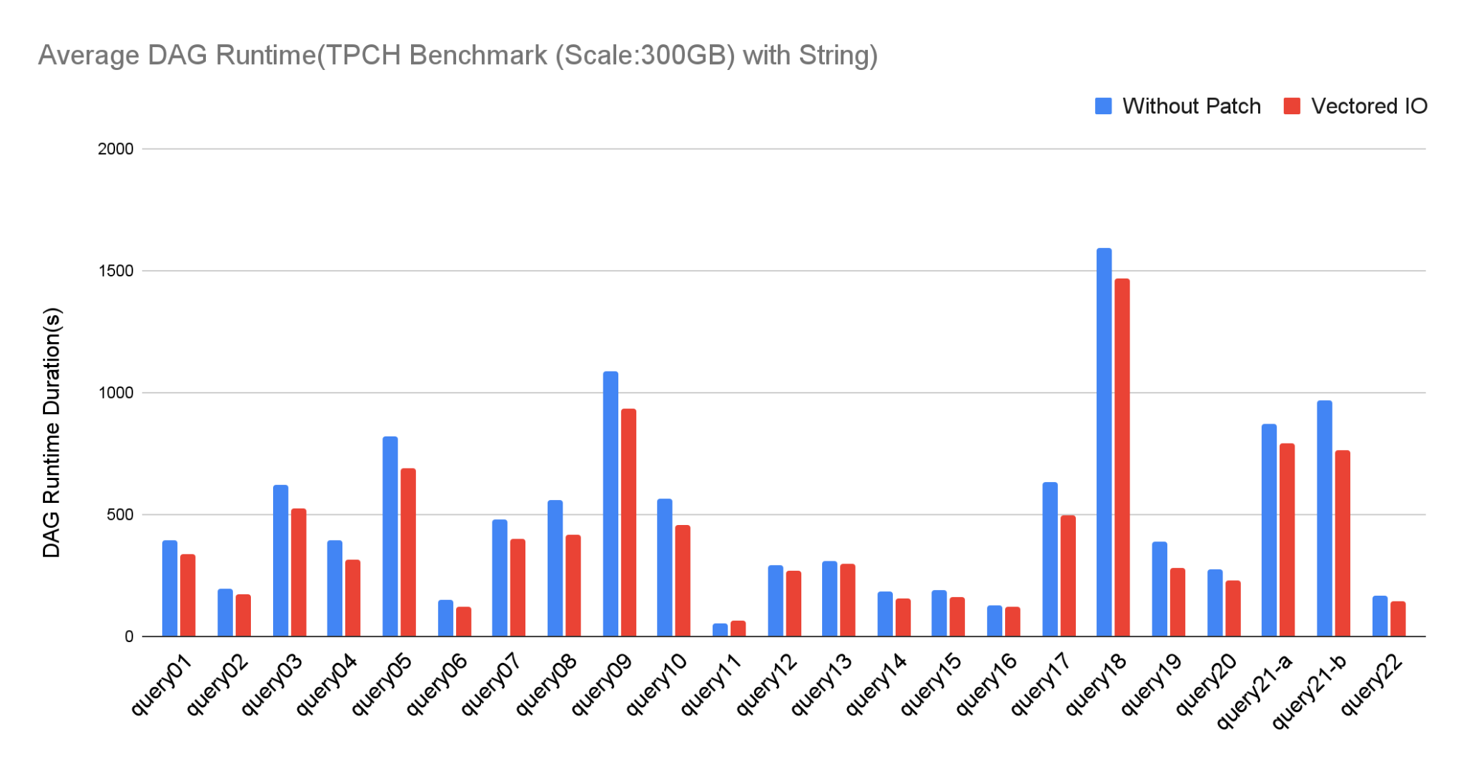
Hive TPCH Benchmark:
10-20% decrease in query runtimes
Notes:
We saw a reduction of 10-20% at least on the overall runtime of each query as can be seen from the graph above. Q11 has a small runtime overall so can be neglected for the sake of comparison.
TPC-H Composite Query-per-Hour Performance Metric (QphH@Size)

Slide 22
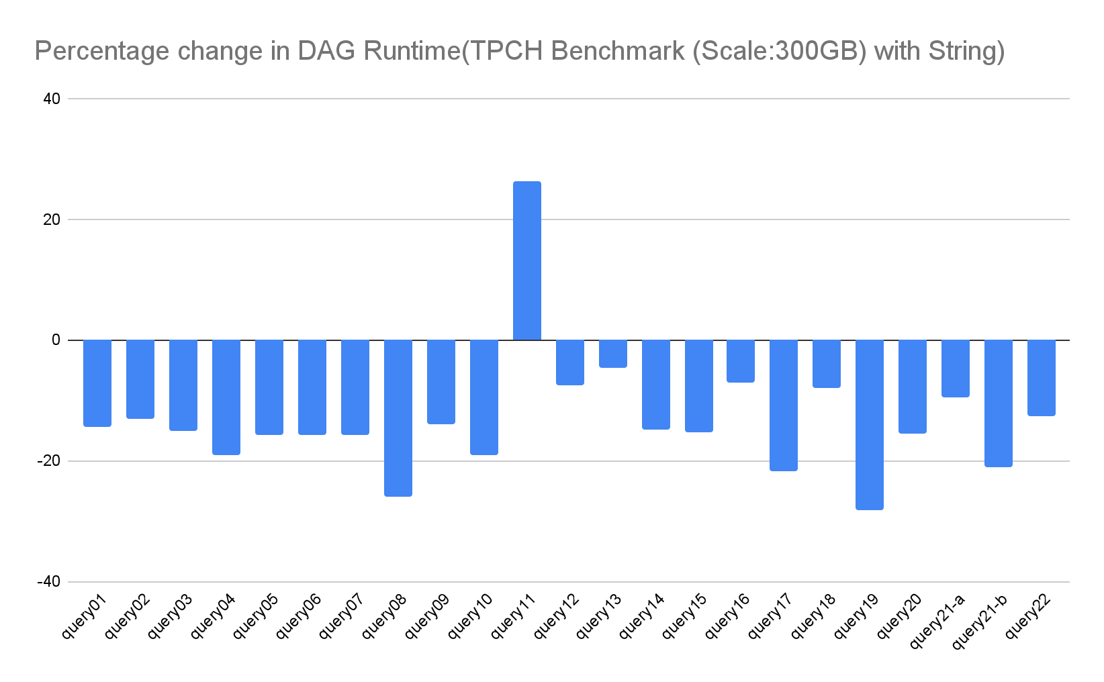
NOTE: Q11 has a small runtime overall ( just few secs) so can be neglected
Notes:
We saw a reduction of 10-20% at least on the overall runtime of each query as can be seen from the graph above. Q11 has a small runtime overall so can be neglected for the sake of comparison.

Slide 23
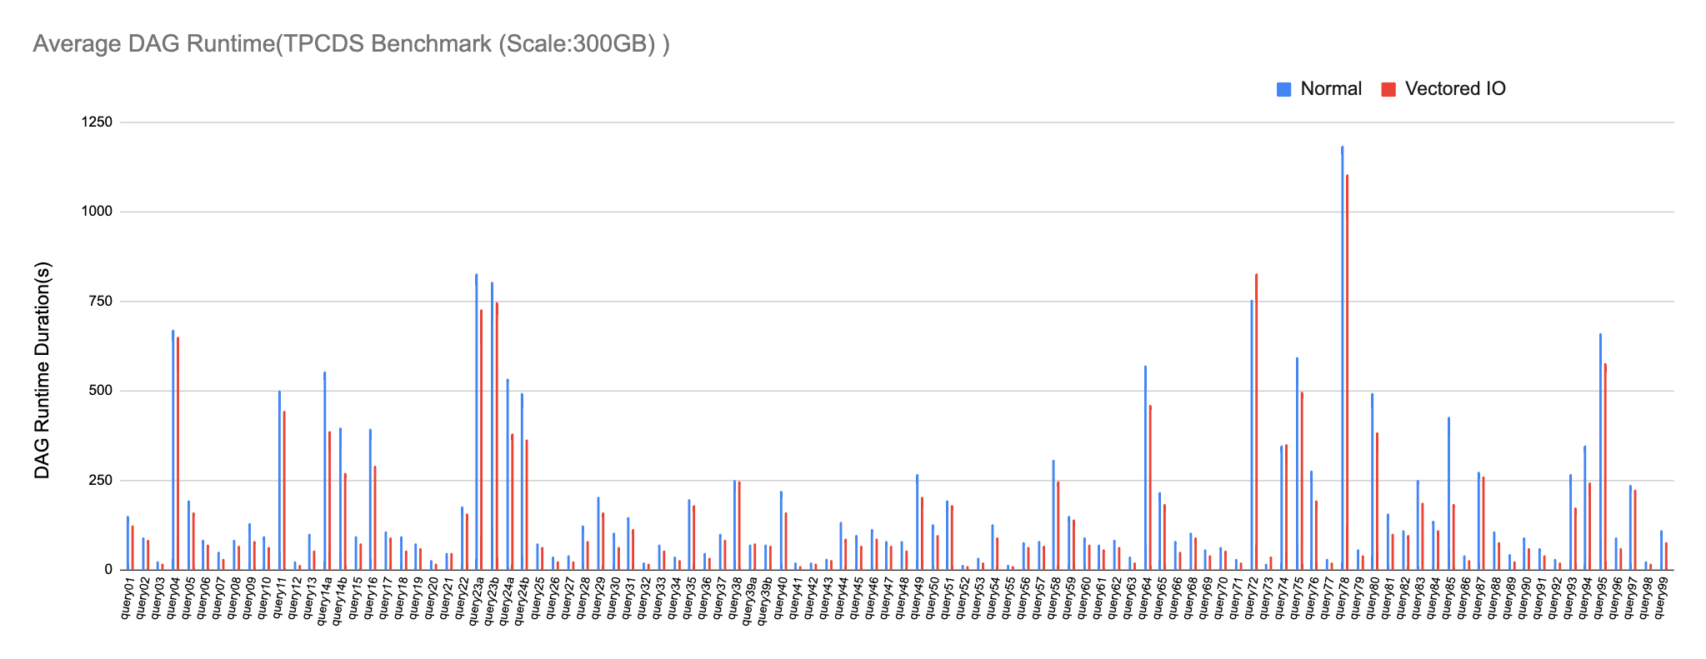
Hive TPCDS Benchmark @ 300GB

Slide 24
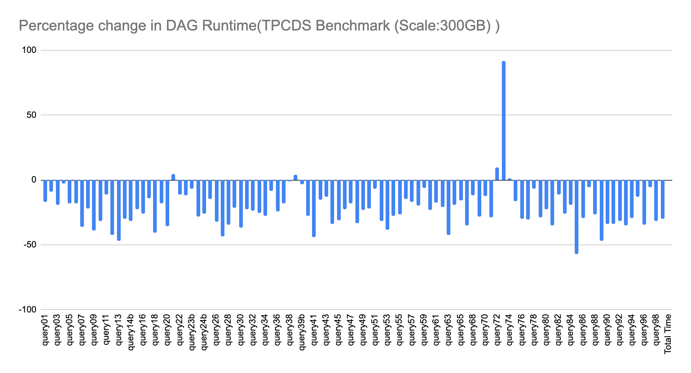
NOTE: Q74 has a small runtime overall ( just few secs) so can be neglected for the sake of comparison. Tez container release time dominated.

Slide 25
Synthetic benchmark of ETL & vectored IO
TPCH benchmarks are too short to show full vectored IO improvements.
Synthetic benchmark to test vectored IO and mimic ETL based scenarios.
Wide string tables with large data reads.
Queries generate up to 33 different ranges on the same stripe

Slide 26
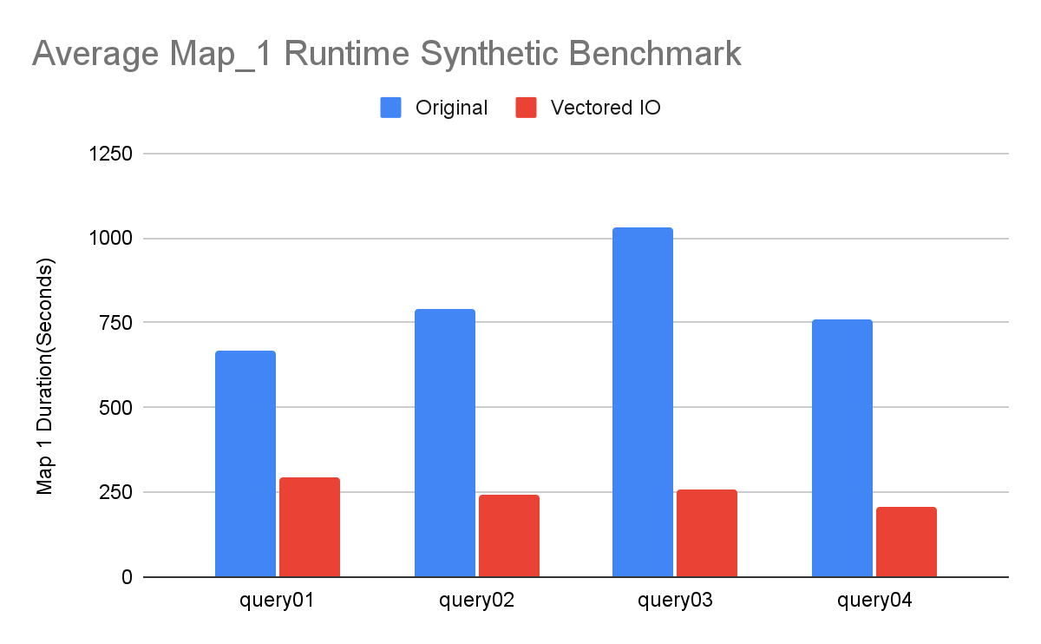
Synthetic benchmark of ETL & vectored IO
Notes:
Scale 250 GB with strings.

Slide 27
Hive ETL benchmark result:
50-70 percent reduction in the mapper runtime with vectored IO.
More performance gains in long running queries. This is because Vectored IO fills the data in each buffer in parallel.
Queries which reads more data shows more speedup.

Slide 28
Shipping in Hadoop 3.3.5!
Available in Hadoop 3.3.5
file:// has local filesystem NIO implementation
S3A does parallel GETs per input stream
Fallback implementation for everything else

Slide 29
Azure and GCS storage: help needed
Azure storage through ABFS
Async 2MB prefetching doesn't do much for columnar formats
Parallel range read would reduce latency
Google GCS through gs://
random/adaptive policies do prefetch and cache footer already
Vectored IO adds parallel column reads
+openFile() supports status and seek policy for Avro and Iceberg.

Slide 30
Problem: the format libraries are stuck
Update the format libraries & the apps get the speedup automatically
ORC-1251. Support VectoredIO in ORC
PARQUET-2171. Implement vectored IO in parquet file format
+Iceberg bundles its own shaded Parquet lib
How to get this into libraries that still want to support Hadoop 2.x?
Cloudera: we can ship our own consistent set of libraries.
WiP: https://github.com/apache/hadoop-api-shim
For now: apply our patches yourself
Notes:
i believe there may be someone from the Parquet team in the audience, and they know what I'm talking about here: I made a change to parquet which used a Hadoop 2.0 method and then someone complained about it breaking their deployments.
the library dev teams don't want to be the ones dictating your updates. But Hadoop 2.x doesn't work completley on java8, and don't even think about java11+.
we need to move on here. And while we do internally, I think it cripples the open source stack.

Slide 31
Conclusions
Vectored IO APIs radically improve processing time of columnar data stored in cloud and local SSD.
Available in Hadoop 3.3.5
Azure and GCS connectors next targets
We need to get support into ORC and Parquet libraries
We need to work together to get support into the ASF releases

Slide 32
Questions?

Slide 33
Backup Slides

Slide 34
Apache Iceberg
Iceberg manifest file IO independent of format of data processed
If ORC/Parquet library uses Vector IO, query processing improvements
As Iceberg improves query planning time (no directory scans), speedups as a percentage of query time *may* improve.
Avro speedups (AVRO-3594, ...) do improve manifest read time.
Even better: PR#4518: Provide mechanism to cache manifest file content

Slide 35
Apache Avro
sequential file reading/processing ==> no benefit from use of the API
AVRO-3594: FsInput to use openFile() API
fileSystem.openFile(path)
.opt("fs.option.openfile.read.policy", "adaptive")
.withFileStatus(status)
.build()
Eliminates HEAD on s3a/abfs open; read policy of "sequential unless we seek()".
(GCS support of openFile() enhancements straightforward...)

Slide 36
Spark support?
Comes automatically with Vector IO releases of ORC/Parquet and Iceberg dependencies
Spark master branch on Hadoop 3.3.5, so ready to play

Slide 37
Apache Impala
Impala already has a high performance reader for HDFS, S3 and ABFS:
Multiple input streams reading stripes on same file in different thread.
Uses unbuffer() to release all client side resources.
Caches the existing unbuffered input streams for next workers.

Slide 38
HDFS Support
Default PositionedReadable implementation works well as latency of seek()/readFully() not as bad as for cloud storage.
Parallel block reads could deliver speedups if Datanode IPC supported this.
Ozone makes a better target
No active work here -yet

Slide 39
CSV
Just stop it!
Especially schema inference in Spark, which duplicates entire read
val csvDF = spark.read.format("csv")
.option("inferSchema", "true") /* please read my data twice! */
.load("s3a://bucket/data/csvdata.csv")
Use Avro for exchange; ORC/Parquet for tables
Notes:
as an exchange format for data it works well; easy to append to. then you can import to orc, parquet, etc.
as it adds its schema to the front (and has a JSON format) it is self describing and can be processed even without precompiling classes off the IDL

Slide 40
HADOOP-18287. Provide a shim library for FS APIs
Library to allow access to the modern APIs for applications which still need to work with older 3.2+ Hadoop releases.
Invoke new APIs on recent releases
Downgrade to older APIs on older Hadoop releases
Applications which use this shim library will work on older releases but get the speedups on the new ones.

