Slide 1
S3A and S3Guard
August 2017

Slide 2
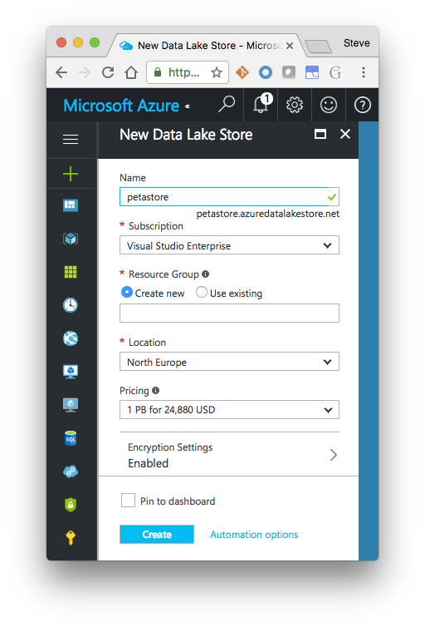
Why Cloud?
No upfront hardware costs – Pay as you use
Elasticity
Often lower TCO
Natural for Data ingress for IoT, mobile apps, ..
Business agility

Slide 3
Shared Data and Cloud Storage
  Cloud Storage is the Shared Data Lake
  For both Hadoop and Cloud-native (non-Hadoop) Apps
  Lower Cost
    HDFS via EBS can get expensive
    HDFS’s role changes
  Built-in geo-distribution and DR
Challenges
  Cloud storage designed for scale, low cost and geo-distribution
  Performance is slower – was not designed for data-intensive apps
  Cloud storage segregated from compute
  API and semantics not like a FS – especially wrt. consistency

Slide 4
Making Object Stores work for Big Data Apps
Focus Areas
  Address cloud storage consistency
  Performance (changes in connectors and frameworks)
  Caching in memory and local storage
Other issues not covered in this talk
  Shared Metastore, Common Governance, Security
across multiple clusters
  Columnar access control to Tabular data
See Hortonworks cloud offering
Also Attend 4pm Talk today “Cloudy with a chance of Hadoop…”
10101
10101010101
01010101010101
0101010101010101010
Shared Data
& Storage

Slide 5

Cloud Storage Integration: Evolution for Agility
Evolution towards cloud storage as the persistent Data Lake
Goal
Application
Application
Application
Input
Output
Output
Input
Input
tmp
HDFS
HDFS
HDFS
Output
Backup
Restore
Upload
AWS –today ->>>>>
Azure
Notes:
on prem = 1
azure @ 3
AWS @ 2
There are also some problems in using S3 to replace HDFS esp for high perfm apps . . For example, HDFS provides much larger read/write throughput, and provides strong file system guarantees. We will talk about the practical problems shortly.
Actually, they have different pros and cons for difference use cases, and fortuantely they are not mutually exclusive. We suggest our customers use the right storage at the right place.

Slide 6
Some Use Cases
Notes:
In all the examples, object stores take a role which replaces HDFS. But this is dangerous, because...

Slide 7






Elastic ETL
external
inbound
ORC
datasets
HDFS (temp)
Notes:
This is one of the simplest deployments in cloud: scheduled/dynamic ETL. Incoming data sources saving to an object store; spark cluster brought up for ETL. Either direct cleanup/filter or multistep operations, but either way: an ETL pipeline. HDFS on the VMs for transient storage, the object store used as the destination for data —now in a more efficient format such as ORC or Parquet

Slide 8



Notebooks
external
datasets
library
HDFS (temp)
Notes:
Notebooks on demand. ; it talks to spark in cloud which then does the work against external and internal data;
Your notebook itself can be saved to the object store, for persistence and sharing.

Slide 9




Streaming
Flink, Spark,
Storm
Notes:
Example: streaming on Azure
+ on LHS add streaming

Slide 10
Danger:
Object stores are not filesystems
Cost & Geo-distribution over
Consistency and Performance
Notes:
In all the examples, object stores take a role which replaces HDFS. But this is dangerous, because...

Slide 11
A Filesystem: Directories, Files → Data
/
work
00
01
pending
complete
00
part-00
part-01
part-01
01
00
01
rename("/work/pending/part-01", "/work/complete")
Notes:
This pictureis classic HDFS – 3 replicas and metadata
First off all there are no real directories in S3 – the directory names are part of the file name – Cloud object store does not treat “/” as a special separator.
Here in the rename all you expect is that the data remains and simply some metadata change – that is what happens in HDFS but no so in S3

Slide 12
Object Store: hash(name)⇒data
hash("/work/pending/part-00")
["s01", "s02", "s04"]
s01
s02
hash("/work/pending/part-01")
["s02", "s03", "s04"]
00
01
01
00
copy("/work/pending/part-01",
"/work/complete/part01")
s03
s04
delete("/work/pending/part-01")
01
00
01
01
01
Notes:
There is no rename operation – a copy and delete has to be done
The copied data is new (Yellow)
The deleted data (Orange)

Slide 13
Object Store: REST APIs
PUT /work/pending/part-01
... DATA ...
s01
s02
GET /work/pending/part-01
Content-Length: 1-8192
00
01
00
PUT /work/complete/part01
x-amz-copy-source: /work/pending/part-01
s03
s04
DELETE /work/pending/part-01
00
01
HEAD /work/complete/part-01
01
GET /?prefix=/work&delimiter=/

Slide 14
Often: Eventually Consistent
s01
s02
GET /work/pending/part-00
00
01
200
00
DELETE /work/pending/part-00
200
s03
s04
01
00
GET /work/pending/part-00
01
200
Notes:
You might say – big deal the data in pending is deleted later – but imaging if you did direct output connector and was deleting failed task output
Also same problem can occur for new data you added.

Slide 15
Eventual Consistency problems
When listing a directory
  Newly created files may not yet be visible, deleted ones still present
After updating a file
  Opening and reading the file may still return the previous data
After deleting a file
  Opening the file may succeed, returning the data
While reading an object
  If object is updated or deleted during the process

Slide 16
The dangers of Eventual Consistency and Atomicity
Temp Data leftovers
  Annoying Garbage or Worse if direct output committer is used
List inconsistency means new data may not be visible
Lack of atomic rename() can leave output directories inconsistent
You can get bad or missing data and not even notice
Especially if only a portion of your large data is missing
Notes:
We will come back to the inconsistency problem and the new S3Guard

Slide 17





org.apache.hadoop.fs.FileSystem
hdfs
wasb
s3a
swift
adl
gs
Notes:
Everything uses the Hadoop APIs to talk to both HDFS, Hadoop Compatible Filesystems and object stores; the Hadoop FS API. There's actually two: the one with a clean split between client side and "driver side", and the older one which is a direct connect. Most use the latter and actually, in terms of opportunities for object store integration tweaking, this is actually the one where can innovate with the most easily.
HDFS is "real" filesystem; WASB/Azure close enough. What is "real?". Best test: can support HBase.

Slide 18



2006
2007
2008
2009
2010
2011
2012
2013
2014
2015
2016
2017
s3:// —“inode on S3”
History of Object Storage Support
s3n://
“Native” S3
s3://
Amazon EMR S3
(proprietary)
swift://
OpenStack
s3a:// Replaces s3n
gs://
Google Cloud
wasb://
Azure WASB
Phase I: Stabilize S3A
Phase II: speed & scale
adl://
Azure Data Lake
oss://
Aliyun
Phase III: scale & consistency
Notes:
This is the history

Slide 19
Cloud Storage Connectors
Azure | WASB | Strongly consistent Good performance Well-tested on applications (incl. HBase)
 | ADL | Strongly consistent Tuned for big data analytics workloads
Amazon Web Services | S3A | Eventually consistent - consistency work in progress by Hortonworks Performance improvements recently and in progress Active development in Apache
 | EMRFS | Proprietary connector used in EMR Optional strong consistency for a cost
Google Cloud Platform | GCS | Multiple configurable consistency policies Currently Google open source Good performance Could improve test coverage

Slide 20
Problem: S3 Analytics is too slow/broken
Analyze benchmarks and bug-reports
Optimize the non-io metadataops (very cheap on HDFS)
Fix Read path for Columnar Data
Fix Write path
Improve query partitioning
The Commitment Problem

Slide 21
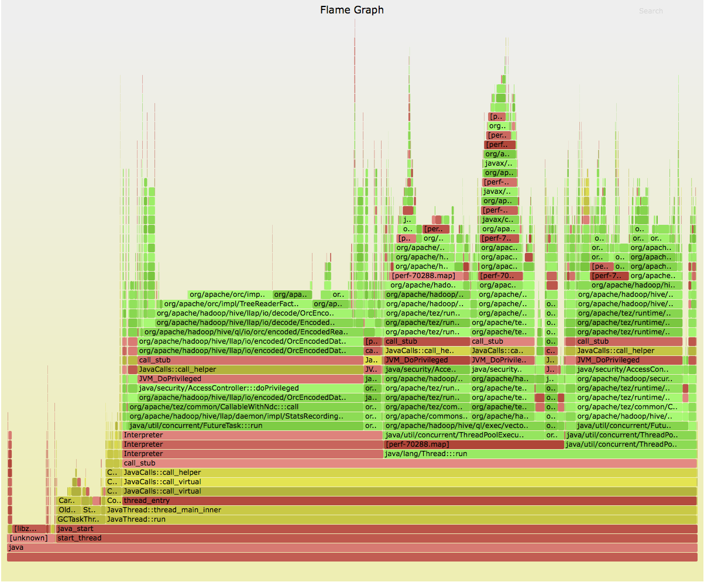
LLAP (single node) on AWS
TPC-DS queries at 200 GB scale
getFileStatus()
read()
readFully(pos)
Notes:
Here's a flamegraph of LLAP (single node) with AWS+HDC for a set of TPC-DS queries at 200 GB scale; we should stick this up online
only about 2% of time (optimised code) is doing S3 IO. Something at start partitioning data

Slide 22
The Performance Killers
getFileStatus(Path) (+ isDirectory(), exists())
HEAD path // file?
HEAD path + "/" // empty directory?
LIST path // path with children?
read(long pos, byte[] b, int idx, int len)
readFully(long pos, byte[] b, int idx, int len)
listFiles(Path)
rename(source, dest)

Slide 23
Positioned reads: close + GET, close + GET
read(long pos, byte[] b, int idx, int len)
throws IOException {
long oldPos = getPos();
int nread = -1;
try {
seek(pos);
nread = read(b, idx, len);
} catch (EOFException e) {
} finally {
seek(oldPos);
}
return nread;
}
seek() is the killer, especially the seek() back
Notes:
Why so much seeking? It's the default implementation of read

Slide 24
HADOOP-12444 Support lazy seek in S3AInputStream
public synchronized void seek(long pos)
throws IOException {
nextReadPos = targetPos;
}
+configurable readhead before open/close()
<property>
<name>fs.s3a.readahead.range</name>
<value>256K</value>
</property>
But: ORC reads were still underperforming

Slide 25
Hadoop 2.8/HDP 2.6 transforms I/O performance!
// forward seek by skipping stream
fs.s3a.readahead.range=256K
// faster backward seek for Columnar Storage
fs.s3a.experimental.input.fadvise=random
// Write-IO - enhanced data upload (parallel background uploads)
// Additional flags for mem vs disk
fs.s3a.fast.output.enabled=true
fs.s3a.multipart.size=32M
fs.s3a.fast.upload.active.blocks=8
// Additional per-bucket flags
—see HADOOP-11694 for lots more!
Notes:
without going into the details, here are things you will want for Hadoop 2.8. They are in HDP 2.5, possible in the next CDH release.
The first two boost input by reducing the cost of seeking, which is expensive as it breaks then re-opens the HTTPS connection. Readahead means that hundreds of KB can be skipped before that connect (yes, it can take that long to reconnect). The experimental fadvise random feature speeds up backward reads at the expense of pure-forward file reads. It is significantly faster for reading in optimized binary formats like ORC and Parquet
The last one is a successor to fast upload in Hadoop 2.7. That buffers on heap and needs careful tuning; its memory needs conflict with RDD caching. The new version defaults to buffering as files on local disk, so won't run out of memory. Offers the potential of significantly more effective use of bandwidth; the resulting partitioned files may also offer higher read perf. (No data there, just hearsay).

Slide 26
HADOOP-13203: fs.s3a.experimental.input.fadvise
// Before
request = new GetObjectRequest(bucket, key)
.withRange(pos, contentLength - 1);
// after
finish = calculateRequestLimit(inputPolicy, pos,
length, contentLength, readahead);
request = new GetObjectRequest(bucket, key)
.withRange(pos, finish);
High performance random IO for column data
Notes:
A big killer turned out to be the fact that if we had to break and re-open the connection, on a large file this would be done by closing the TCP connection and opening a new one.
The fix: ask for data in smaller blocks; the max of (requested-length, min-request-len).
Result: significantly lower cost back-in-file seeking and in very-long-distance forward seeks, at the expense of an increased cost in end-to-reads of a file (gzip, csv).
It's an experimental option for this reason; I think I'd like to make it an API call that libs like parquet & orc can explicitly request on their IO: it should apply to all blobstores

Slide 27
Every HTTP request is precious
HADOOP-13162: Reduce number of getFileStatus calls in mkdirs()
HADOOP-13164: Optimize deleteUnnecessaryFakeDirectories()
HADOOP-13406: Consider reusing filestatus in delete() and mkdirs()
HADOOP-13145: DistCp to skip getFileStatus when not preserving metadata
HADOOP-13208: listFiles(recursive=true) to do a bulk listObjects
see HADOOP-11694
Notes:
If you look at what we've done, much of it (credit to Rajesh & Chris) is just minimising HTTP requests. Each one can take hundreds of millis, sometimes even seconds due to load balancer issues (tip: reduce DNS TTL on your clients to <30s). A lot of the work internal to S3A was culling those getFileStatus() calls by (a) caching results, (b) not bothering to see if they are needed. Example: cheaper to issue a DELETE listing all parent paths than actually looking to see if they exist, wait for the response, and then delete them.
The one at the end, HADOOP-13208, replaces a slow recursive tree walk (many status, many list) with a flat listing of all objects in a tree. This works only for the listStatus(path, true) call —to be benefit you need to use that API call, not do your own treewalk.

Slide 28
Write Pipeline
PUT blocks as part of a multipart
Parallel uploads during data creation
Buffer to disk (default), heap or byte buffers
Great for distcp
fs.s3a.fast.upload=true
fs.s3a.multipart.size=32M
fs.s3a.fast.upload.active.blocks=8

Slide 29
S3guard
Fast, consistent S3 metadata
HADOOP-13445
Notes:
Recap – S3 is eventually cinsistent

Slide 30
S3Guard: Fast And Consistent S3 Metadata
Goals
  Provide consistent list and get status operations on S3 objects written with S3Guard enabled
    listStatus() after put and delete
    getFileStatus() after put and delete
  Performance improvements that impact real workloads
  Provide tools to manage associated metadata and caching policies.
Again, 100% open source in Apache Hadoop community
  Hortonworks, Cloudera, Western Digital, Disney …
Inspired by Apache ­licensed S3mper project from Netflix
Seamless integration with S3AFileSystem

Slide 31

Use DynamoDB as fast, consistent metadata store
HEAD part-00
200
s01
s02
00
01
DELETE part-00
200
00
00
s03
s04
HEAD part-00
404
01
00
01
PUT part-00
200
Notes:
Details about out-of-band, and source of truth etc.

Slide 32
Installation and use
Provision a DynamoDB table in same region as HDC cluster & buckets
(best cost/IO resilience through shared table across >1 bucket)
Enable S3Guard in clients
Authoritative mode = fastest —but can we trust it yet?

Slide 33
Settings
<property>
<name>fs.s3a.metadatastore.impl</name>
<value>org.apache.hadoop.fs.s3a.s3guard.DynamoDBMetadataStore</value>
</property>
<property>
<name>fs.s3a.s3guard.ddb.table</name>
<value>ireland-team</value>
</property>
<property>
<name>fs.s3a.metadatastore.authoritative</name>
<value>false</value>
</property>

Slide 34
hadoop s3guard
hadoop s3guard init -meta dynamodb://ireland-team s3a://ireland-1
hadoop s3guard import s3a://ireland-1
hadoop s3guard diff s3a://ireland-1
hadoop s3guard destroy s3a://ireland-1
hadoop s3guard prune -days 7 s3a://ireland-1
(see also DynamoDB TTL option)

Slide 35
Dynamic table creation
<property>
<name>fs.s3a.s3guard.ddb.table.create</name>
<value>true</value>
</property>
<property>
<name>fs.s3a.s3guard.ddb.table.capacity.read</name>
<value>10</value>
</property>
<property>
<name>fs.s3a.s3guard.ddb.table.capacity.write</name>
<value>10</value>
</property>
Better to share table, explicitly create, monitor in AWS console

Slide 36
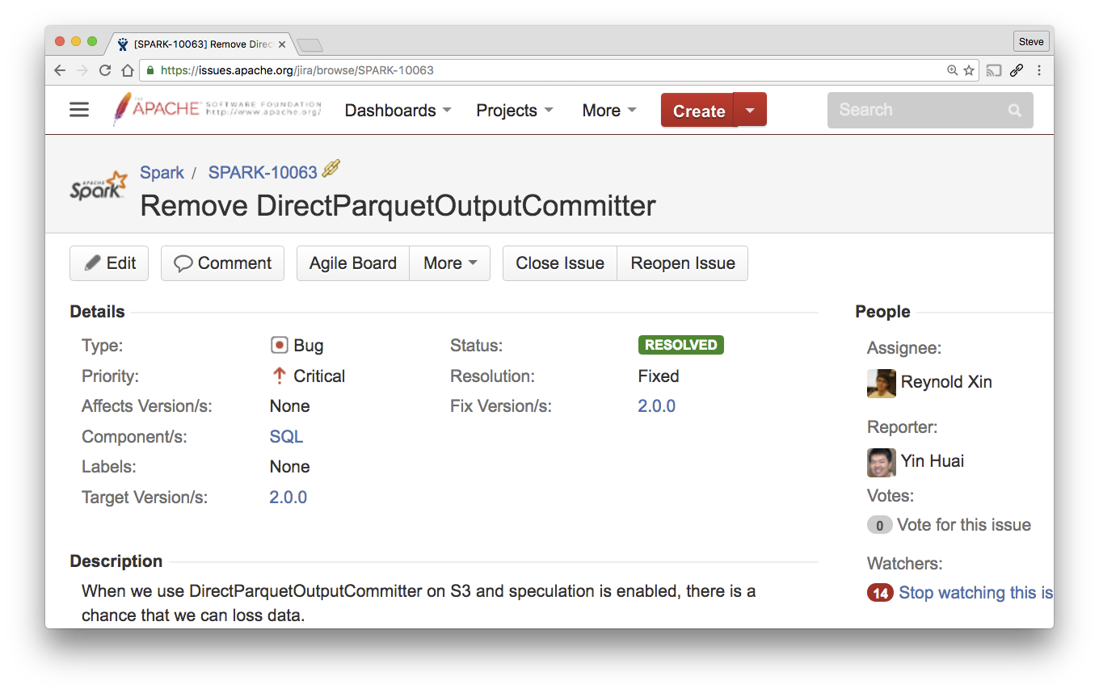
Spark's Direct Output Committer? Risk of Corruption of data
Notes:
This invariably ends up reaching us on JIRA, to the extent I've got a document somewhere explaining the problem in detail.
It was taken away because it can corrupt your data, without you noticiing. This is generally considered harmful.

Slide 37
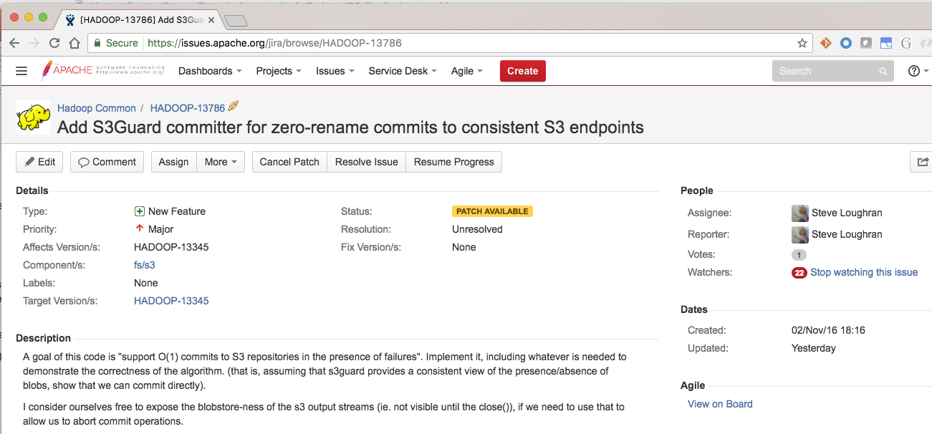

Slide 38
Netflix Staging Committer
Saves output to file://
Task commit: upload to S3A as multipart PUT —but does not commit the PUT, just saves the information about it to hdfs://
Normal commit protocol manages task and job data promotion in HDFS
Final Job committer reads pending information and generates final PUT
—possibly from a different host
Outcome:
No visible overwrite until final job commit: resilience and speculation
Task commit time = data/bandwidth
Job commit time = POST * #files

Slide 39
Availability
Read + Write in HDP 2.6 and Apache Hadoop 2.8
S3Guard: preview of DDB caching in HDC
Commit to ASF trunk/branch-2 this month
...then backport
Zero-rename commit: work in progress

Slide 40
Big thanks to:
Rajesh Balamohan
Mingliang Liu
Chris Nauroth
Dominik Bialek
Ram Venkatesh
Everyone in QE, RE
+ everyone who reviewed/tested, patches and added their own, filed bug reports and measured performance

Slide 41
Questions?
stevel@hortonworks.com @steveloughran
sanjay@hortonworks.com @srr

