Slide 1


the wondrous curse of interoperability
what interop is,
and how to cope
steve loughran
hp laboratories
slo@hplb.hpl.hp.com
january 2003
Notes:
presentation for padnug,org; http://www.padnug.org/padnug/WebServicesSIG.aspx
Interop: What were they thinking of?

Slide 2
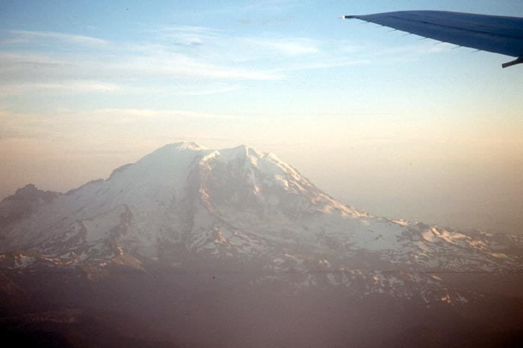
why is S/W dev like mountaineering?
all looks fine from 30,000'
vision
Notes:
A bit of a distraction before we get into the detail, with the definitive mountaineering metaphor slideshow.
Most uses of mountaineering 'many people work on an Everest expedition, only two summit' are done by HR and managers who don’t know the details of modern Alpinism. But I do, so here is a comparison accompanied by photos mostly from Ranier, some from Mt Hood and one from the Alps (Ecrins Massif).

Slide 3
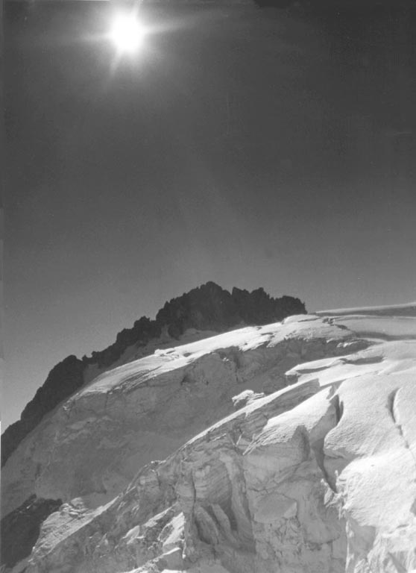
up close it's terrifying
reality

Slide 4
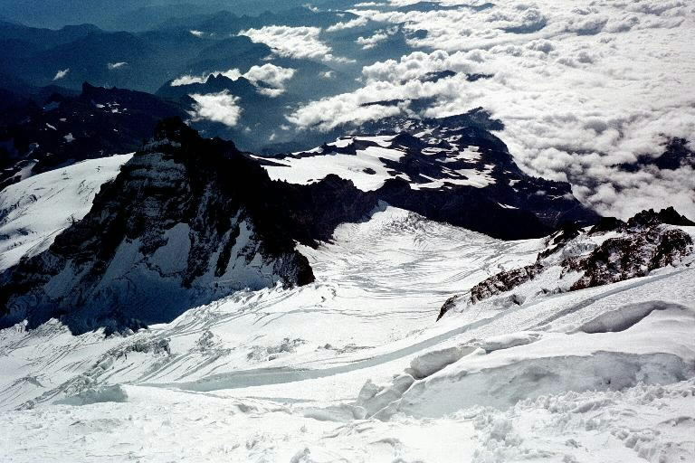
and it is too late to turn back
commitment!
Notes:
The only way out is through.

Slide 5

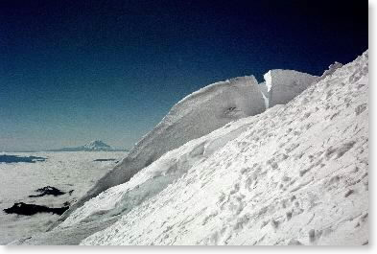
how do you survive?
equipment
process
practice
planning
fear management
Notes:
There is one big difference: get it wrong in the mountains and you are dead, survivors make money selling airport books about near-death-experiences, for reading by passengers who don’t find fly-by-wire planes programmed by us developers scary enough.
Get it wrong in most software projects and you are still alive, just with a different employer. And those who survive in the same company end up vilified and fielding support calls.

Slide 6

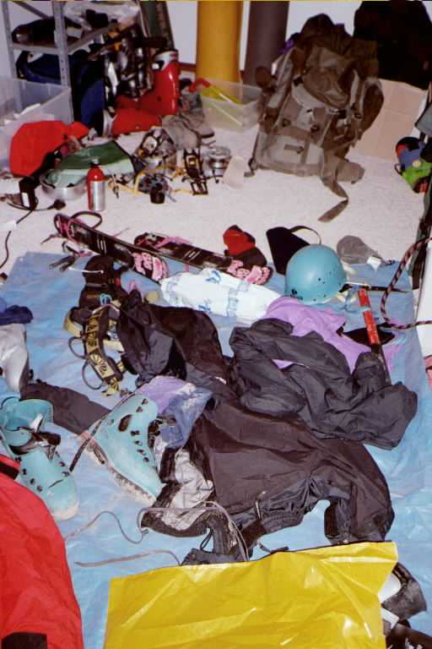
equipment
good CPU, lots of RAM, HDD, WLAN...
IntelliJ IDEA
WSDL editor
Ant+JUnit/HttpUnit/Cactus
cellphone & caffeine
Continuous Integration
Automated Deployment
Notes:
Note that a cellphone actually goes onto the list of both types of entertainment.

Slide 7

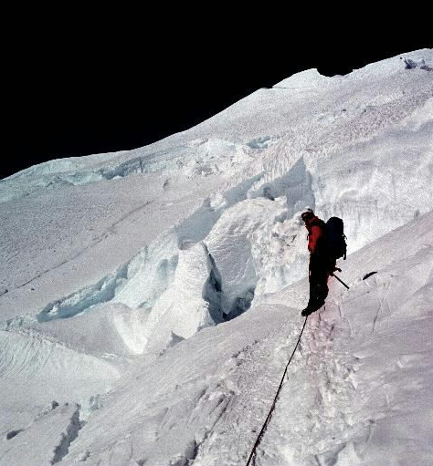
process, planning, preparation
alpine starts
speed
maps, milestones, checkpoints
practice: crevasse rescue, first aid, navigation in zero-visibility, snow-caves...
heaviest person goes first
Notes:
-Set off early so that if anything goes pear shaped you have most of the day
-know what your objectives are, have maps, milestones, don’t be afraid to replan
-don’t climb Rainier (or even Mt hood) without some practice under your belt. And that means more than practice of nice weather days out; you need to practice things going wrong: crevasse rescue, bad weather days, dehydration days.
-send the person most likely to fall into a crevasse first. Its better for everyone if things go wrong ahead rather than behind or in the middle of the team. This doesn’t mean they are expendable, just more likely to find problems.
Which brings us to web services, interop and the testing, thereof.

Slide 8

the
Web Services vision
XML over HTTP lets everything talk to everything else
Notes:
the 30,000' view

Slide 9

problem:
sometimes it gets a bit "technical"
Notes:
Up close.
Good days ::= days when the network is good, person writing the service knew what they were doing, no attempt to share binaries, manage sessions, etc.

Slide 10
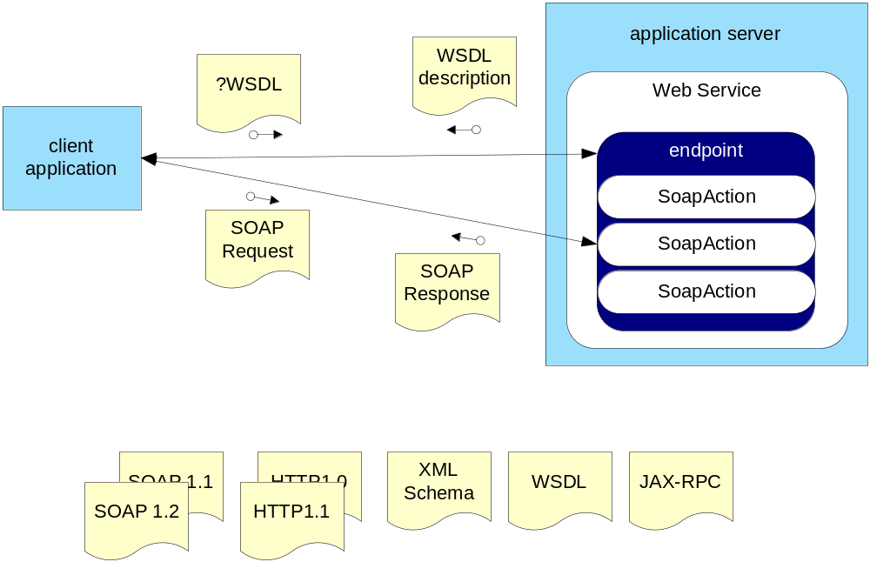
Web Services: quick summary
.NET
Axis
Pocket-SOAP
JAX-RPC RI
SOAP::Lite
kSOAP
gSOAP
MS STK
...
many specs
many languages + many implementations = interop problems
Notes:
if you are ignorant of SOAP, here is the one page reminder. note that WSDL is optional, SOAP messages have envelopes, headers and bodies, and there are two ways of encoding stuff: RPC/Encoded and DOC/literal

Slide 11

key problem: naïve and unrealistic expectations
you can't send things like java.io.File over the wire.
you shouldn’t send serializable objects like javax.swing.JPanel over the wire.
you can't do transactions (yet)
there is no good authentication system (yet? ever?)
SOAP is not Corba, RMI, RMI-IIOP, .NET remoting, DCOM(+), or any other classic
remote object invocation mechanism

Slide 12
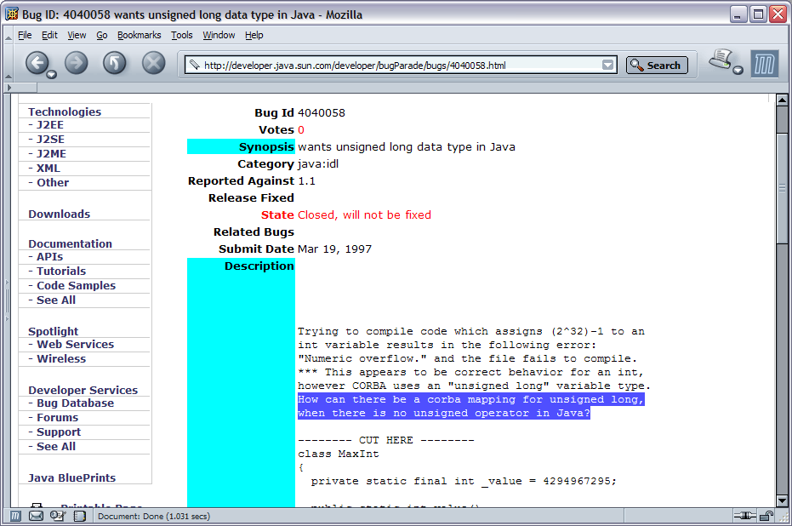
primitive data types
uint, ulong, char
[WebMethod]
public ulong Increment(ulong counter) {
return counter+1;
}
[WebMethod]
public char GetChar() {
return (char)(32+random.Next(64));
}
Java bug database bug # 4186775
"The omission of unsigned integral types from Java is somewhat controversial,
but they are in fact inessential, if perhaps convenient nonetheless."
Notes:
Sun don’t think you need unsigned datatypes, therefore you cant work with any service that uses them.
XSD doesn’t have a char datatype, so there isn't a standard way to send them over the wire.
"What were they thinking of?"

Slide 13
enumerations
C# bitfield enums
[Flags]
public enum Rating : int {
unknown=0, fun=1, scary=2, hard=4, painful=8
}
[WebMethod]
public Rating HowWasIt(String route) {
return (Rating)random.Next((int)Rating.painful*2);
}
are marshalled as an XML Schema list
<>fun scary hard</>
that many things (Axis, Castor) cannot handle yet
Notes:
We can't even do enums reliably if the far end cant handle the XSD space-separated-list-in-an-XML-element form of lists.
This isnt a fundamental issue, just an engineering one.

Slide 14

exceptions
how do you send exceptions down the wire
how does the far end handle them?
what about extra data in a SoapFault?
what about languages with no notion of exceptions?
JAX-RPC tries to send any Exception over the wire.
axis: throw AxisFault with info in the details
Notes:
See the JAX-RPC spec for Java exception handling. Basically JAX-RPC is trying to marshall Java exceptions in a way that they can be recreated. This is because Java methods need to state the exceptions they throw, the exception set can be included in the WSDL, client versions written, etc. But how does this work across languages? How does it work across implementations of JAX-RPC?

Slide 15

framework objects and collections
ArrayList
DataSet
java.util.HashTable
"the hashtable problem"
Notes:
The problem here is that just because you can send stuff over the wire, doesn’t mean the far end can handle it. Sometimes they cant, sometimes they can, but not by creating the obvious bindings you'd expect.

Slide 16

sessions
cookies
SoapHeaders
dynamic endpoints
sessionID in API
-W3C push for SOAP GET is incompatible with SOAP Headers
-WSDL for dynamic endpoints?
-we need a SoapHeader standard
[WebMethod(
EnableSession=true
)]
stub.
setMaintainSession(true)
Notes:
The flaws with cookies are well known, with the extra caveat that whoever maintains java.net.UrlConnection has never read the bit of the HTTP spec that covers them. For that, the pains with different paths to the service serving up cookies differently, makes them something to avoid. Also not all clients support them, and it aint always by default. e.g Apache Axis, you must enable it client side.
SoapHeaders are the cleaner and more elegant way. But it does require
Dynamic endpoints: returning new URLs after a login. I like this model, but it is hard to work with, too 'RESTful'; but maps nicely to objects. .NET remoting gives you this.
API: include session ID in messages. Ugly, at odds with AOP, but works well, works consistently, and is easily tested. Guess which I use.
see W3c: http://www.w3.org/TR/soap12-part0/ on the subject of SOAP and GET
"What were they thinking of?"

Slide 17
no attachments in
Basic .NET 1.0
binaries:
SOAP with Attachments (SwA) is in JAX-RPC
DIME is in WS-toolkit for .NET
Axis: SwA and DIME
(but not WSDL)
base-64 is the fallback
 | SwA | DIME
Axis | ✓ | ✓
Sun JWSDP | ✓ | ✗
.NET 1.0 | ✗ | ✗
.NET WSE | ✗ | ✓
Notes:
You could maybe point the blame at this for XML; there is no way to reliably include arbitrary binary code in an XML file. If only they'd had a length+data way of encoding binary, life would be simple.
The other blame is at Team .NET for leaving out SwA because DIME was better. Maybe it is, but they didn’t ship with DIME either. So leaving out SwA was either a schedule driven play or an attempt to stop SwA becoming ubiquitous.
For now: xs:base64binary, xs:hexBinary. But try sending 2GB of print data in base 64 format. Actually, try sending 2GB of data in any SOAP attachment format.

Slide 18
other surprises
RPC/ENC versus DOC/LIT
floating point: decimal places, infinity
DateTime & timezones
object references
ragged arrays
Sun's JAX-RPC reference implementation bails out if it can't handle all methods at an endpoint.
Notes:
This is just other little showstoppers that will hurt you if you are not careful.

Slide 19

why did we get into this mess?
Web Services grew by accretion, not planning.
nobody wants to scare developers off.
coding 'IDL' is considered harder than exporting methods.
closed world systems (DCOM, RMI) don’t have interop issues.
Notes:
From a CS perspective, SOAP+XSD+WSDL is ugly, only their mothers would love them, and even then they'd hope the next kid will look better.
But ugly is irrelevant.
(nb, notice that Corba can have interop; but when used as a C++ to C++ system it is generally ok, because everything is well specified in the very large CORBA spec and its mostly one language everywhere)

Slide 20

there is no point writing a Web Service unless you want interoperability
Notes:
Why are you writing a web service unless you want people to call you? And can you dictate what language they will be using, or do you want all customers, regardless of what they call you with.
But lets look at what we have:
+finding: UDDI, WSIF, SLAv2)
+binding: WSDL
+invocation: SOAP
+data representation: XSD
The finding and binding features of SOAP, indeed WSDL on its own, are what makes SOAP so interesting today. The fact that interop is a big issue is a detail, compared to the profound notion that you can browse to a web page, download some description of endpoints and suddenly start posting structured data to it.

Slide 21

who can fix this?
the architects: W3C, WS-I
the engineers: SoapBuilders
you
Notes:
WS-I: I havent seen an enum or session working group here, that is the kind of implementation detail that architects don’t bother with. Plus WS-I is very political.
SoapBuilders: This is where interop does seem to get solved. But we could do with Collections, exceptions, , char, enum and a big fat 'guide to interoperability' paper
Axis: well, you are axis devs if you are users; work with us on the docs, exceptions, better interop tests, etc.
W3C: add xml headers to HTTP GET s.t. SOAP GET works; char on Schema.
Sun: give us unsigned data, add HashTable &c to JAX-RPC, fix the exceptions model.
MS: Give us SwA on .NET, document DataSet, add HashTable &c. Oh, and Zip support too; you can't send or receive zipped data right now.
You: fix your own app to not have interop issues.

Slide 22

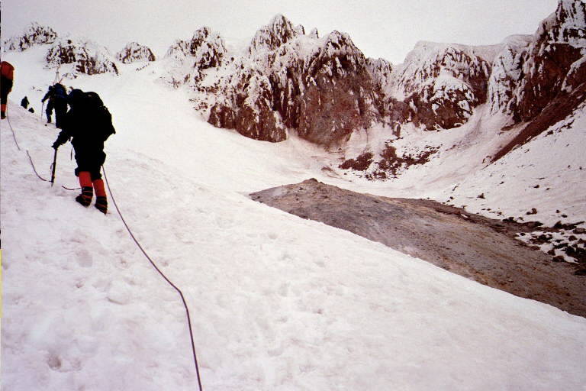
stay out of trouble
understand the nature of the problem
avoid the big issues
drive off the XSD & WSDL
test for interop
Notes:
Question: what are the hazards in this picture, taken below the summit of Mt Hood?
Most people think of the usual ice and rock problems, but a big safety issue here is that bare patch of rock to the centre-right of the scene. Anything at that angle at that altitude should normally be covered in snow –but it isnt. This could be because of an avalanche, but there is no crown-wall, and you'd expect to see the base layer of snow unless the low-friction base was actually frozen turf.
The reason the rocks are bare is because we are climbing a volcano, this is the crater, and they are being heated by gases coming up from below. The atmosphere near the rocks is too toxic to be breathable. If you have done your research, you know this. If you haven't, and you go over to take a look, you are in trouble.

Slide 23

avoid the big issues
no unsigned datatypes, char, enums
don’t send fancy objects
stick to your own simple 'structs' and arrays
support multiple binary upload mechanisms
worry about sessions
Notes:
This is all very dumbed down, but it is pragmatic. Arrays work. Simple objects with attributes and get/set methods work.
If you keep everything simple and avoid well known trouble spots, all should work

Slide 24
start with the XML Schema
the schema defines your serialization format
this should be independent of use (files, SOAP, REST)
but you must use the subset of that interoperates over SOAP.

Slide 25

drive off the WSDL
create a WSDL file using the Schema
create server stubs from the WSDL
just as if you were writing an IDL specification
only uglier
Notes:
This is a hard one. I hate looking at WSDL, it is just so convoluted. Same for XSD, though that one I can handle, slowly, even if something like XML Spy or VS.NET is needed to make it easier. Omniopera and CapeClear are alternatives.
One q: Why do you need to buy a new tool to edit WSDL files? Was there ever such a thing as an IDL editor other than a text editor? And so somehow WSDL is better than IDL? I don’t understand that.

Slide 26
test for interop
pick the likely 'other' platforms
generate client bindings from the WSDL
write test cases to call the service.
compile, run, fix
repeat
Notes:
The way to test for interop is to call your service from different toolkits and languages, which means replicating the usual client coding process.
To do this in a test case environment, you need to automate the process.
I'm going to look at automating the Java side test process

Slide 27

ant
JUnit
jakarta.apache.org/Ant
imports WSDL
<wsdltodotnet>
<axis-wsdl2java>
automated build and test with CruiseControl, Gump, Anthill
unit test framework from junit.org
httpunit: adds http functional testing
Axis can generate JUnit tests from WSDL
Notes:
These two tools are the secret of why Java projects are staying in control; everyone is using the same test framework, and the same build tools, tools that understand testing is integral. Together nothing gets deployed that doesn’t pass the tests.
As well as using them for pure Java dev, we can use them for .NET interop testing.

Slide 28

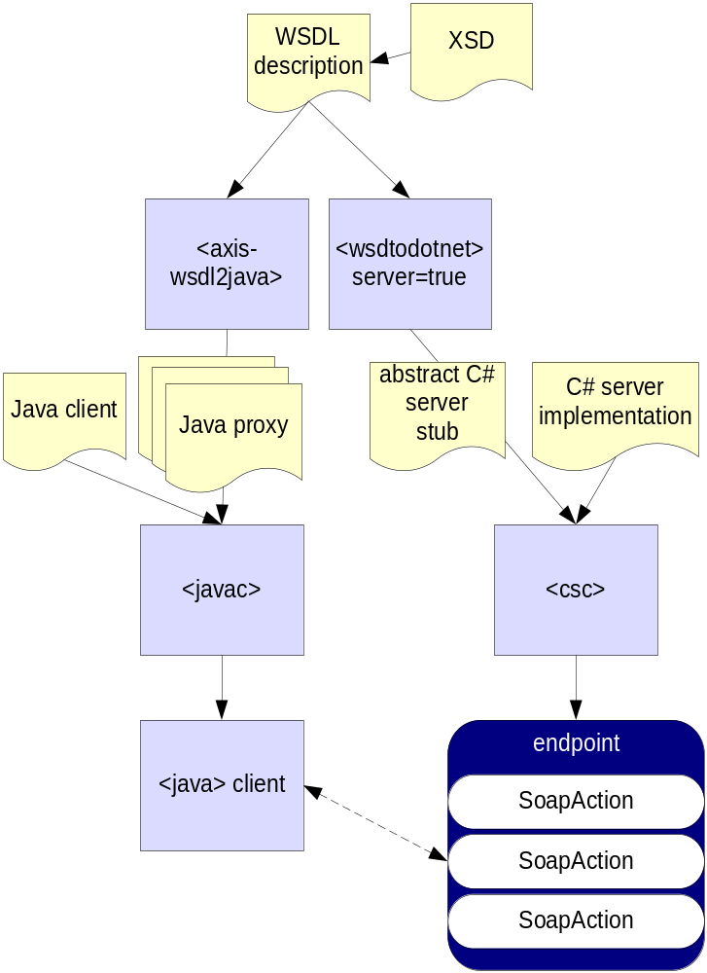
drive off the WSDL
Notes:
I'm not going to demo this, just show that you can work with Schema and WSDL as if it were an IDL spec of a service, that both the service and the clients adhere to.

Slide 29
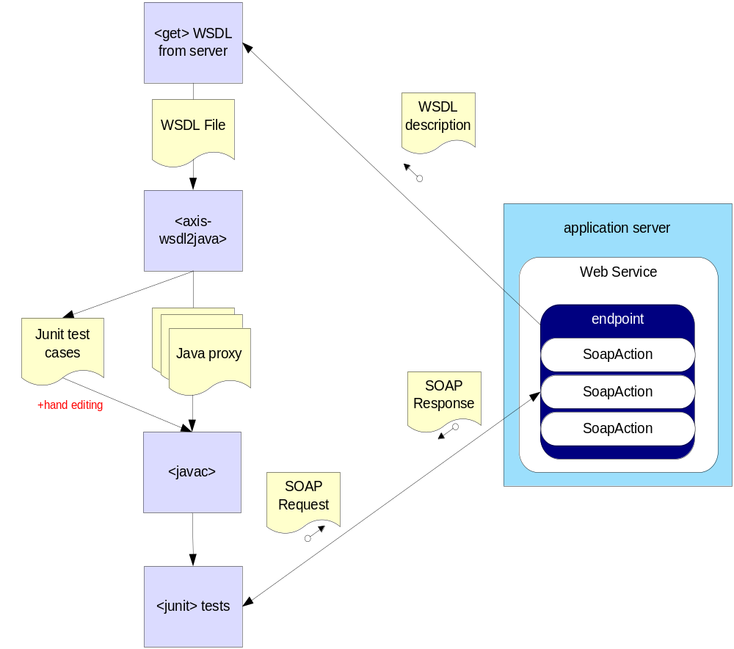
ant-based test process
Notes:
this is our test workflow, what we will do in Ant.

Slide 30
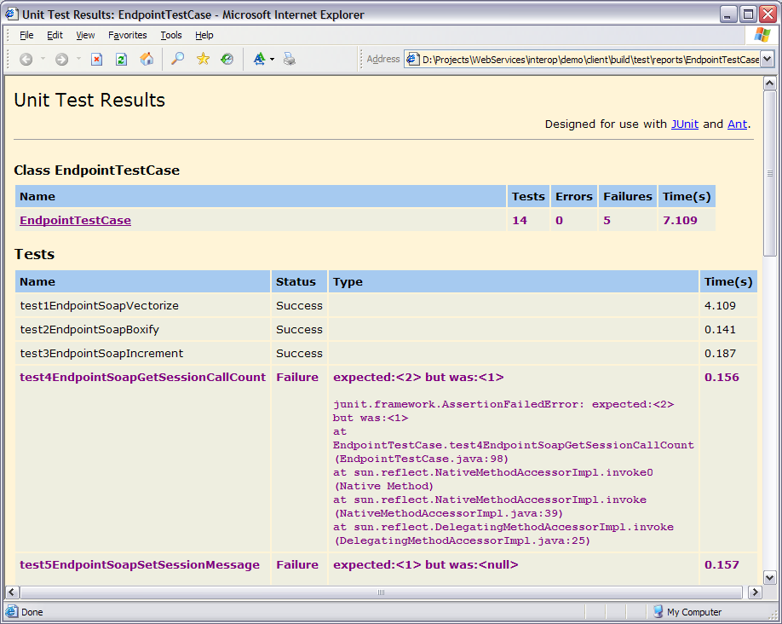
result: you know what to avoid
Notes:
This is the output: a list of how many tests ran, what the failures were.

Slide 31

interop issues: find them before you fall into them
summary
Notes:
And that's it.
We've looked at areas of trouble, ranging from language issues (uint), framework differences and just bits of SOAP that arent nailed down yet. If your app strays into the trouble areas, you are going to get hurt.
The trick is not to stay off the mountain, but to go through the crevasses carefully. Probe the snowbridges, know where trouble lies and plan your route, and just be careful.

Slide 32


read these
copyright © 2002-2003 Hewlett-Packard Company
Notes:
Java Development with Ant, by me and Erik, shows how to use ant, how to interop test Axis servers with .net clients, set up continuous integration servers and many other useful things.
also, http://iseran.com/Steve/papers.html

Slide 33


and maybe these
Notes:
Patterns of enterprise app arch by martin fowler: good enterprise patterns, including a critique of EJB
flaws: maybe too much emphasis on data binding, not the other aspects of big server side apps
Scotland's Winter Mountains, Martin Moran. Best book on mountaineering ever. Full of facts, figures and anecdotes.
flaws: second edition still covers the nutritional values of fried breakfasts and hangovers, but omits the religious debate between bars of chocolate and honey slices. Also by virtue of a focus on Scotland, has nothing on glacier work.

