Slide 1
Dancing Elephants: Working with Object Storage in Apache Spark and Hive
Steve Loughran
Sanjay Radia
April 2017

Slide 2
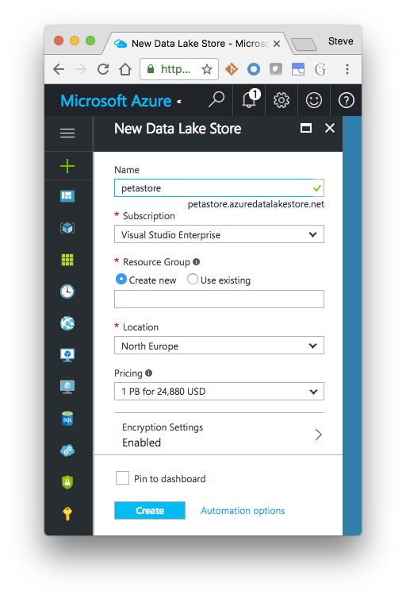
Why?
No upfront hardware costs
Data ingress for IoT, mobile apps
Cost effective if sufficiently agile

Slide 3
Object Stores are a key part of agile cloud applications
It's the only persistent store for in-cloud clusters
Object stores are the source and final destination of work
Cross-application data storage
Asynchronous data exchange
External data sources
Also useful in physical clusters!

Slide 4

Cloud Storage Integration: Evolution for Agility
Evolution towards cloud storage as the persistent Data Lake
Goal
Application
Application
Application
Input
Output
Output
Input
Input
tmp
HDFS
HDFS
HDFS
Output
Backup
Restore
Upload
AWS –today
Azure
Notes:
on prem = 1
azure @ 3
AWS @ 2

Slide 5






Elastic ETL
external
inbound
ORC
datasets
HDFS
Notes:
This is one of the simplest deployments in cloud: scheduled/dynamic ETL. Incoming data sources saving to an object store; spark cluster brought up for ETL. Either direct cleanup/filter or multistep operations, but either way: an ETL pipeline. HDFS on the VMs for transient storage, the object store used as the destination for data —now in a more efficient format such as ORC or Parquet

Slide 6


Notebooks
external
datasets
library
Notes:
Notebooks on demand. ; it talks to spark in cloud which then does the work against external and internal data;
Your notebook itself can be saved to the object store, for persistence and sharing.

Slide 7



Streaming
Notes:
Example: streaming on Azure
+ on LHS add streaming

Slide 8
Danger: Object stores are not filesystems∗
Cost & Geo-distribution over
Consistency and Performance
∗for more information, please re-read
Notes:
In all the examples, object stores take a role which replaces HDFS. But this is dangerous, because...

Slide 9
A Filesystem: Directories, Files → Data
/
work
00
01
pending
complete
00
part-00
part-01
part-01
01
00
01
rename("/work/pending/part-01", "/work/complete")

Slide 10
Object Store: hash(name)⇒data
hash("/work/pending/part-00") ["s01", "s02", "s04"]
s01
s02
hash("/work/pending/part-01") ["s02", "s03", "s04"]
00
01
01
00
copy("/work/pending/part-01",
"/work/complete/part01")
s03
s04
delete("/work/pending/part-01")
01
00
01
01
01

Slide 11
Object Store: REST APIs
PUT /work/pending/part-01 ... DATA ...
s01
s02
GET /work/pending/part-01 Content-Length: 1-8192
00
01
00
PUT /work/complete/part01
x-amz-copy-source: /work/pending/part-01
s03
s04
DELETE /work/pending/part-01
00
01
HEAD /work/complete/part-01
01
GET /?prefix=/work&delimiter=/

Slide 12
Often: Eventually Consistent
s01
s02
GET /work/pending/part-00
00
01
200
00
DELETE /work/pending/part-00
200
s03
s04
01
00
GET /work/pending/part-00
01
200

Slide 13
The dangers of Eventual Consistency
Temp Data leftovers
List inconsistency means new data may not be visible
Lack of atomic rename() can leave output directories inconsistent
You can get bad data and not even notice

Slide 14




org.apache.hadoop.fs.FileSystem
hdfs
wasb
s3a
swift
adl
gs
Notes:
Everything usies the Hadoop APIs to talk to both HDFS, Hadoop Compatible Filesystems and object stores; the Hadoop FS API. There's actually two: the one with a clean split between client side and "driver side", and the older one which is a direct connect. Most use the latter and actually, in terms of opportunities for object store integration tweaking, this is actually the one where can innovate with the most easily. That is: there's nothing in the way.
Under the FS API go filesystems and object stores.
HDFS is "real" filesystem; WASB/Azure close enough. What is "real?". Best test: can support HBase.

Slide 15



2006
2007
2008
2009
2010
2011
2012
2013
2014
2015
2016
2017
s3:// —“inode on S3”
History of Object Storage Support
s3n://
“Native” S3
s3://
Amazon EMR S3
(proprietary)
swift://
OpenStack
s3a:// Replaces s3n
gs://
Google Cloud
wasb://
Azure WASB
Phase I: Stabilize S3A
Phase II: speed & scale
adl://
Azure Data Lake
oss://
Aliyun
Phase III: scale & consistency
Notes:
This is the history

Slide 16
Make Apache Hadoop at home in the cloud
✔ ✔
✔
Step 1: Hadoop runs great on Azure
Step 2: Beat EMR on EC2
Notes:
Simple goal. Make ASF hadoop at home in cloud infra. It's always been a bit of a mixed bag, and there's a lot with agility we need to address: things fail differently.
Step 1: Azure. That's the work with Microsoft on wasb://; you can use Azure as a drop-in replacement for HDFS in Azure
Step 2: EMR. More specifically, have the ASF Hadoop codebase get higher numbers than EMR

Slide 17
Problem: S3 Analytics is too slow/broken
Analyze benchmarks and bug-reports
Fix Read path for Columnar Data
Fix Write path
Improve query partitioning
The Commitment Problem

Slide 18
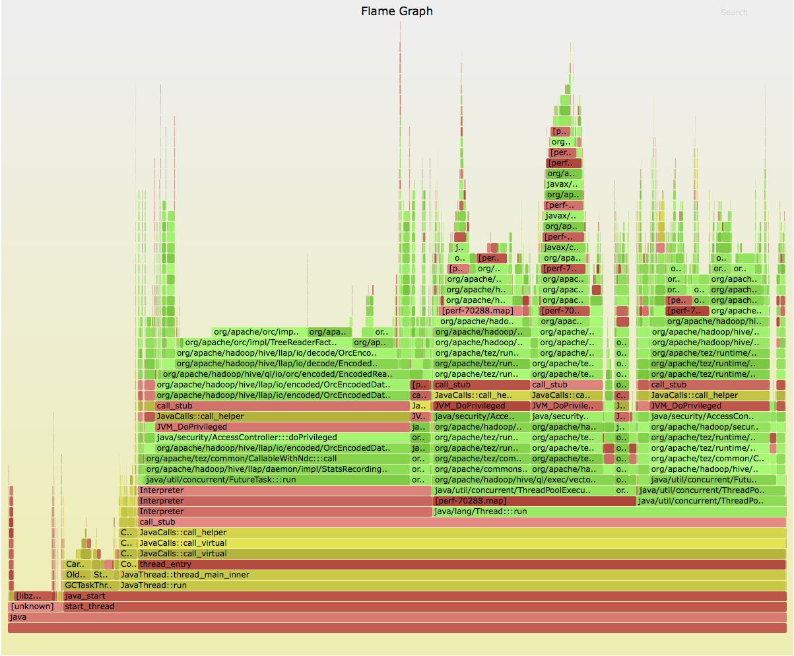
LLAP (single node) on AWS
TPC-DS queries at 200 GB scale
getFileStatus()
read()
readFully(pos)
Notes:
Here's a flamegraph of LLAP (single node) with AWS+HDC for a set of TPC-DS queries at 200 GB scale; we should stick this up online
only about 2% of time (optimised code) is doing S3 IO. Something at start partitioning data

Slide 19
HDP 2.6/Hadoop 2.8 transforms I/O performance!
// forward seek by skipping stream
fs.s3a.readahead.range=256K
// faster backward seek for Columnar Storage
fs.s3a.experimental.input.fadvise=random
// enhanced data upload
fs.s3a.fast.output.enabled=true
—see HADOOP-11694 for lots more!
Notes:
without going into the details, here are things you will want for Hadoop 2.8. They are in HDP 2.5, possible in the next CDH release.
The first two boost input by reducing the cost of seeking, which is expensive as it breaks then re-opens the HTTPS connection. Readahead means that hundreds of KB can be skipped before that connect (yes, it can take that long to reconnect). The experimental fadvise random feature speeds up backward reads at the expense of pure-forward file reads. It is significantly faster for reading in optimized binary formats like ORC and Parquet
The last one is a successor to fast upload in Hadoop 2.7. That buffers on heap and needs careful tuning; its memory needs conflict with RDD caching. The new version defaults to buffering as files on local disk, so won't run out of memory. Offers the potential of significantly more effective use of bandwidth; the resulting partitioned files may also offer higher read perf. (No data there, just hearsay).

Slide 20
benchmarks != your queries your data your VMs your directory tree
…but we think we've made a good start
Notes:
Don't run off saying "hey, 2x speedup". I'm confident we got HDP faster, EMR is still something we'd need to look at more.
Data layout is still a major problem here; I think we are still understanding the implications of sharding and throttling. What we do know is that deep/shallow trees are pathological for recursive treewalks, and they end up storing data in the same s3 nodes, so throttling adjacent requests.

Slide 21
S3 Data Source 1TB TPCDS LLAP- vs Hive 1.x:
1 TB TPC-DS ORC DataSet
3 x i2x4x Large (16 CPU x 122 GB RAM x 4 SSD)
Notes:
And the result. Yes, currently we are faster in these benchmarks. Does that match to the outside world? If you use ORC & HIve, you will gain from the work we've done. There are still things which are pathologically bad, especially deep directory trees with few files

Slide 22
Apache Spark
Object store work applies
Needs tuning
Commits to S3 "trouble"

Slide 23
spark-default.conf
spark.hadoop.fs.s3a.readahead.range 256K
spark.hadoop.fs.s3a.block.size 32M
spark.hadoop.fs.s3a.fast.output.enabled true
spark.hadoop.fs.s3a.experimental.input.fadvise random
spark.hadoop.mapreduce.fileoutputcommitter.algorithm.version 2
spark.hadoop.parquet.enable.summary-metadata false
spark.sql.orc.filterPushdown true
spark.sql.orc.splits.include.file.footer true spark.sql.orc.cache.stripe.details.size 10000
spark.sql.hive.metastorePartitionPruning true
spark.sql.parquet.filterPushdown true
spark.sql.parquet.mergeSchema false

Slide 24
Hive settings
fs.s3a.readahead.range 256K
fs.s3a.block.size 32M
fs.s3a.fast.output.enabled true
fs.s3a.experimental.input.fadvise random
mapreduce.fileoutputcommitter.algorithm.version 2
parquet.enable.summary-metadata false

Slide 25
The S3 Commitment Problem
rename() depended upon for atomic transaction
Time to copy() + delete() proportional to data * files
Compared to Azure Storage, S3 is slow (6-10+ MB/s)
Intermediate data may be visible
Failures leave storage in unknown state

Slide 26
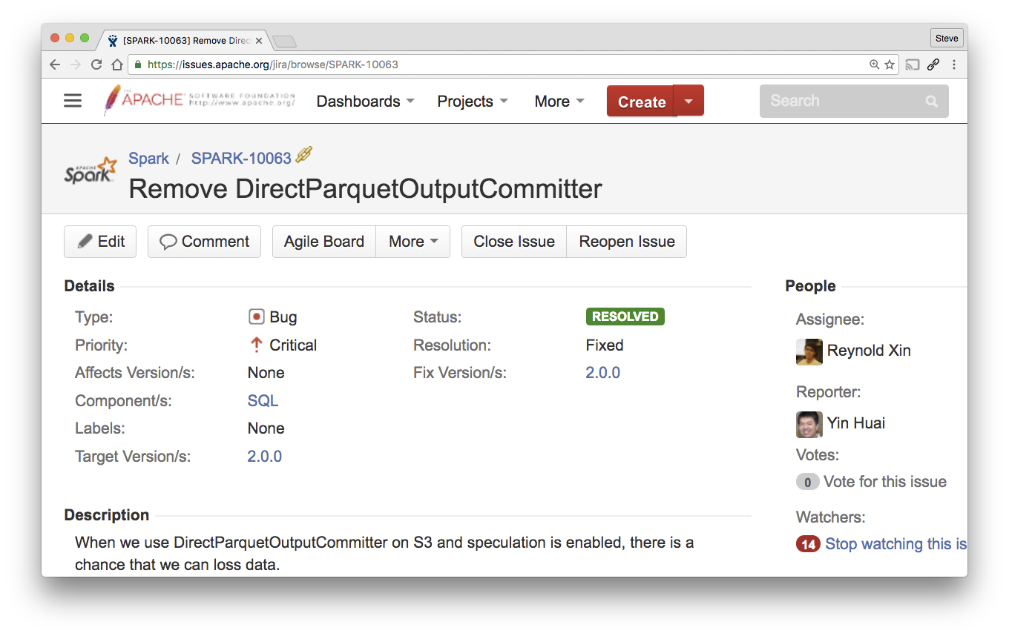
Spark's Direct Output Committer? Risk of Corruption of data
Notes:
This invariably ends up reaching us on JIRA, to the extent I've got a document somewhere explaining the problem in detail.
It was taken away because it can corrupt your data, without you noticiing. This is generally considered harmful.

Slide 27
S3guard Fast, consistent S3 metadata
HADOOP-13445

Slide 28

DynamoDB as fast, consistent metadata store
HEAD part-00
200
s01
s02
00
01
DELETE part-00
200
00
00
s03
s04
HEAD part-00 404
01
00
01
PUT part-00
200

Slide 29
Netflix Staging Committer
Saves output to local files file://
Task commit: upload to S3A as multipart PUT —but do not complete it
Job committer completes all uploads from successful tasks; cancels others.
Outcome:
No work visible until job is commited
Task commit time = data/bandwidth
Job commit time = POST * #files

Slide 30
Availability
Read + Write in HDP 2.6 and Apache Hadoop 2.8
S3Guard: preview of DDB integration soon
Zero-rename commit: work in progress
Look to HDCloud for the latest work!

Slide 31
Big thanks to:
Rajesh Balamohan
Mingliang Liu
Chris Nauroth
Dominik Bialek
Ram Venkatesh
Everyone in QE, RE
+ everyone who reviewed/tested, patches and added their own, filed bug reports and measured performance

Slide 32
Questions?
stevel@hortonworks.com @steveloughran
sanjay@hortonworks.com @srr

