Slide 1
Alexa,
Is the Smart Home vision failing?
Steve Loughran
stevel@apache.org
github: steveloughran

Slide 2
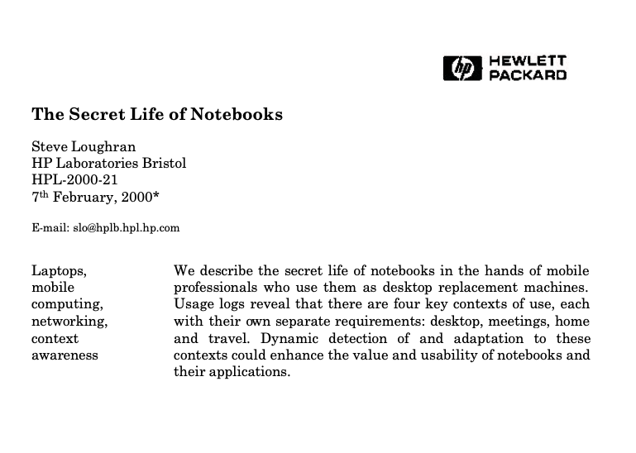
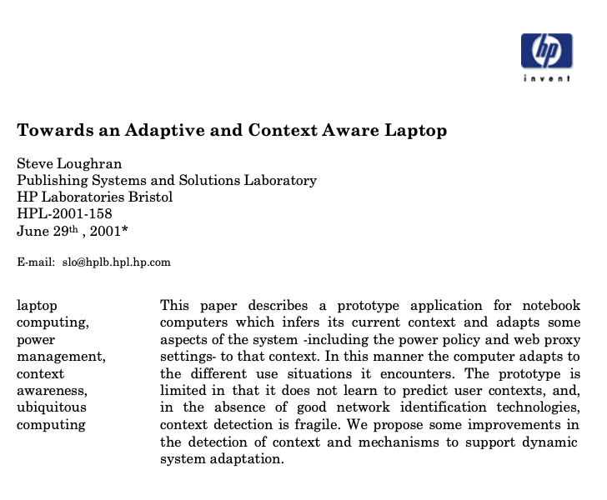
me: lapsed research scientist
ACM CHI 2000
UBICOMP 2001

Slide 3
Microsoft’s 1999 vision video

Slide 4
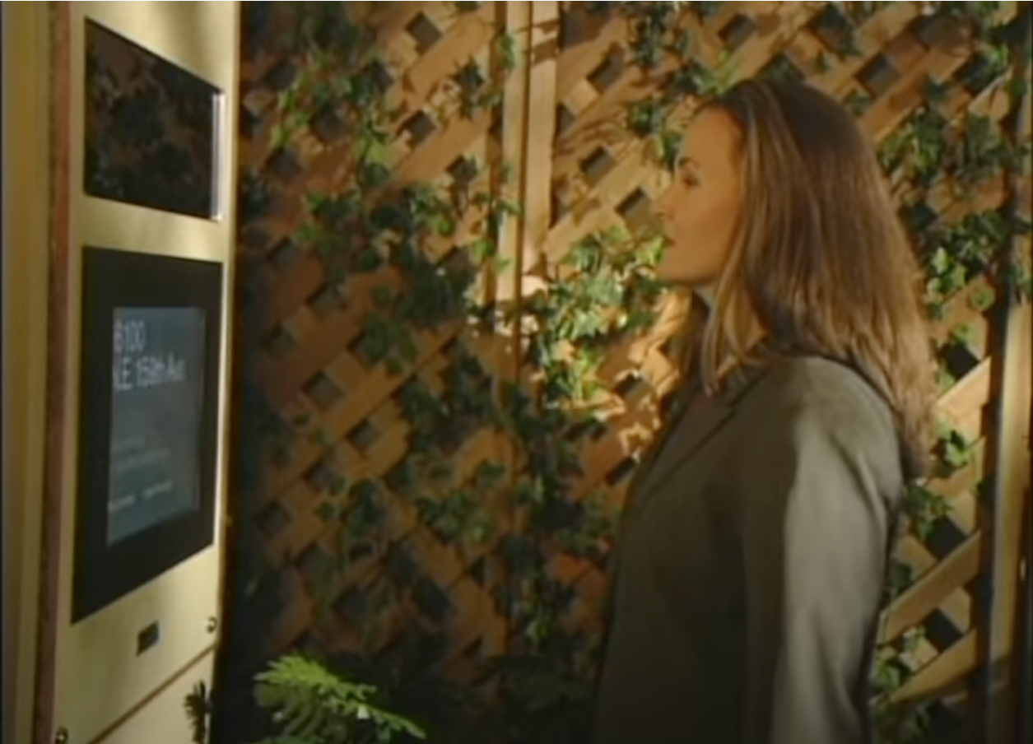
Mother returns from work

Slide 5
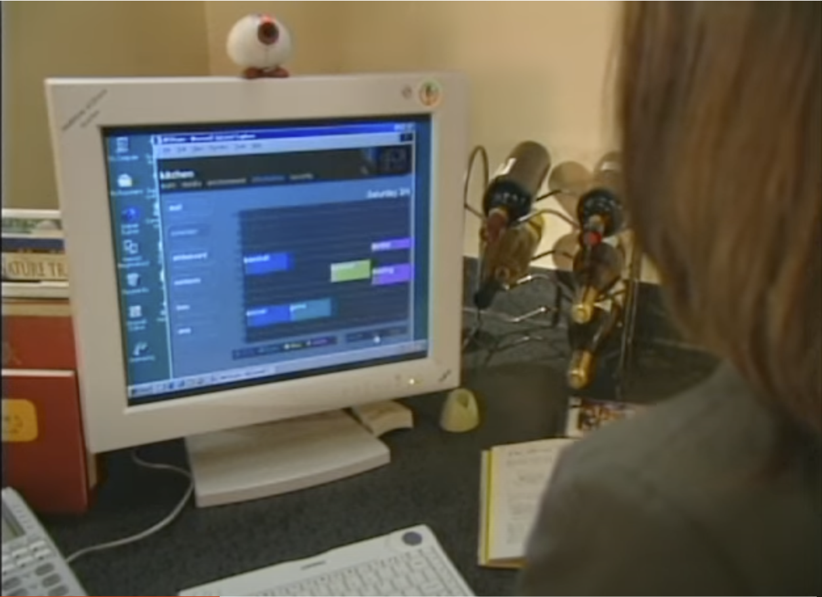
Checks family calendars

Slide 6
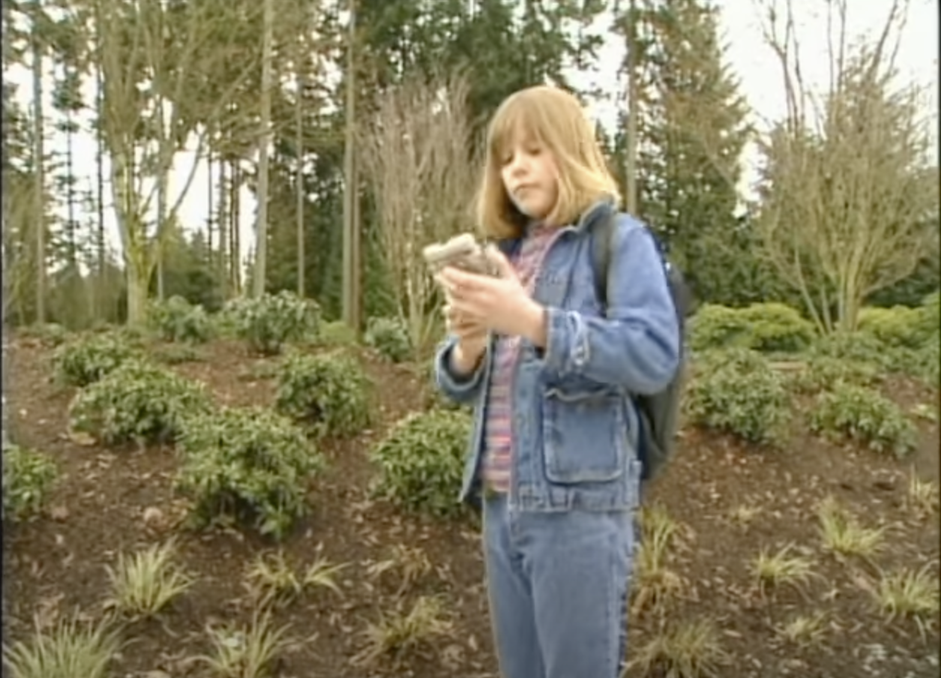
Texts daughter's PDA

Slide 7

Hands-free call to partner

Slide 8
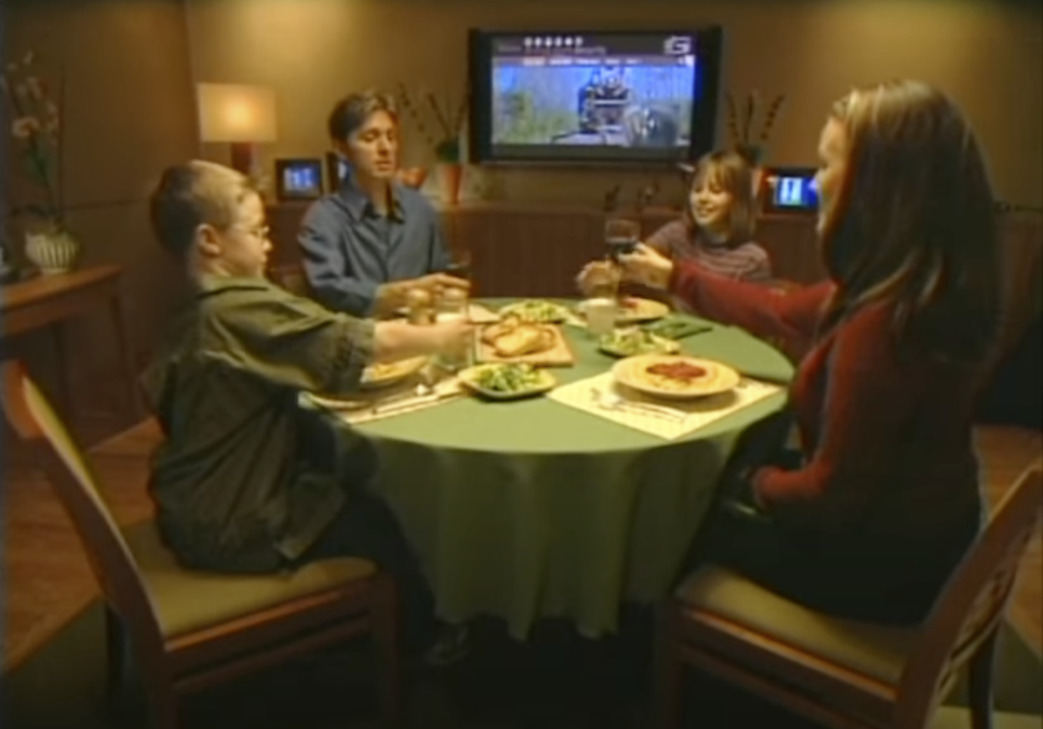
Family meal with wine and TV

Slide 9
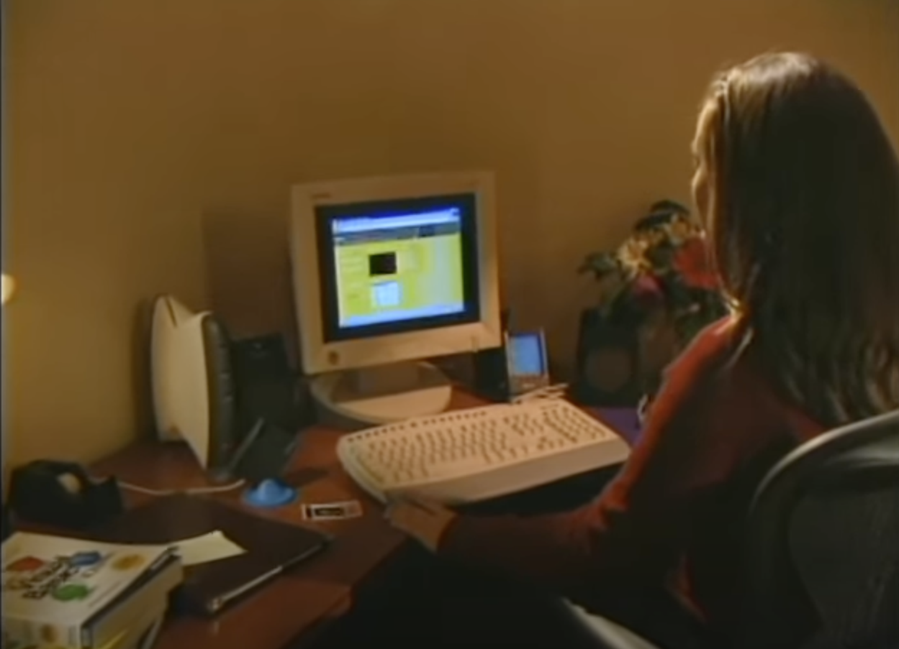
Post-meal cluster admin

Slide 10
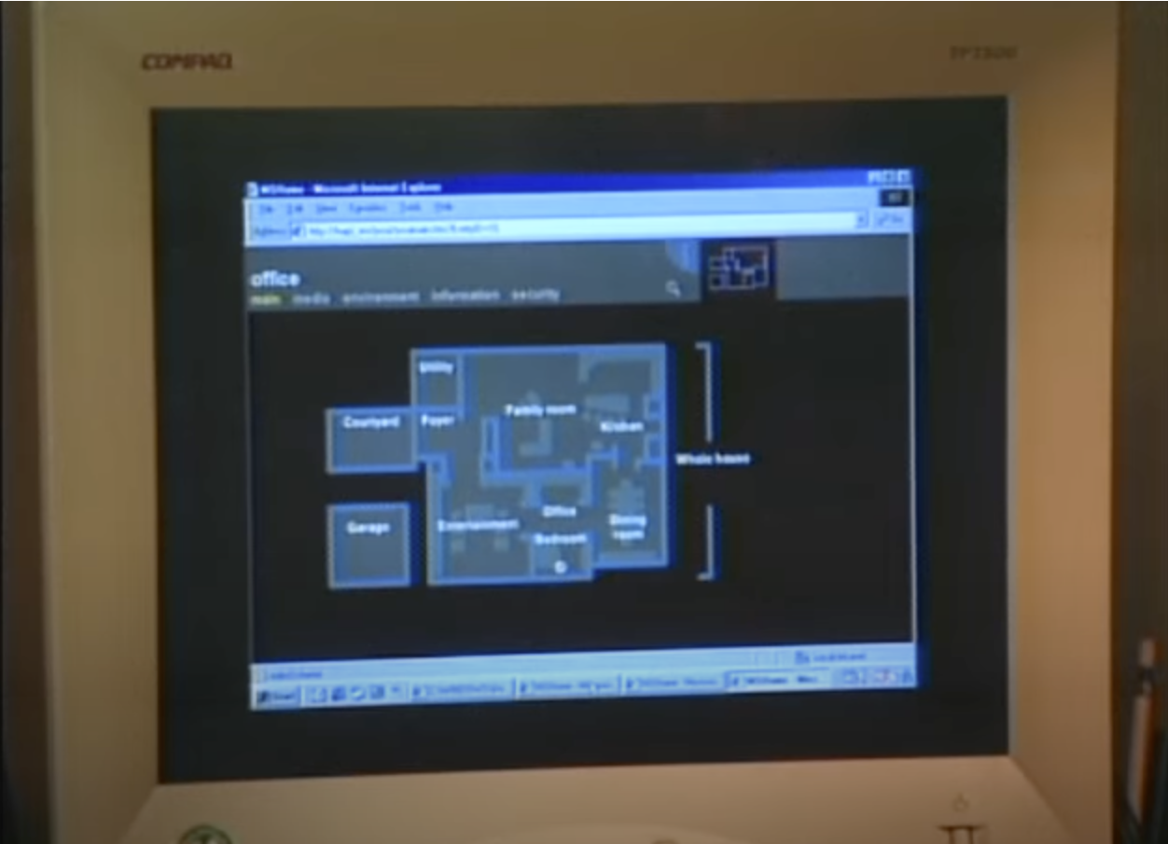
Visio/Active Directory
Z

Slide 11
The dream
Cliché US suburban family & lifestyle
A house you can talk to
System admin is fun
Happiness all round
https://youtu.be/9V_0xDUg0h0

Slide 12
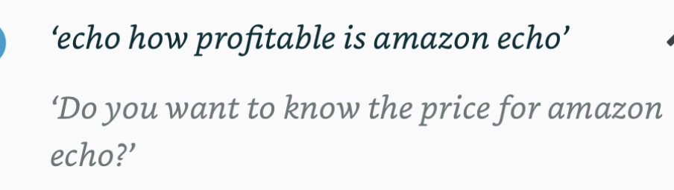
Yes, but does it work?
Amazon’s $10B question

Slide 13
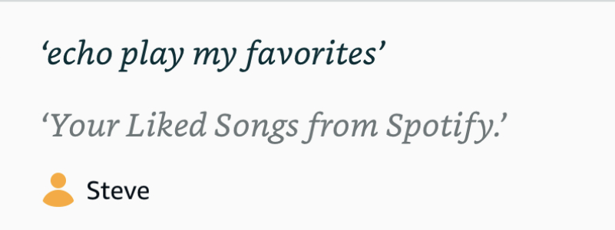
SELECT COUNT(1) FROM PLAYLISTS
WHERE NAME='liked' AND USER='steve'

Slide 14
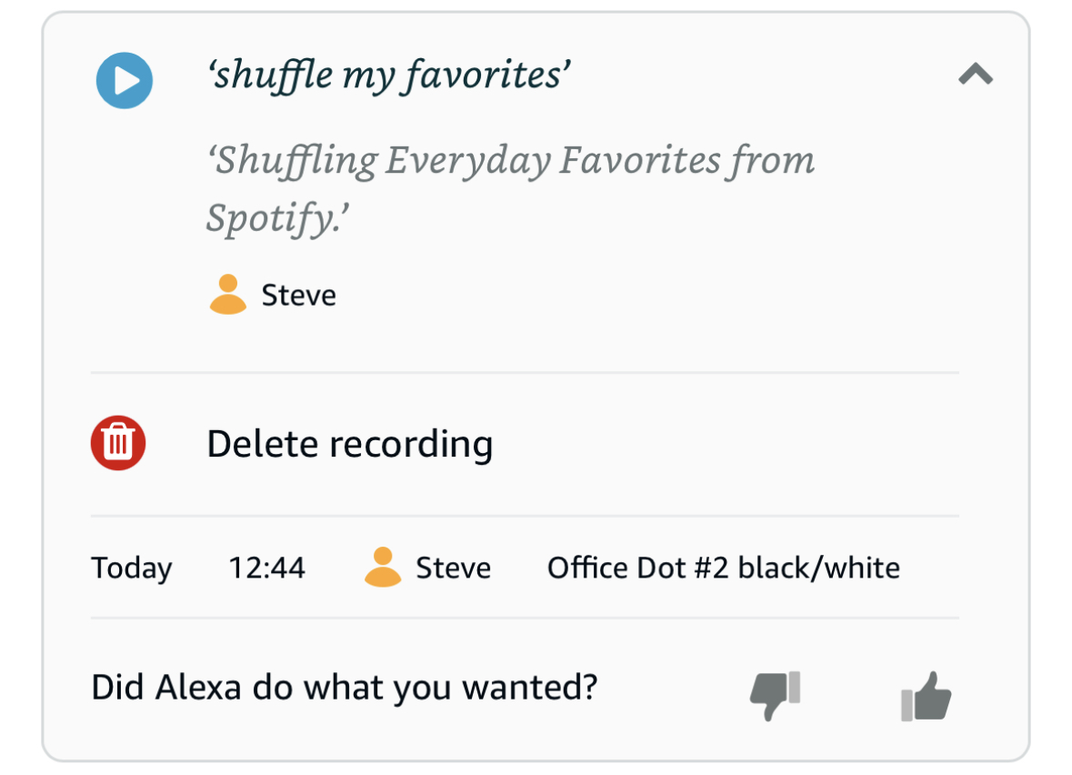
SELECT COUNT(1) FROM PLAYLISTS
WHERE LIKE '%favorites%'

Slide 15
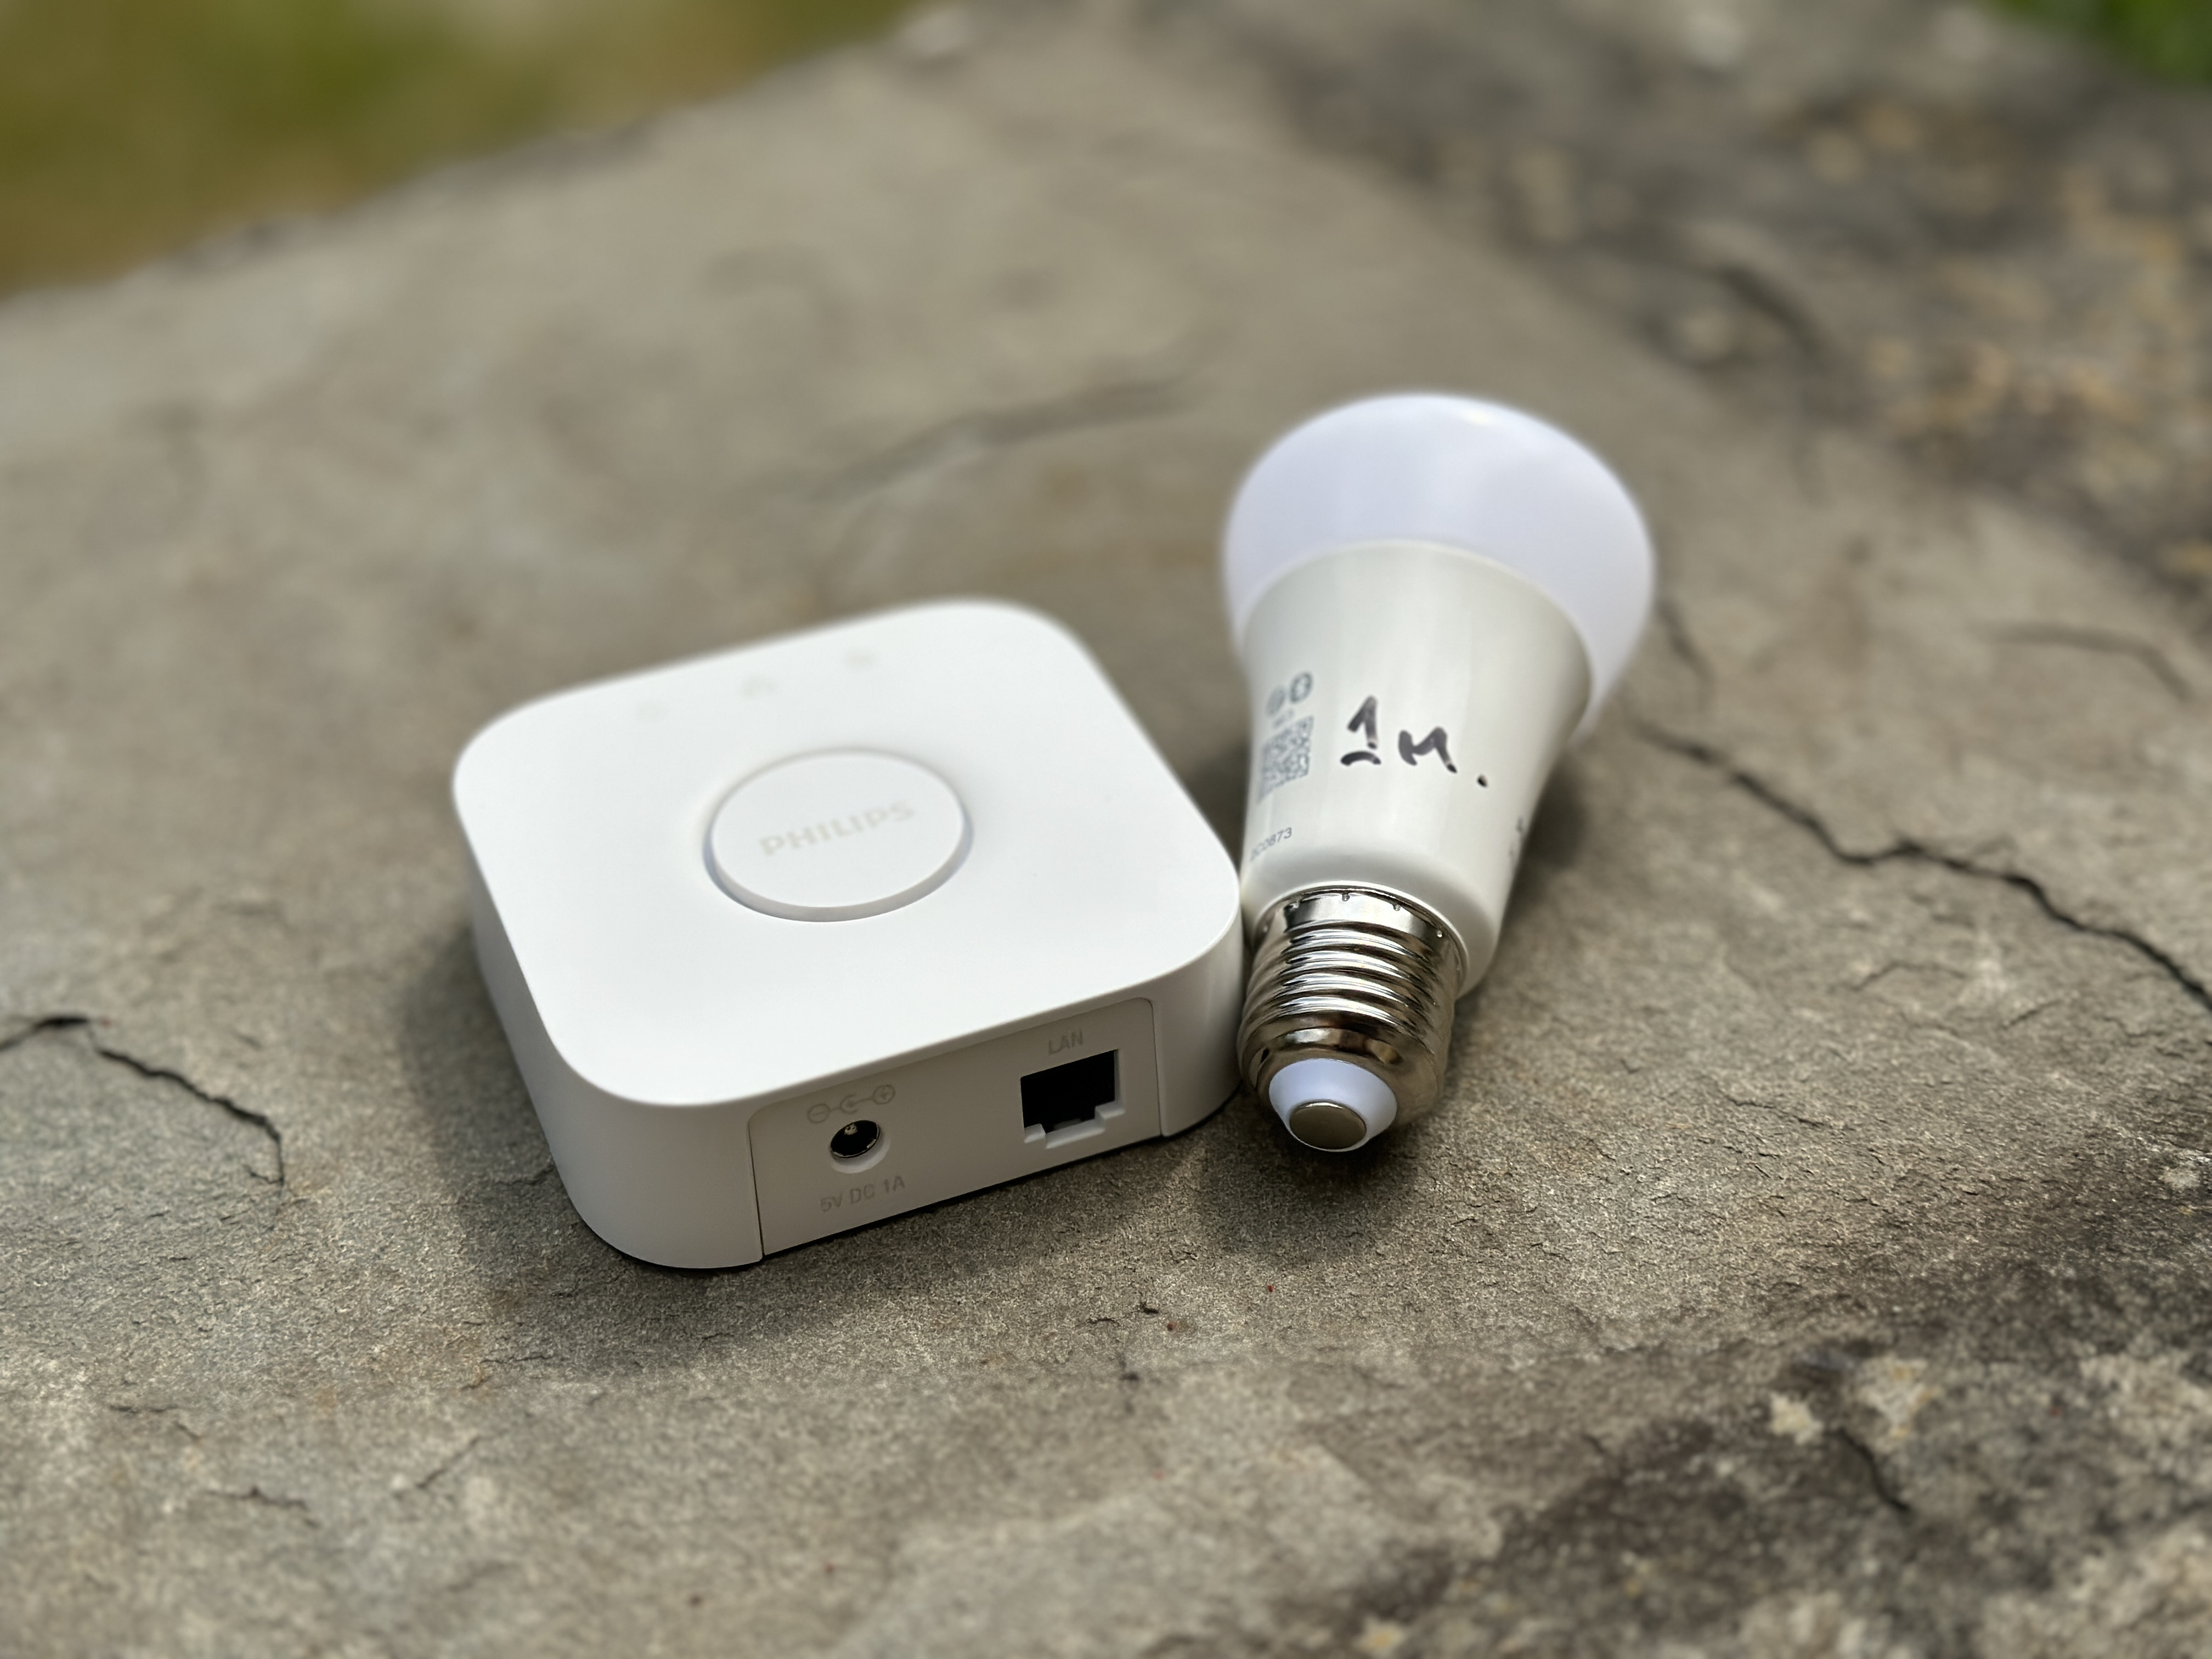
Home Automation: Zigbee
Ad-hoc multihop low-power network
Device discovery
Lights, switches, more
Plug-and-play products from device vendors (Philips, IKEA)
Retro-fit to existing lights

Slide 16
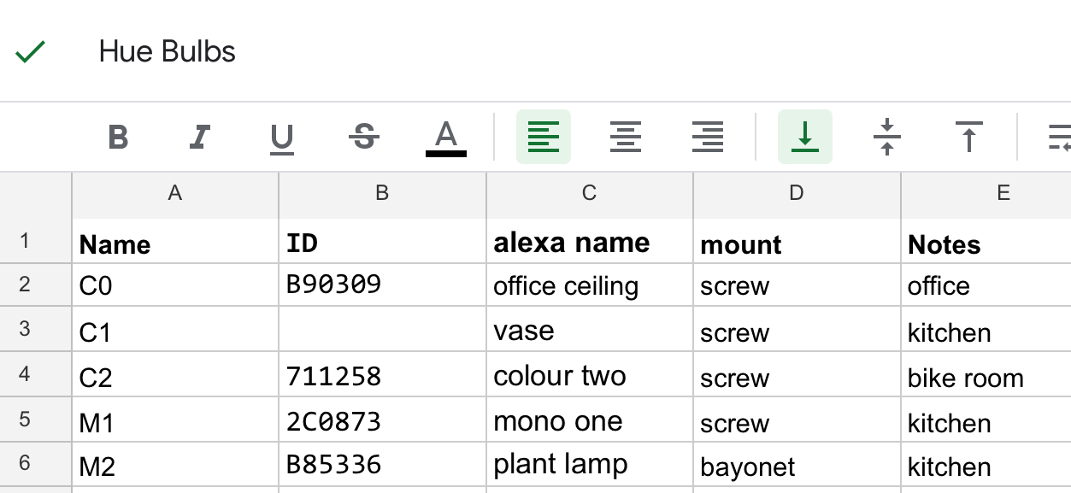
System Admin Fun
Critical mass of devices needed
Disassociation
Debugging
Vendor interoperability
2024: Thread + Matter may help

Slide 17
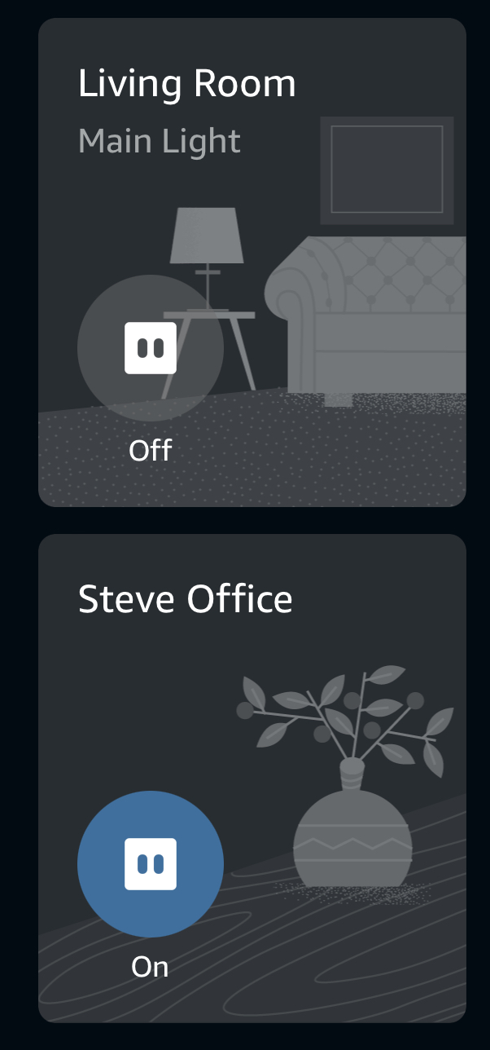
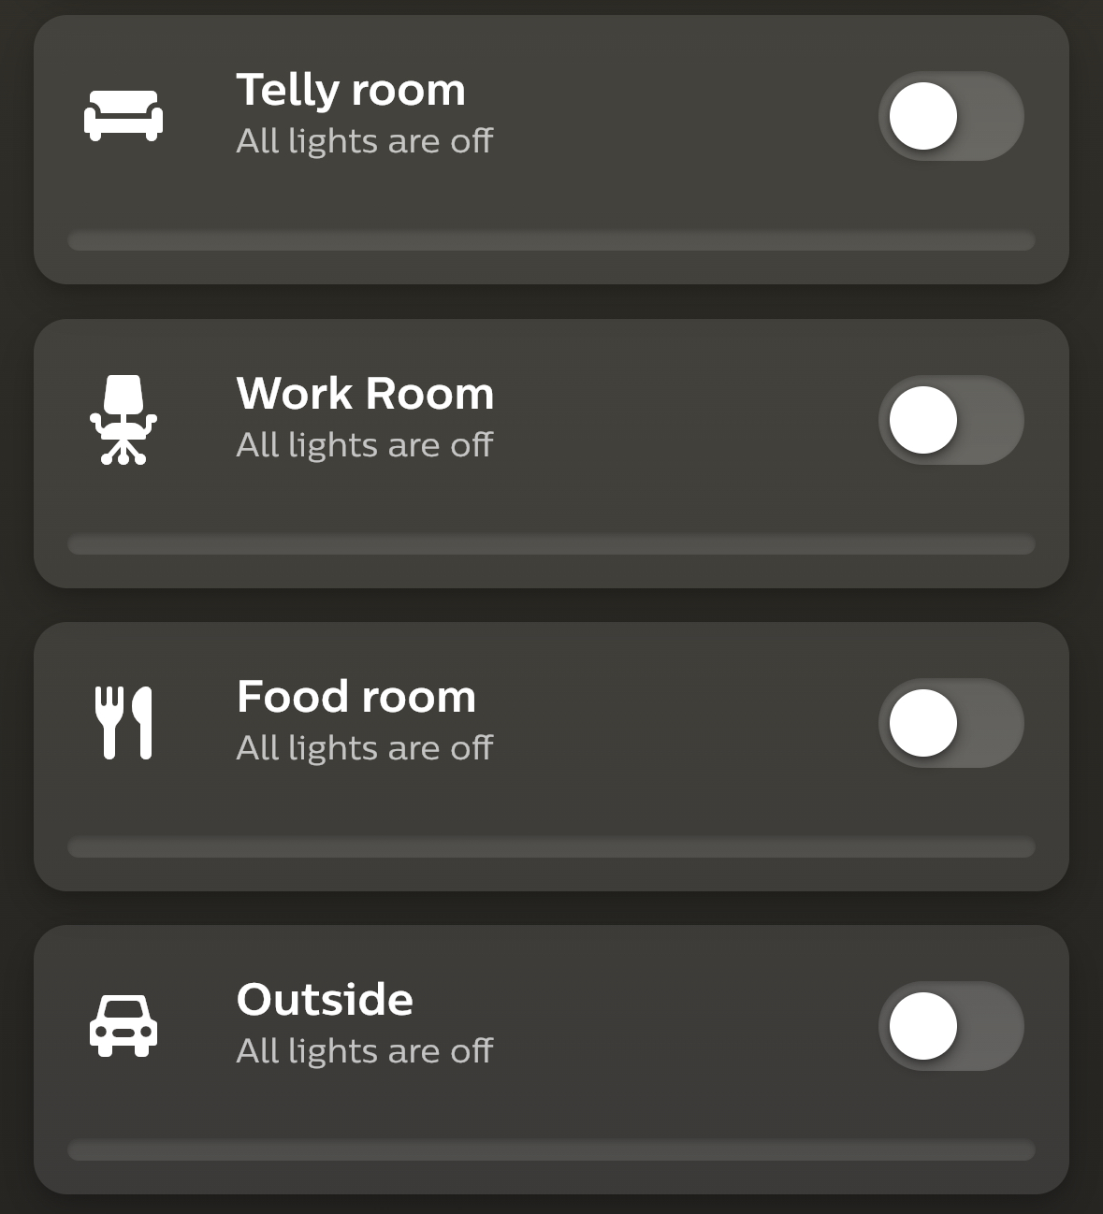
debugging "office"

Slide 18
Social structure is not handled
multi-user a 2.0 feature with bad assumptions:
static state of household
one user, one household
children don't grow up

Slide 19
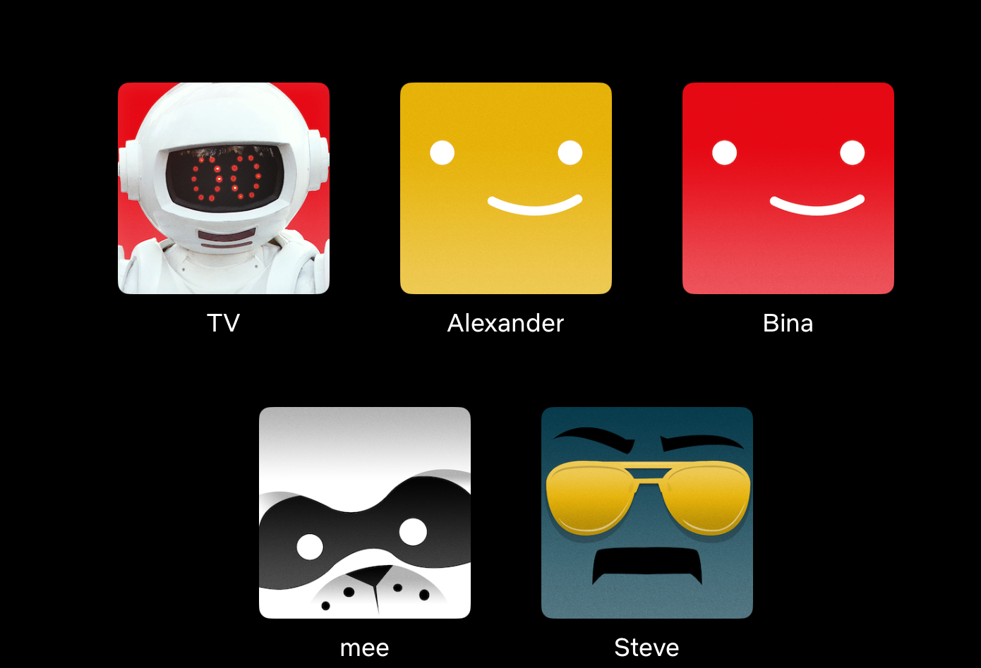
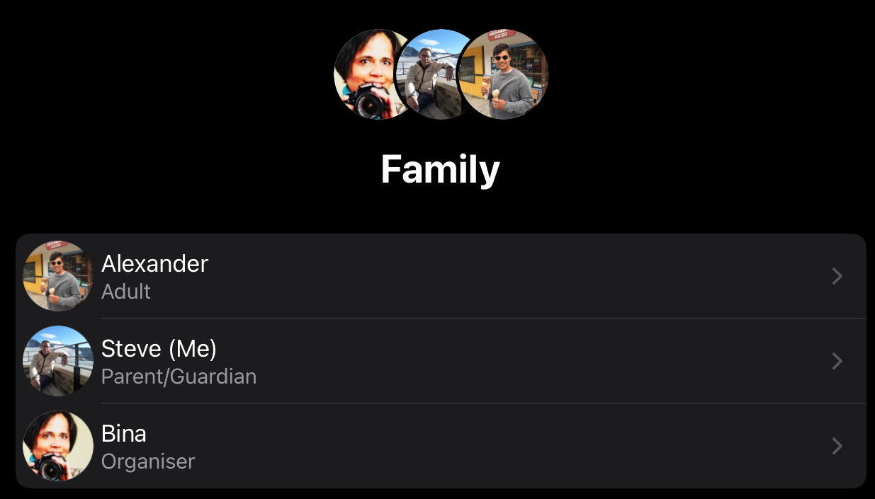


Slide 20
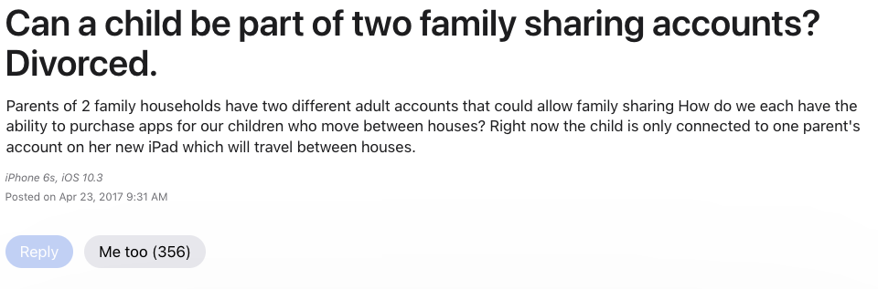
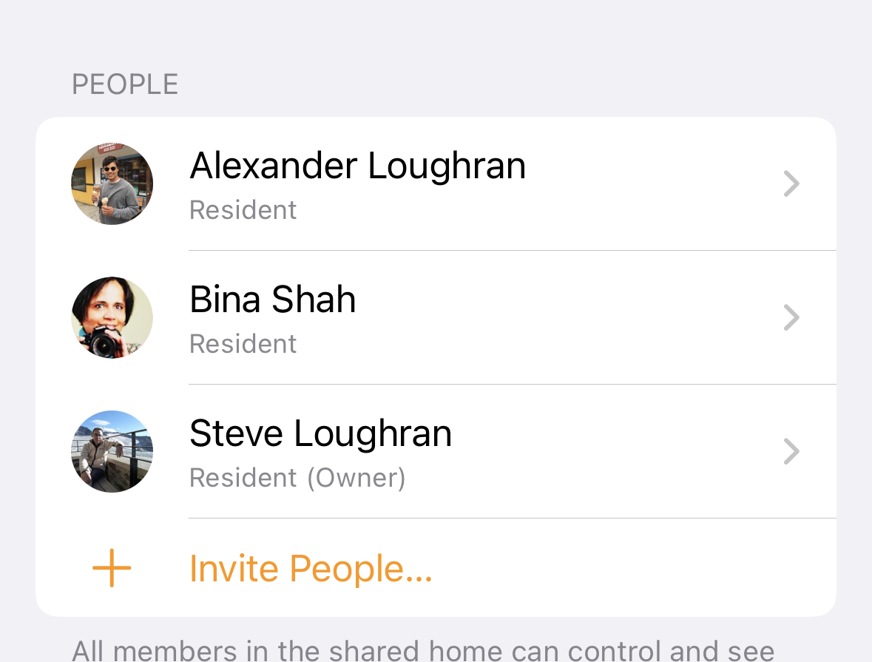
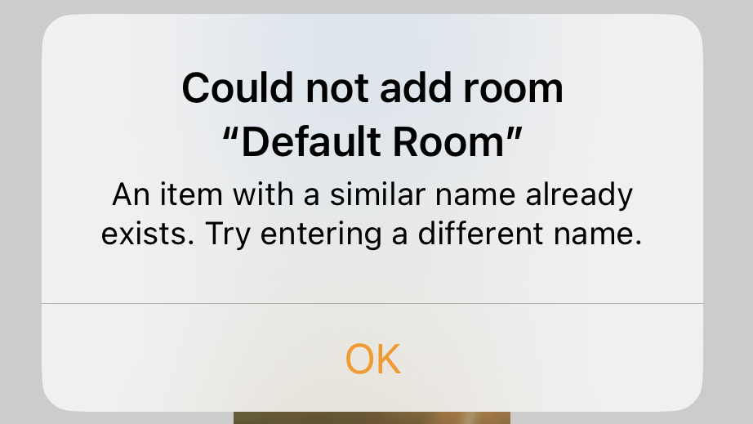
Surely Apple gets it right? No

Slide 21
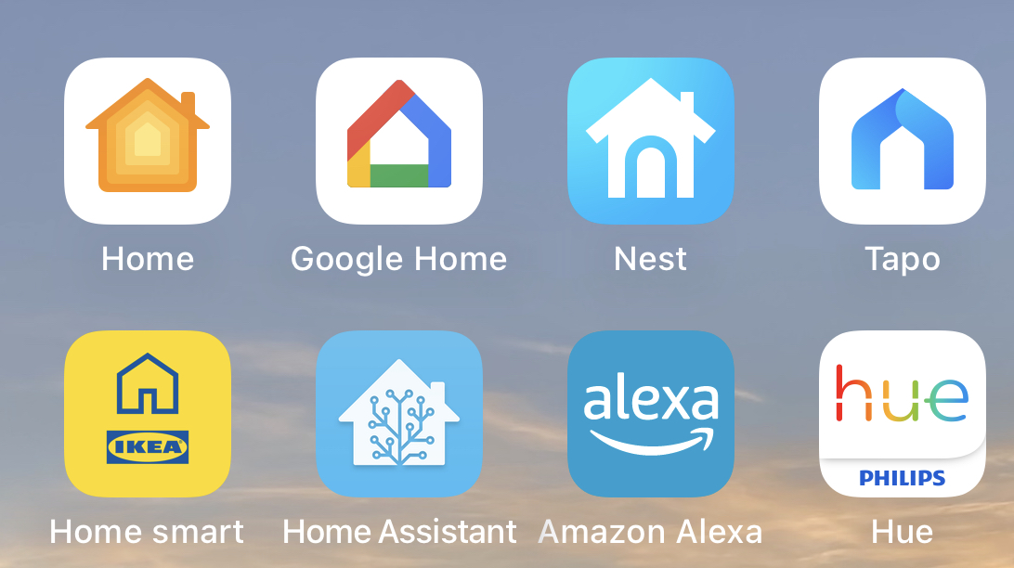
ecosystem conflict

Slide 22
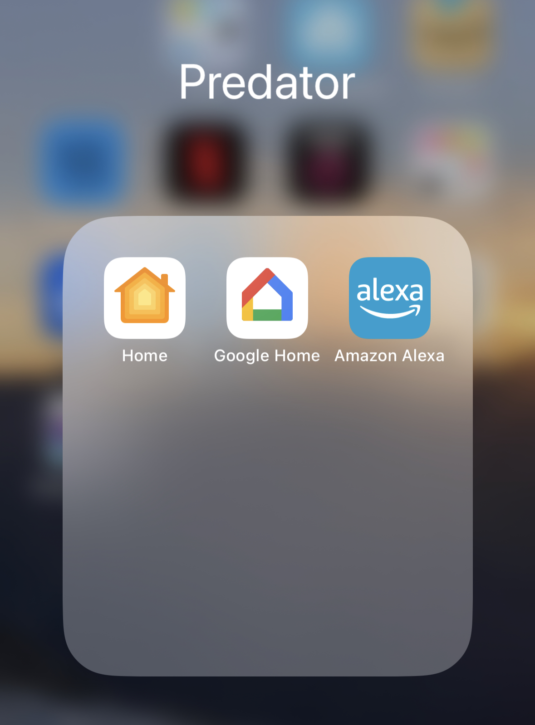
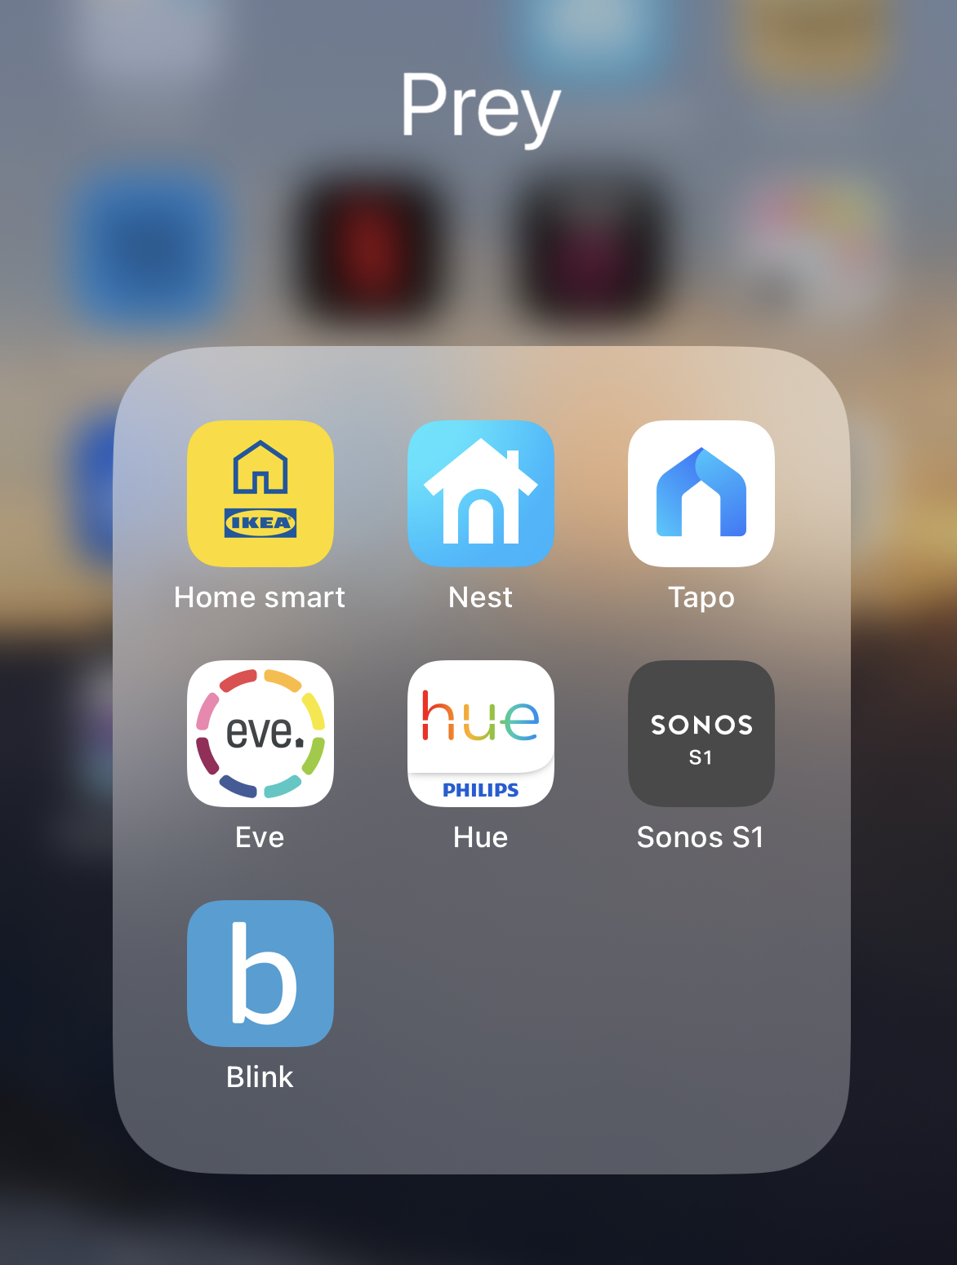

Slide 23
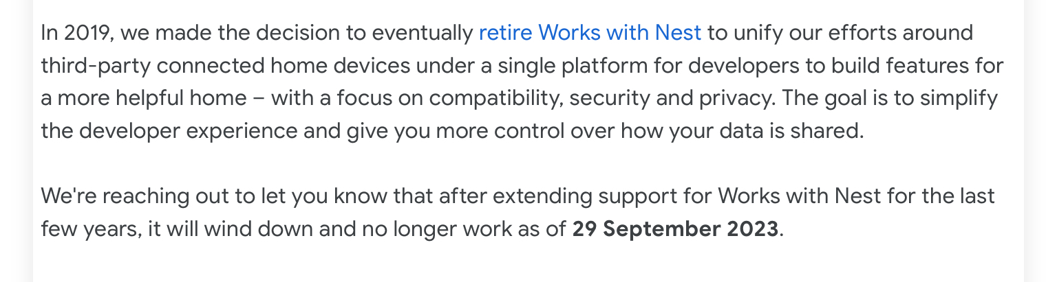
Prey gets eaten

Slide 24
Assertions
The phone represents people
Everything else is a peripheral
But: app-only is brittle & inflexible
Everything needs a Web UI and a Web API

Slide 25
What to do?

Slide 26
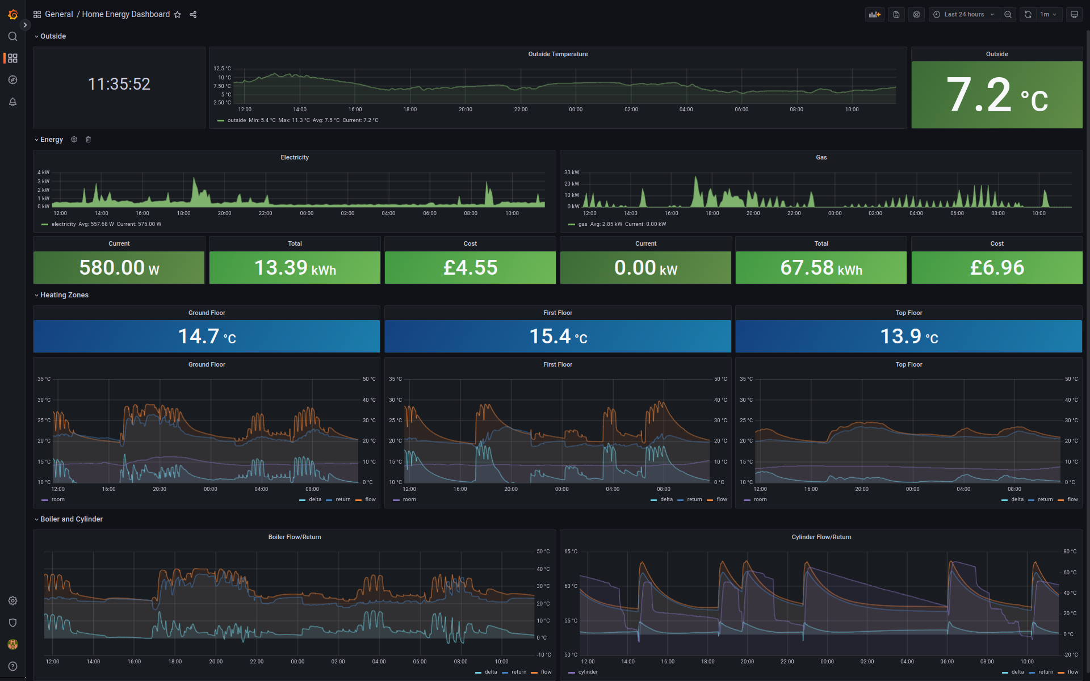
Fully self sufficient

Slide 27

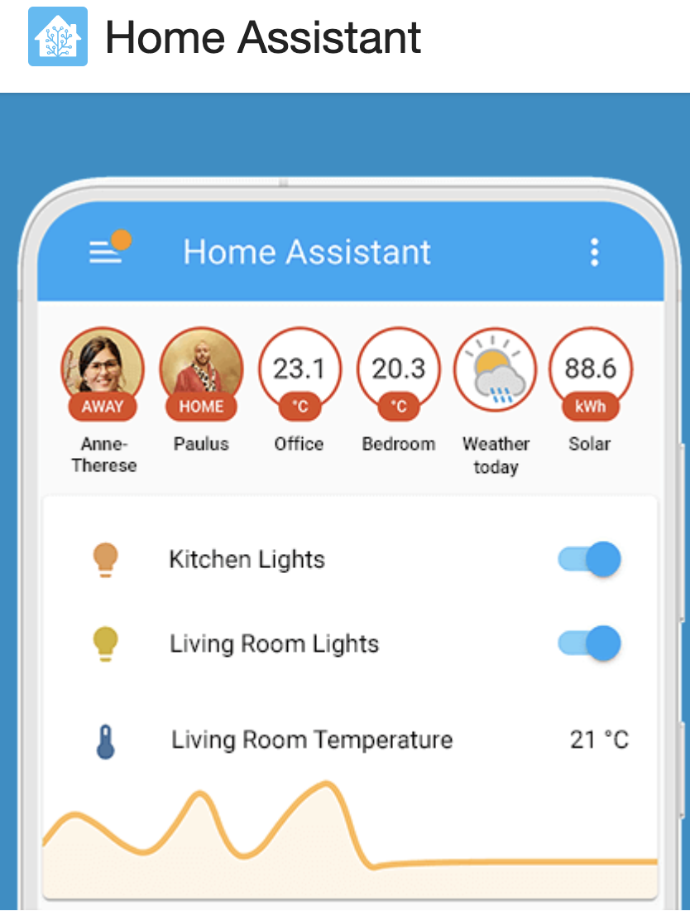

Slide 28
Give up and be happy?

Slide 29


Slide 30
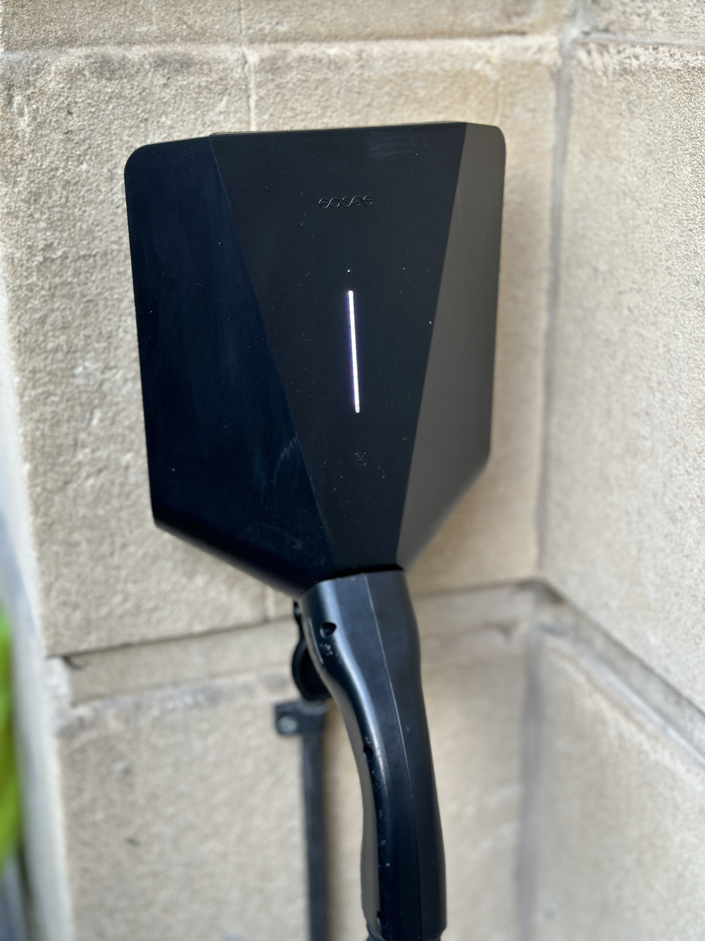

Slide 31

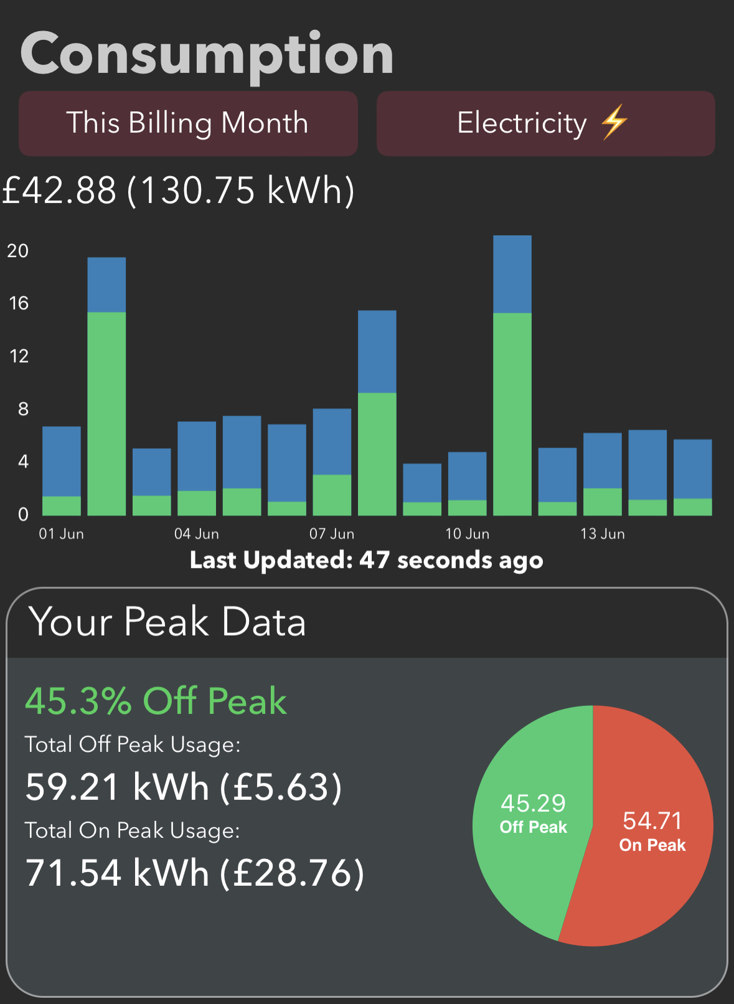

Slide 32
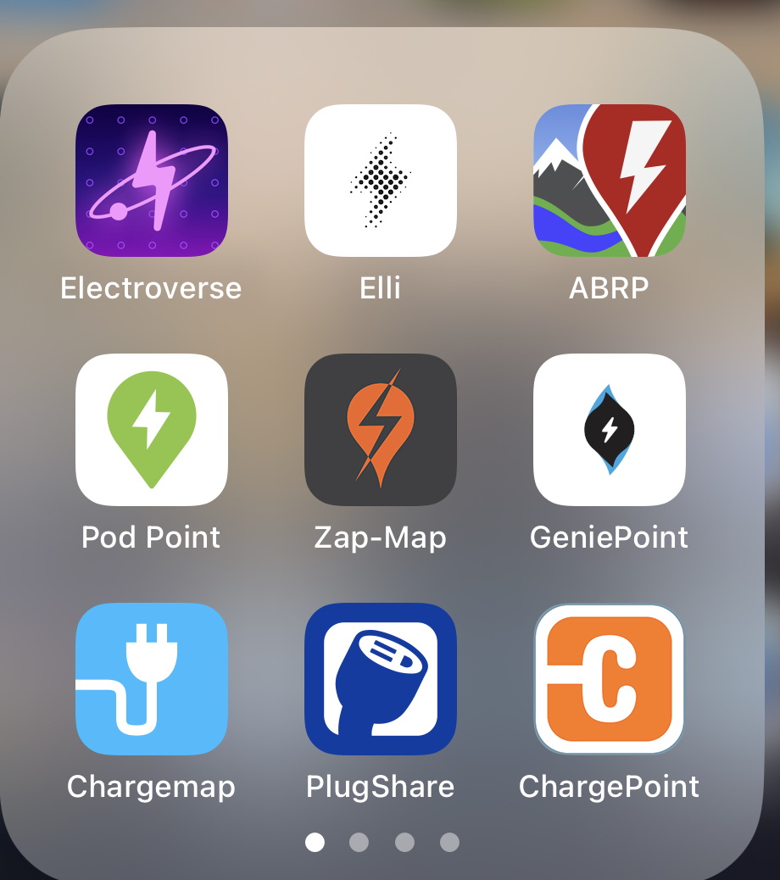

Slide 33
Same world, just outdoors
Weak social structure again
App-first/only world again
Manufacturers vs. phones again

Slide 34
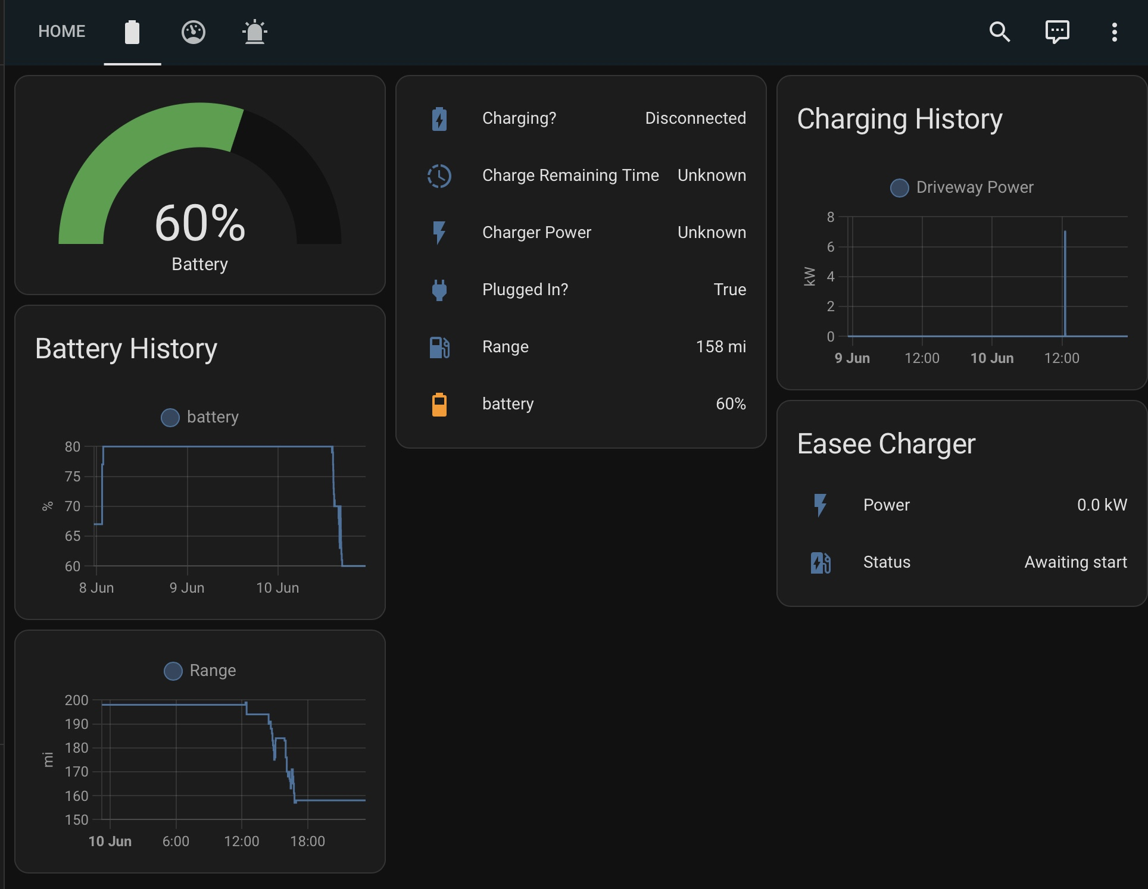
Home Assistant
+Tronity @ €5/mo

Slide 35
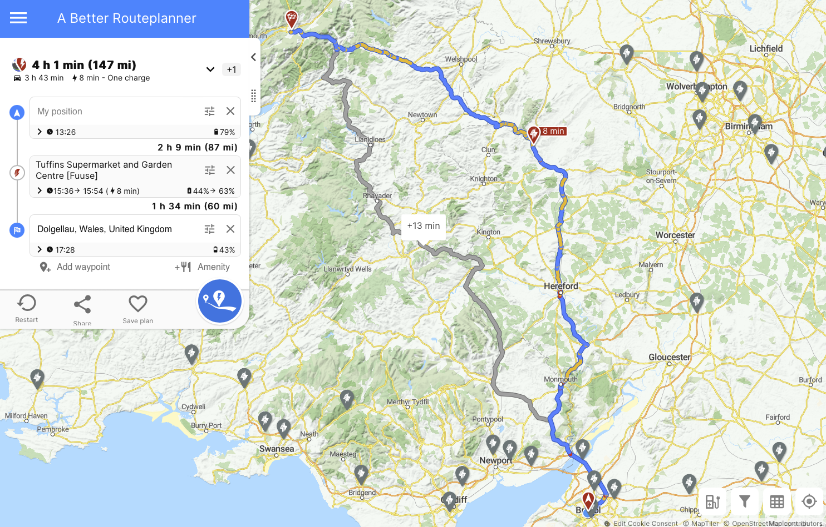
€5/mo

Slide 36
How we survive this world?
Subscribe to the startups!
Demand APIs everywhere!
Contribute to plugins!
Code for people!

Slide 37
Hadoop Vectored IO
Maschinenhaus
13:50

