Slide 1
Alexa,
Is the Smart Home vision failing?
Steve Loughran
stevel@apache.org
github: steveloughran

Slide 2
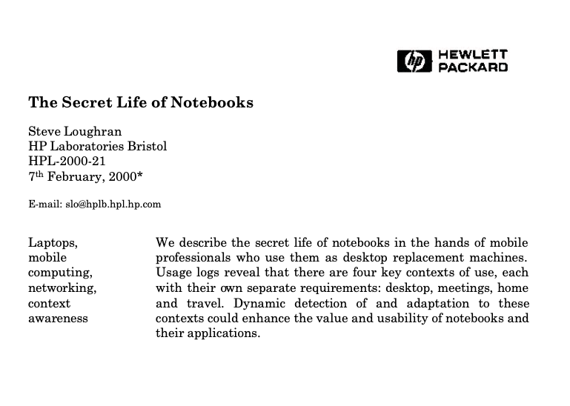
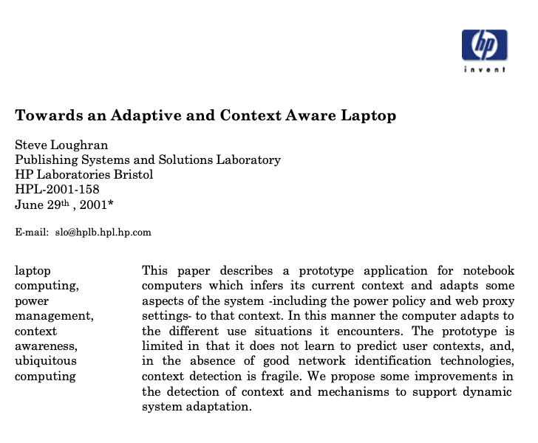
me: ex-research scientist
ACM CHI 2000
UBICOMP 2001

Slide 3
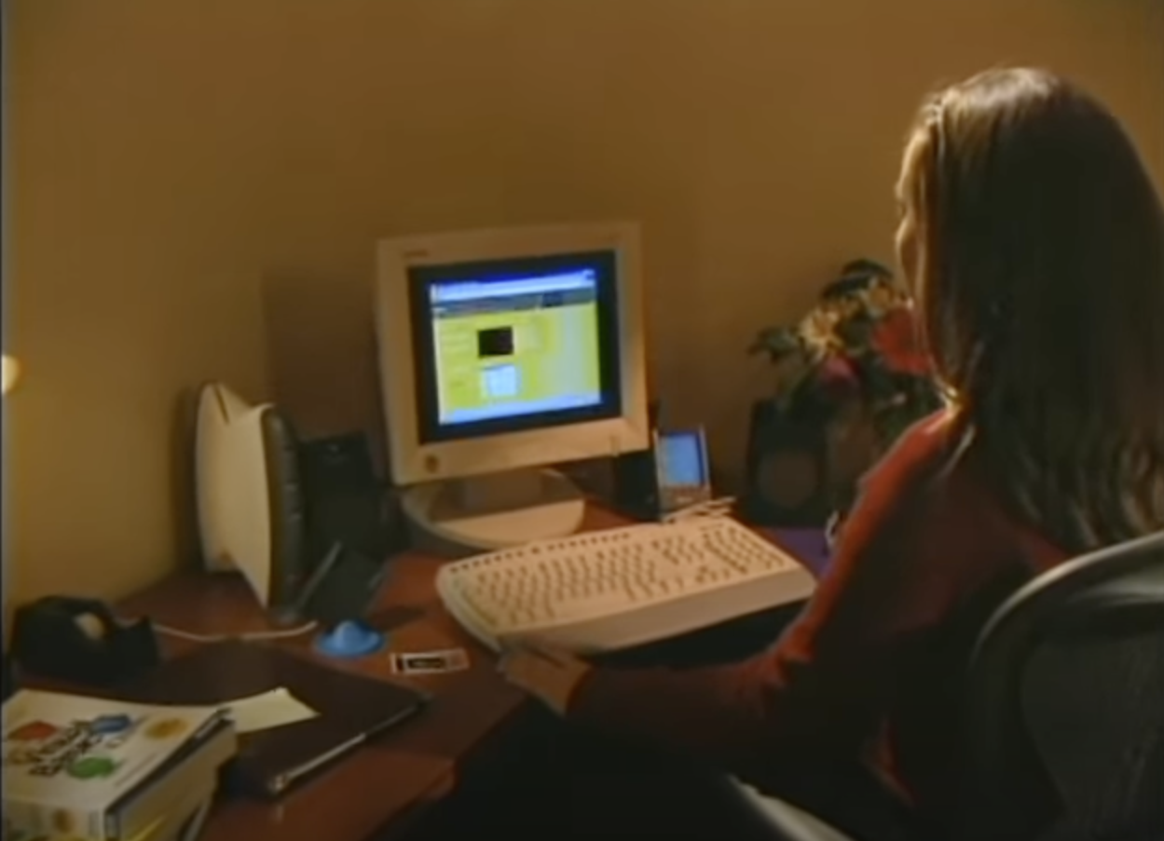
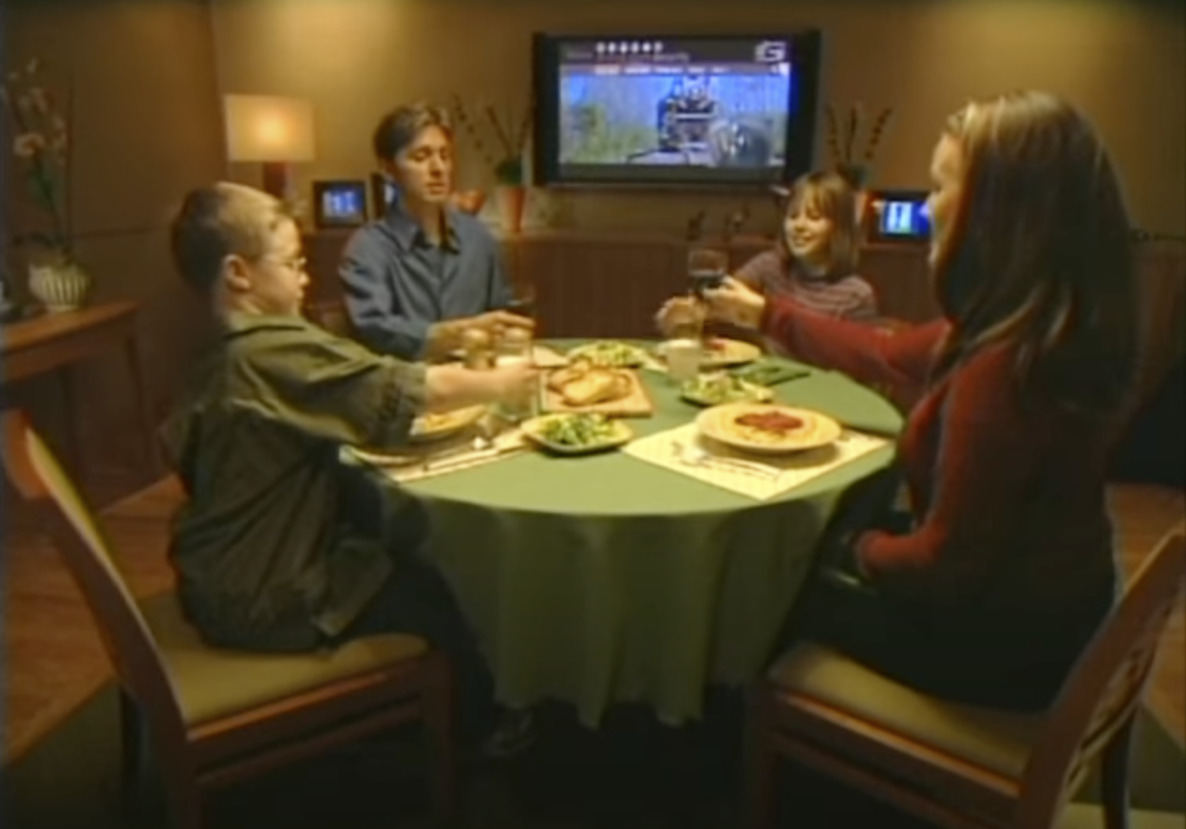

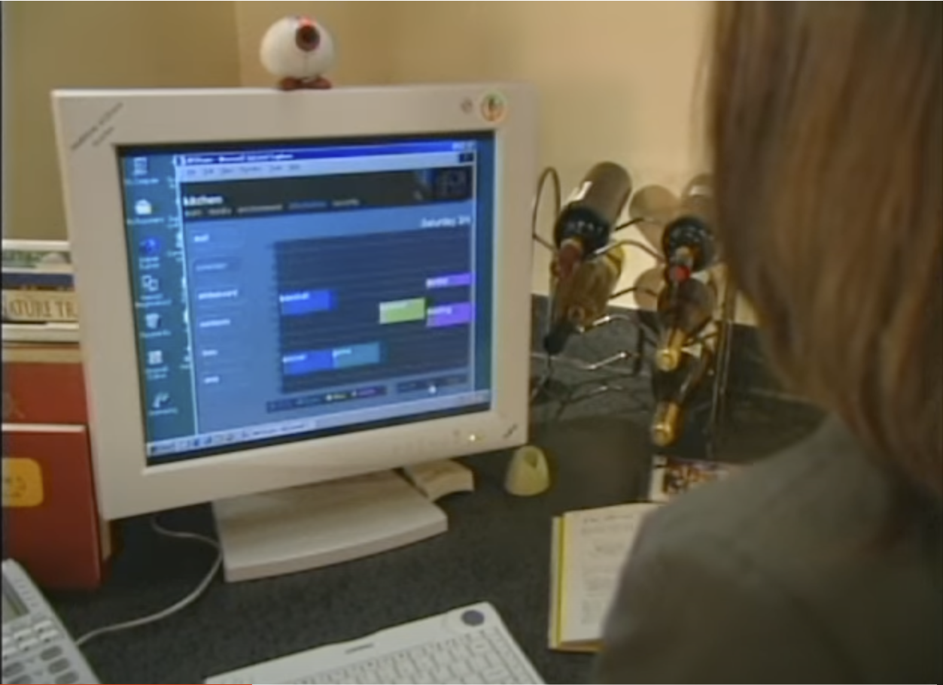
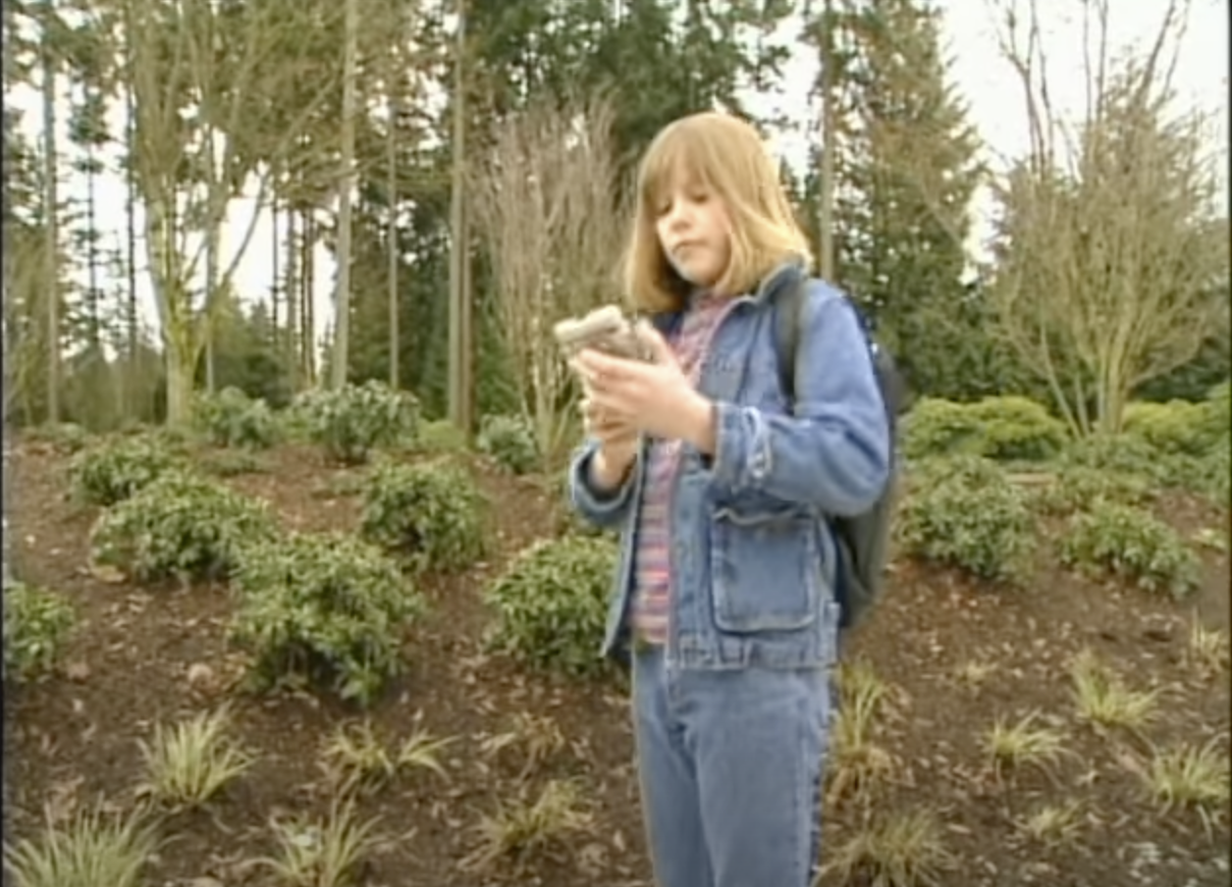
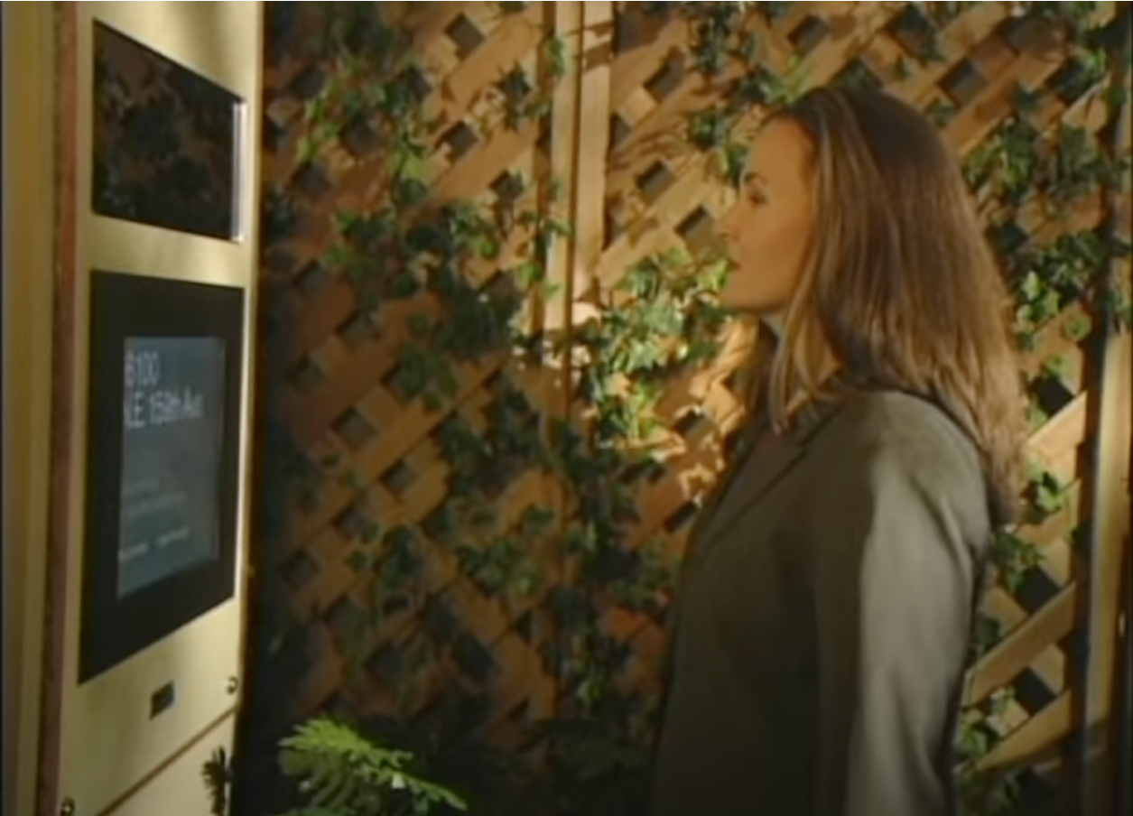
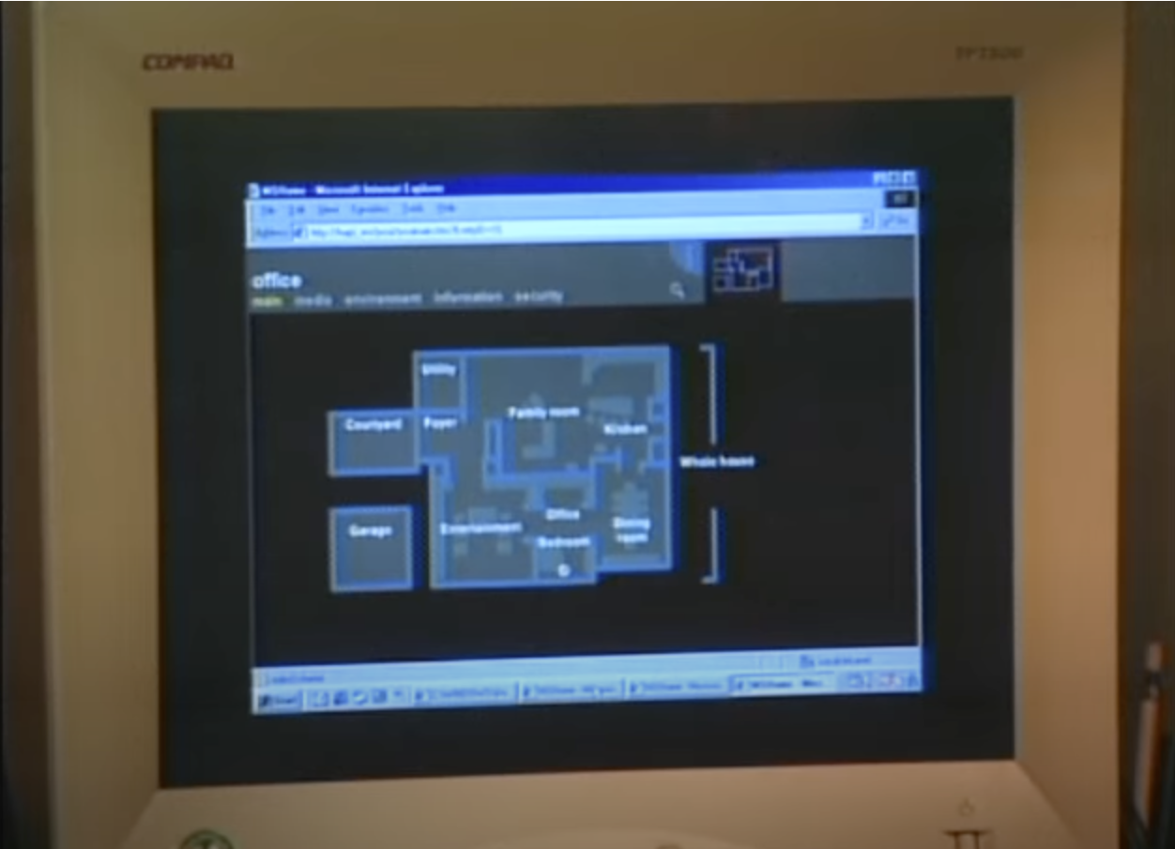
Microsoft’s 1999 vision video
Z

Slide 4
The dream
Cliché US suburban family & lifestyle
A house you can talk to
System admin is fun
Happiness all round
https://youtu.be/9V_0xDUg0h0

Slide 5
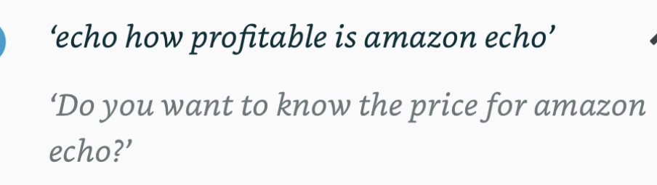
Yes, but does it work?
Amazon’s $10B question

Slide 6
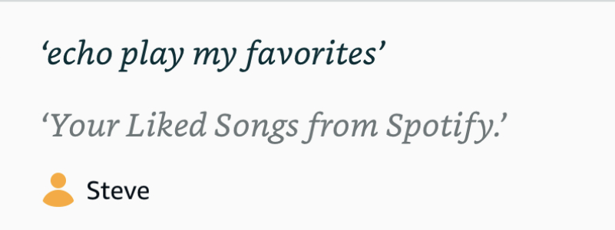
SELECT COUNT(1) FROM PLAYLISTS
WHERE NAME='liked' AND USER='steve'

Slide 7
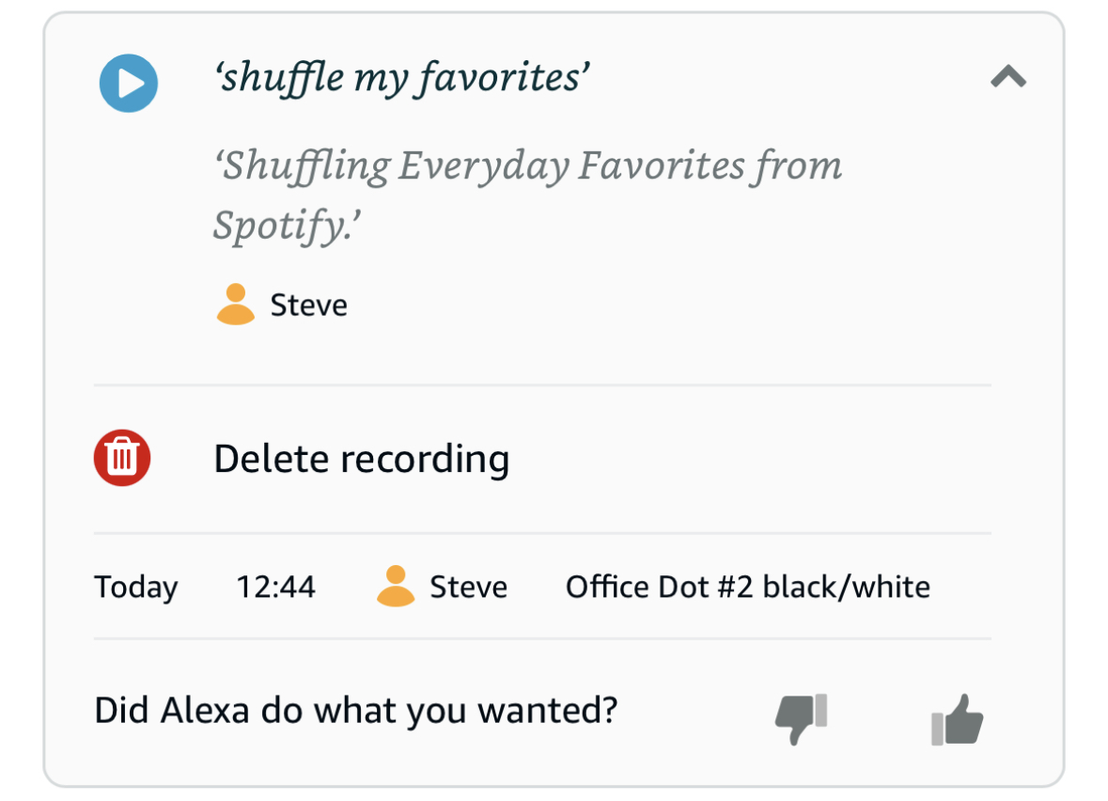
SELECT COUNT(1) FROM PLAYLISTS
WHERE LIKE '%favorites%'

Slide 8
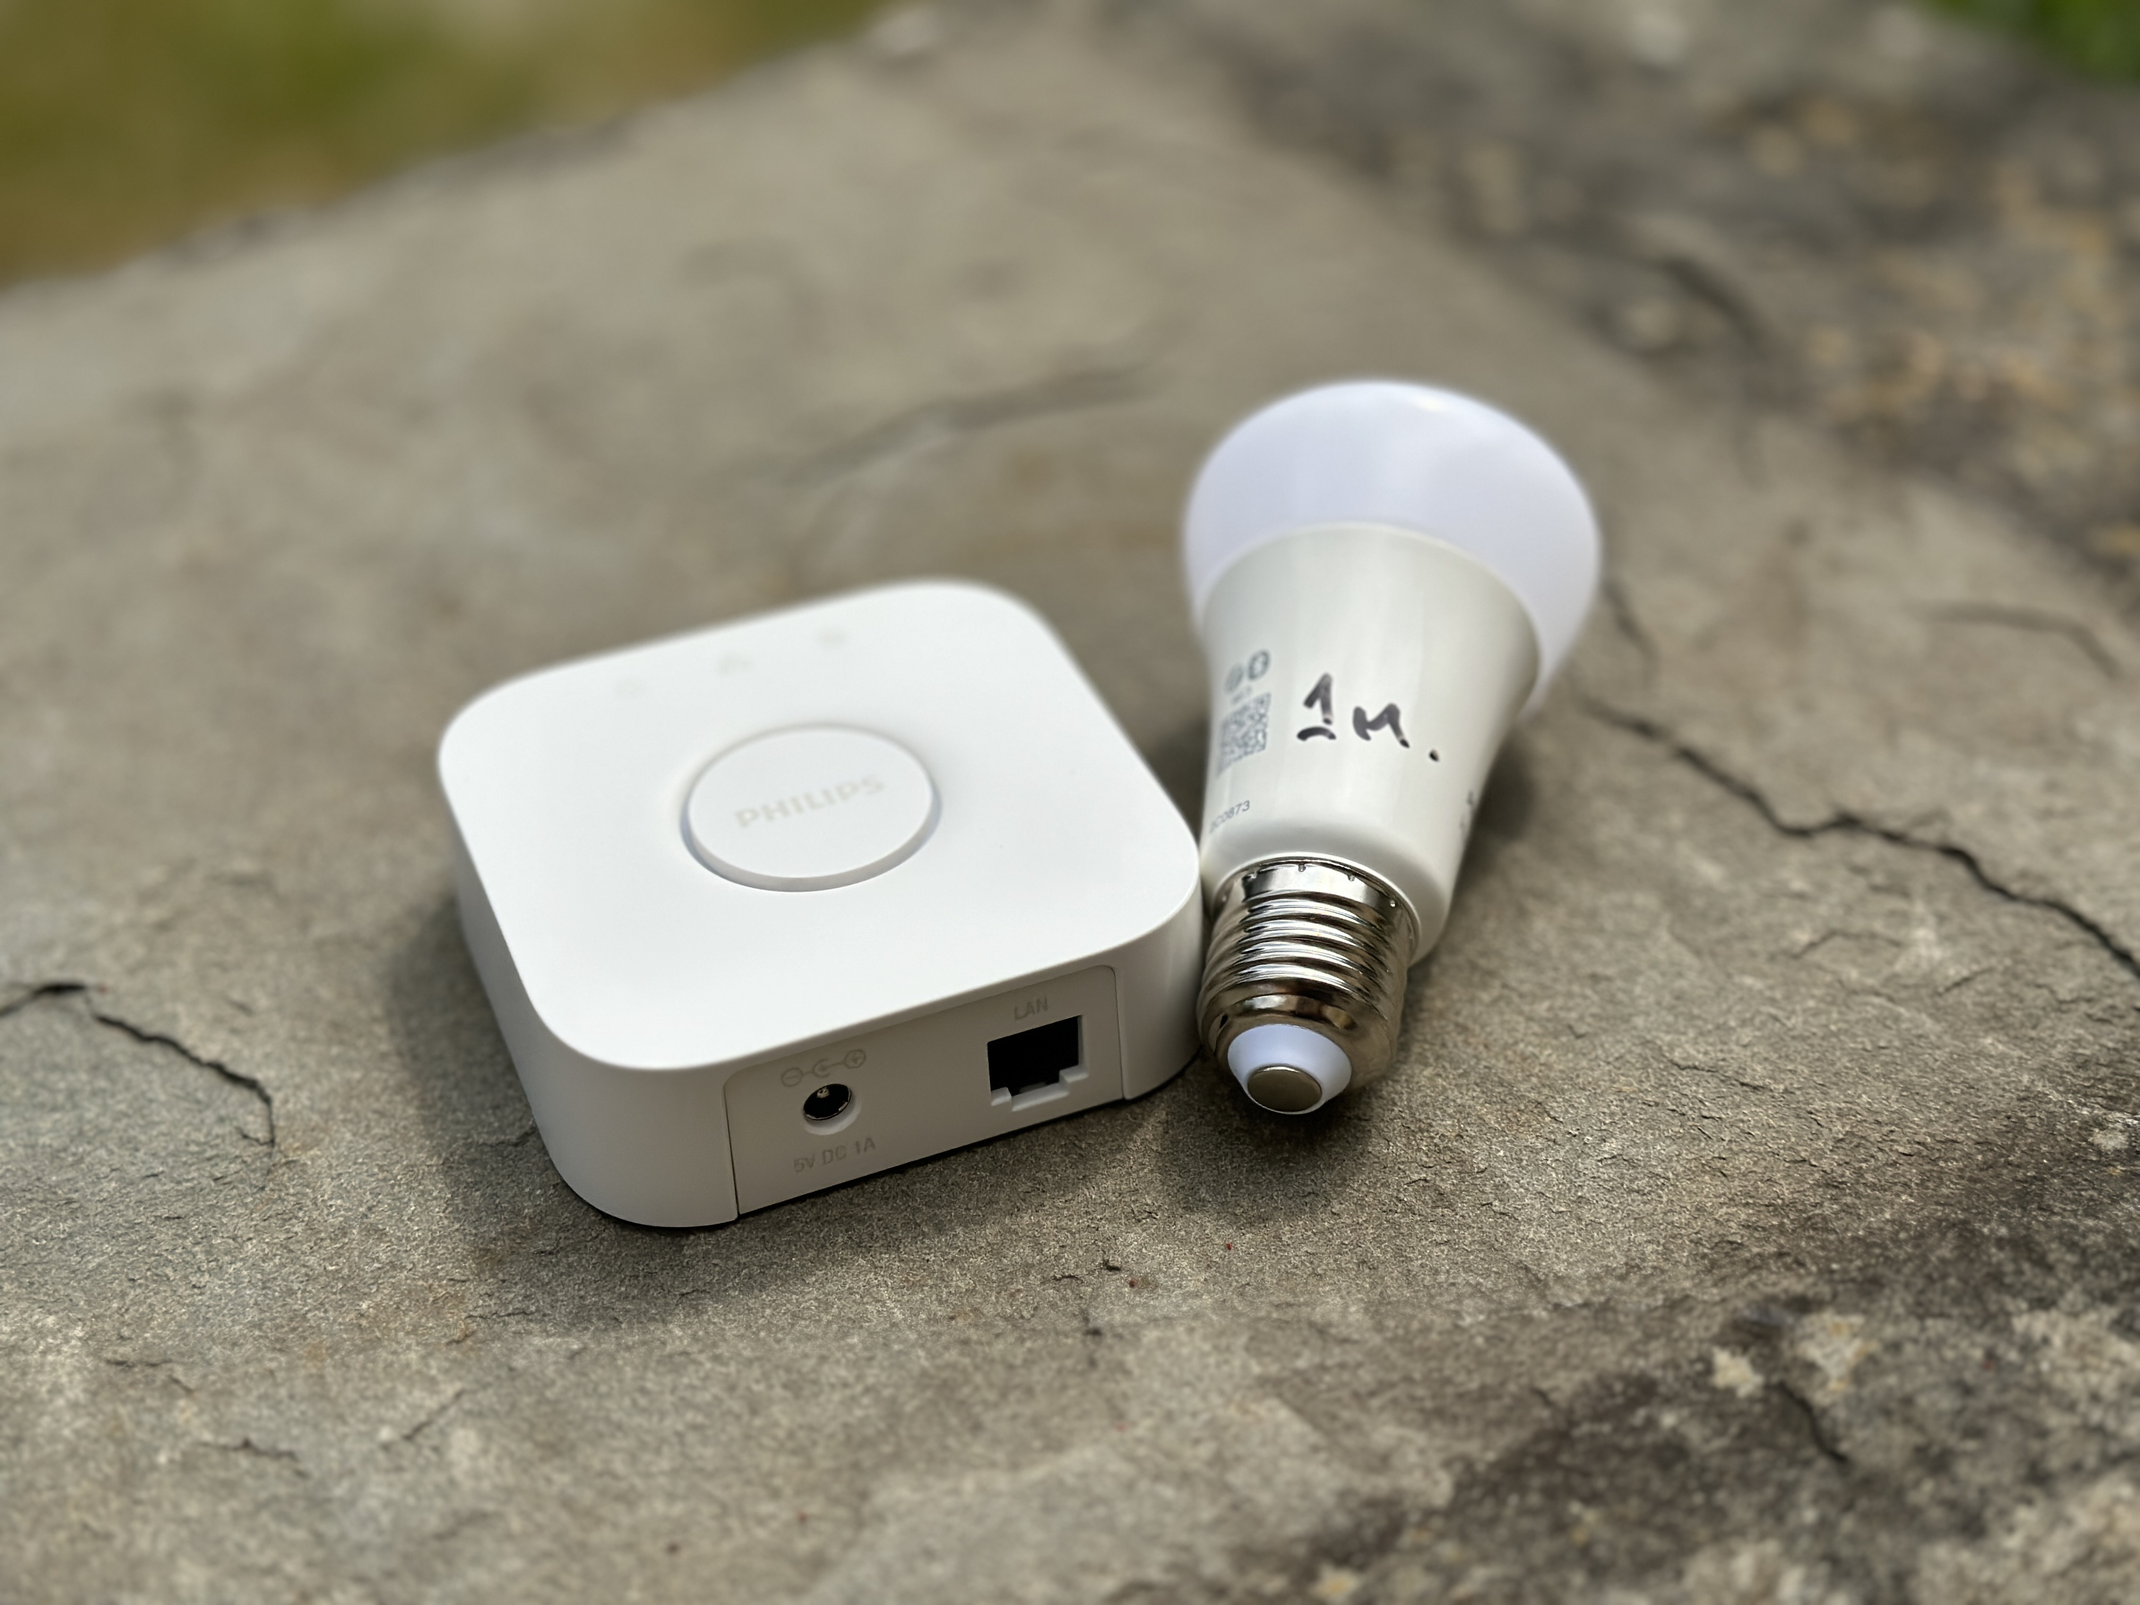
Home Automation: Zigbee
Ad-hoc multihop low-power network
Device discovery
Lights, switches, more
Plug-and-play products from device vendors (Philips, IKEA)
Retro-fit to existing lights

Slide 9
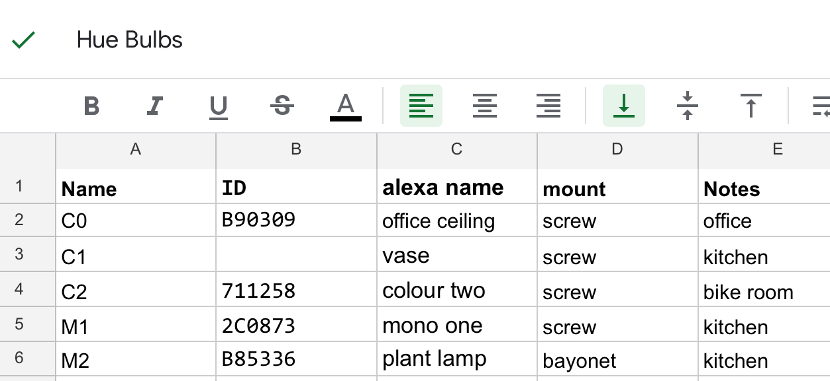
System Admin Fun
Critical mass of devices needed
Disassociation
Debugging
Vendor interoperability
2024: Thread + Matter may help

Slide 10
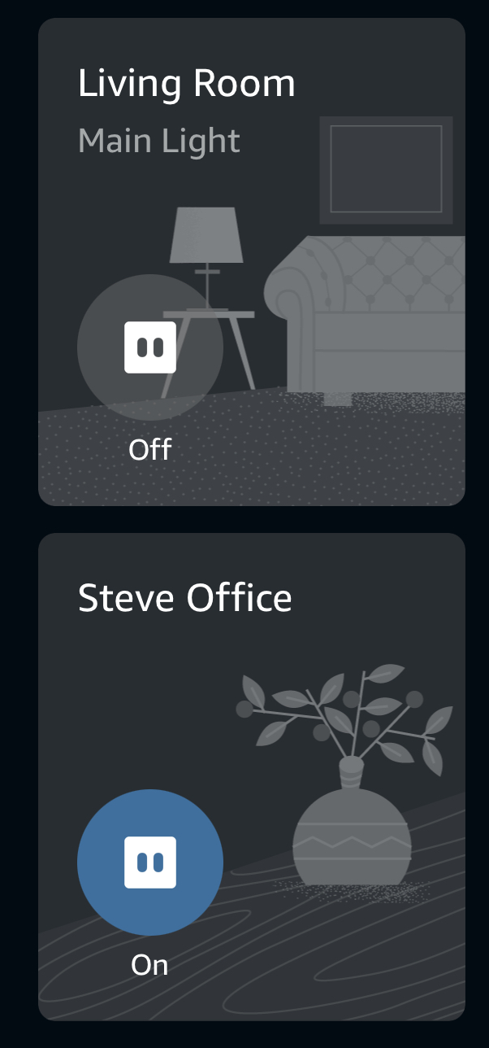
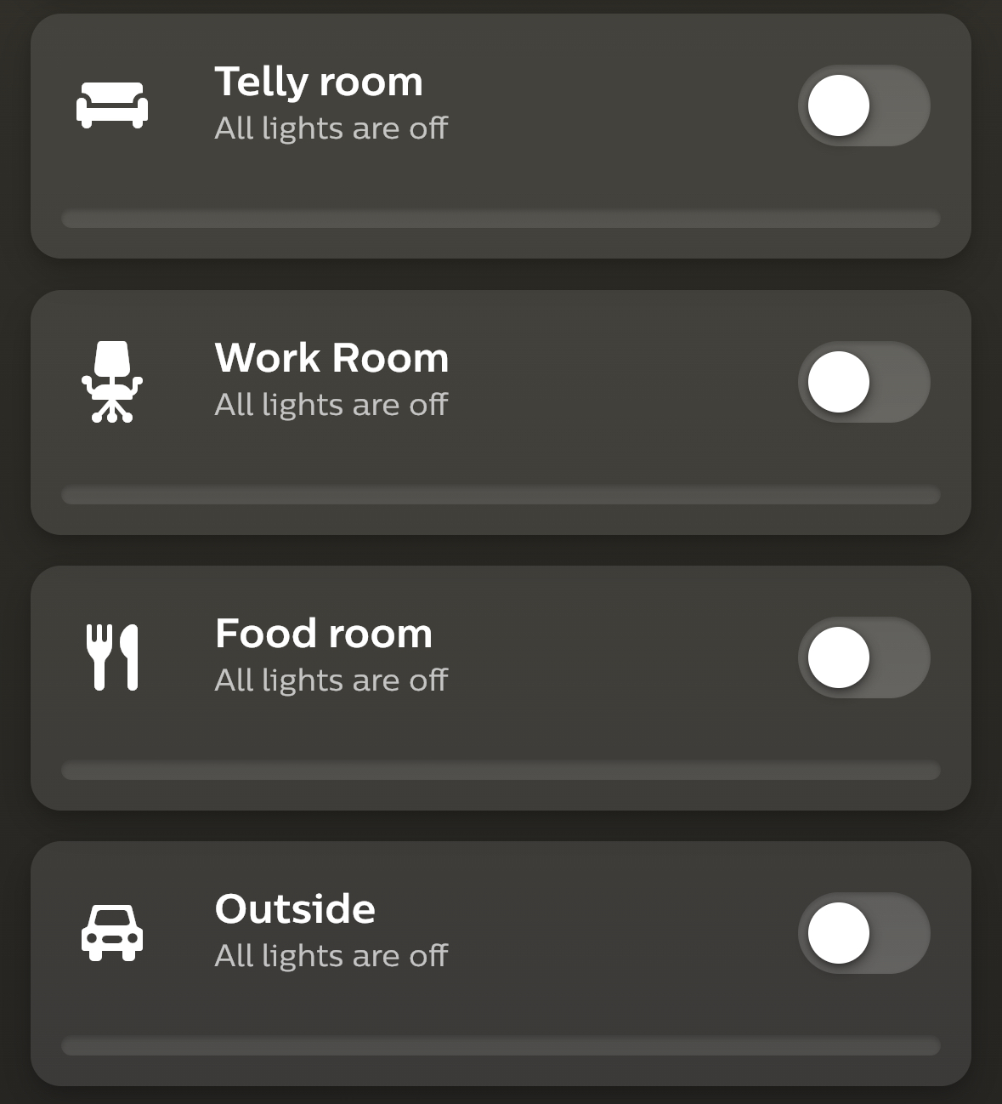
debugging "office"

Slide 11
Social structure is not handled
multi-user a 2.0 feature with bad assumptions:
static state of household
one user, one household
children don't grow up

Slide 12
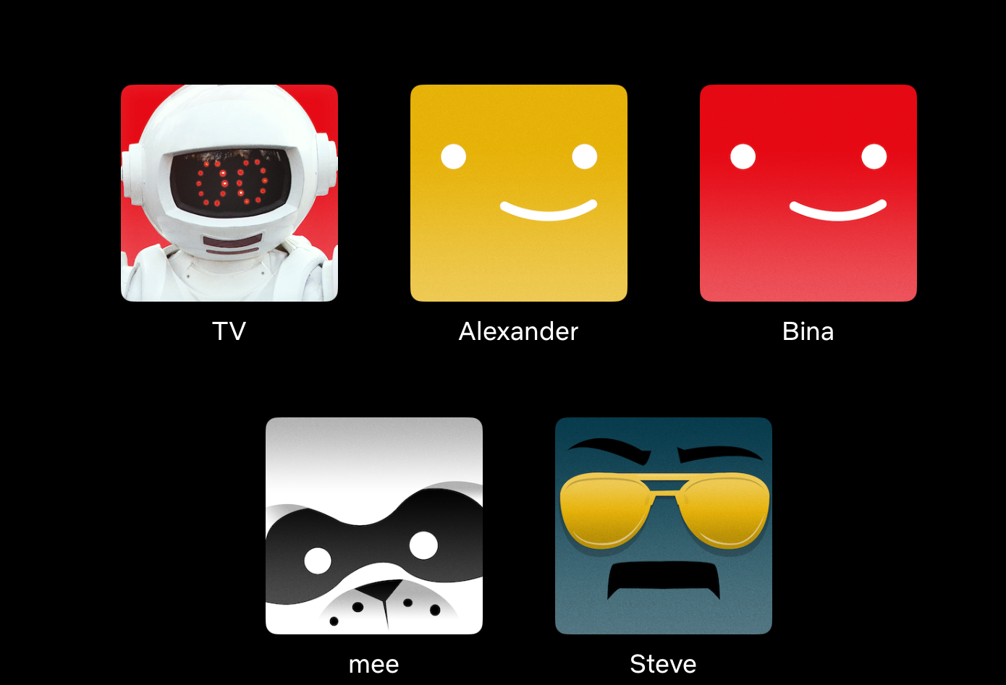
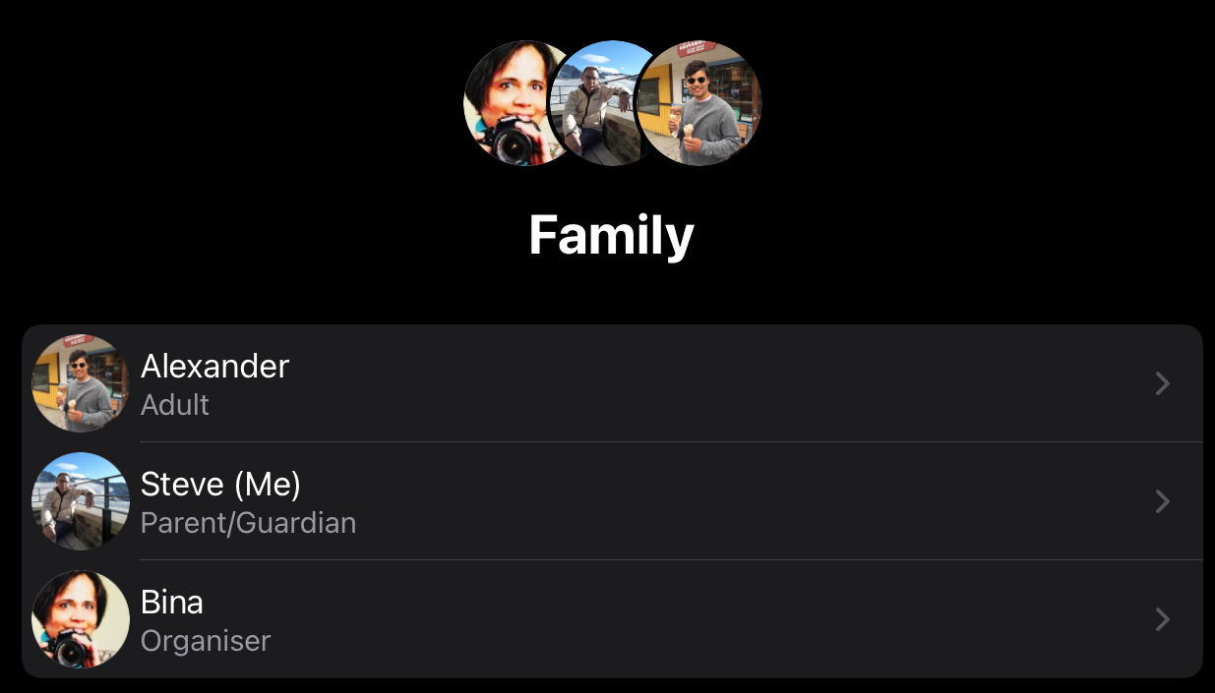


Slide 13
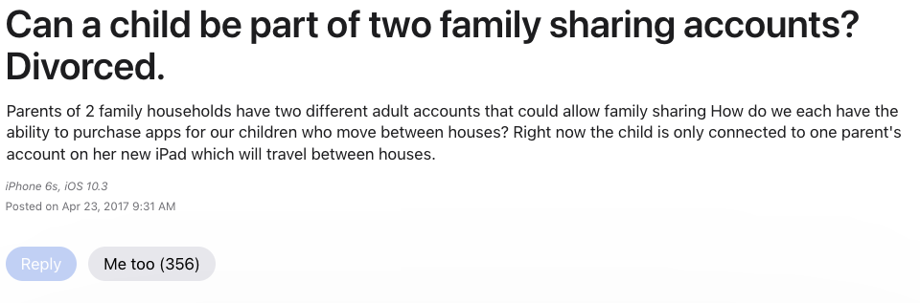
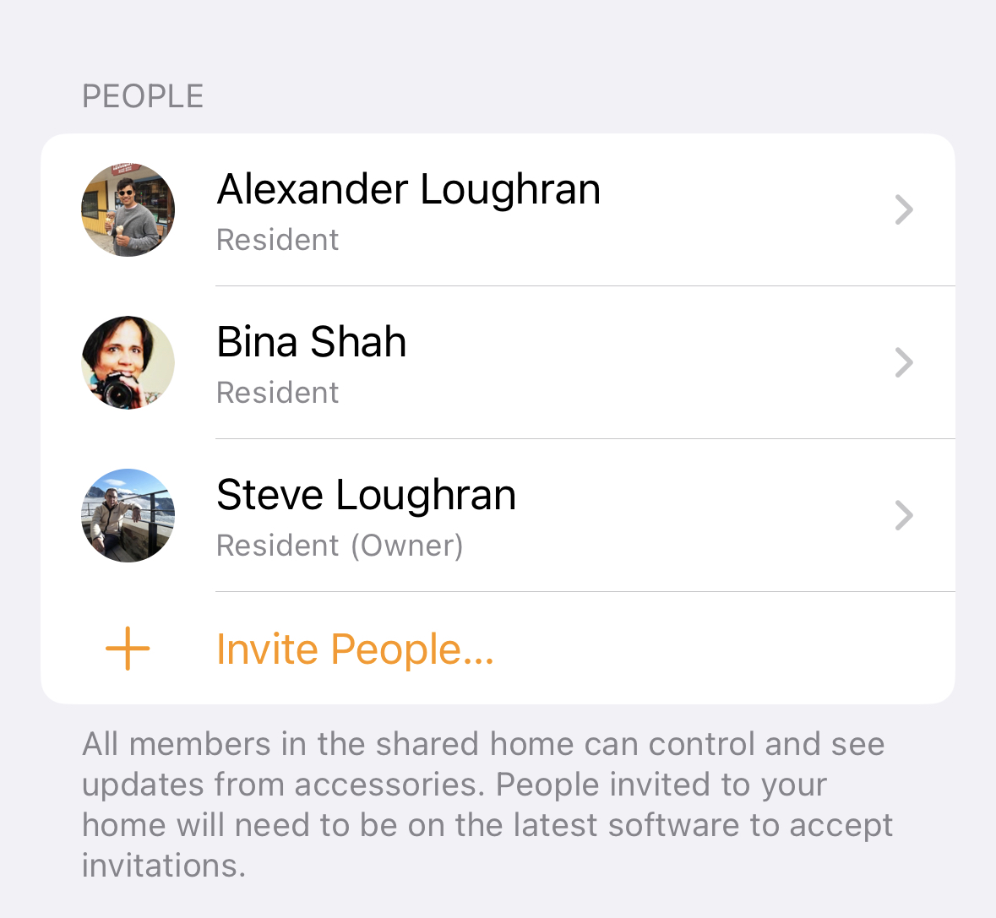
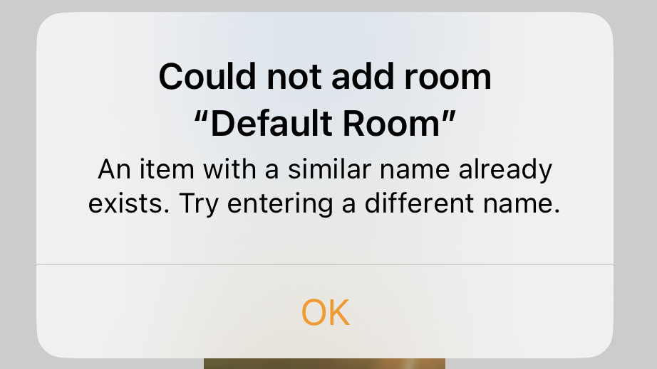
Surely Apple gets it right? No

Slide 14
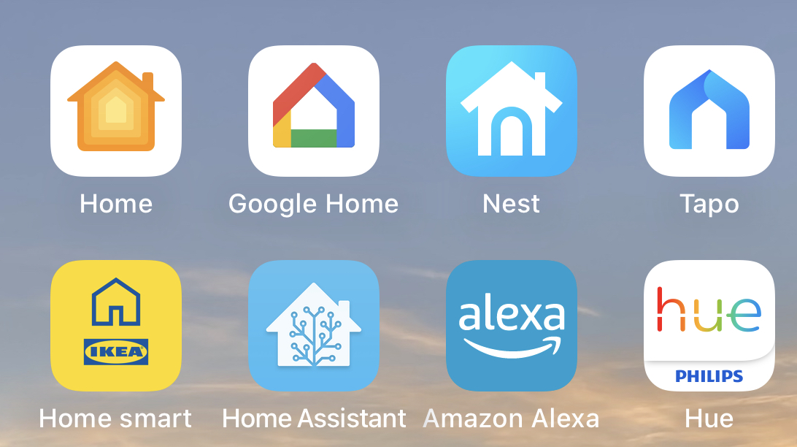
ecosystem conflict

Slide 15
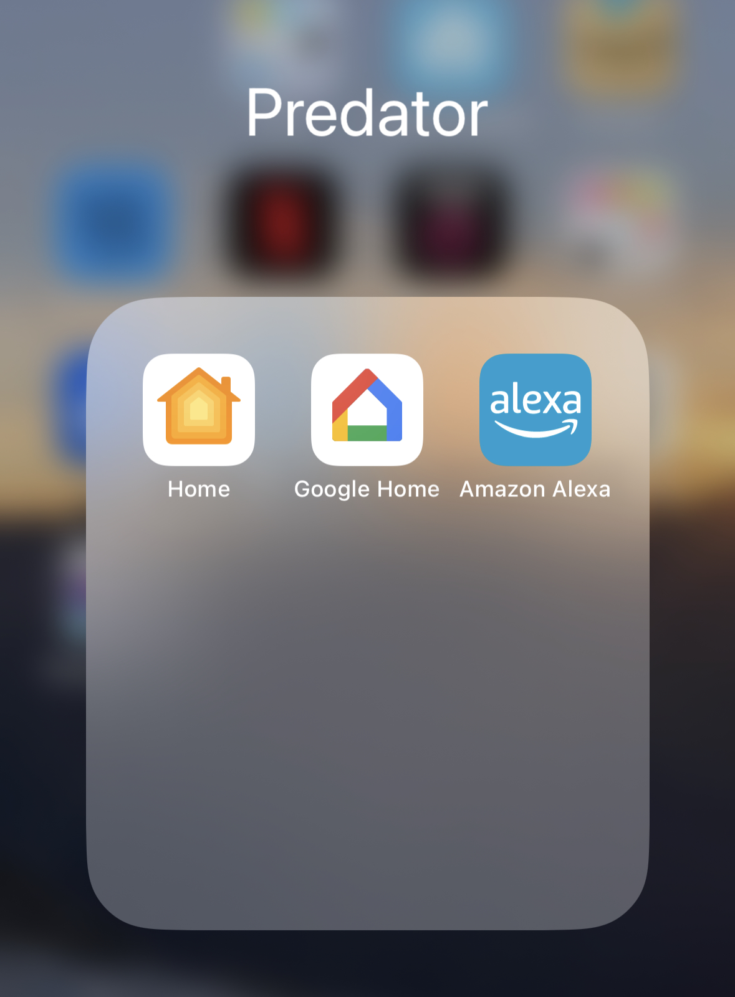
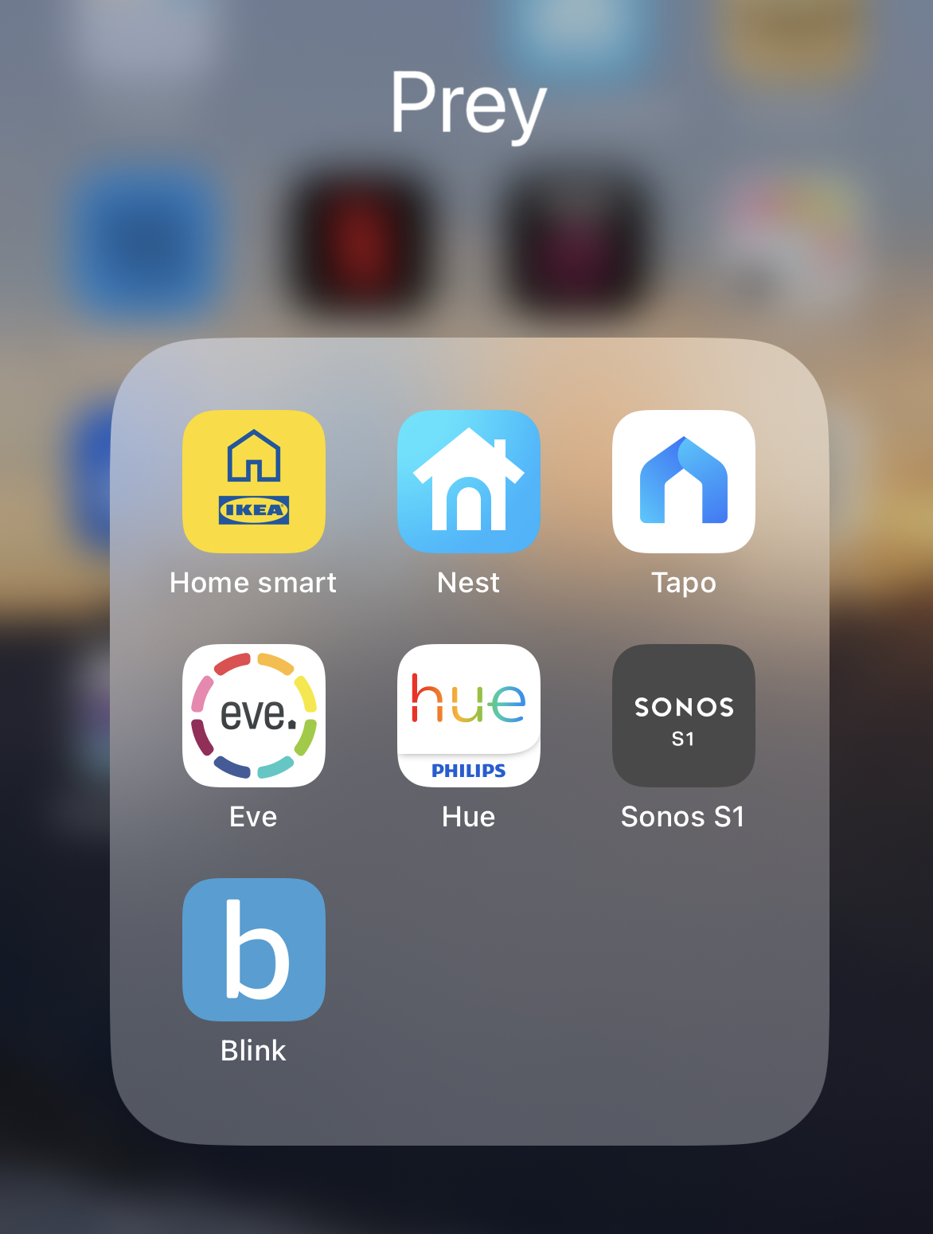

Slide 16
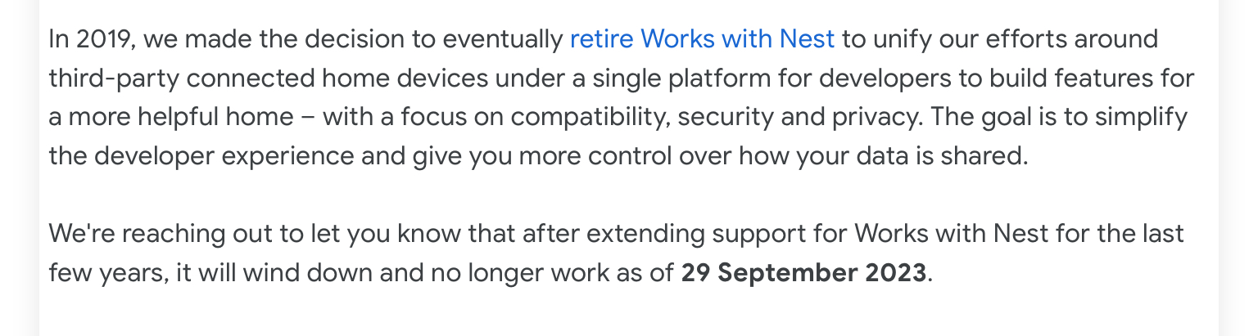
Prey gets eaten

Slide 17
Assertions
The phone represents people
Everything else is a peripheral
But: app-only is brittle & inflexible
Everything needs a Web UI and a Web API

Slide 18
What to do?

Slide 19
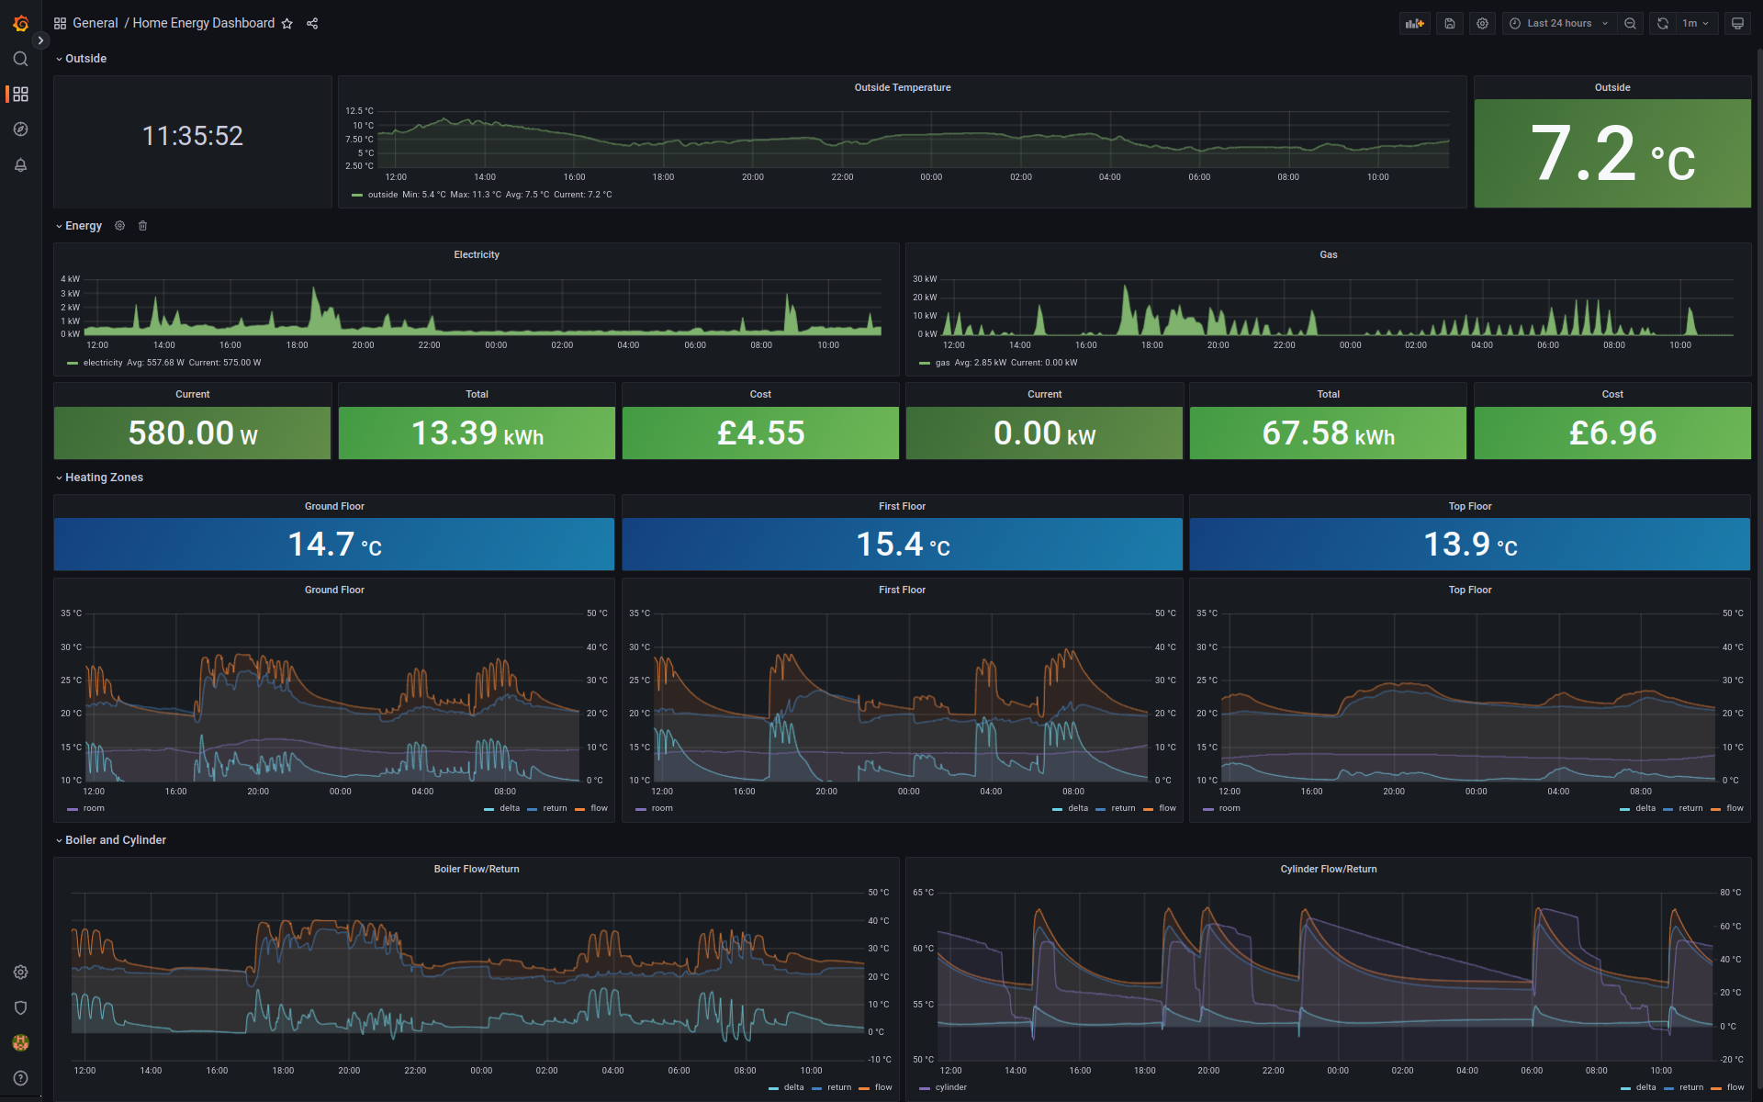
Fully self sufficient

Slide 20

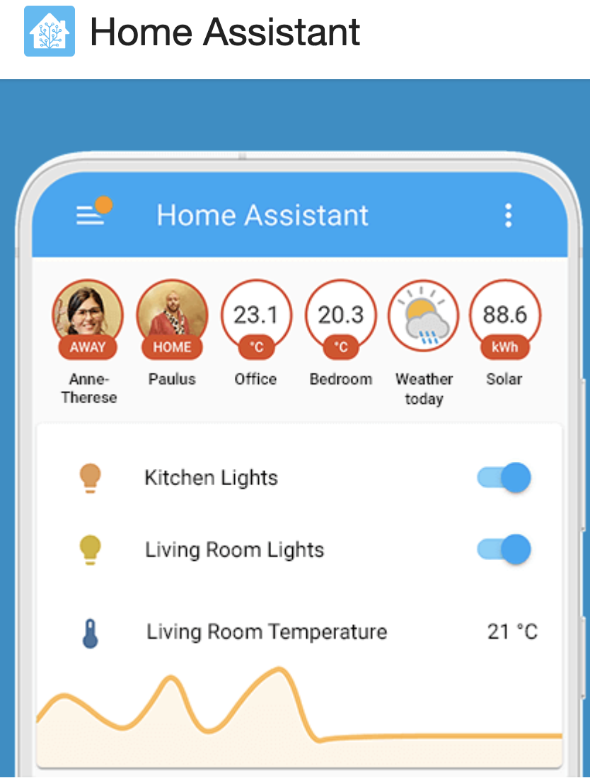

Slide 21
Give up and be happy?

Slide 22


Slide 23
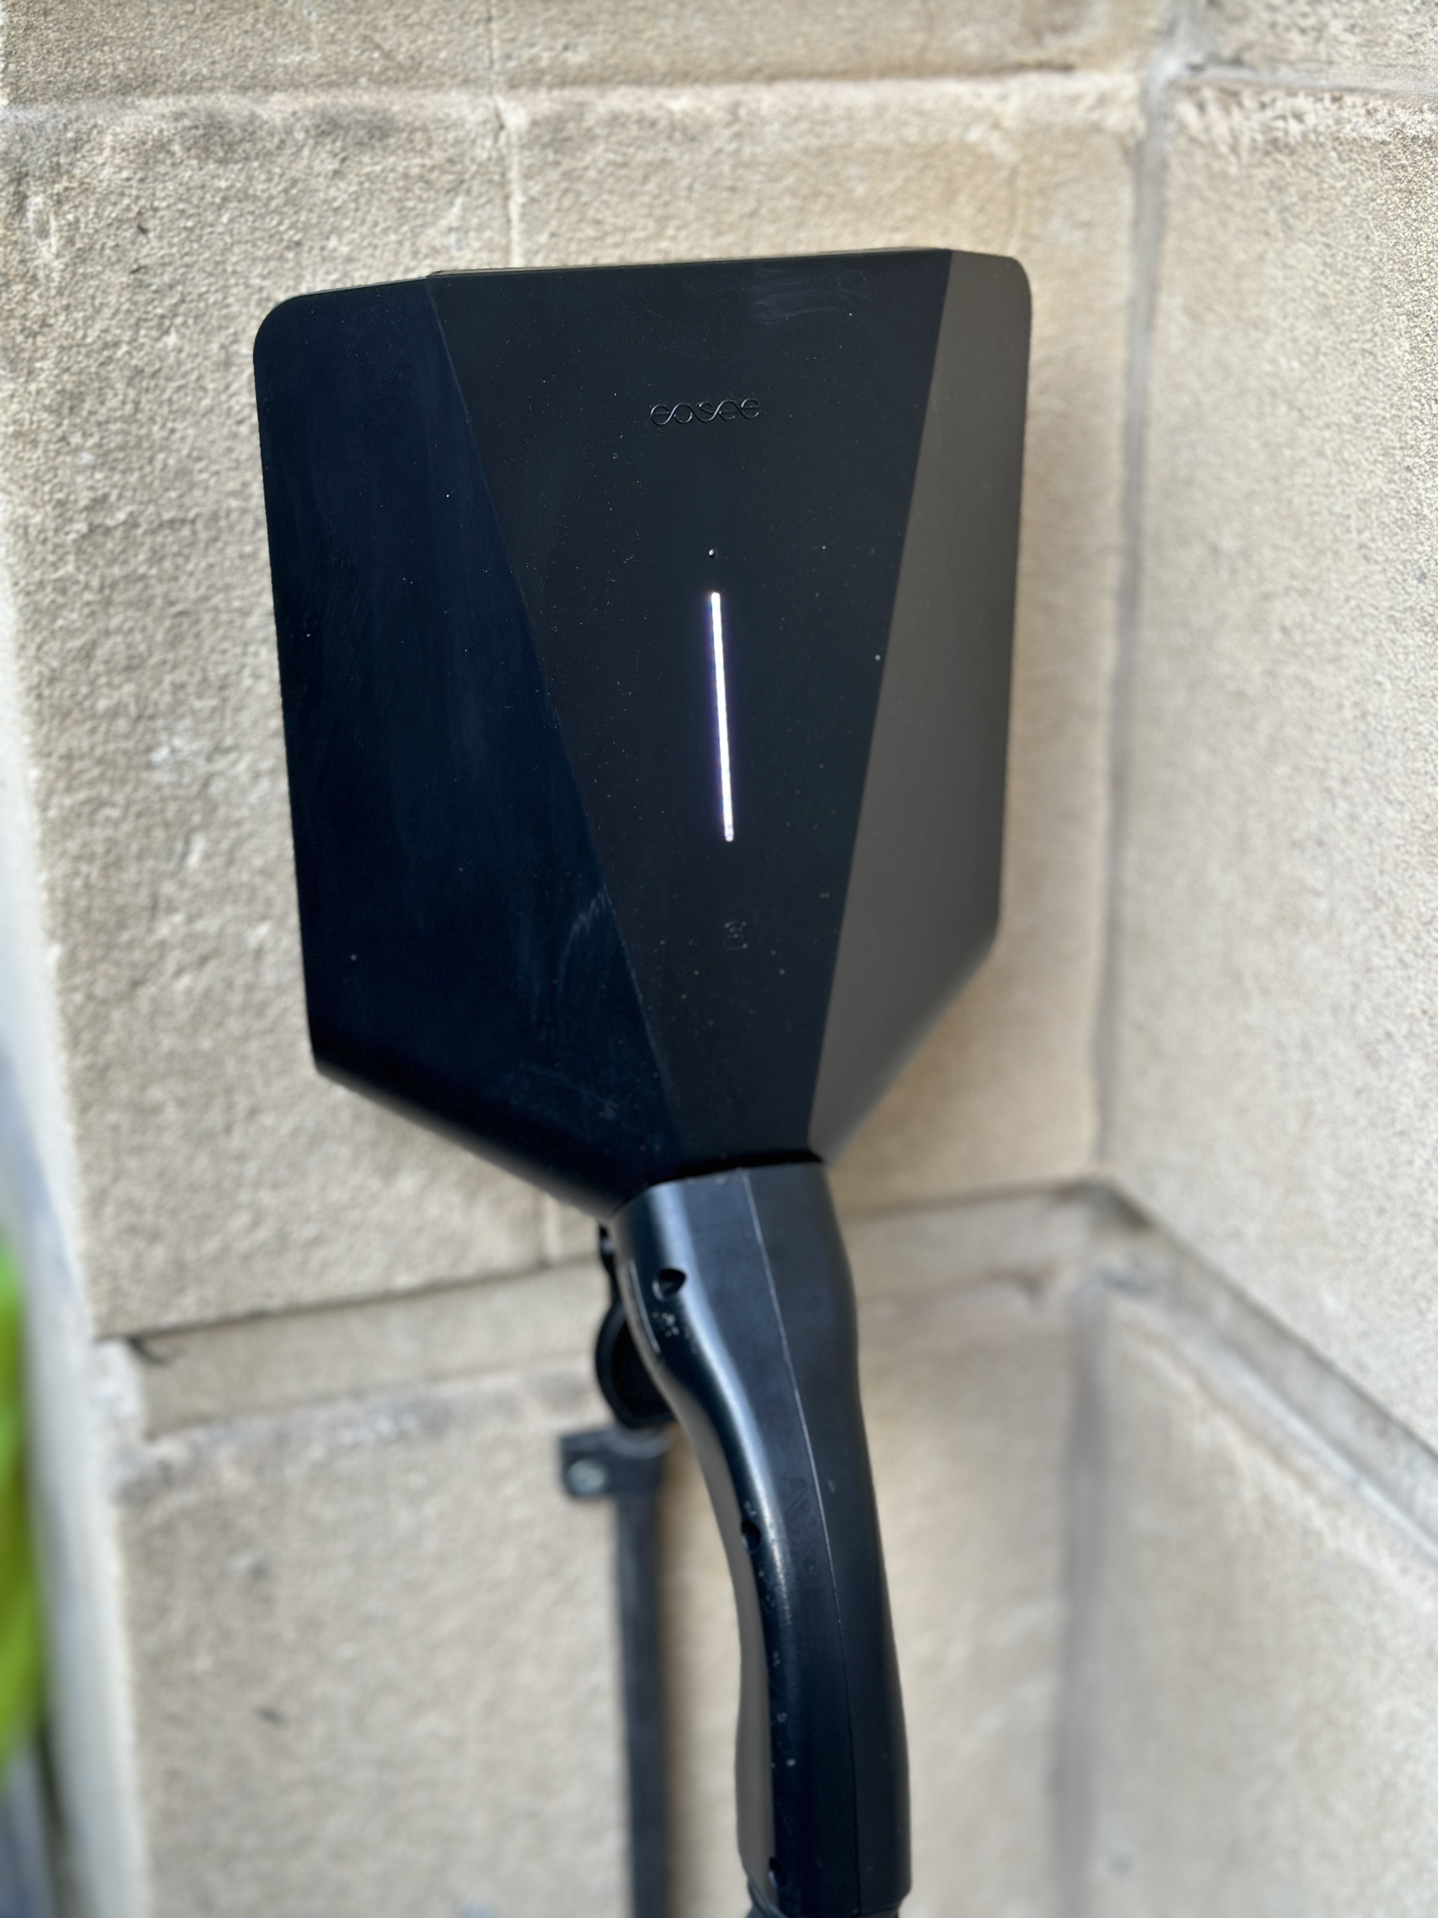

Slide 24

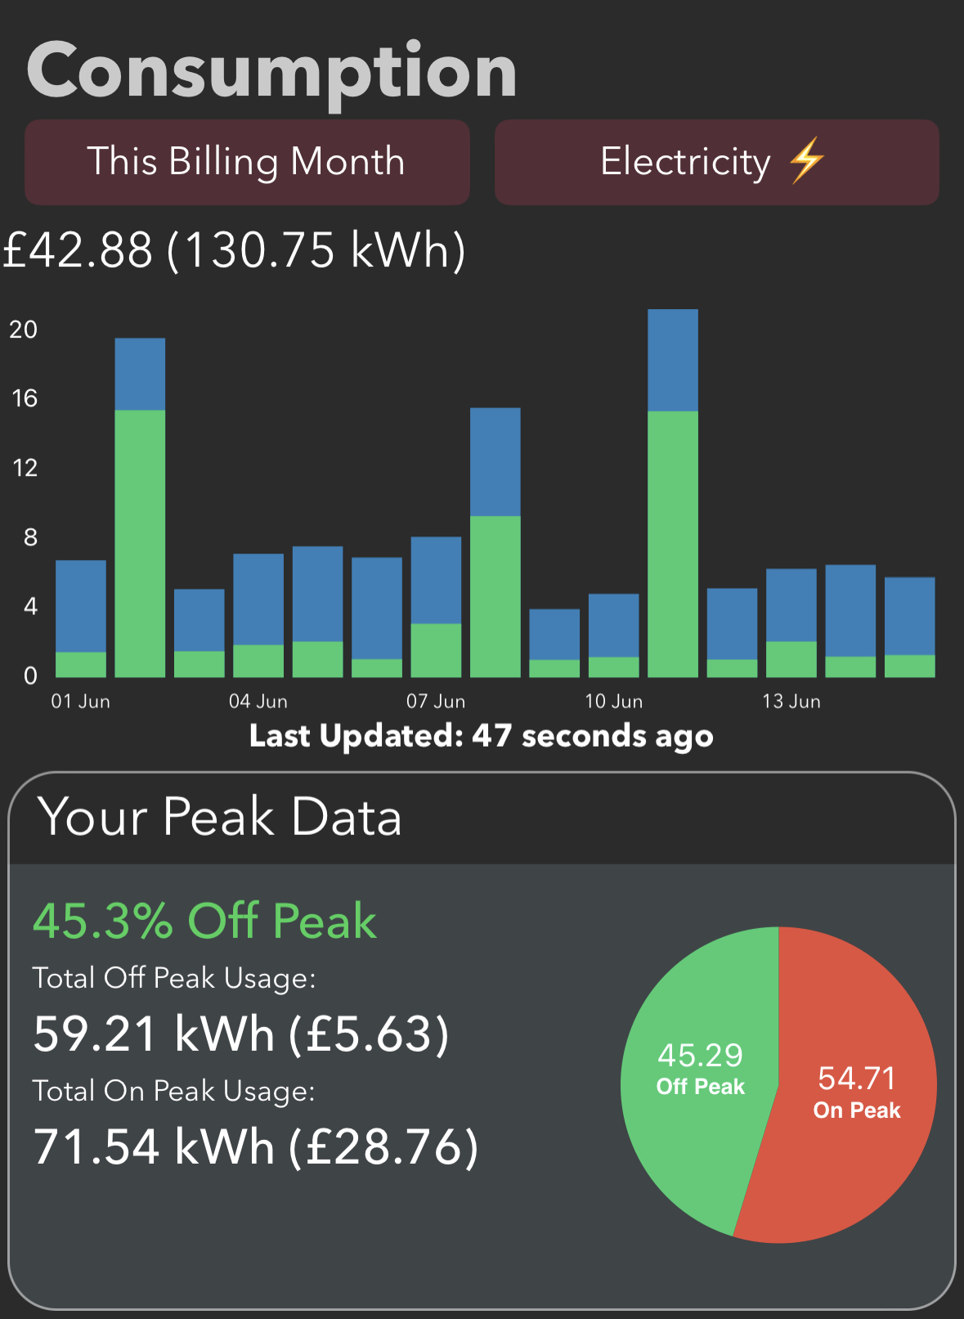

Slide 25
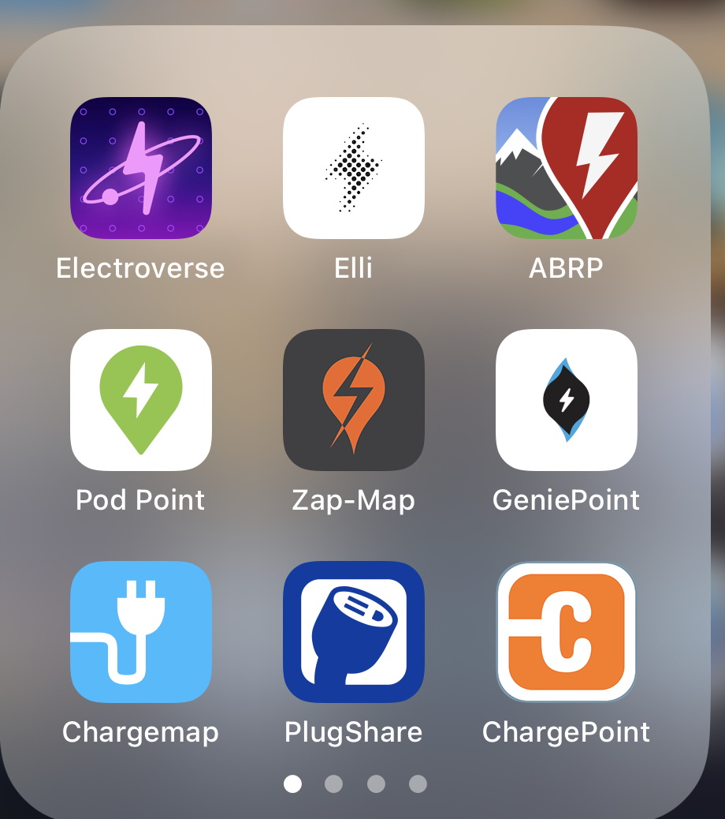

Slide 26
Same world, just outdoors
Weak social structure again
App-first/only world again
Manufacturers vs. phones again

Slide 27
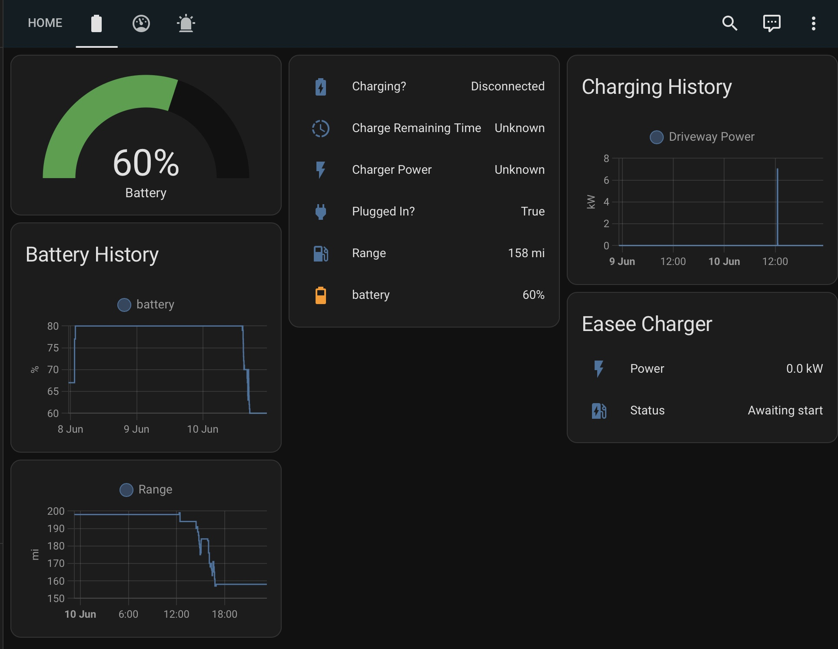
Home Assistant
+Tronity @ €5/mo

Slide 28

€5/mo

Slide 29
How we survive this world?
Subscribe to the startups!
Demand APIs everywhere!
Contribute to plugins!
Code for people!

Slide 30
Hadoop Vectored IO
Maschinenhaus
13:50

