Slide 1

  Steve Loughran

Slide 2
Topics
What is Ivy?
What does it do?
ivy.xml
Managing dependencies in a single project
Publishing artifacts
Choreography
Repositories
Migrating to Ivy
Continuous Integration
Offline use

Slide 3
What is Ivy?
an antlib; a JAR that adds new tasks to ant
Dependency management tasks Ant
  can fetch artifacts from remote repositories
  can publish files to a local repository
  can determine the correct order to build a set of projects.
Ivy does not change how you build, only how you set up the classpath, and (possibly) how you publish artifacts in a build

Slide 4
What does it do?
reads in the ivy.xml files of each project, containing module name, artifacts, dependencies
resolves the dependencies
  transitive dependencies
  pulls in metadata from maven and ivy repostories
  conflict resolution (plugins)
reports on dependencies (nice)
can set up paths to locally cached artifacts
can copy all artifacts to a directory
can publish project artifacts to a repository

Slide 5
Concepts
  organisation the project/group behind the code
  module a single project within the organisation
  artifact anything produced in the module
  listed by (organisation,module,version)
  ivy.xml per-module metadata
  ivyconf.xml Ivy configuration for a build
  repository local or remote store of artifacts
  dependency an artifact that a module depends on
  configuration a specific configuration of a module, with its own dependencies and artifacts
  resolution the act of determining the complete dependencies of a module, and fetching them

Slide 6
ivy.xml
<ivy-module version="1.0">
<info organisation="org.smartfrog" module="sf-testharness"/>
<configurations> ... </configurations>
<publications>
<artifact />
</publications>
<dependencies>
<dependency org="org.smartfrog" name="smartfrog"
changing="true"
rev="latest.integration">
<dependency org="org.smartfrog" name="sf-tasks"
changing="true" rev="latest.integration">
<dependency org="junit" name="junit"
rev="${junit.version}">
</dependencies>
</ivy-module>
organisation details
configurations
artifact matches the module name
depend on smartfrog
latest version; check for changes every run
depend on sf-tasks
junit is not changing; version set in
components/libraries.properties
Notes:
Every module needs an ivy.xml file

Slide 7
ivyconf.xml : configures Ivy for a build
<ivyconf>
<include url="${ivy.default.conf.dir}/ivyconf-local.xml"/>
<conf defaultResolver="default"/>
<resolvers>
<ibiblio name="maven2" m2compatible="true"
root="${ibiblio-maven2-root}"
pattern="${maven2.pattern.ext}" />
<chain name="default" dual="true">
<resolver ref="local"/>
<resolver ref="maven2"/>
</chain>
<chain name="internal">
<resolver ref="local"/>
</chain>
</resolvers>
<modules>
<module organisation="org.smartfrog"
name=".*" resolver="internal"/>
</modules>
</ivyconf>
build in resolver
ibibio repository
default resolver looks local, then remote
internal resolver is local only
internal resolver is local only
org.smartfrog artifacts are only
resolved using "internal"
resolvers can include conflict resolution policies
Notes:
The ivyconf.xml file defines how ivy is configured for the rest of the run,and how artifacts are resolved. it is important to get right.
the real file is in antbuild/ivy/ivyconf.xml; it adds a repository under SCM, and some more artifacts to resolve locally only.
It still uses the build in resolver, which is use latest version

Slide 8
Repositories
http://mirrors.ibiblio.org/maven2
You have to be online the first time you build
  set ANT_OPTS=
  -Dhttp.proxyHost=web-proxy -Dhttp.proxyPort=8088
Pretty painful for laptops
And no, Java1.5's proxy stuff doesn't work.
Security: SHA1 checksums verified, but no signatures
Best search site: http://mvnrepository.com/
Notes:
This is critical for anyone building inside HP. You must have your IDE and Ant set up with the proxy settings when you need to hit the remote repository. for files in cache, or from the SCM-managed repository, you dont need this.
We do have a local cache of the repository on brunel2, but it is not updating against the server or officially live. When it is, it should be a first choice for a local repository in Bristol, as it is very fast.

Slide 9
Managing dependencies
Use http://mvnrepository.com/ to find things
Use Ant properties to define versions in the file
declare versions in components/libraries.properties
Exclude things you do not need
Depend on the master configuration if you don’t want transient dependencies

Slide 10
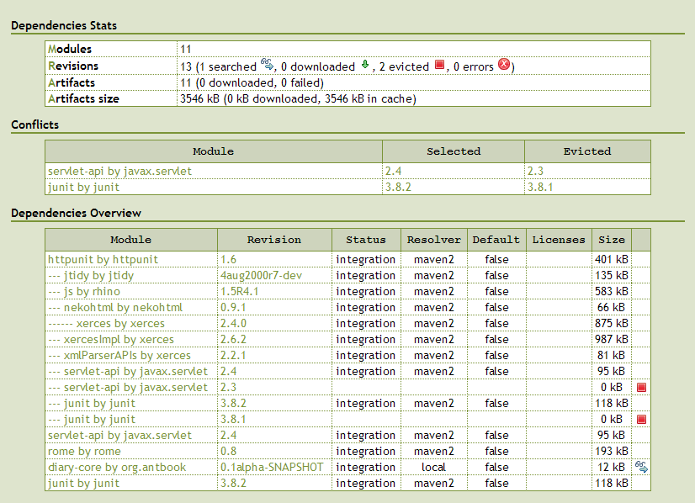
Conflict Managers: latest time, latest version, all, halt, custom
Notes:
Conflict resolution is extensible. The most efficient built in is latest-by-version.
-All adds everything
-latest-time: by timestamp
-latest-version: by version number
-strict halts if there is a conflict
-custom conflict managers are allowed; there are some helpers to start you.
There is no built in equivalent of Maven2's "closest artifact" policy

Slide 11
Publishing artifacts
ivy-publish target.
ivy xml lists artifacts
Could stop numbering files at build time?
Add test JAR and javadoc zip as artifacts
Extend library components with policy to read JARs from the local Ivy cache & repository
=> let's us dynamically load in artifacts from the cache from deployment descriptors

Slide 12
Choreography
Ivy can create an graph of dependencies
and turn it into a list for <subant> to call.
All build files in components/ extras/ with an ivy.xml file get included.
even those that don’t use it to set up their paths
As does any third-party project under external/
makes it easy to merge things in

Slide 13
Migrating to Ivy
Nobody can build without Ant set up to use proxies
  <property name="ivy.enabled" value="true" />
  ant published //publishes all artifacts
  ant ivy-report //creates the report
Test targets should depend on test JAR being packaged; this JAR is added to the classpath, not build/test/classes
Every build file needs a 'published' target to publish the JAR artifacts to the local repository.
Need Standard ivy configurations across all projects

Slide 14
Release Process
core/release is a project to aggregate all known artifacts
what do we do with them?
We can do the same for javadocs
But what about the source?
We need to publish (signed?) sf jars to the ibiblio repository
Proposal: strip all JARs from the source tree, make the source distro a complete zip of core/

Slide 15
Continuous Integration
Projects need to publish artifacts for later builds.
Could have a nightly target to flush the locally published artifacts (~/.ivy/local) so that we know everything is still working
CI server needs proxy setup too

Slide 16
Other issues

Slide 17
Summary
Ivy gives us dependency management
cross-build choreography
SmartFrog uses to build
We still need to do the release process
And CI (Gump, CC) are still stabilizing
Don't forget to set up your proxies!
Work with me if you need help setting up your build

Slide 18
Call to Action
Write ivy.xml files for all projects
Hand off classpath setup to Ivy
Add new configurations for custom tasks
Work with me if you need help
Don't forget to set up your proxies!

