Slide 1
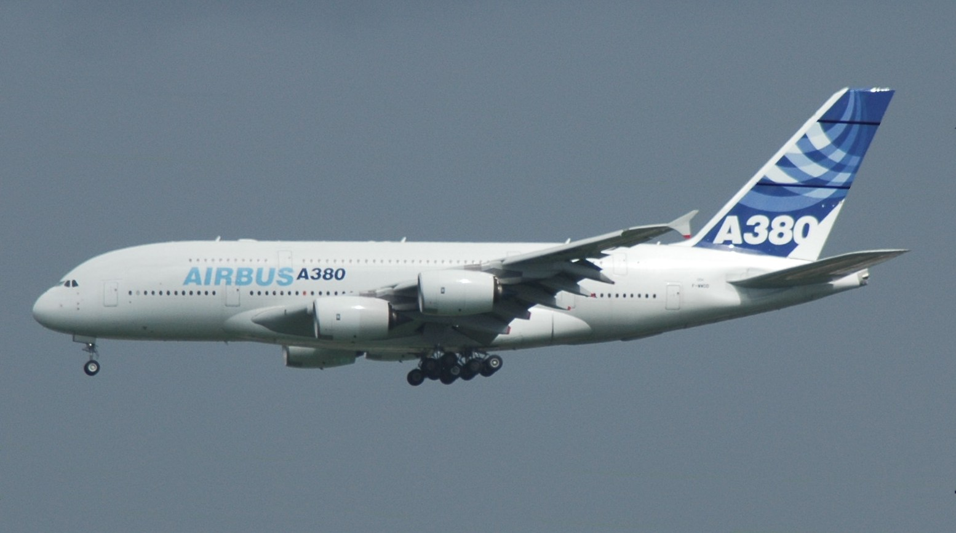
Long Haul: the dream

Slide 2

Where we are today

Slide 3
Long-Haul Hadoop
HADOOP-
This is not an Apache problem, but we'll need to work with the OS vendors & others to integrate
5
4 August 2009
Notes:
Public EC2 images are growing at 10% month -nice earner for Amazon.
Brings on lots of maintenance costs to users, plus security risks.
For short-lived images, better to have tools to create OS images from a list of deb/RPM files and any other state changes -you needed to automate that system config anyway, didn't you?
This is not the Apache focus point -but we need to work with people doing this as their business plan is keeping our cloud services up and running.

Slide 4
In-datacentre: binary
Hadoop RPC, Avro, thrift
Efficient
Brittle – fails with odd messages
Insecure - trusts caller

Slide 5
long-haul: WS-*
Integrates with SOA story
Can integrate w/ WS Management tools
BPEL-ready
Auto-generation of client code from WSDL
Auto-generation of WSDL from server code
Stable Apache stacks
Security through HTTPS and WS-security

Slide 6
Workflow Options
HADOOP-5303 Oozie, Hadoop Workflow System
Cascading
BPEL (!)
5
4 August 2009
Notes:
Public EC2 images are growing at 10% month -nice earner for Amazon.
Brings on lots of maintenance costs to users, plus security risks.
For short-lived images, better to have tools to create OS images from a list of deb/RPM files and any other state changes -you needed to automate that system config anyway, didn't you?
This is not the Apache focus point -but we need to work with people doing this as their business plan is keeping our cloud services up and running.

