Slide 1
Benchmarking
Steve Loughran
Julio Guijarro

Slide 2
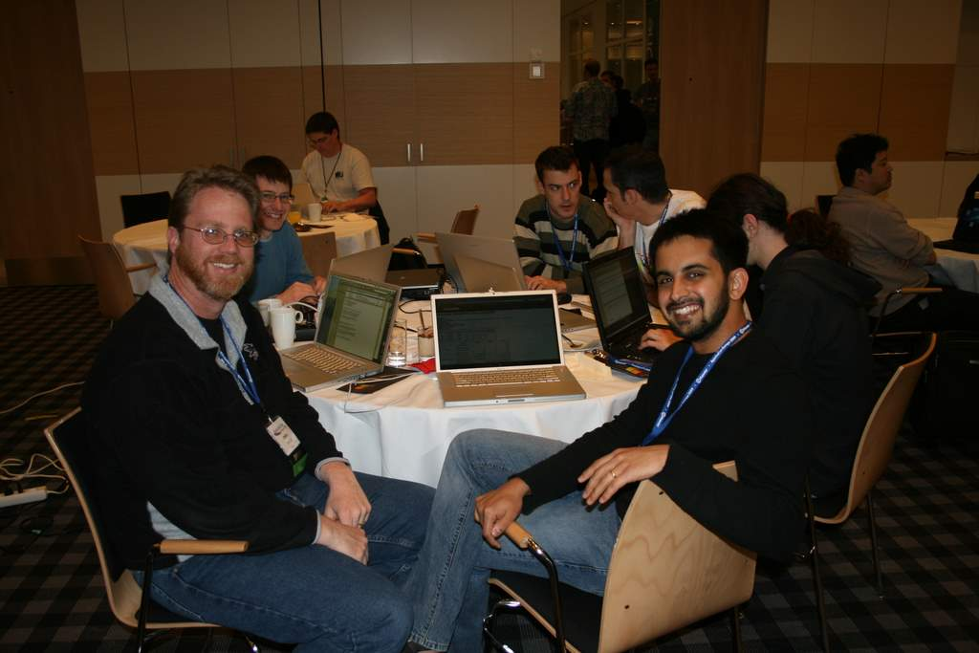
Benchmarks
Notes:
This is Owen and Arun at apachecon, smirking as they have just set a new record for a Terasort

Slide 3
Some Problems
Estimating Hadoop performance of hardware
Estimating Hadoop performance of a cluster
Designing Hadoop-ready servers
Designing Hadoop-ready clusters
Optimising the network for Hadoop
Optimising Hadoop/HDFS for specific applications

Slide 4
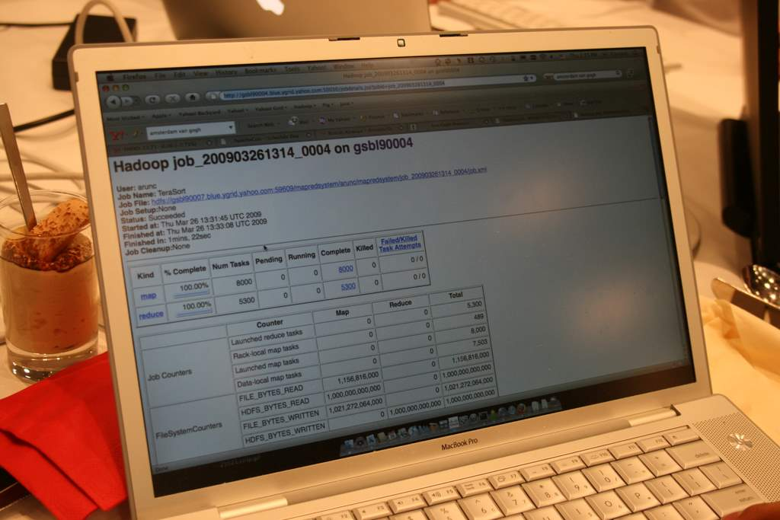
Notes:
This is what we have today, terasort.

Slide 5
Recent customer request
"They want data for
Hadoop Sort
for 100GB."

Slide 6
Terasort: what else?
PageRank: CPU intensive, small (static) input dataset
Something that stresses RAM and CPU
Something that seeks in the files?

Slide 7
Test Datasets
Wikipedia: 5-10 TB of XML data with changes; user relationships have to be inferred
SpamAssassin: 70+ GB of SPAM
Physics? Something Small?
Notes:
Thomas says:
I am working on two data sets. One contains all the text of all revisions on all wikipedia pages (articles, talk pages etc), and is about 18 GB in 7zip format. I am still working on making it sit well in Hadoop so that the researcher can process it in the way he wants. It requires some expensive custom non-parallelizable preprocessing since 7zip is not supported by Hadoop and it is not splittable. The 18GB file in uncompressed form is about 5-10 TB of xml depending on how we preprocess it. The second data set is a dump of the text and meta data for all the latest article revisions. In uncompressed Hadoop readable format it is just ~20GB.
There is no inherent friend structure among users so you have to infer it based on them editing the same articles or articles in the same category, etc. There is also a wikipedia dump of how pages reference each other, but the dump is in SQL format and my db just chokes when trying to read it because it is too big. References within pages are pretty easy to extract from the text though with either of the two data dumps I mentioned above.
In terms of using wikipedia as a reference dataset, yes indeed that is our intention. And going one step further we are also planning on providing a Wikipedia Hadoop API that allows Wikipedia researchers to easily plug in their analyses to easily do various studies without having to worry about the Hadoop layer.
In terms of Hadoop support I have been talking to some people at Yahoo! and they are working on a bzip codec since most wikidumps are in bzip format. There is also an xml reader in the streaming contrib that we are using. Neither of these efforts will solve the problems we have with the huge revision data set though. In either case it demonstrates the value of doing the preprocessing work on behalf of users...

Slide 8
Network Measurement
  What to add to Hadoop/Avro/Thrift to monitor network traffic -and relate to specific jobs?
Notes:
Been discussing this with Todd and Phil in Cloudera –could we add enough tracing options in Avro and/or Thrift to track what happens at the bottom. Phil wants to save everything for debugging, and for wire monitoring, have a plain text option.

Slide 9
Predicting performance
Can an MR job on small datasets predict performance on full size datasets?
What extra instrumentation can help?

Slide 10
Hardware Q
What should a Hadoop-ready server look like?
What about a rack?
Or a container?
Notes:
The closest HP has to Hadoop hardware is the SL170z; if ordered in quantity they will even remove bits off the mainboard.
But is the best that can be done? What other tricks are there?
Servers:
GPUs for offloaded work
Better power management of HDDs -reduced RPM- and integration with the scheduler? Or does that shorten datacentre life?
Tested with Hadoop from the beginning
Racks
Shared PSUs, and awareness of this in block placement
Networking? Center centre center thru through realise
Container
Ready to Run HDFS out the box
Networking?

