Slide 1

Avalanche
Distributed deployment and configuration management portal.
www.smartfrog.org
draft

Slide 2
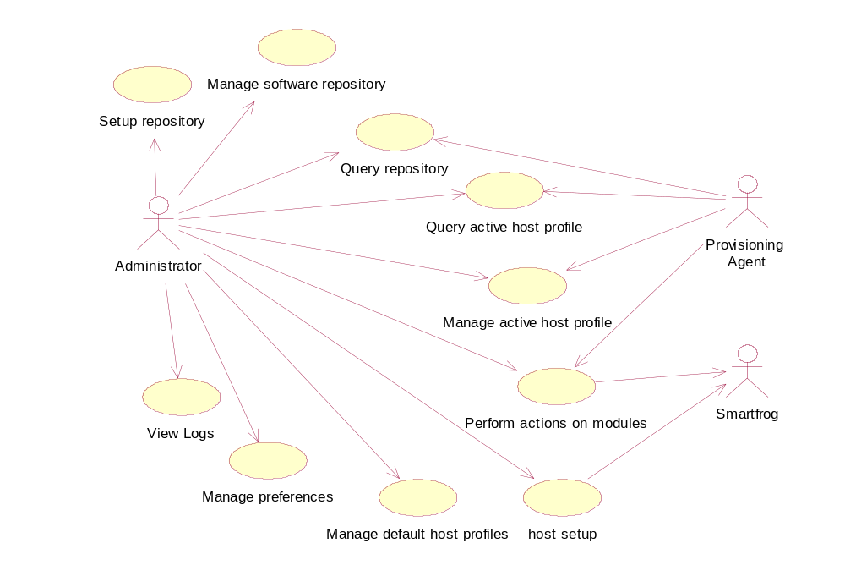
Use cases

Slide 3
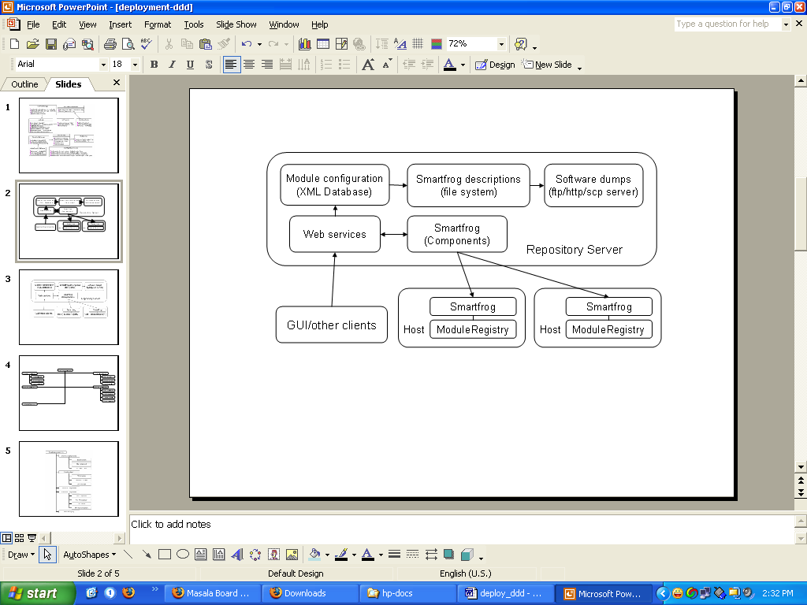
System overview

Slide 4
Concepts
Module
  A component( exe, lib, WS etc) installed independently.
  Can have multiple versions, multiple distributions for each version for different platforms.
  Actions are defined for modules like DOWNLOAD, INSTALL etc.
  For each action a smartfrog description file is present which uses standard templates with varying values.
  Actions can be executed for a module for a target machine.
  Taking action for a module for a machine means submitting the corrosponding smartfrog description file to the sfDaemon on the repository with host as target machine.
  Module description is defined in an XML file.

Slide 5
Concepts
Default host profile
  XML file.
  List of module Ids and version that should go on a machine.
  Mapped to machine properties, hostSelector ( supports regular expressions).
Active host profile
  XML file.
  List of module Ids and version actually present on the machine.
  Includes module status updated from monitoring system ( ganglia/Anubis )
Module group
  List of module Ids and versions.
  Taking action on a module group means taking actions on all modules in the module group.
Host group
  List of hosts.

Slide 6
Data on repository server
Active
host profiles
Module
groups
Host Groups
Host Groups
Default
host profiles
Module
dumps
Smartfrog
descriptions
Other subsystems
(ModuleLocator,
GUI etc)
Storage managers
Query engine
Storage adapters
XML DB
File
system
FTP
server

Slide 7
Deployment on repository server
Storage managers
Multi-host
deployer
GUI
Repository
Server
( main interface)
Smartfrog adapter
(sfDispatcher)
Smartfrog
daemon on
client node
WS-Interface
Logger
(Log4J)
Event logger
(Ganglia, Anubis)

Slide 8
Client Node –Components
FTP
Downloaders
GridFTP
GPT
Smartfrog
daemon on
client node
Installer
Repository server
RPM
Uninstaller
Make/Ant
Executable
Initializer
Jar
Terminator
WS (WSDD)

Slide 9
Client node - Components
Downloaders
ModuleRegistry
(local sf component)
Smartfrog
daemon on
client node
Installer
Repository server
Uninstaller
Logger ( Log4J)
Initializer
EventsAdapter
(Anubis, Ganglia)
Terminator
Shared components on client nodes

Slide 10
Monitoring
Active host profile manager
Failure recovery layer
Event logger
Server node
Event channel
Client node
Download component
Installer component
Startup/terminate component

Slide 11

HP logo

Slide 12
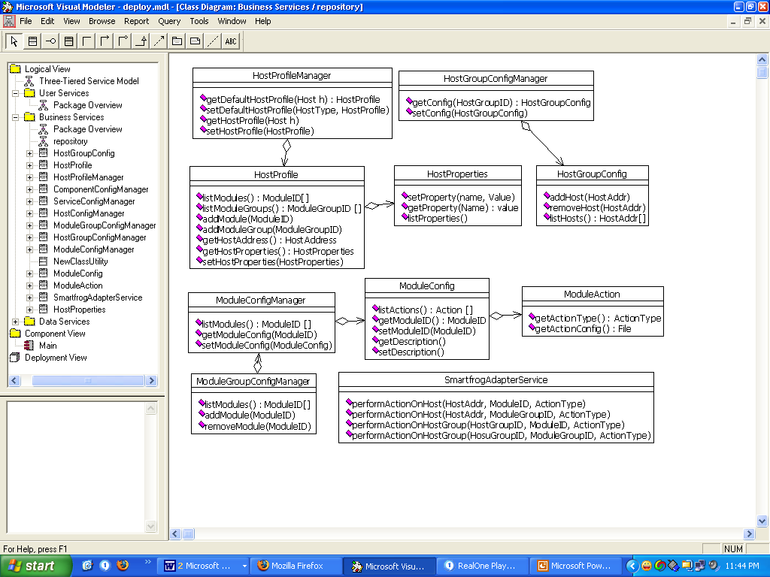
Repository server – WS interface

Slide 13
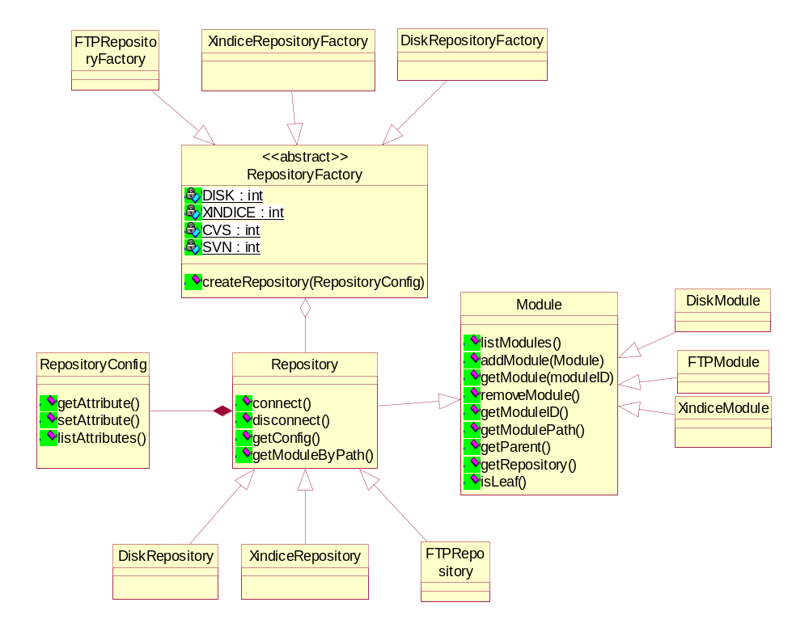
Repository server - storage subsystem

Slide 14
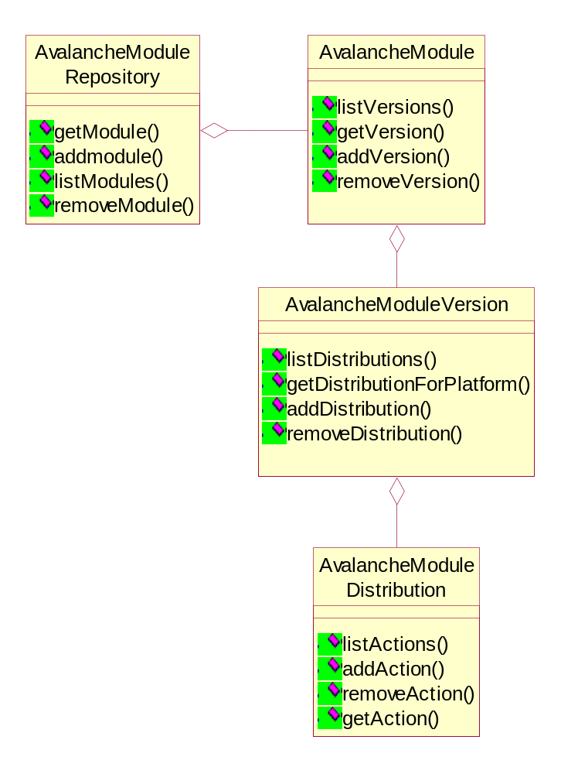
Repository server - storage subsystem

