Slide 1

Avalanche Implementation
Sanjay Dahiya
Sanjay.dahiya@hp.com
FOR INTERNAL USE ONLY

Slide 2
V1 Implementation Overview
Avalanche Server core is a set of jar files.
Can be used in a web app ( JSP/Tomcat) or a standalone java application.
Avalanche client is Smartfrog with a few extra components/configurations.
Uses XMPP (Jabber) for distributed asynchronous events.
Uses Berkeley DB-JE for data storage on server and optionally on client.
Uses XML beans for access to data objects, which are serialized (text) and stored in BDB.

Slide 3
V1 Data Model
XML Schemas
(Module.xsd, Host.xsd, HostGroup.xsd, ModuleGroup.xsd etc)
XML Object
(ModuleType, HostType, HostGroupType, ModuleGroupType)
Bindings
XMLBeans Compiler
(Ant task)
ObjectToDatabase
DatabaseToObject
Berkeley DB API
avalancheTypes.jar
Used for manipulating data programmatically
Disk

Slide 4
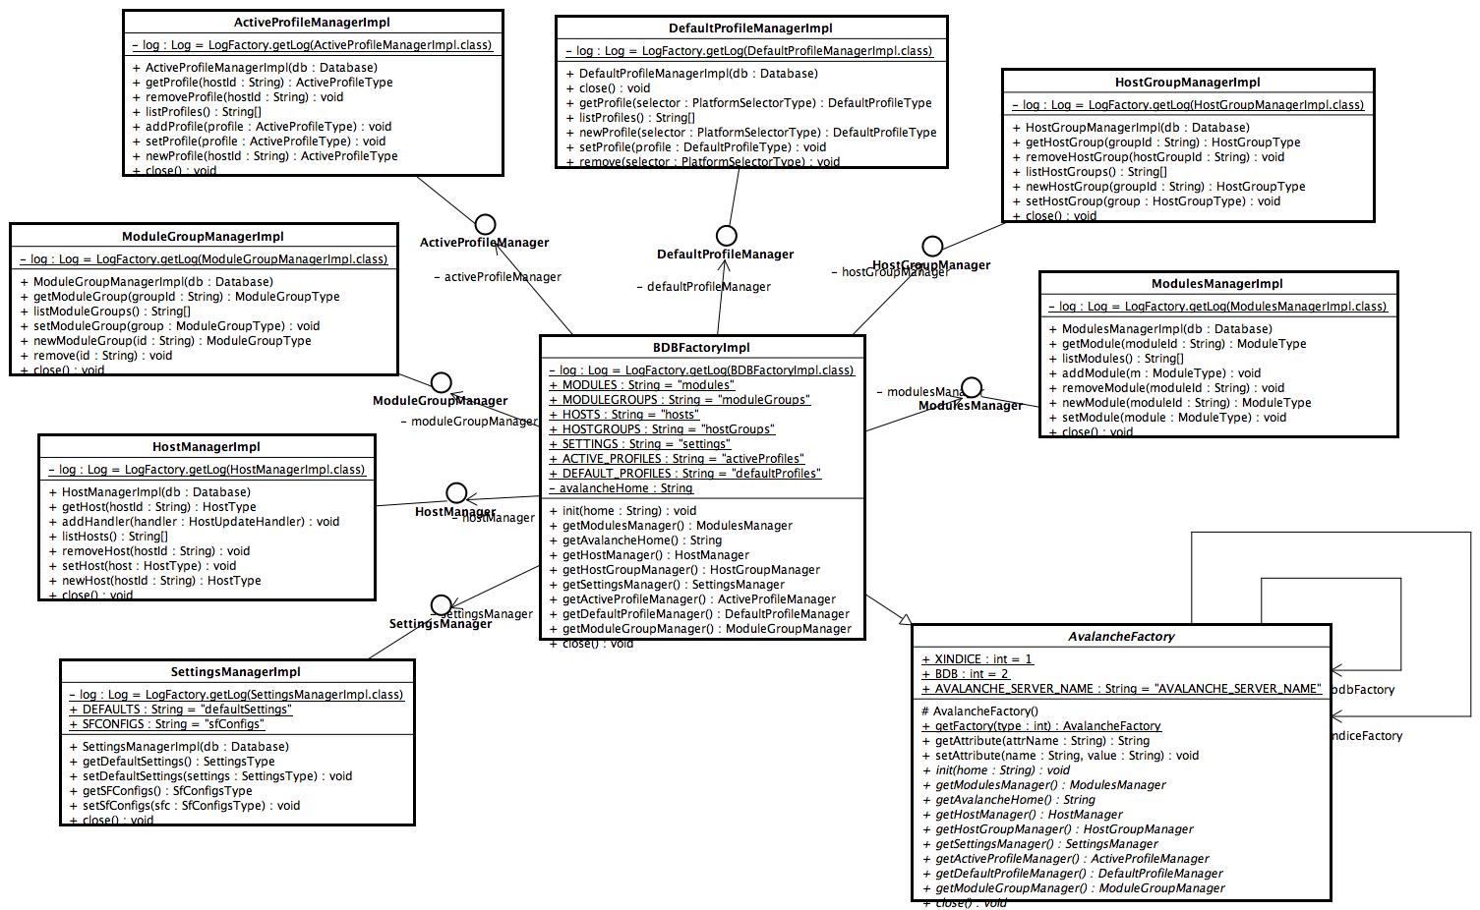
V1 Implementation - Data Access

Slide 5
V1 Event Model
XMPP Server
Login(Host Id)
Client
Send Event
(addressed to listener)
admin
listener
Components
Create Host user
Receive Event
Avalanche Server

Slide 6
V1 Event Model - Flow
Host Ignition
Host Manager
XMPP Admin
XMPP Listener
XMPP Server
Smart Frog
XMPP Client
Add Host
Create user
Host Ignite
install
start
Login
Send Event
Send Event
Flow

Slide 7
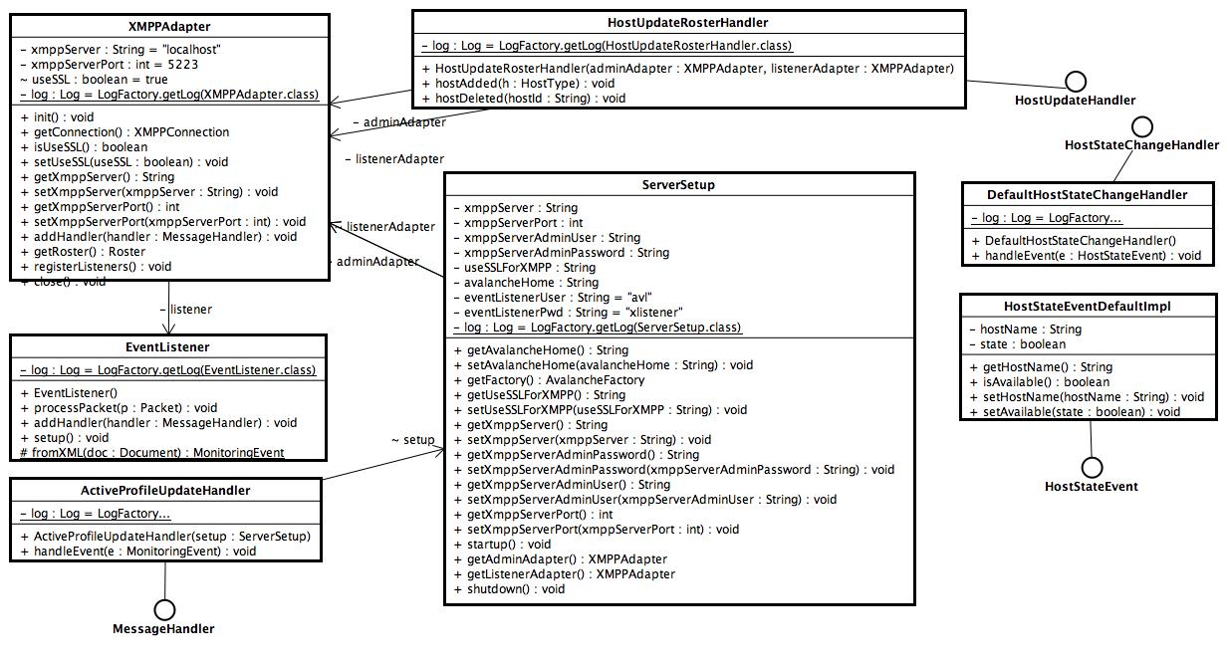
V1 Events Implementation

Slide 8
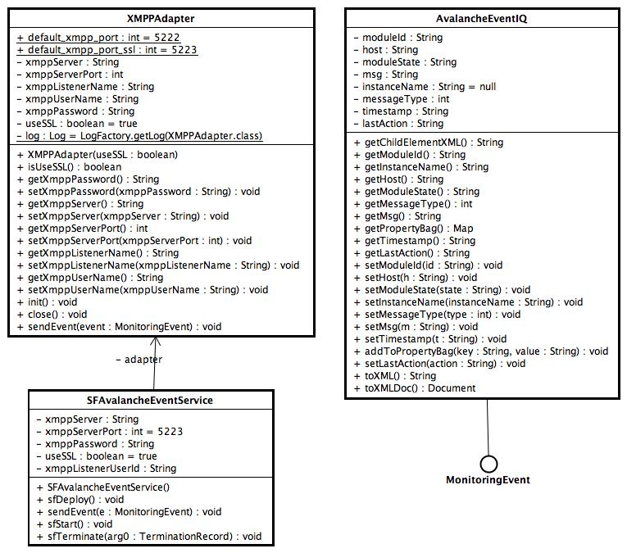
V1 Client Events

Slide 9
V1 Deployment Model
sfConfig extends Prim{
ftpServer “”;
Password “”;
} // packed in a Jar file
Add Jar to server
Module Manager
[sfConfig:ftpServer=“grid.hp.com”]
[sfConfig:password=“password”]
[sfConfig:ftpServer=“grid.hp.com”]
[sfConfig:password=“password”]
Deployment Adapter
Database
Deploy
SmartFrog on Client
Event Handler
XMPP Listener
XMPP Client
Status
XMPP Server

Slide 10
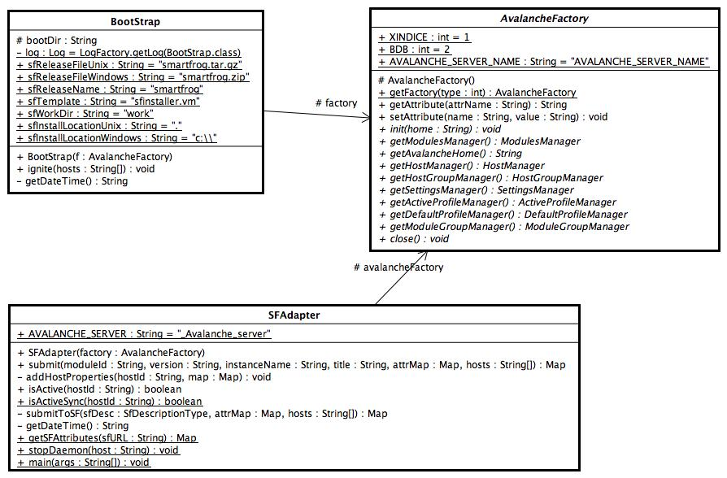
V1 Deployment

Slide 11
V1 Deployment Custom Attributes
SF Adapter adds extra attributes in all SF descriptions like moduleId, instanceName, version number etc.
These attributes are available to all smartfrog components.
Used for events and logging.
System properties as defined on Avalanche Server host data also available to Smartfrog components.

Slide 12
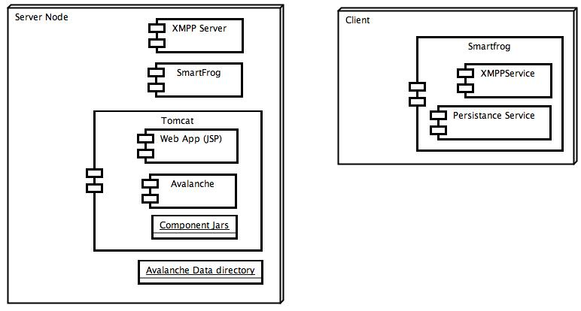
V1 Setup

Slide 13
Deployment with Tomcat
($CATALINA_HOME/webapps/GDS/WEB-INF/web.xml)
AvalancheContextListener
ServerSetup
adminAdapter
listenerAdapter
SFAdapter
AvalancheFactory
Startup()
init
adminAdapter
listenerAdapter()
registerListeners()
startSF(OPTIONAL)

Slide 14
Random
Use persistence service to store deployment specific data on client nodes using instance Id’s.
Add extra event types using shared/MonitoringConstants.java on client and Event Handlers on server.
Add extra services in Smartfrog client while host ignition by using MonitoringSetup.sfcd.

Slide 15

HP logo

Slide 16
Concepts
Module
  A component( exe, lib, WS etc) installed independently.
  Can have multiple versions, multiple distributions for each version for different platforms.
  Actions are defined for modules like DOWNLOAD, INSTALL etc.
  For each action a smartfrog description file is present which uses standard templates with varying values.
  Actions can be executed for a module for a target machine.
  Taking action for a module for a machine means submitting the corrosponding smartfrog description file to the sfDaemon on the repository with host as target machine.
  Module description is defined in an XML file.

Slide 17
Concepts
Default host profile
  XML file.
  List of module Ids and version that should go on a machine.
  Mapped to machine properties, hostSelector ( supports regular expressions).
Active host profile
  XML file.
  List of module Ids and version actually present on the machine.
  Includes module status updated from monitoring system ( ganglia/Anubis )
Module group
  List of module Ids and versions.
  Taking action on a module group means taking actions on all modules in the module group.
Host group
  List of hosts.

