Slide 1


Rethinking the
Java SOAP Stack
Steve Loughran
HP Laboratories
steve_loughran@hpl.hp.com
Edmund Smith
University of Edinburgh
esmith4@inf.ed.ac.uk
Notes:
This talk is about JAXRPC, the Java SOAP stack. Anyone who doesn't use this stack may not think it applies to them, but matters if either of the following cases hold
0. Something automatically creates the contract, the WSDL+Schema from their implementation code
1. their SOAP toolkit tries to seamlessly turn native classes/interfaces into SOAP messages. Many of the problems listed here may well apply in that environment.
2. they need to interoperate with Java systems. Henceforth you have good ammunition to explain to your Java endpoints, what fundamental errors they made.
I am a research scientist at HPLabs, Bristol, UK. I was on a sabbatical building things out in the US for four years, where I started off using the (now defunct hp e"speak -eservices system, did some live services using XMLRPC (see: When Web Services Go Bad), and then doing prototype stuff using SOAP since then, getting commit access to the Apache codebase in the process -primarily as a way of getting things working. If you use Axis, then happyaxis.jsp is the main bit of work of mine you will visibly encounter, though my fingerprints can also be found in the servlet entry point, the fault handling and the ant tasks.
When I criticise JAXRPC implementations. Axis will be the one I'll be holding up to example. Now, there are some ways it is particularly suboptimal; things do not have to be quite that bad, but the core problems are the same, regardless of implementation.
Ed Smith is someone I met while working on a GGF standard service "deployment SOAP API". Very simple: upload files, upload a configuration descriptor, move the app through its lifecycle, subscribe to events

Slide 2
Project: CDDLM Deployment
Upload program files (.jar, .exe, .rpm ...)
Upload configuration descriptor (inline or URL)
WS-I SOAP (+various attachment options)
Direct callback on client-supplied endpoint
The WSDL/XSD + semantics of the service are part of a Global Grid Forum Standard
Trying to do this in Java hurts!
Notes:
This is what we were doing. I don’t intend to cover it, but go to www.gridforum.org and look for the CDDLM working group documents. This is the deployment API. Since our first iteration, we have reworked it to use WSRF and integrate with WSDM. That adds a whole new level of complexity, and is not going to be covered here.

Slide 3
WSDL from source is misguided
#1 problem
Notes:
This is it. The key problem. Trying to generate your interface from your implementation is silly.
1. It makes the contract brittle against the soap stack, JVM, code
2. To tweak the WSDL for interop, you have to work one step removed, in the Java source
3. It starts you thinking that SOAP is about Java-Java communications
4. it stops you learning about WSDL at the beginning of the project, when deadlines are far away, delaying it till the end of your project, when the deadline was two weeks ago, integration with the customer is broken, and you are scared of voicemail.

Slide 4
serialisation
O/X Mapping
#2 problem
Notes:
Whenever someone talks about serialization of data over SOAP, I want you to correct tem and say "you mean O/X mapping".
Serialization implies something simple, looking at the fields of a type and sending it out over the wire.
O/X mapping tells the truth: that mapping to and from XML trees/graphs is as hard as O/R mapping, and something
That is not as well researched.

Slide 5
O/X mapping troublespots
Supported subset of XSD different from other platforms.
Reserved words
Restrictions on XSD types (i.e. string patterns)
Fault mapping “quirky”
There is no validation of incoming messages
There is no elegant way to handle versions, missing bits, extra bits
Notes:
All these add up to make going from valid XSD/WSDL to working JAXRPC code hard. You end up with interop problems by virtue of the subset of XML that is supported.

Slide 6
Access to raw XML is discouraged
public Element getAsDOM() throws Exception
{
String elementString = getAsString();
Reader reader = new StringReader(elementString);
Document doc = XMLUtils.newDocument(
new InputSource(reader));
return doc.getDocumentElement();
}
Axis MessageElement gives you the DOM by replaying and reparsing the graph
Notes:
It doesn’t have to be this way, and apparently the JWSDP implementation is better, but here is how axis gives you the graph of children. It turns it back into a string, and parses it. Now, if the content is stored as Sax events, this sort of makes sense, but it is still very inefficient.
Consequence: asking for the XML in a message is actually very inefficient.

Slide 7
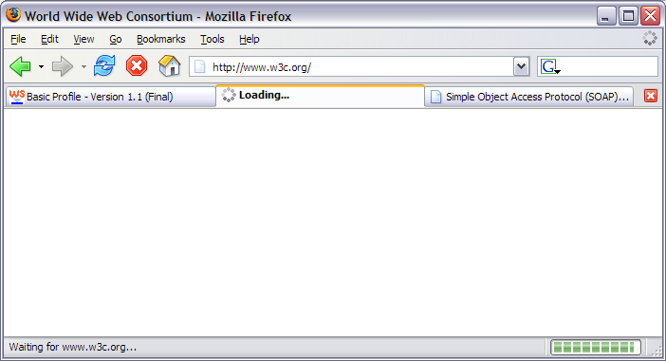
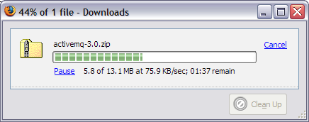
Blocking RPC is just wrong
Observe the cancel buttons and progress bars
Notes:
Blocking RPC calls are insidious; they work well in local demo and test, where the fact that state is implicit in the program counter makes life a lot easier.
But realistically, when you work over long distances, and talk to unreliable systems, it is not enough. Here we have w3c.org not reachable, but our proxy is live so there is a weird state of connection-open but endpoint not responding. Hands up who knows (a) what the default timeout on their SOAP calls are and (b) how to adjust it. I do, because I had to fix the default of Axis "forever" down to something more sensible "5 minutes", but that is still a 5 minute lockout in that thread.

Slide 8
What were the goals of SOAP?
Internet-scale communications
(=long haul; interesting failure modes...)
Interoperability
Integration with XML technologies
  Inline XML content
  Use of XML processing tools/pipelines
Extensibility through headers
Notes:
SOAP is a kind of covergence. XMLRPC was the first mainstream RPC-over-HTTP-in-XML; it lacked namespacing and was only typed; you would send <int>2</int><int>3</int>
RPC/ENC is an evolution of XMLRPC with a stronger type system and the ability to send a graph of structures, not a tree. There are also traces of the MS design of COM-OVER-XML in there, such as in the faultcode element, which is directly equivalent to an HRESULT error code. SOAP0.9 was minimal, predated XSD and could be used for things like Xorba; Rogue Wave's implementation of Corba-over-SOAP.
Internet scale comms. Use HTTP as the transport, some integration w/ HTTP error codes. Slow, unreliable links.
Interop: this was meant to be broadly implemented. Not just as a Java/C++/C# bridging tool.
XML-Centric. The development of doc/lit XML lets you almost directly inline XML docs (caveat: no processing instructions), as long as the stuff is in a different namespace.
Structured extensibility: SoapHeaders. One could argue it has gone too far then, what with ws-addressing and other bits stuck inside. Now the destination of a message is a hard thing to determine without parsing the message (c.f. the soapaction header debacle)
Overall then, the underlying SOAP specs are friendly to sending XML stuff between different things, over HTTP connections.

Slide 9
JAX-RPC 1.0 vs. SOAP's Goals
Interoperability —No
Internet-scale communications
(=long haul; interesting failure modes...)
— arguable
Integration with XML technologies —Barely!
  Inline XML documents
  Use of XML processing tools/pipelines
Extensibility through headers —through Handlers
Notes:
These are our personal assessments of how well JAXRPC meets these goals.

Slide 10
Why the mismatch? Java RMI
  Java RMI: a single-language distributed-object RPC mechanism. Works on the LAN, brittle and troublesome over space and time.
  SOAP: A multi-language, distributed message protocol. Meant to be better than its predecessors
Trying to make Java SOAP like Java RMI was a mistake

Slide 11
RMI is the wrong metaphor
RMI | JAX-RPC | SOAP
Remote objects Modeled by proxies | Remote sessions Modeled by proxies | (stateless) endpoints
Remote Methods | Remote Methods | Messages; sometimes responses
Serialized class data | Serialized class data | XML messages
Structured, immutable Faults | Structured, Immutable Faults | SOAPFault (+HTTP errors).
Specify by Java interfaces | Java classes or WSDL+XSD | WSDL+XSD
Notes:
If you look at JAXRPC, you can see that Java RMI is the underlying paradigm that is reused. All that is absent is the object model, with distributed GC, and the two way nature of communications, where any Remote interface passed in an RMI method is automatically turned into an exported callback.
I really like Java RMI; it is one of the simplest RPC mechanisms ever. But remember its failings. It is brittle to change (all you can do is freeze classes and provide a serialUID, or write your own serializer and deserializer), and it is Java only. Plus distributed GC is still a research problem.
What I don’t like is any attempt to make SOAP look like RMI. Look at the difference between the API and the reality.
Making JAXRPC look like RMI may have made it easier for RMI users to transit into writing SOAP services, but this has been achieved at the expense of writing effective SOAP services.

Slide 12
How JAXRPC cripples Open Source
JAXRPC puts a hard split between developer-side “XML” and user-side “Java” code.
Lots of problems related to WSDL-Java conversion
The test kit (TCK) is covered by an NDA
This means
Developers have extra workload
TCK access is very restricted
It's hard to cross over from end user to developer
Most OSS stack developers are J2EE vendors
Notes:
These are some personal observations as an Axis developer. Too often the user mail lists are full of people trying serialize a complex Java graph and complaining that axis is failing with an obscure error message. These people suffer, but are not in the position to fix the code (ok, they could improve the error message). By having the framework hide the XML, they are kept hidden from understanding what is going on, and kept unable to fix it.
As a consequence, many of the OSS stack developers are J2EE/JMS vendors. I cant give the percentages, but it is high. Nobody else wants to work on it, nobody should have to.

Slide 13
JAX-RPC2/JAX-WS?
Delegates O/X mapping to JAXB
This moves the blame onto someone else
Some asynchronous operations.
@WebMethod, @WebService annotations
Engineering costs still too high
Test cases still secret
Notes:
Doesn’t JAX-WS fix this? Nope. JAXB does support a wider subset of XML than before, but it is still a subset, and it is still focused on mapping between custom Java classes and the XML message
What is worse, this will be built into Java 6.0. With a built in HTTP server for callbacks. This is scary.

Slide 14
It doesn’t have to be this way!
Notes:
We do not have to suffer like this. It is entirely an option of our own choosing.

Slide 15

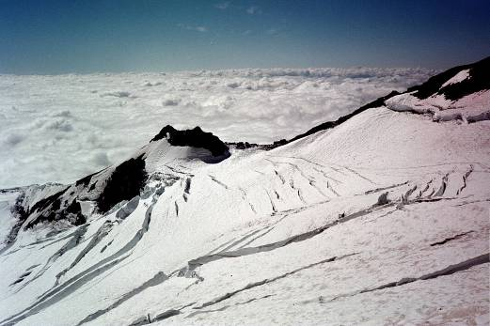
Interlude: Himalayan vs. Alpine style
Slow teams take paid tourists up big mountains
Individuals travel light and fast
Notes:
This seems like a little diversion, but it will make sense at the end.
There are many ways to climb big mountains. In historic order, it goes
-classic alpine style: hemp ropes, hobnailed boots. Doing stuff (eiger nordwand) never done before. (read: the white spider, Harrer)
-Himalayan style: brute force ascent, military-grade operations. Originally to climb the impossible (here, kanchenjunga from darjeeling), now to take tourists up for many $. Read: Harrer, 7 years in Tibet; Krakenaur: into thin air
-Modern Alpine style: state of the art equipment. Travel fast and light, survival through speed. Here descending pelvoux from a night in the hut, courtesy of visa card bookings made over GSM phones on the way up. Returning to our car that will take us back to the UK in a 12 hour sustained drive.
-Super-Alpine: apply alpine techniques to the Himalayan, Andean peaks. Read: Simpson, Touching the void.
Alpine is about fast, light agile. There is risk, but if managed well you can be out and back before the weather gets bad. Himalayan style needs to be set up for storms, as the duration of a climb makes it inevitable.
Returning to JAX

Slide 16
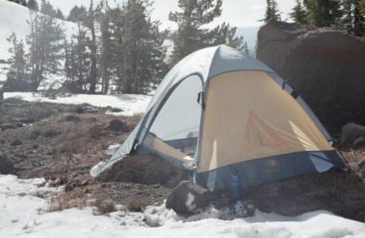
We need Alpine-style SOAP stacks
Retain handler chain
Drop rpc/encoded SOAP
Embrace XML & XPath
Queued/Asynchronous communications
Notes:
I'm going to look at JAXRPC alternatives: Axis2, activeSOAP and what I'm doing. I'm omitting xfire, though I am aware of it.

Slide 17
Axis 2 core
AXIOM object model
Supports XmlBeans and for JAX-WS, JaxMe
In theory, if you avoid JaxMe, the core would work
It will depend upon how it gets used. Too much reflection-based WSDL generation and it will be no better than before.
XPath promised
Engineering effort for JAX-WS still needed
Notes:
Axis2 is a complete rewrite of Axis1; essentially the third generation Apache SOAP stack (the first was an IBM donation).
I think it is a nice start, but with a lot of focus still on JAXRPC support, the inherent problems are still there.
One of the nice things is that it will be mainstream, so you can write handlers or client code that works direct with Axiom. But people who want the dubious benefits of WSDL-from Java can stick with Jaxb bindings.

Slide 18
ActiveSOAP
“ActiveSOAP is a lightweight & easily embeddable REST and SOAP stack based on StAX with support for WS-Addressing and WSIF.”
JAXB, XmlBeans, XStream or DOM
http://activesoap.codehaus.org/
Notes:
This is one of my favourite SOAP stacks; it looks very interesting, and may be the one I will end up using

Slide 19
Alpine “M32” prototype
XOM based
Factory chain to generate extended Xom nodes.
Route via endpoint and then WS-Address (tricky)
No WSDL support
No Attachments
Inadequate testing
A SOAP stack in three days
Notes:
If you are driving from Bristol to the Alps, via Eurotunnel, the M32 is the first road of any significance. You can go quite quickly down it, till something like the M4 and M25 get in the way.
XOM underneath. Context permits dynamic generation of helper classes.
One problem is WS-A; if you start to generate stuff then you have existing context-dependent content before you can determine the ultimate destination. This complicates my idea for endpoint-specific Xom node factories.

Slide 20
M32 vs. SOAP's Goals
Interoperability —Yes, with caveats
Internet-scale communications — ongoing
Integration with XML technologies
— Strong within XOM
Extensibility through headers
—through Handlers
Notes:
After critiquing JAXRPC, we must turn our criteria to the prototoype.
Weaknesses? Xpath performance is one issue.

Slide 21
Discussion Points
What is the right way to do Web Services:
WSDL-first or WSDL-last?
Is XML something developers need to be sheltered from?
If WSDL and XSD are the problems,
can't we just fix them?

