Slide 1
My other computer is
a datacentre
Steve Loughran
Julio Guijarro
December 2010

Slide 2
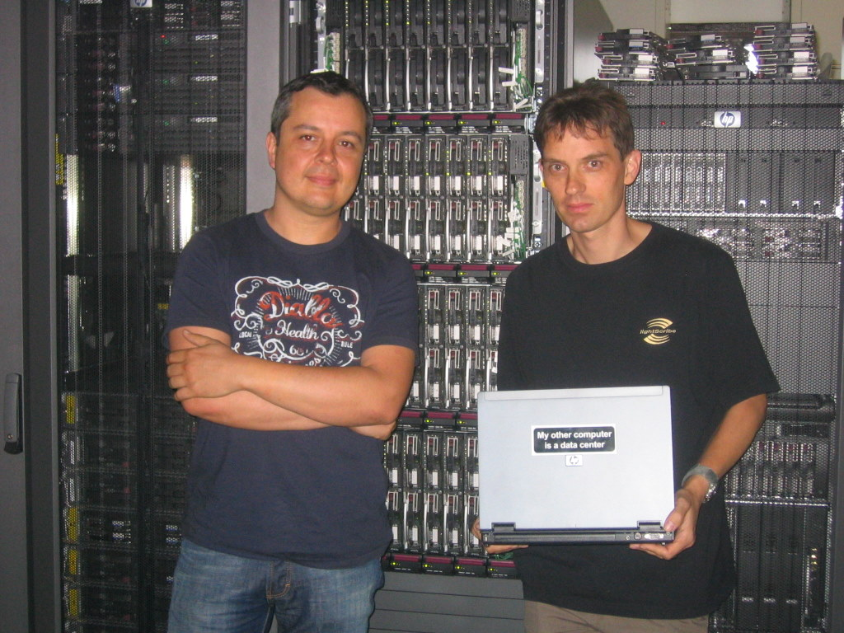
Our other computer is
a datacentre

Slide 3
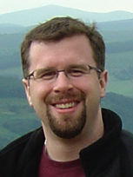
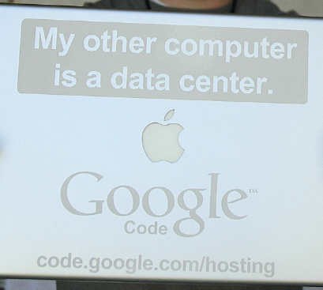
His other computer is a datacentre
Open source projects
SVN, web, defect tracking
Released artifacts
code.google.com

Slide 4
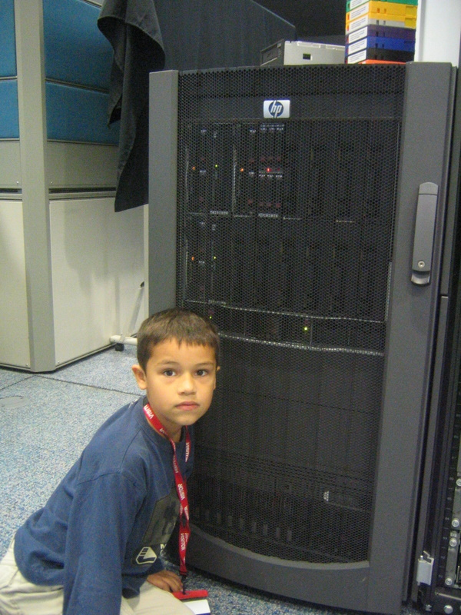
His other computer is a datacentre
Email
Videos on YouTube
Flash-based games

Slide 5
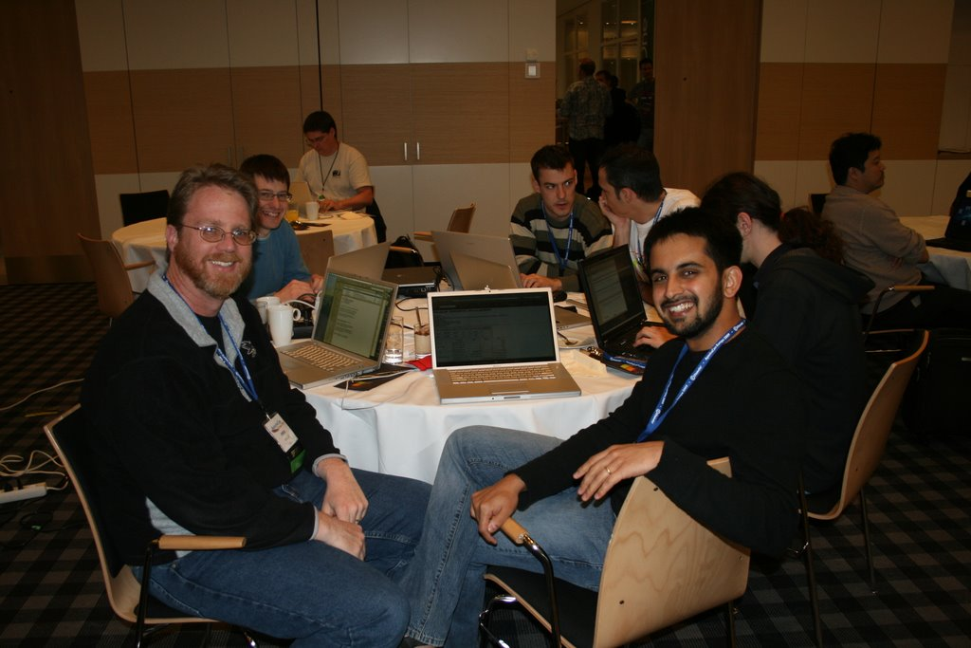
Their other computer is a datacentre
Owen and Arun at Yahoo!

Slide 6
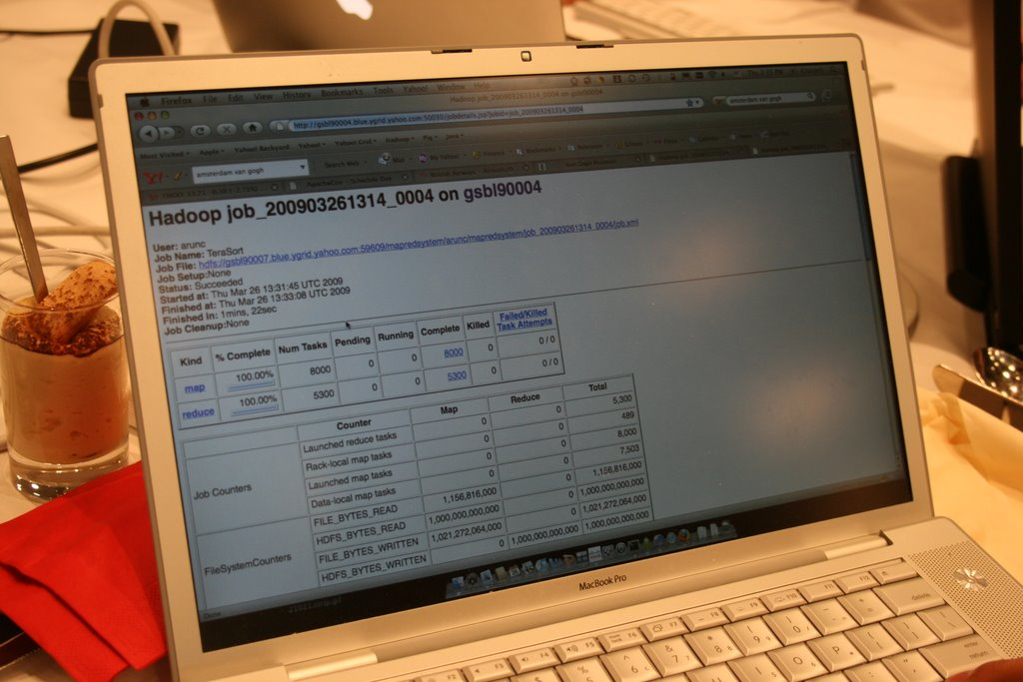
That sorts a Petabyte in 82s

Slide 7
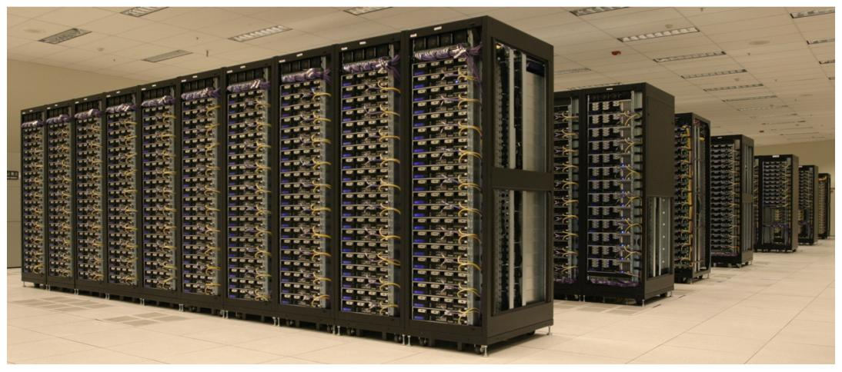
This datacentre
Yahoo! 8000 nodes, 32K cores, 16 Petabytes

Slide 8
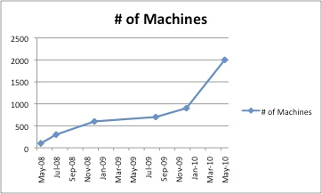

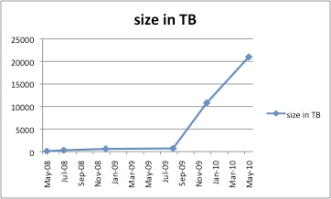
His other computer is a datacentre
Dhruba at Facebook!

Slide 9
Problem: Big Data
Storing and processing PB of data

Slide 10
Cost-effective storage of Petabytes
Shared storage+compute servers
Commodity hardware (x86, SATA)‏
Gigabit networking to each server
Redundancy in the application, not RAID
Move problems of failure to the app, not H/W

Slide 11
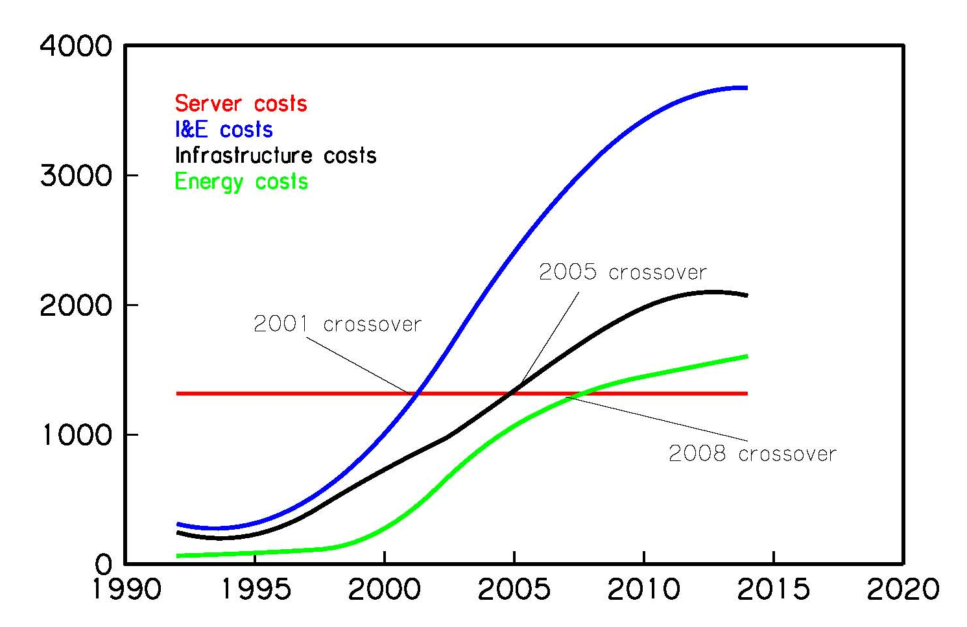
There are no free electrons

Slide 12
Power
HVAC power 1.5-2X system power
=server W saved has follow-on benefits
Idle servers still consume 80% peak power
=keep busy or shut down
Gigabit copper networking costs power
SSD front end machines save on disk costs, and can be started/stopped fast.

Slide 13
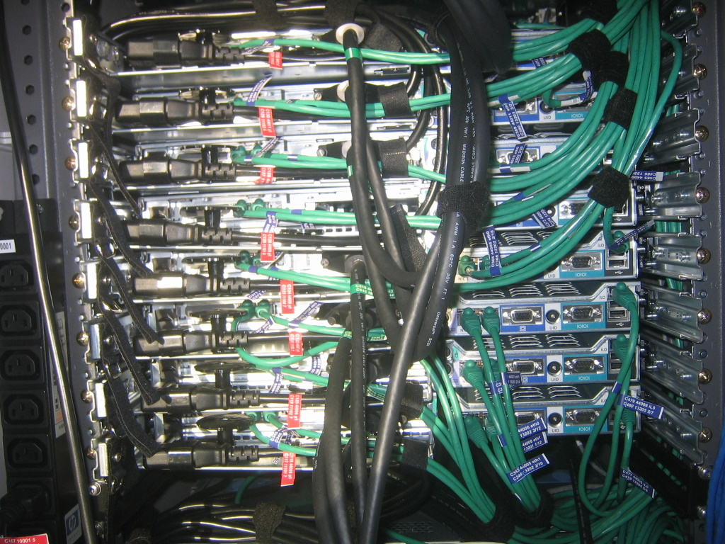
Hardware

Slide 14
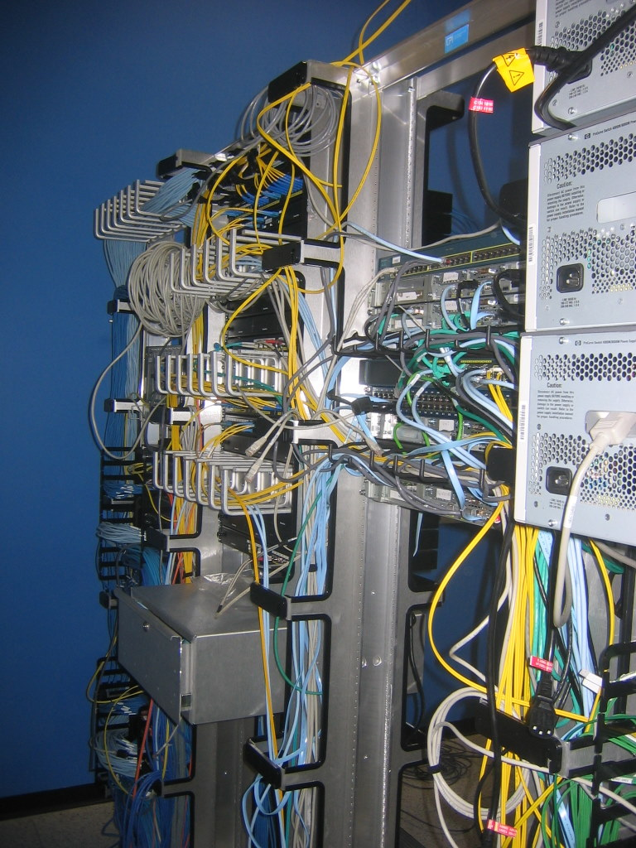
Network Fabric
1Gbit/s from the server
10 Gbit/s between racks
Two 10Gb/s for failover
Multiple off-site links
Bandwidth between racks is a bottleneck

Slide 15
Where?
Low cost (Hydro) electricity
Cool and dry outside air (for open air cooling)
Space for buildings
Networking: fast, affordable, >1 supplier
Low risk of earthquakes and other disasters
Hardware: easy to get machines in fast
Politics: tax, govt. stability/trust; data protection.

Slide 16
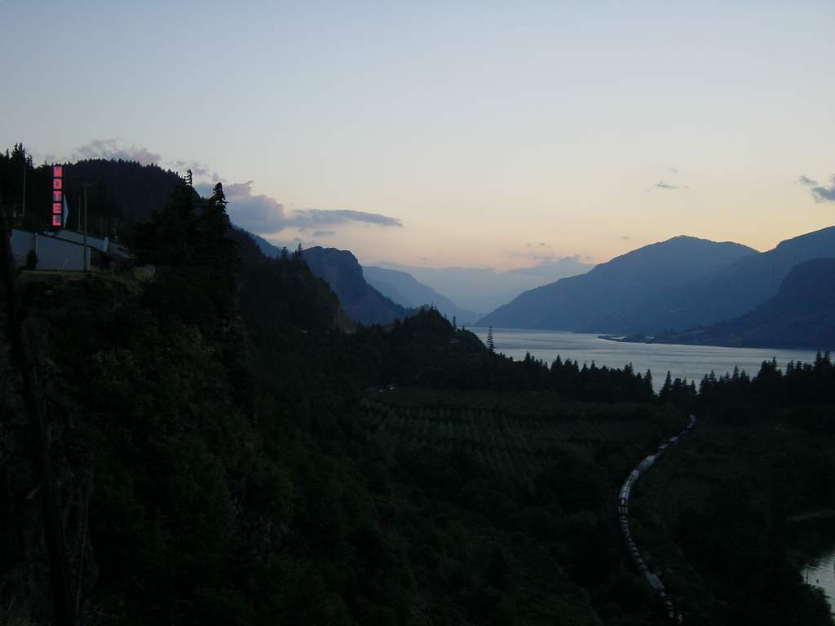
Oregon and Washington States
Notes:
This is the view from a motel in Hood River, Oregon. Behind the camera, about 15 + miles is Google's Dalles facility. Further up river, are the MS and amazon datacentres. Beyond that, the Hanford reservation where U238 extraction took place in the Manhattan Project. Why? Hydroelectric power.

Slide 17
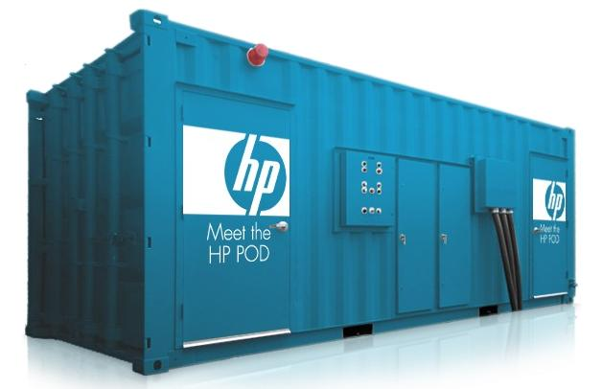
Trend: containerized clusters

Slide 18
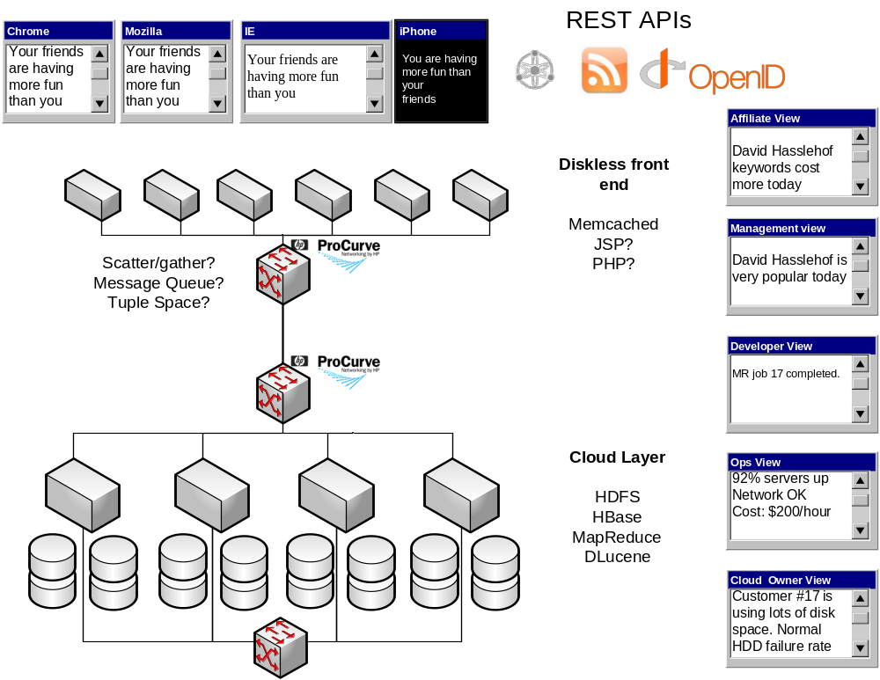

Slide 19
High Availability
Avoid SPOFs
Replicate data.
Redeploy applications onto live machines
Route traffic to live front ends
Decoupled connection to back end: queues, scatter/gather
Issue: how do you define live?

Slide 20
Web Front End
Disposable machines
Hardware: SSD with low-power CPUs
PHP, Ruby, JavaScript: agile languages
HTML, Ajax
Talk to the back end over datacentre protocols

Slide 21
Work engine
Move work to where the data is
Queue, scatter/gather or tuple-space
Create workers based on demand
Spare time: check HDD health or power off
Cloud Algorithms: MapReduce, BSP

Slide 22

MapReduce: Hadoop

Slide 23
Highbury Vaults Bluetooth Dataset
{lost,"00:0F:B3:92:05:D3","2008-04-17T22:11:15",1124313075}
{found,"00:0F:B3:92:05:D3","2008-04-17T22:11:29",1124313089}
{lost,"00:0F:B3:92:05:D3","2008-04-17T22:24:45",1124313885}
{found,"00:0F:B3:92:05:D3","2008-04-17T22:25:00",1124313900}
{found,"00:60:57:70:25:0F","2008-04-17T22:29:00",1124314140}
Six months worth of discovered Bluetooth devices
MAC Address and timestamp
One site: a few megabytes
Bath Experiment: multiple sites

Slide 24
MapReduce to Day of Week
map_found_event_by_day_of_week(
{event, found, Device, _, Timestamp}, Reducer) ->
DayOfWeek = timestamp_to_day(Timestamp),
Reducer ! {DayOfWeek, Device}.
size(Key, Entries, A) ->
L = length(Entries),
[ {Key, L} | A].
mr_day_of_week(Source) ->
mr(Source,
fun traffic:map_found_event_by_day_of_week/2,
fun traffic:size/3,
[]).

Slide 25
Results
traffic:mr_day_of_week(big).
[{3,3702},
{6,3076},
{2,3747},
{5,3845},
{1,3044},
{4,3850},
{7,2274}]
Monday
3044
Tuesday
3747
Wednesday
3702
Thursday
3850
Friday
3845
Saturday
3076
Sunday
2274

Slide 26
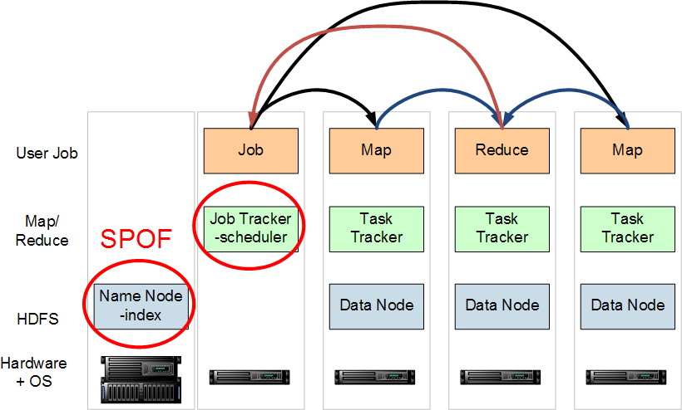
Hadoop running MapReduce

Slide 27
Filesystem
Commodity disks
Scatter data across machines
Duplicate data across machines
Trickle-feed backup to other sites
Long-haul API: HTTP
Archive unused files
In idle time: check health of data, rebalance
Monitor and predict disk failure.

Slide 28
Logging & HealthLayer
Everything will fail
There is always an SPOF
Feed the system logs into the data mining infrastructure: post-mortem and prediction
Monitor and mine the infrastructure
-with the infrastructure

Slide 29
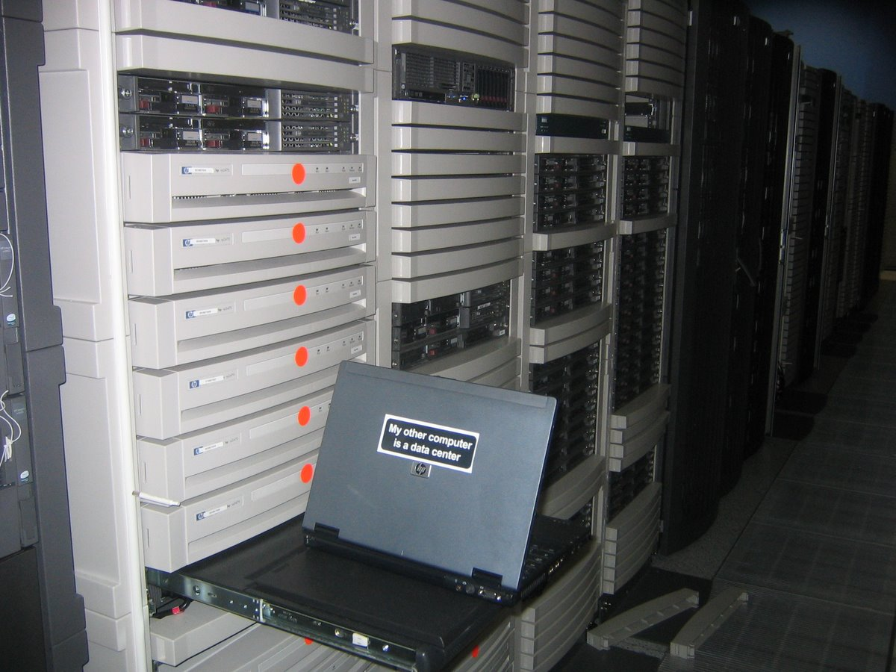
What will your datacentre do?

Slide 30
Management Layer
JMX for Java Code
Nagios
Jabber: use google talk and similar to monitor.
Future: X-trace, Chukwa
Feed the logs into the filesystem for data mining
Monitor and mine infrastructure

Slide 31
Infrastructure Layer
Public API: create VM images, deploy them
Internal: billing for CPU, network use
Monitoring: who is killing our network?
Prediction: what patterns of use will tie into purchase plans
Data mining of all management data

Slide 32
Testing
Bring up a test cluster during developer working hours
Run local tests (Selenium, HtmlUnit, JMeter) in datacentre to eliminate latency issues
Run remote tests in a different datacentre to identify latency problems
Push results into the filesystem and mine

