Slide 1
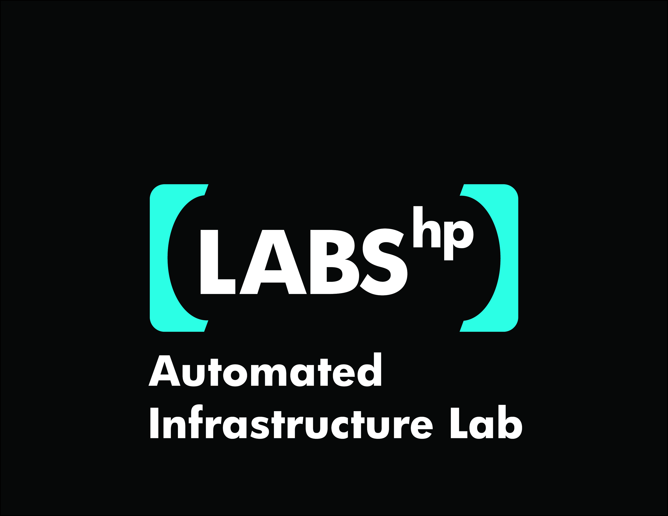
Deploying Apache Hadoop with SmartFrog
Steve Loughran
Julio Guijarro

Slide 2
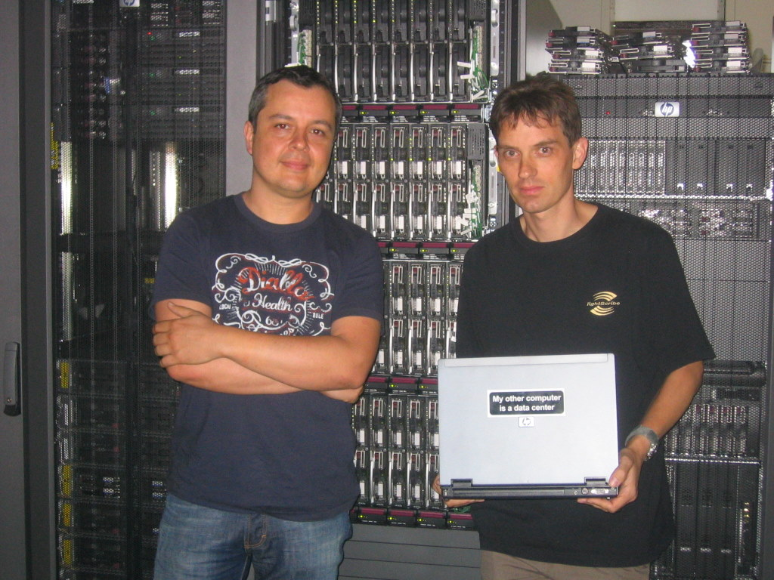
Our other computer really is a datacentre
Notes:
Some people say "when your data is in the cloud, you don't need to know where it is". We say, if you have the pager that goes off when the data isn't reachable, you do -or you need to know the phone number of someone else who does.

Slide 3


Make Hadoop deployment agile
Integrate with dynamic cluster deployments
12 June 2008
Notes:
This is one of the things we are doing in HPL. A lot of our work is actually on the infrastructure for cloud computing installations, the services for machine and storage, the services below the services. Hadoop is something to run on real or virtual machines

Slide 4
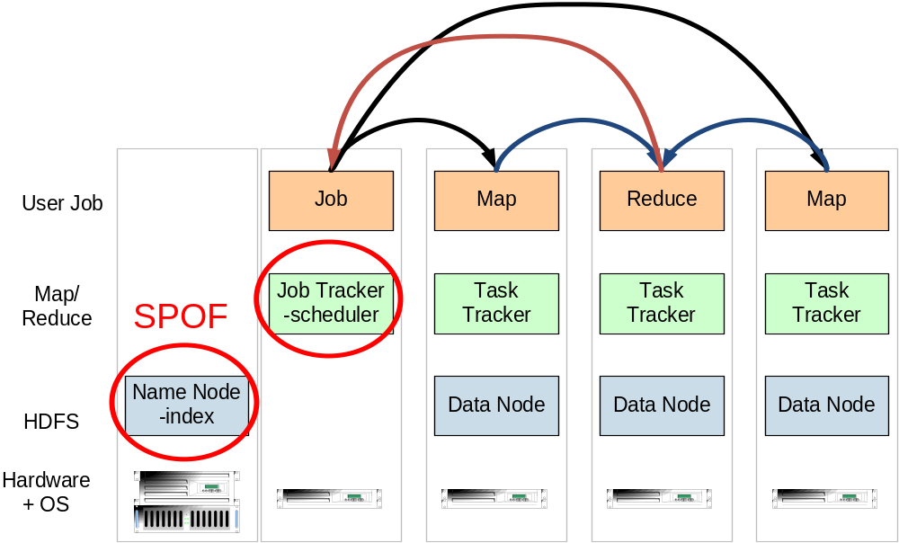
Hadoop on a physical cluster
one namenode, 1+ Job Tracker, many data nodes and task trackers
12 June 2008

Slide 5
Cluster design
Name node: high end, RAID + backups.
-this is the SPOF. Nurture it.
Secondary name node —as name node
Data nodes: mid-range multicore blade systems
2 disks/core. No need for RAID.
Job tracker: standalone server
task trackers: on the data servers
Secure the LAN
Expect failures of everything
12 June 2008
Notes:
Name nodes are a point of failure. Look after them.
Data nodes have to be viewed as transient. They come down, they come back up. If they arent stable enough, you have problems as you wont ever get work done.
Some organisations track hard disks. They matter more than CPUs, when you think about it. Keep track of every disk's history, its batch number, the #of power cycles of every machine it is in, etc, etc. etc. Run the log s through hadoop later to look for correlations.
Trusted machines: until hadoop has real security, you have to trust everything on the net that can talk to the machines. Either bring them all up on a VPN (performance!) or a separate physical network

Slide 6
The hand-managed cluster
Manual install onto machines
SCP/FTP in Hadoop zip
copy out hadoop-site.xml and other files
edit /etc/hosts, /etc/rc5.d, ssh keys …
Installation scales O(N)‏
Maintenance, debugging scales worse
Do not try this more than once
12 June 2008
Notes:
We regularly see this discussed on the list -the problem of keeping /etc/hosts synchronised, pushing out site stuff. Don’t do it. Do it once to know what the files are, then stop and look for a better way.

Slide 7
The locked-down cluster
PXE Preboot of OS images
RedHat Kickstart to serve up (see instalinux.com)‏
Maybe: LDAP to manage state, or custom RPMs
Chukwa for log capture/analysis
Requires:
uniform images, central LDAP service, good ops team, stable configurations, home-rolled RPMs
How Yahoo! work?
12 June 2008
Notes:
This is how Yahoo! appear to run the largest Hadoop clusters in production. There's a good set of slides on this from ApacheCon.
LDAP would seem to add a SPOF, but you can have HA directory services. Also, if DNS is integrated with LDAP, the loss of DNS/LDAP is equally drastic, so availability is not made any worse than not using LDAP.
You also need your own RPMs, as you will need to push out all binaries in RPM format. This often scares Java developers, but isn't that hard once you start on it. Hard to test though.
Now, in this world, where to the hadoop XML files come from?

Slide 8
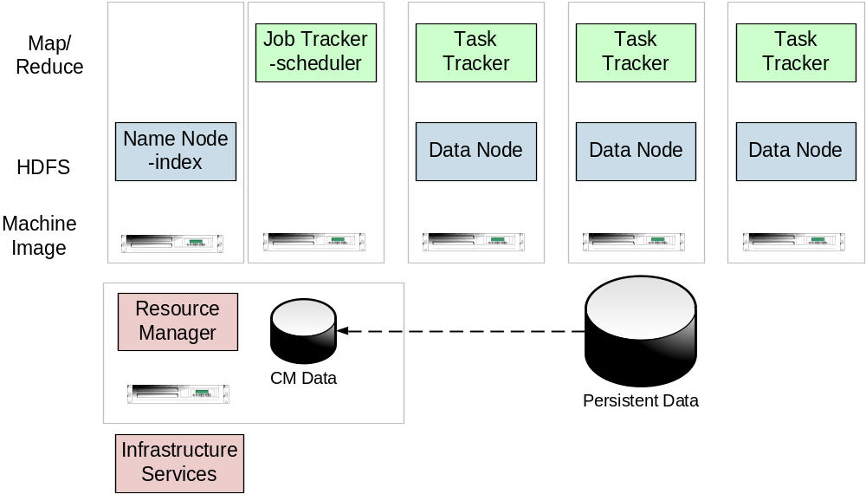
Virtual Hadoop
Resource Manager keeps cluster live; talks to infrastructure
Persistent data store for input data and results
12 June 2008

Slide 9
CM-tool managed cluster
Configuration Management tools
State Driven: observe system state, push it back into the desired state
Workflow: apply a sequence of operations to change a machine's state
Centralized: central DB in charge
Decentralized: machines look after themselves
CM tools are the right way to manage big clusters
12 June 2008
Notes:
CM tools -of any kind- are the only sensible way to manage big clusters. Even then, there are issues about which design is best, here are some of the different options. What I'm going to talk about is decentralized and mostly state driven, though it has workflows too

Slide 10
SmartFrog - HPLabs' CM tool
Language for describing systems to deploy
—everything from datacentres to test cases
Runtime to create components from the model
Components have a lifecycle
LGPL Licensed, Java 5+
(BSD switch being considered)‏
http://wiki.smartfrog.org/
12 June 2008
Notes:
This is our CM tool, used inside HP and with the core app and components LGPL licensed for anyone to use. We are looking at switching to BSD, as it would make it even easier to integrate with Hadoop inside Apache itself.

Slide 11
Model the system in the SmartFrog language
TwoNodeHDFS extends OneNodeHDFS {
localDataDir2 extends TempDirWithCleanup {
}
datanode2 extends datanode {
dataDirectories [LAZY localDataDir2];
dfs.datanode.https.address "https://localhost:0";
}
}
Inheritance, cross-referencing, templating
12 June 2008

Slide 12
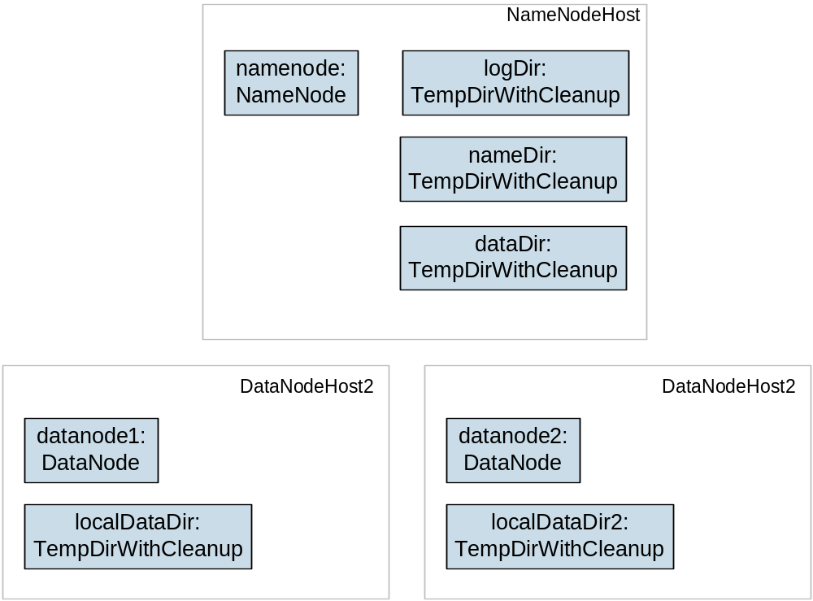
The runtime deploys the model
12 June 2008

Slide 13
Steps to deployability
Configure Hadoop from an SmartFrog description
Write components for the Hadoop nodes
Write the functional tests
Add workflow components to work with the filesystem; submit jobs
Get the tests to pass
12 June 2008

Slide 14
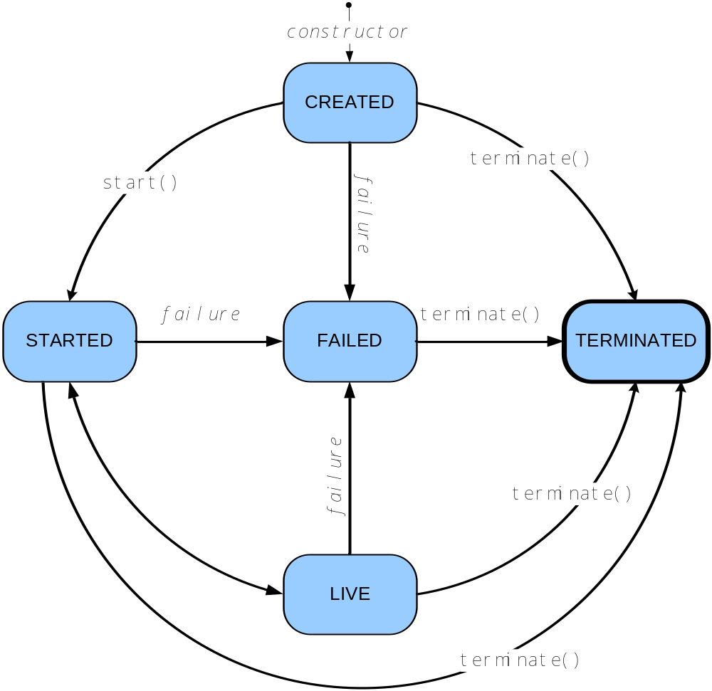
HADOOP-3628: A lifecycle for services
12 June 2008
Notes:
This is what the current proposed lifecycle for hadoop services: namenode, datanodes, trackers, etc. Things you start and stop and wait for starting. You create something, start it, it then chooses to jitter between started and live unless it fails

Slide 15
Base Service class for all nodes
public class Service {
public void start() throws IOException;
void ping() throws IOException;
void close() throws IOException;
State getLifecycleState();
public enum State {
UNDEFINED,
CREATED,
STARTED,
LIVE,
FAILED,
CLOSED
}
}
12 June 2008
Notes:
This is part of the base class. There's a lot more to it just to make it easy to subclass and move from state to state

Slide 16
Subclasses implement inner methods
protected void innerStart() throws IOException {
initialize(bindAddress, getConf());
setServiceState(ServiceState.LIVE);
}
public void innerPing() throws IOException {
if (namesystem == null) {
throw new LivenessException("No name system");
}
namesystem.ping();
}
12 June 2008
Notes:
This is a namenode with a lifecycle interface patched in. This lifecycle does map to the SF one, except that it has no dependencies and expects all exceptions to be IO exceptions. It is not SF specific, merely happens to match. What is new is termination and ping.

Slide 17
Health and Liveness: ping()‏
public void innerPing() throws IOException {
if (ipcServer == null) {
throw new LivenessException("No IPC Server running");
}
/*
if (dnRegistration == null) {
throw new LivenessException("Not registered to a namenode");
}
*/
}
12 June 2008
Notes:
This is the ping of the datanode. For a while I had it failing if the namenode wasn’t there, but it was failing early on during startup.

Slide 18
Liveness issues
If a datanode cannot see a namenode, is it still healthy?
If a namenode has no data nodes, is it healthy?
Should we propagate block checker failures?
Can we run test jobs through the Task Trackers?
How unavailable should the nodes be before the cluster is declared "unhealthy"?
12 June 2008
Notes:
This is where ping() gets complex. How do you define healthy in a cluster where the overall system availability is not 'all nodes are up' but 'we can get our work done'.

Slide 19
Proposal
Have specific exceptions for no-workers, no-master node; include time they were last seen
Let the callers interpret those failures.
A service failing a ping() should not go into FAILED state immediately; it may be transient.
Push the problems up!
12 June 2008
Notes:
This is what I'm thinking here. We have standard exceptions for no workers, no masters, maybe no disk space, and throw them when there are problems. Its up to the management tools to decide the implications of that, because everyone has a different set of priorities.

Slide 20
SmartFrog wrapper components
public class TaskTrackerImpl extends HadoopServiceImpl
implements HadoopCluster {
public synchronized void sfStart() throws SmartFrogException,
RemoteException {
super.sfStart();
ManagedConfiguration configuration;
configuration = createConfiguration();
try {
TaskTracker tracker = new TaskTracker(configuration);
deployService(tracker, configuration);
} catch (IOException e) {
throw SFHadoopException.forward(ERROR_NO_START,
e,this,configuration);
}
}
}
12 June 2008
Notes:
This is part of the task implementation; it is a SF component that is deployed where told to; it binds to its configuration and then creates an Extended task tracker

Slide 21
Replace hadoop-*.xml with .sf files
NameNode extends FileSystemNode {
sfClass "org.smartfrog.services.hadoop.components.namenode.NamenodeImpl";
nameDirectories TBD;
dataDirectories TBD;
logDir TBD;
dfs.http.address "http://localhost:8021";
dfs.namenode.handler.count 10;
dfs.namenode.decommission.interval (5 * 60);
dfs.name.dir TBD;
dfs.permissions.supergroup "supergroup";
dfs.upgrade.permission "0777"
dfs.replication 3;
dfs.replication.interval 3;
. . .
}
12 June 2008

Slide 22
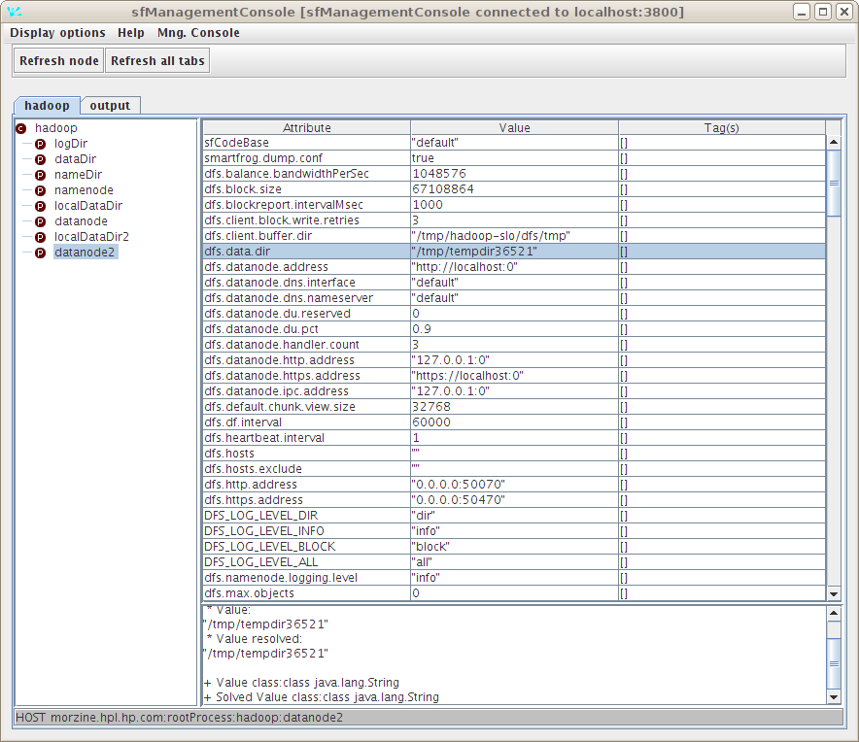
Result: we can bring up an HDFS cluster
12 June 2008

Slide 23
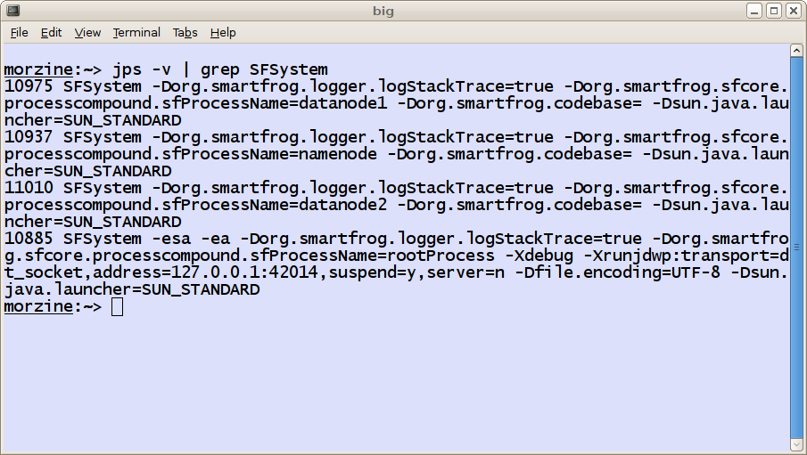
in different processes and hosts
datanode2 extends datanode {
sfProcessName "datanode2";
dataDirectories [LAZY localDataDir2];
}
12 June 2008

Slide 24
Aggregated logs
08/08/18 15:42:02 INFO datanode.DataNode : DatanodeRegistration(127.0.0.1:46504, storageID=DS-1347621537-127.0.1.1-46504-1219070522618, infoPort=42568, ipcPort=53148)In DataNode.run, data = FSDataset{dirpath='/tmp/tempdir36763/current'}
08/08/18 15:42:02 INFO datanode.DataNode : State change: DataNode is now LIVE
08/08/18 15:42:02 INFO datanode.DataNode : BlockReport of 0 blocks got processed in 12 msecs
08/08/18 15:42:02 INFO datanode.DataNode : Starting Periodic block scanner.
08/08/18 15:42:03 INFO datanode.DataNode : BlockReport of 0 blocks got processed in 1 msecs
08/08/18 15:42:04 INFO hdfs.StateChange : BLOCK* NameSystem.registerDatanode: node registration from 127.0.0.1:39522 storage DS-1890915122-127.0.1.1-39522-1219070524453
08/08/18 15:42:04 INFO net.NetworkTopology : Adding a new node: /default-rack/127.0.0.1:39522
08/08/18 15:42:04 INFO HOST morzine.hpl.hp.com:rootProcess:hadoop - DataNode deployment complete: service is now LIVE
12 June 2008

Slide 25
Workflow operations
DFS manipulation: DfsCreateDir, DfsDeleteDir, DfsListDir, DfsPathExists, DfsFormatFileSystem, …
DFS I/O: DfsCopyFileIn, DfsCopyFileOut
Job Submission in progress
touch extends DfsCreateFile {
cluster LAZY PARENT:namenode;
path "/test-filename";
text "this is a very small file for Hadoop";
}
12 June 2008

Slide 26
What can this do?
Set up and tear down Hadoop clusters
Workflow for manipulating the filesystem (files in, out, maintenance operations)‏
Management console view of the whole system
Allow different cluster configurations
Automate failover policies
12 June 2008

Slide 27
Status as of January, 2009
SmartFrog code in sourceforge SVN
HADOOP-3628 patches Hadoop source
Building RPMs for managing local clusters
Integrating with virtualized machine hosting
12 June 2008

Slide 28
TODO list
Work on ping() policy
Get changes into Hadoop
Extend Hadoop config for better integration with SmartFrog, LDAP and other tools.
More complex testing: explore the configuration space of Hadoop
Add support for applications on top of Hadoop
12 June 2008

Slide 29
SmartFrog work
Move to BSD license; no license barrier to use in Apache projects
Finishing OSGi merge and move to Java6+ only
Apache Incubation?
-if you want that, we need support
12 June 2008

Slide 31
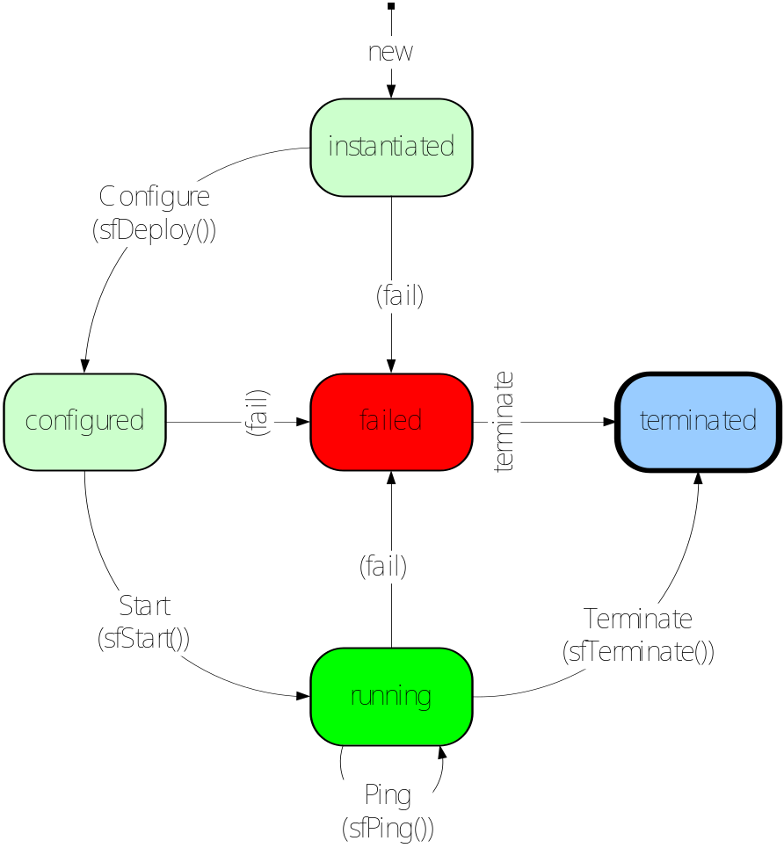
The lifecycle of a SmartFrog component
Parent Components have a matching lifecycle; they can deploy children as they choose
12 June 2008

