Slide 1
FARMING HADOOP
IN THE CLOUD
Steve Loughran
HP Laboratories
June 2010
Notes:
6 June 2010
HP Confidential
1

Slide 2
ABOUT ME
Researcher at HP Laboratories Bristol, England
Datacentre-scale apps & IaaS
ASF Member: stevel@apache.org
Committer: Ant, Hadoop-common, HDFS, MapReduce
Author: Ant in Action
Somewhat obsessive about testing

Slide 3
CLOUD ELIMINATES
Buying hardware based on predicted load
2+ week lead time on new hardware, storage
High Availability
Homogeneity
Static machine names, addresses and capabilities
Stable machines
A fast private network
Someone in the datacentre who cares about you
Notes:
What does all this mean?
You don’t need to predict your customer load in advance, though you had better hope your supplier can offer a service to match
You don’ t have to wait a few weeks for some order of hardware to get delivered.
You can’t buy HA kit: RAID, L7 routers, other nice things, to address availability. You need to design these in
You can’t be sure your machines will stay around, that when they come back their names and IP Addresses may change
You don’t have someone with a pager in the room who will track down network problems for you
6 June 2010
HP Confidential
1

Slide 4
APPLICATIONS MUST BE AGILE
Directory, database or CM service to configure
Applications to handle moving services
Use dynamic DNS services; don’t cache IPAddrs
Don’t expect HDD content to last on a single disk
Restart VMs on any app failure
Nothing is static. Nothing lasts.
Notes:
We really need to rethink how to design apps in this world, the old ways don’t. When a VM goes, so does any transient HDD. When a machine gets terminated and re-instantiated, it can have different hostname and address. Nor can that server deal with machines moving around. Which is a pity as the simplest way to deal with app trouble is to reset the VM. No need to worry about what its previous state
June 6, 2010
HP Confidential
1

Slide 5
CLASSIC TEAM ROLES
Architecture
Business Development
Development
Operations
Notes:
Here are some of the classic roles of back-end projects. There’s also graphic designers, marketing, content generation, etc. But this is the code side. Everyone’s job is hard.
Biz dev: make sure the idea is good, predict demand, get the ops team to work with Arch and Finance to get machines to meet the demand
Architecture: design something that works in the machines that ops will bring up
Developers: code and test the app, produce something that works
6 June 2010
HP Confidential
1

Slide 6
BEFORE
Business Development
Architecture
Design
Development
Staging
Live
Operations
Code
Test
Notes:
This is how things were built -at best- if you had a static set of machines as your target.
Even if you design/code/test in a cycle, going live creates problems. Different systems, different networks, etc. Staging is meant to simplify this with a setup that mimics production, but it still has different users.
June 6, 2010
HP Confidential
1

Slide 7
RESPONSIBILITIES
Work
Architects design the application
Developers code and test on local machines
Operations buy and configure production machines
Blame
Developers get blame for things not working
Operations get blame for security & availability problems
Getting predictions of demand wrong can kill your project
Notes:
This is how things are today. Set up for conflict. The big one is developers "ship code that is functional" and ops "run secure services".
6 June 2010
HP Confidential
1

Slide 8

EVERYTHING BLURS
Architecture
Design
Development
Business Development
Code
Test
Staging
Operations
Live
Notes:
Once you stop needing a physical cluster of machines to test on, you can give every developer a virtual cluster which mimics that in production. You can bring up a staging site on the public server farm, let third parties play with it, switch it over when you are happy (ignoring data issues)
6 June 2010
HP Confidential
1

Slide 9
DIFFERENT ROLES - DIFFERENT TOOLS
Role | Task | Tooling
Cloud Architect | Design App structure | Text editor (?)) Powerpoint (?
Cloud Operations | Build VMs, set parameters Manage production | Text under SCM Web & Command line
Developers | Request test VMs | Web, IDE, build tools
Biz Dev | Worry about money | Web & Spreadsheet
Notes:
Developers shouldn’t be creating the machine configurations; that’s a job for the architect and ops
Ops have to move beyond the pager when a machine fails to getting an overall statistical view of what works, doesn't work, and look at the total, perceived picture. No more panicing when a machine goes down, but do worry when all the machines start to fail too often. Solution: monitoring and statistics. Datamining. Hadoop.
Biz dev/management need to keep an eye on costs and revenue. Costs: machines. Revenue, things like why people are switching from free to premium, where customers are coming from. Statistics.Datamining. Hadoop.
June 6, 2010
HP Confidential
1

Slide 10

Hadoop's datamining services
are needed by the developers,
biz-dev, operations and
infrastructure teams
Notes:
At this scale, datamining and statistics becomes an essential background activity
Test result collection and analysis
Application and VM log file capture, analysis: chukwa
Application load analysis - feed into VM create/destroy
User/paying customer mining -when do people pay, when do they leave?
Infrastructure: how do people and their VMs behave?
6 June 2010
HP Confidential
1

Slide 11
HADOOP’S ASSUMPTIONS
Master nodes don’t move
Workers can spin for them
Failed workers get blacklisted
Single, static hostnames
Cache all DNS entries
Disks don't move between hosts
We need different strategies
Notes:
These are where Hadoop contains assumptions that are valid in the physical datacentre, but which don't work in a virtual world.
6 June 2010
HP Confidential
1

Slide 12
CLOUDFARMER
Role-driven VM allocation
UI split by team role

Slide 13
ROLE SPECIFICATION
worker extends HadoopVMRole {
description "A Hadoop Worker";
vmPrefix "vm";
bootAutoVol "vol-0-1-47";
min 0;
recommendedMin 3;
deploy "worker.sf"
links extends HadoopServlets {
hdfs DFS_DATANODE_HTTP_DEFAULT_PORT;
"Hadoop DFS" ["http", hdfs, "/"];
"Hadoop DFS metrics" ["http", hdfs, METRICS];
"Hadoop DFS stacks" ["http", hdfs, STACKS];
"Hadoop DFS conf" ["http", hdfs, CONF];
"Hadoop DFS conf JSON" ["http", hdfs, CONF_JSON];
}
}

Slide 14
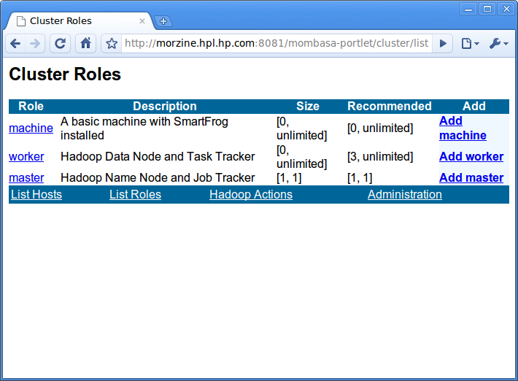
WEBAPP LISTS AVAILABLE ROLES
VMs with post-deployment actions
Notes:
This for everyone to create machines. You can only create machines in roles you have the right to. This is more than a constrained image, much more of the config is locked down: VM, networking, dynamic options.
June 6, 2010
HP Confidential
1

Slide 15
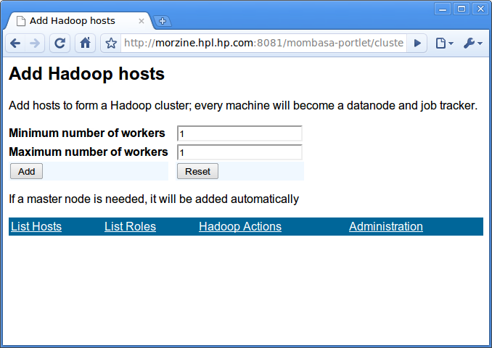
HADOOP CLUSTER: MASTER + WORKER
Webapp does the binding and cluster config
Notes:
I’ve cheated and added some Hadoop-specificness in the web front end; you can create Hadoop workers and it knows to create the Master first, and passes the master hostname down so that the workers bond properly. This use case needs to be made generic
June 6, 2010
HP Confidential
1

Slide 16
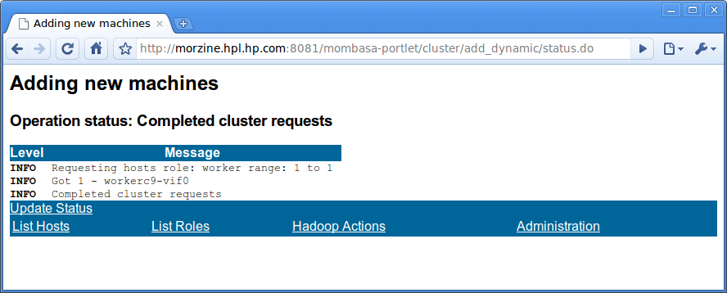
REQUEST COMPLETED
Notes:
This is a fairly weak Web UI but it’s designed to feed into portals. It also happens to test easily.
6 June 2010
HP Confidential
1

Slide 17
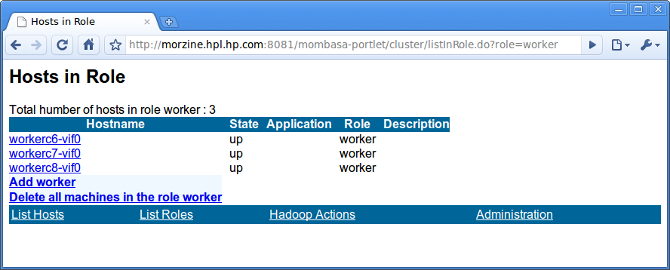
LIST HOSTS IN A ROLE
Actions: Add a worker, delete all in role “worker”

Slide 18
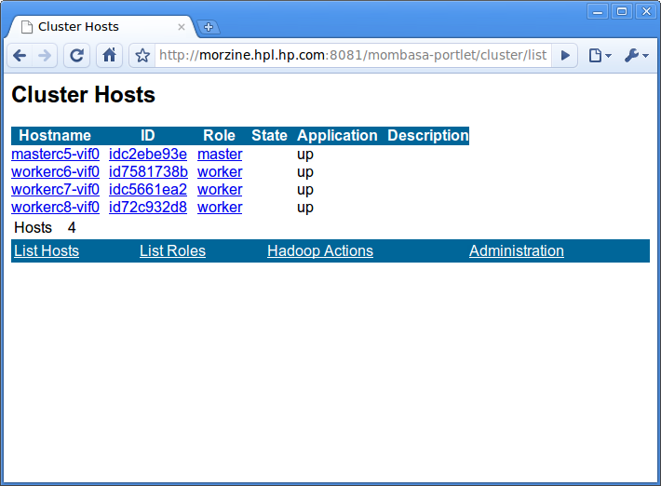
LIST ALL HOSTS

Slide 19
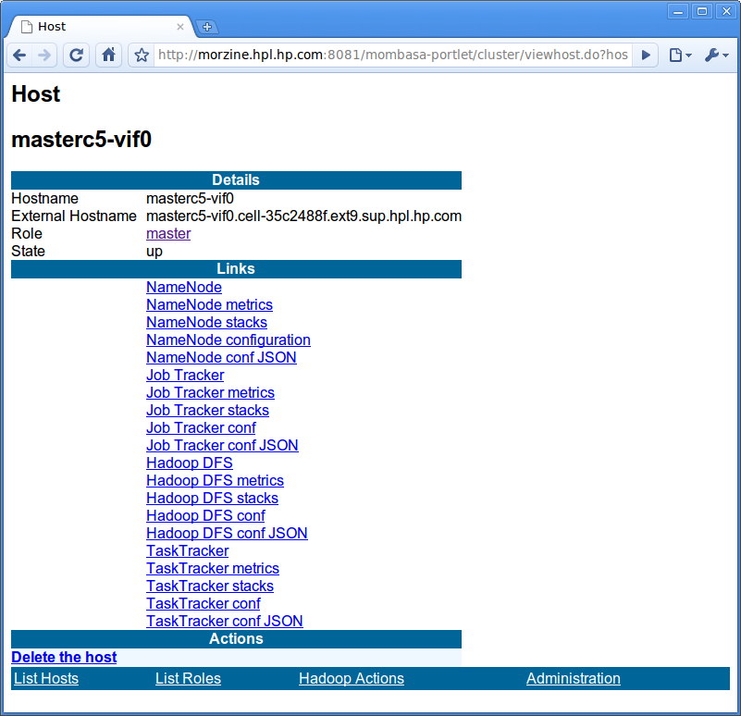
VIEW A HOST

Slide 20
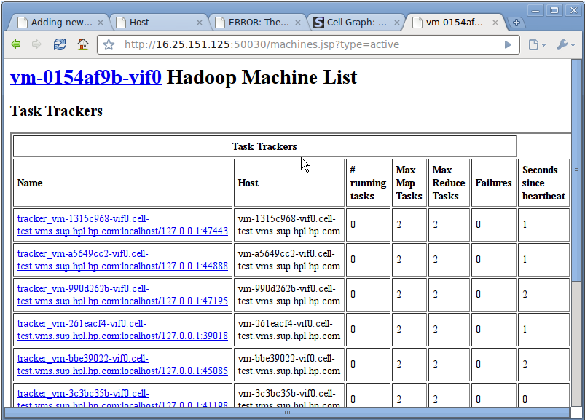

Slide 21
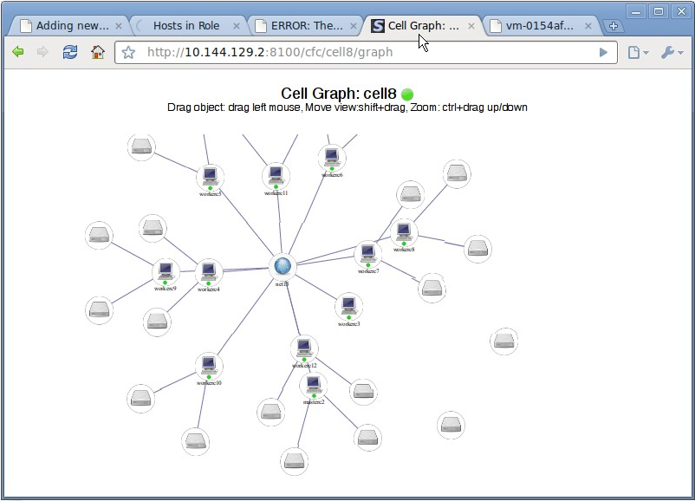
GRAPH VIEW

Slide 22
BENEFITS
Infrastructure can do late-binding install/deploy
Feeds into the UI
Web, IDE, build tools, ...
“Role” CPU/network history can aid placement
Other templates: network, aggregate clusters

Slide 23
TODO
VM Placement based on (data, user, VM role)
What is the right cloud UIs for biz dev?
Collecting, analysing test runs
Collect, analyse VM histories
Hadoop: lifecycle patches in
Hadoop: make agile against NN & JT
Hadoop: more job monitoring

Slide 24
Q&A
Notes:
6 June 2010
HP Confidential
1

