Slide 1

Hadoop and Universities
V 1.1

Slide 2
Strategic Goals
CS and other science graduates come out knowing how to code with MapReduce
Postgraduate research is done on and inside Hadoop.
The UK & EU grids host Hadoop for PB of data and the computation
Engagement between the ASF/Hadoop team and the Academic community
Notes:
Here are some Goals I've just made up –ones that are easy to measure
CS teach

Slide 3
Where is Hadoop being used?
CS: MapReduce as an algorithm
AI: datamining (Edinburgh, Glasgow)
Other sciences: Hadoop for data storage/analysis?

Slide 4
CS Teaching
Cloudera VM
The Eclipse plugin needs love
Common datasets
Re-use and adapt US coursework
Is Hadoop over-complex?
MapReduce is great with Haskell, Prolog, Erlang

Slide 5
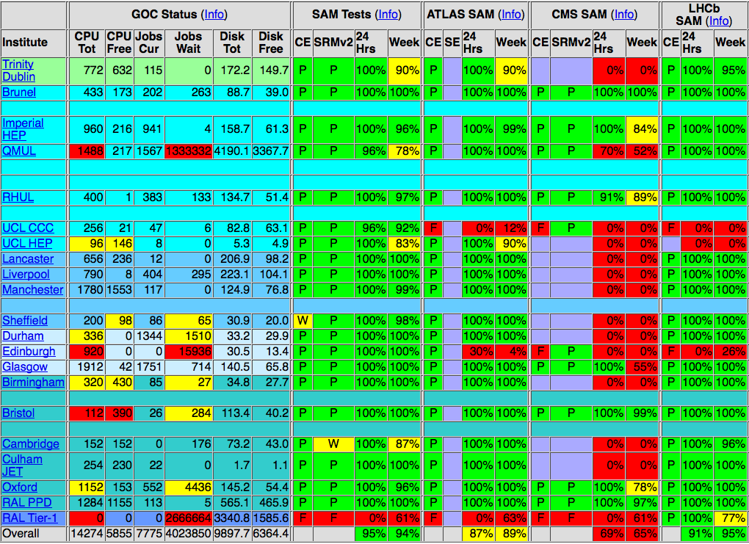
Hadoop over GGF grids?
Notes:
One plan of mine is to take over some of the EGEE clusters. How to do this?

Slide 6
What can we do?
Lecture at the local universities
Help people set up clusters
Offer cluster-time and datasets
Anything else?

Slide 7
Postgraduate Research
On Hadoop: new algorithms, layers on top
On Hadoop: MR for science
In Hadoop: scheduling, placement
Present at ApacheCon, HUG
Cluster time on OpenCirrus?
Steer researchers away from trouble, mentor them
Notes:
This is an area of interest, getting postgraduate work.
On Hadoop: new algorithms, analysing lots of data.
In Hadoop: improving the bits that are raw
For the researchers: get their work done, participate in a managed apache project
For ASF: get more people used to working on our code

Slide 8
A hadoop-research sub-project?
Place to bring in researchers
Mailing list where advanced topics are covered:
graph theory, NP-completeness, physics events
SVN repo –teach them Apache processes
Notes:
One easy action is to create a hadoop-research sub-project; focus on research things, not a list to discuss classpath problems. This would be unusual for the ASF as it would be a fairly intense CS, AI-hard list. These are the next generation of algorithm authors, we want them on our platform. In fact, we want their code regression tested on hudson, every night.

Slide 9

UK Hadoop-in-eScience event?
﻿Ross Gardler: "OSS Watch are putting on
an open source conference in Q2 2010..."
Notes:
I have discussed this a bit with Ross Gardler, part of JISC in Oxford
They're planning an OSS conference in 2Q10, we could do something as part of this.

