Slide 1
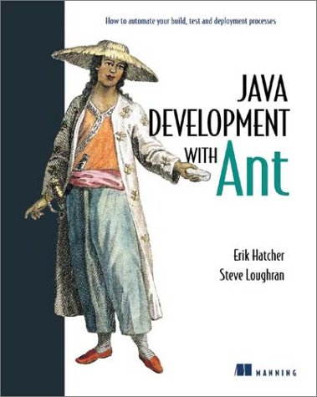
JUnit : Testing for Java
Steve Loughran
Erik Hatcher

Slide 2
concepts
agile programming: use the right process
test-centric programming: test first
pair-programming: the team is everything
refactoring: edit existing code when it 'smells'
continuous integration & deployment

Slide 3
test-centric
if it isn't tested, it doesn't work
automated test suites enable automated builds
write tests first
test to break code
don't just debug: write more detailed tests
JUnit is our tool here

Slide 4
refactoring
restructuring of software by applying a series of internal changes that do not affect its observable behavior
Fowler, Refactoring, 1999

Slide 5
refactoring
it's OK to change existing code
provided you don't break anything
i.e. when you have good test coverage or want to do regression proofs
changing code keeps the systems clean, maintainable, reduces duplication, lets you be flexible
what if there are no tests? write them first

Slide 6
JUnit: powerful but simple
Assert
<<interface>>
Test
*
TestCase
TestSuite
YourTest
Courtesy of Mike Clark
www.clarkware.com

Slide 7
Our first unit test
package org.example.antbook.common;
import junit.framework.TestCase;
public class SearchUtilTest extends TestCase {
public void testSearch() throws Exception {
// right API?
Document[] docs =
SearchUtil.findDocuments("erik");
assertTrue(docs.length > 0);
}
}

Slide 8
green is good
package org.example.antbook.common;
public class SearchUtil {
public static final Document[]
findDocuments(String queryString)
throws SearchQueryException,
SystemException {
Document[] results = new Document[1];
return results;
}
}

Slide 9
JUnit Assertions
assertTrue(boolean condition)
assertFalse(boolean condition)
assertEquals(Object expected, Object actual)
  Uses equals() comparison
  Overloaded for all primitive types
assertSame(Object expected, Object actual)
assertNotSame(Object expected, Object actual)
  Uses == comparison
assertEquals(float expected, float actual, float tolerance)
assertNull(Object o)
assertNotNull(Object o)
fail(String message)
+ overloaded
String methods

Slide 10
good tests
A good test finds a bug.
write devious, complex, ruthless tests:
fault on callbacks; invalid data, race conditions.
automate the assessment of success.
add more detail to the success tests

Slide 11
defects
write a test to replicate
then fix
but what if there is a long gap between test and fix –won't that break the build?
we will need 'tests that we know fail'
but even these need to verify that they fail in expected ways.
the false negative problem

Slide 12
JUnit Rules and Conventions
Subclass TestCase
Prior to v3.8, String-arg constructor required
Test methods
  public void testXXX() [throws …]
  Any number of assertions per method
Implement main to run from command-line, but not necessary
Optionally add setUp / tearDown methods.

Slide 13
Test fixture
import junit.framework.TestCase;
public class HtmlDocumentTest extends DocumentTestBase
{
HtmlDocument doc;
public void setUp() throws IOException {
doc = new HtmlDocument(getFile("test.html"));
}
public void testDoc() {
assertEquals("Title", "Test Title", doc.getTitle());
assertEquals("Body", "This is some test",
doc.getBodyText());
}
public void tearDown() {
doc = null;
}
}

Slide 14
TestCase lifecycle
setUp()
testXXX()
tearDown()
Repeats 1 through 3 for each testXXX method…
Use setUp() and tearDown() to prepare for and clean up every test; test class constructor to prepare immutable stuff

Slide 15
Test Suites
package org.example.antbook;
import junit.framework.Test;
import junit.framework.TestCase;
import junit.framework.TestSuite;
import org.example.antbook.junit.SimpleTest;
import org.example.antbook.ant.lucene.HtmlDocumentTest;
public class AllTests {
static public Test suite() {
TestSuite suite = new TestSuite();
suite.addTestSuite(SimpleTest.class);
suite.addTestSuite(HtmlDocumentTest.class);
return suite;
}
}
Notes:
We actually have separate package hierarchies for SmartFrog, because of security issues: the JARs are sealed signed so we cannot add new classes into the packages.

Slide 16
JUnit Best Practices
Separate production and test code
But typically in the same packages
Compile into separate trees, allowing deployment without tests
Don’t forget OO techniques, base classing
Test-first development

Slide 17
Test base classing
public abstract class DocumentTestBase extends TestCase
{
protected File getFile(String filename)
throws IOException {
String fullname = this.getClass()
.getResource(filename).getFile();
File file = new File(fullname);
return file;
}
}
tests share common code: factor it out

Slide 18
Ant and JUnit
Facilitates continuous integration and testing
Richer and more flexible reporting than otherwise possible, including publishing and e-mailing
Fail builds if tests fail

Slide 19
<junit> task
<target name="test-summary" depends="test-compile">
<junit printsummary="yes" haltonfailure="true">
<classpath refid="test.classpath"/>
<test name="tests.HtmlDocumentTest"/>
</junit>
</target>

Slide 20
<batchtest> and formatters
<target name="test-batch" depends="test-compile">
<junit printsummary="no"
errorProperty="test.failed"
failureProperty="test.failed">
<classpath refid="test.classpath"/>
<formatter type="xml"/>
<batchtest todir="${test.data.dir}">
<fileset dir="${test.dir}”
includes="**/*Test.class"
/>
</batchtest>
</junit>
</target>

Slide 21
<junitreport>
Aggregates XML generated by <junit> XML formatter output
Transforms result using XSLT into report
Default “frames” and “noframes” HTML stylesheets built-in, but customizable

Slide 22
<junitreport> syntax
<junitreport todir="${test.data.dir}">
<fileset dir="${test.data.dir}">
<include name="TEST-*.xml"/>
</fileset>
<report format="frames”
todir="${test.reports.dir}"
/>
</junitreport>

Slide 23
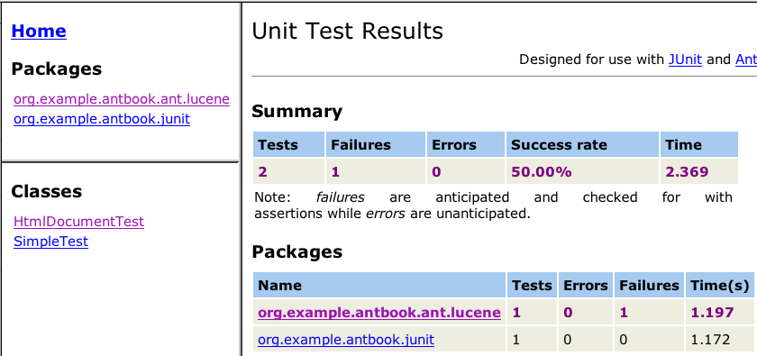
<JUnit Report>

Slide 24
Ant Best Practices
Naming conventions:
  *Test.java
  *TestCase.java
Fork <junit>
Use errorproperty and failureproperty
<fail> after <junitreport>
<copy> resources to build directory
Pass parameters using <sysproperty>

Slide 25
Passing parameters to tests
<junit … >
<sysproperty key="docs.dir”
file="${test.dir}”
/>
<sysproperty key="index.dir”
file="${test.dir}/index”
/>
…
</junit>
private String docsDir = System.getProperty("docs.dir");
private String indexDir = System.getProperty("index.dir");

Slide 26

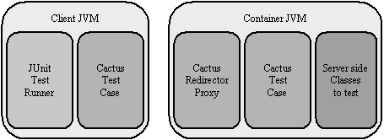
Cactus
unit testing of deployed J2EE apps
http://jakarta.apache.org/cactus/
excellent for testing:
  EJB
  Servlets, Filters, Taglibs
  Container-dependent frameworks, like Struts

Slide 27
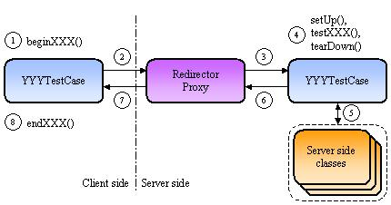
Cactus Architecture

Slide 28
import org.apache.cactus.ServletTestCase;
import org.apache.cactus.WebRequest;
public class RequestUtilTest extends ServletTestCase
{
public void beginGetValueParam(WebRequest theRequest) {
theRequest.setURL("localhost:8080", "/antbook",
"/test/test.jsp", null, "param=url");
}
public void testGetValueParam() {
request.setAttribute("param", "request");
assertEquals("url",
RequestUtil.getValue(request, "param"));
}
public void testGetValueAttribute() {
request.setAttribute("param", "request");
assertEquals("request",
RequestUtil.getValue(request, "param"));
}
}

Slide 29
implemented
import javax.servlet.http.HttpServletRequest;
public class RequestUtil {
public static final String
getValue (HttpServletRequest request, String key) {
String value = request.getParameter(key);
if (value != null) {
return value;
}
value = (String) request.getAttribute(key);
return value;
}
}

Slide 30
Cactus details
<runservertests> task to start, test, stop
Deploy
  Tests
  Cactus APIs
  Cactus-enabling web.xml

Slide 31
Cactus - Servlet Test Runner
New addition, allows tests to be run through browser
XML results returned
Using XSLT capable browser, report transformed to HTML on the fly

Slide 32
Other JUnit Extensions
HttpUnit
  Parses HTML results into DOM
  Easy link navigation and form population
  Useful for automated acceptance tests
Canoo WebTest
  HttpUnit inside Ant
JUnitPerf
  Wrap any JUnit tests
  Measure desired performance and scalability tolerances

Slide 33
Continuous Integration
Build often, triggered by commit or clock
Anthill, CruiseControl, Gump
We are running CruiseControl http://serrano.hpl.hp.com:8080/cc/main.jsp
We have a gump entry in http://jakarta.apache.org/gump
Expect email on the smartfrog-developer list

Slide 34
cruise control
http://serrano.hpl.hp.com:8080/cc/main.jsp

Slide 35
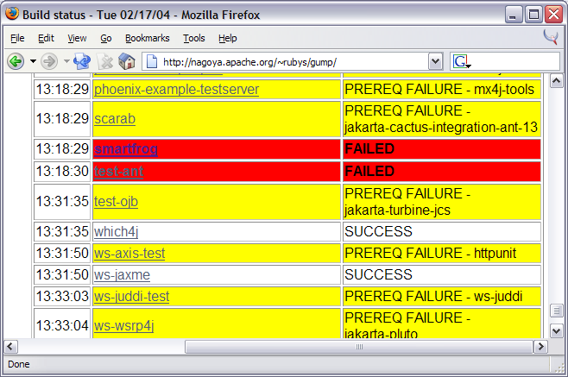
Gump
a clean build of important OSS Java projects
http://jakarta.apache.org/gump/

Slide 36
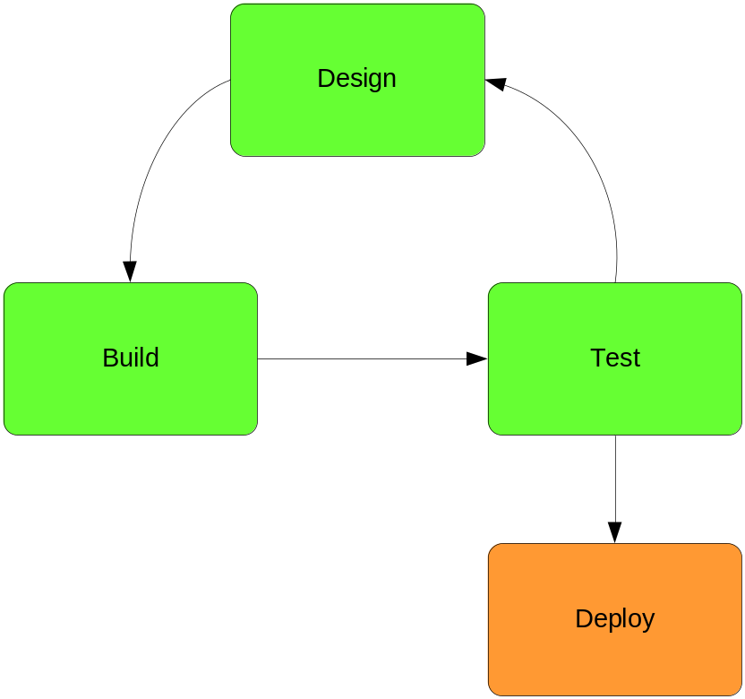
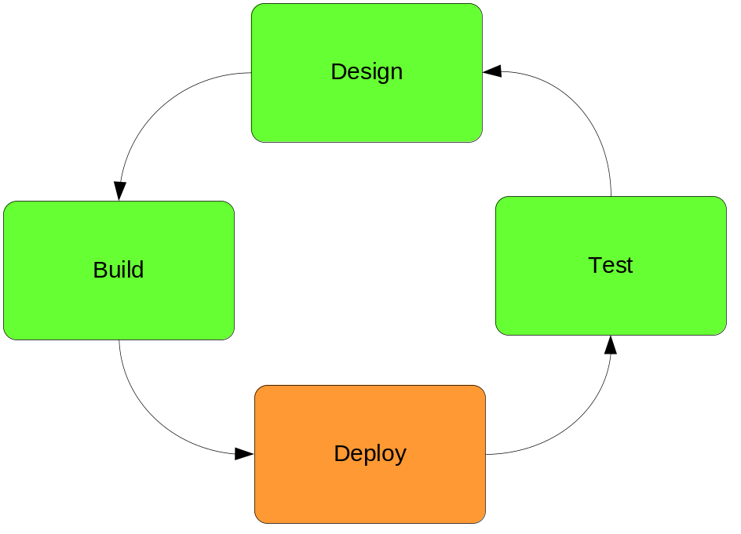
Continuous Deployment
waterfall
integrated
SmartFrog belongs here!
Notes:
if you can build continuously, why not deploy?
great for functional testing
not for public systems; scheduled deployment (overnight or 4x/day) better

Slide 37
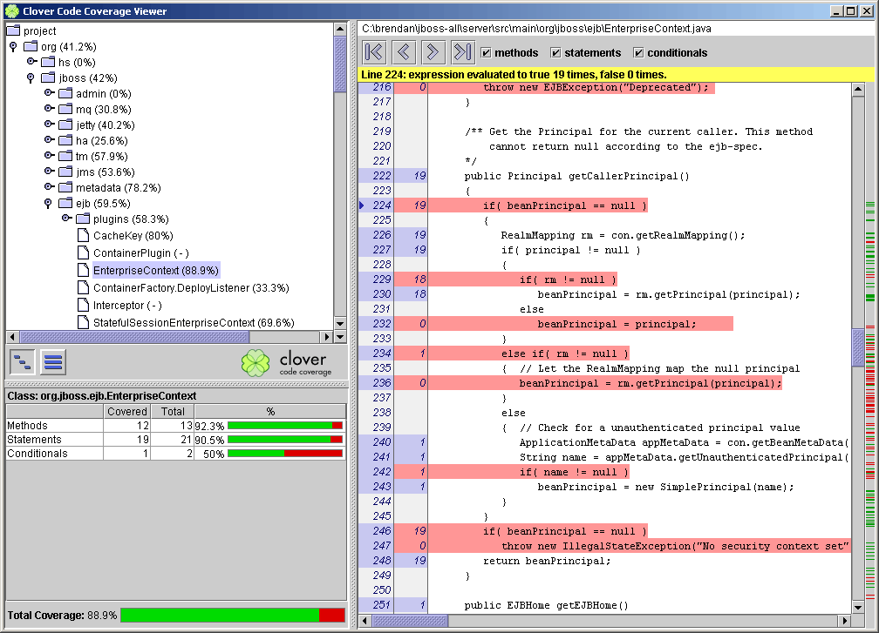
Code Coverage
Notes:
This is clover. OSS projects get this free; we need tests before bothering :)

Slide 38
Conclusions
Code without tests is probably broken
JUnit is easy to work with
Automated testing eases integration
Write tests as you go along
Continuous integration enables continuous deployment
Notes:
[1] unless you prove it works :)

Slide 39
Online Resources
JUnit.org
  http://www.junit.org
Cactus
  http://jakarta.apache.org/cactus
Clover
  http://www.thecortex.net/clover
dbUnit
  http://www.dbunit.org
HttpUnit
  http://www.httpunit.org
Canoo WebTest
  http://webtest.canoo.com
Mike Clark’s site
  http://www.clarkware.com
Glenn’s reference card
  http://www.delphis.com/java/junit-refcard.pdf

Slide 40
Books
eXtreme Programming Explained
  Kent Beck
Refactoring: Improving the Design of Existing Code
  Martin Fowler (Addison-Wesley, 1999)
Java Development with Ant
  (steve and erik)
Extreme Programming with Ant

