Slide 1
Cuda vs. MLK running FFT on 1GB of data
Presented by Stephen MacKenzie
Former VC++ member for 20 years.

Slide 2
Overview
Purpose of the demo
• Goals: high-throughput FFT, telemetry decoupling, GPU autotuning
• Tools used: Python, CUDA, MKL, memory-mapped files, NVIDIA Perf
This demo is running on an Intel Ultra 7 system with 32 GB of DDR5 RAM, NVMe SSD storage, and an NVIDIA GeForce RTX 4060 GPU. The GPU is using NVIDIA Studio drivers and is set to autotune mode for optimal performance.
Notes:
🗒️ Speaker Notes — Slide 1: Overview
The purpose of this demo is to showcase a high-throughput, hardware-aware signal processing pipeline that balances real-time telemetry capture with GPU-accelerated FFT benchmarking. We’re demonstrating how to decouple telemetry logging from performance-critical workflows, enabling uninterrupted data acquisition while pushing GPU utilization to its limits.
This setup is designed for reproducibility, modularity, and cross-platform compatibility. It’s not just a benchmark — it’s a blueprint for scalable, low-latency processing in environments where data integrity and throughput are non-negotiable.

Slide 3
Voltage Collection Pipeline
- `packet_forwarder.py`: captures controller voltage packets
- Memory-mapped file strategy: 8 parallel maps for immediate use
- Benefits: zero-copy access (cpu side), scalable ingestion
NOTE: I have included two zip files memmaps1.zip and memmaps2.zip, extract them into one directory and make sure the memmap_dir in main points to it.
Notes:
Slide: Voltage Collection Pipeline
packet_forwarder.py used to handle Ethernet packets, but that’s legacy code. It now reads from a COM port. You need to make sure the correct port is selected and the baud rate matches the device. On Windows, go to Device Manager, expand "Ports (COM & LPT)", and check the Properties of the relevant port to confirm settings.
NOTE: I have included two zip files memmaps1.zip and memmaps2.zip, extract them into one directory and make sure the memmap_dir in main points to it.

Slide 4
FFT Reference Section
Voltage Over Time = Composite Signal
Fast Fourier Transform
Fast Fourier Transform (diagram of the real data in this project)
Simulation (diagram of python generated graph)
Bibliography
Notes:
The following slides provide a brief overview of how voltage signals are interpreted in the frequency domain using FFT. These are included for context and reference, the slides are checked is as slides.pdf

Slide 5
Voltage Over Time = Composite Signal
When you sample voltage over time (e.g., V[0], V[1], ..., V[N]), you're capturing a single waveform. But that waveform is usually not a pure sine wave — it's a complex shape made up of many overlapping oscillations.
🧩 Signals as Sums of Sine Waves
Any periodic signal — even jagged or noisy ones — can be decomposed into a sum of sine and cosine waves at different frequencies, amplitudes, and phases. This is the essence of Fourier analysis.
Your voltage array might look messy or smooth.
But mathematically, it's just a weighted combination of frequencies.
Notes:
Why Multiple Frequencies?
Because real-world signals are rarely pure:
• A square wave contains odd harmonics (3×, 5×, 7× the base frequency).
• A pulse contains broadband energy — many frequencies.
• Noise adds random high-frequency components.
Even a simple sensor reading might have:
• A slow drift (low frequency),
• A periodic heartbeat (mid frequency),
• Electrical noise (high frequency).
🔍 FFT Reveals the Ingredients
The FFT takes your voltage array and tells you:
• Which frequencies are present,
• How strong each one is.
It’s like turning a complex sound into its musical notes.

Slide 6
Fast Fourier Transform
Time Domain (Raw Voltage)
Each sample represents a snapshot of voltage at a specific moment, driven by a clock (e.g., 10 kHz sampling rate).
The waveform shows how voltage varies over time, capturing the analog signal as a series of digital values.
This is useful for observing trends, noise, and transient behavior.
Frequency Domain (Post-FFT)
The FFT transforms the time-domain signal into its frequency components — showing how much of each frequency is present.
The sharp peak in the spectrum indicates a dominant frequency — likely a periodic component in the original signal.
The rapid decline after the peak suggests that most of the signal’s energy is concentrated in a narrow band, with little high-frequency content.
The flat baseline elsewhere means there's minimal noise or harmonic distortion — a clean signal.
Notes:
What Is Frequency?
Frequency is the measure of how often something repeats over time.
In signal processing, it's specifically:
The number of cycles per second of a repeating waveform.
Measured in Hertz (Hz), where 1 Hz = 1 cycle per second.
📈 In a Signal Context
Imagine a sine wave:
If it completes 1 full wave per second, its frequency is 1 Hz.
If it completes 1000 waves per second, that’s 1 kHz.
So frequency tells you how fast the signal oscillates.
Why It Matters
Low frequencies (e.g., 1–100 Hz): Often represent slow changes — like temperature drift or mechanical motion.
High frequencies (e.g., MHz–GHz): Represent fast changes — like radio signals, CPU clocks, or high-speed telemetry.

Slide 7
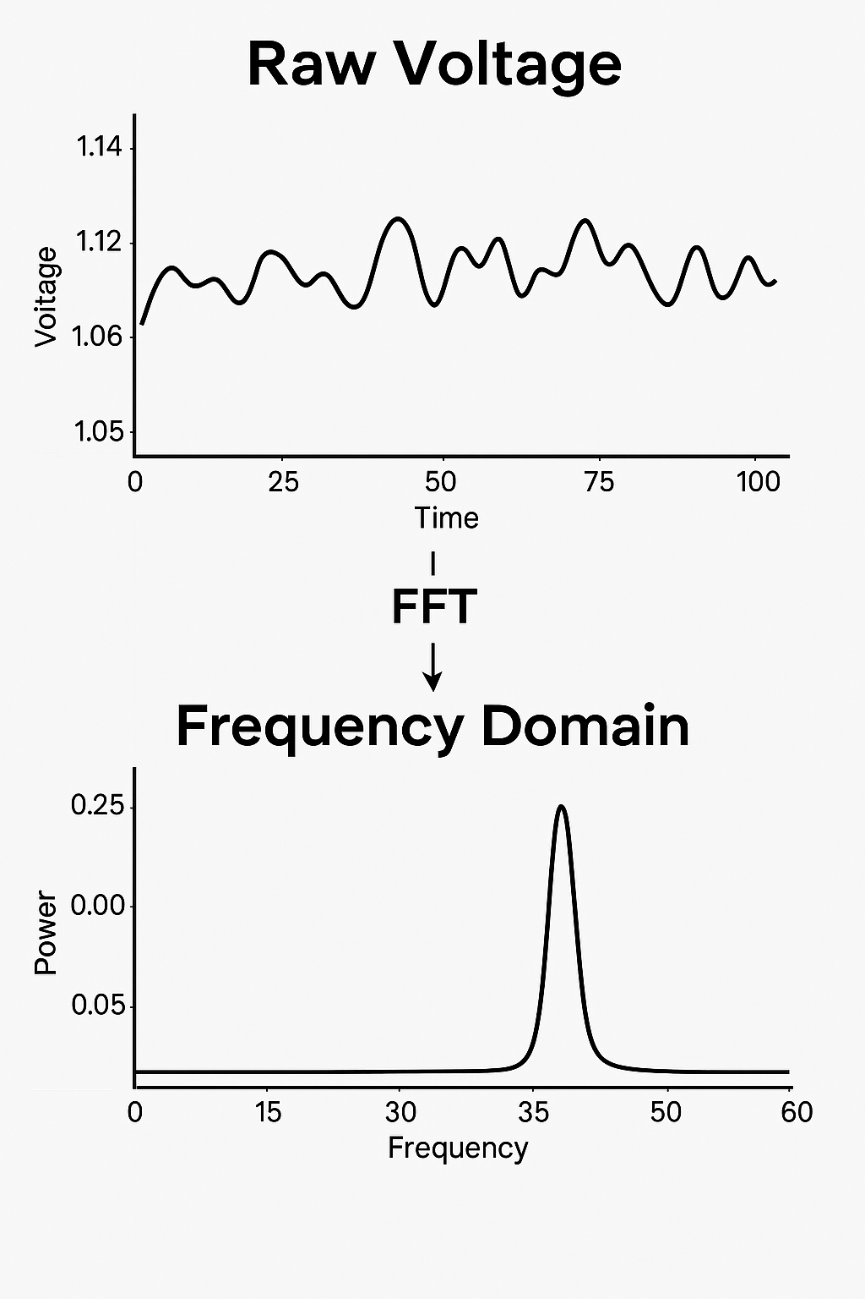
Fast Fourier Transform
Notes:
In FFT Terms
When you run an FFT on a time-domain signal:
You're decomposing it into a sum of sine waves of different frequencies.
The output tells you how much of each frequency is present in the original signal.

Slide 8
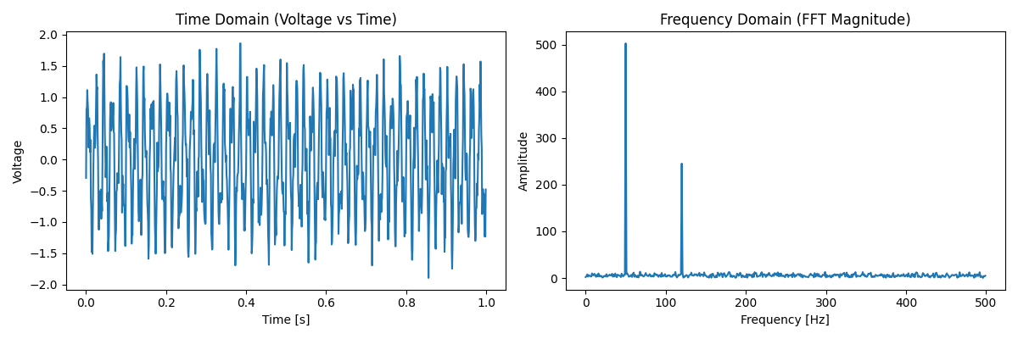
Simulation
Notes:
What You'll See
Left plot: Voltage over time — looks noisy and complex.
Right plot: Clear peaks at 50 Hz and 120 Hz, showing the dominant frequencies.
The noise appears as a low-level spread across the spectrum.

Slide 9
Bibliography for FFT
Horowitz, P., & Hill, W. (2015). The Art of Electronics (3rd ed.). Cambridge University Press.
Sedgewick, R. (1992). Algorithms in C++. Addison-Wesley.
Cormen, T. H., Leiserson, C. E., Rivest, R. L., & Stein, C. (2009). Introduction to Algorithms (3rd ed.). MIT Press

Slide 10
GPU Autotuning & Monitoring
- Setting GPU to autotune mode
- Using NVIDIA Performance App for live metrics
- Complementary logging via `monitor.py`
Notes:
Open NVIDIA app, go to perf

Slide 11
Library Setup: CUDA vs MKL
- Dual-path FFT implementation
- Comparison goals: throughput, latency, resource usage
- Performance tradeoffs between CUDA and MKL
- At small chunk sizes: - MKL benefits from tight CPU cache locality and low overhead - CUDA suffers from kernel launch latency and PCIe transfer costs
- As chunk size increases: - CUDA amortizes launch and transfer overhead across more data - GPU parallelism becomes dominant, especially for batched FFTs - MKL hits memory bandwidth and thread contention limits -
Result: - CUDA overtakes MKL in throughput and per-float latency beyond a certain chunk threshold - Especially true when host-device marshalling is optimized and telemetry is decoupled
Notes:
MKL (Intel Math Kernel Library)
- Optimized for multi-core CPUs with strong cache locality
- Excellent performance for small to medium-sized problems
- Lower overhead for host-side memory access and control
- Easier integration with legacy CPU-based workflows
- Limited scalability for very large datasets or real-time GPU acceleration
CUDA (NVIDIA GPU)
- Massive parallelism for large-scale FFTs and matrix ops
- Higher throughput for batched or chunked workloads
- Requires careful host-device memory management (e.g., pinned memory, async transfers)
- Overhead from PCIe transfers and kernel launch latency
- Best suited for pipelines where data stays on device or preprocessing is minimal

Slide 12
Build Configuration
- main.cu: hardcoded paths for includes, libs
- Required setup:
- #include paths
- libpath and libs
- LOG_CUDA, LOG_MKL, LOG_TELEMETRY

Slide 13
Telemetry Decoupling
- Why telemetry logging is separated from performance benchmarking
- Impact on latency and GPU utilization
- Diagram showing decoupled data paths
Notes:
Telemetry is separated from the performance-critical path because logging and data inspection introduce latency and can degrade throughput. However, both are essential — telemetry ensures the captured data is valid, complete, and not malformed. By decoupling the two, we maintain high GPU utilization while still verifying data integrity in parallel.

Slide 14
File Handle Queuing
- Strategy for preloading and queuing file handles
- Benefits: reduced I/O latency, smoother GPU pipeline
- FileMapper class, std::vector of mapped files.
Notes:
The FileMapper class manages memory-mapped files by encapsulating OS-level handles and cleanup logic. Each mapped file is represented by a lightweight struct or object stored in a std::vector, allowing batch operations and deferred cleanup.
🔧 Key Members (per mapped file):
HANDLE hFile = nullptr; // OS file handle from CreateFile HANDLE hMapping = nullptr; // Handle to the file mapping object from CreateFileMapping void* mapped_ptr = nullptr; // Pointer to the mapped memory region from MapViewOfFile size_t size = 0; // Size of the mapped region
🧹 Lifecycle Management:
Construction: FileMapper opens the file, creates a mapping, and maps it into memory.
Queuing: Each mapped file is stored in a std::vector, allowing chunked or batched access.
Destruction: In the destructor (~FileMapper()), all handles are closed and memory is unmapped to prevent leaks.
This design ensures safe, efficient access to large files while maintaining control over system resources.

Slide 15
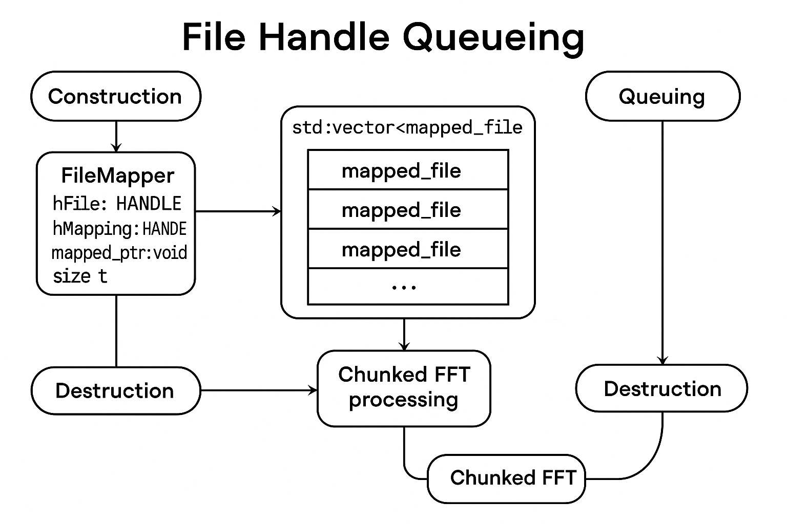
File Handle Queue and Lifetime Management

Slide 16
Execution Workflow
- Step-by-step:
- Start `monitor.py`
- Launch `CudaBigData.exe`
- Run `benchmark.py`
- If telemetry enabled: run `analyze_spectrum_report.py`
- Terminal screenshots or command sequence

Slide 17
Report Interpretation: Spectrum Analysis
- analyze_spectrum_report.py output
- Axis definitions:
- X-axis: frequency bins
- Y-axis: amplitude or power
- Variables:
- Sampling rate
- FFT size
- Windowing function (if any)
- Annotated spectrum plot
Notes:
Go to the next slide to explain the graph

Slide 18
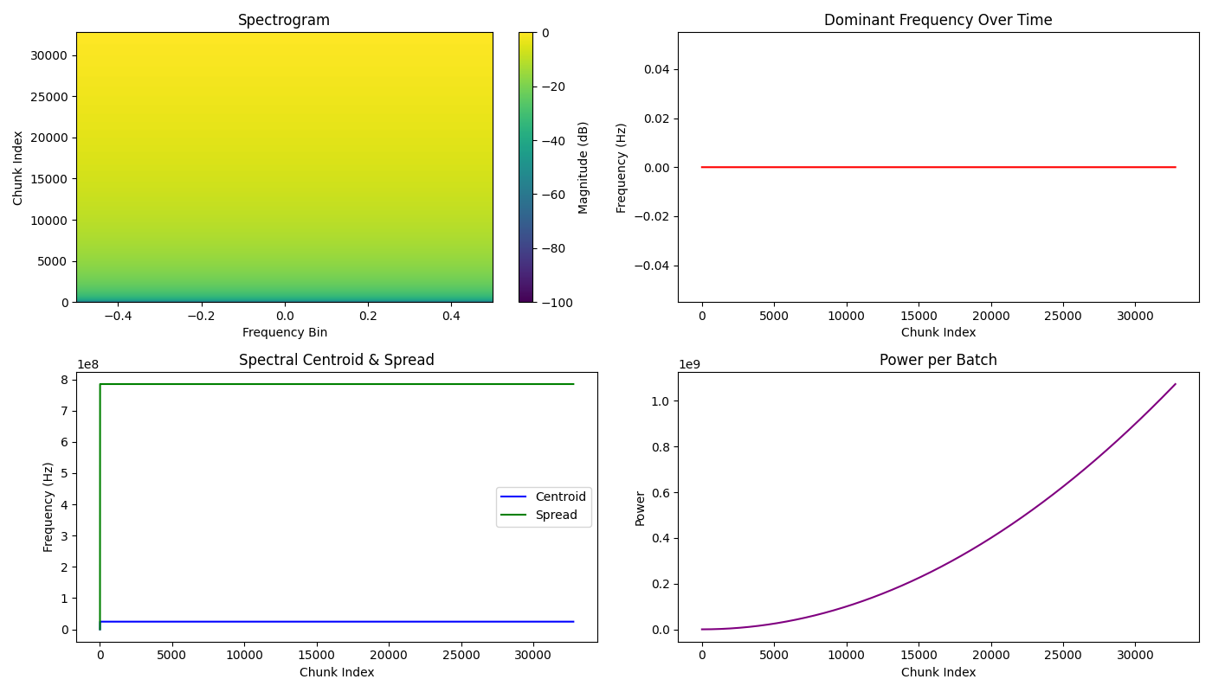
Spectrum Analysis
Notes:
A spectrogram is a visual representation of how the frequency content of a signal changes over time.
- X-axis: Time
- Y-axis: Frequency
- Color or brightness: Amplitude (or power) of each frequency at each time slice
Dominant Freq: This voltage trace shows no oscillatory behavior. Its dominant frequency is 0 Hz because the signal is essentially static or slowly drifting — there are no cycles, pulses, or periodic features
Spectral Centroid Represents the center of mass of the spectrum — a weighted average of frequencies.
Used to estimate brightness or tonal sharpness of a signal.
Spectral Spread: Measures the variance around the centroid — indicates how wide or narrow the frequency content is.
High spread = noisy or broadband signal; low spread = tonal or focused signal.
Power per Batch increases steadily, showing that the signal becomes progressively more energetic as processing advances through the data stream.

Slide 19
Report Interpretation: Benchmark Metrics
- `benchmark.py` output
- Metrics:
- Per-float latency
- Chunk throughput
- GPU vs CPU comparison
- Bar chart or line graph with callouts
Notes:
Go to the next slide to explain.

Slide 20
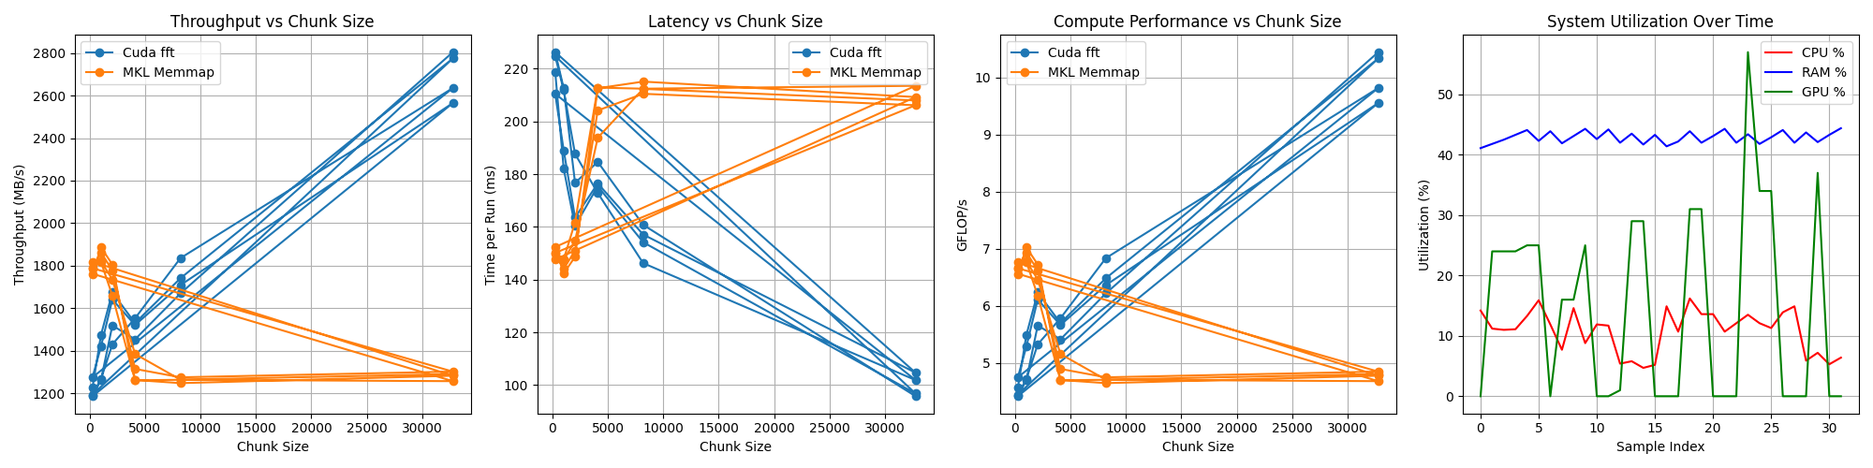
Benchmark Diagram
Notes:
Throughput vs Chunk Size
Larger chunk sizes generally improve throughput by reducing overhead and maximizing sustained data transfer.
Latency vs Chunk Size
Smaller chunks reduce latency per operation but increase coordination overhead, while larger chunks may delay individual results.
Compute Performance vs Chunk Size
Compute efficiency often improves with larger chunks due to better cache usage and reduced per-unit overhead.
System Utilization
Utilization reflects how effectively CPU, memory, and GPU resources are engaged during batch processing and FFT computation.

Slide 21
Summary & Takeaways
Key performance insights
- Lessons learned from telemetry decoupling
- Next steps: tuning, scaling, open-source release
- Host-device marshalling: performance degradation when attempting in-place interleaving or preprocessing on device; forced host-side staging and copy-back due to lack of direct access to mapped buffers, increasing PCIe traffic and latency
- Mitigation: batch transfers with pinned memory and deferred preprocessing to reduce contention and improve overlap

Slide 22
Links
The code:
https://github.com/stevemac321/cuda_fft_batch_mmap_1g
My linkedin:
https://www.linkedin.com/in/stevemac321/
My Technology and Music YouTube Channel:
https://www.youtube.com/@stephenmackenzie6782

