Slide 1
Why C? Refuting C++ Pretentiousness
By: Stephen MacKenzie
Former 20 year Member Microsoft Visual C++ Team
Notes:
This is not about C/C++ versus other languages.
It is about the viability of C distinguished from C++.

Slide 2
C++: Get Off My Lawn
Talk is NOT about C/C++ vs. Rust, Go, Python, Java, etc.
It specifically refutes imperatives coming out of the C++ camp
C is Obsolete
Stop Teaching C
I used to be a C programmer, but now I’ve seen the light
Stop using linked lists
Who Am I?
Why do I care? (no dog in the fight)
Humor, but not joking

Slide 3
Who Am I?
Who am I to challenge Barney, the creator of the highly successful C++?
No one
Shred the slave mentality, don’t worship credentials.
Judge the message, not the messenger
If Barney wants to evangelize C++, fine.
But if he starts talking smack about C, don’t be surprised if someone calls BS.

Slide 4
C++ Throws Down the Gauntlet
I have no dog in the fight
Just someone who is convicted to say what needs to be said.
Program in any language you want, it’s a free country.
But C++ is getting aggressive trying to marginalize C
C is Obsolete, Barney Stroustrup
Linux is Obsolete, Andy Tannenbaum
Wanting it to be true does not make it true.
Not about the merits of C++, plenty of content
Stop Teaching C, Kate Gregory
C to C++ “Conversion Stories.”

Slide 5
C is NOT Obsolete; Keep Teaching C
We will examine the assertions: Is it True?
Assertion: Not about technology, its propaganda
We will look at some physical data
We will talk about some inconvenient truths about header based libs
C is the system language (see man 2)

Slide 6
Is C Obsolete? Is it a true assertion?
Largest Software Project in the World
Android
The Spirit of C
Technical Reasons
Notes:
Show youtube Bjorna C is Obsolete
Show youtube Kate Gregory Stop Teaching C
Who died and made these people pope? Do you automatically bow down to people based upon their industry status? Do you allow others to dictate their morality upon you simply because they might have a higher IQ than you? If you do, I am of the opinion that this a sort of idolatry or slave thinking. But maybe that’s just me.

Slide 7
Its Propaganda, Dogma
C++ Gurus are “preaching.”
Words are powerful
Open Source started a new movement, party, denomination
RMS preaches values: unjust society, malware, surveillance engine, tracking device, Ibad, Amazon Swindle, Internet of Stings, etc.
When you say, C is Obsolete, Stop Teaching C, it is fair to say:
“There is no circumstance EVER when C is appropriate.”
1990’s monopolistic attitude, fighting for a piece of a finite pie

Slide 8
C Strengths
C Respects You (The Spirit of C)
C Has a Small Feature Set
C is a Great Language for Electrical Engineers
C Has a Stable ABI
C++ breaks ABI by design every major release
C is the language of Unix-style Kernels (see man 2)
C Helps You Think Like a Computer
C++ paradigm: all about the code, real world modeling
C paradigm: about the data
Notes:
Linux Torvalds, Ken Thompson, Richard Stallman
1.) speculation, but informed based up experience
2.) There is something compelling about a small language and feature set that you can master

Slide 9
(continued.)
Popular in the Microcontroller realm
Approved by Mission Critical Standards
Modern C++ is not allowed by MISRA etc.
IAR Embedded Workbench C++98/03
C is able to implement C++ features
Pimpl idiom (interfaces)
Generics, polymorphism
C Libraries for Developers are NOT header based
MS09-035
Active Template Library Security Update for Developers
Attention Customers!!!!

Slide 10
The Spirit of C (X3J11 C89)
TRUST THE PROGRAMMER.
Don’t prevent the programmer from doing what needs to be done.
KEEP THE LANGUAGE SMALL AND SIMPLE
Provide only one way to do an operation

Slide 11
The Spirit of C++?
The programmer is NOT to be trusted
Don’t use pointers, use unique_ptr or shared_ptr
Don’t’ use const char *, use strings
Don’t use stdio.h, use iostream
Make the language large and complex, constantly churning.
Library doubled in size 2008 TR1
Suffers from terminal feature creep
Ignore data, the code will simplify your problem.
The compiler will do it for you
Don’t try to help the compiler
Don’t engineer your own data structures and algorithms
Use our library

Slide 12
C Respects ; C++ Suspects
C: Respects and empowers you.
C++: Suspects you. You need to be constantly suckled, remaining tied to the hip with the new features, rebuild to the new ABIs
In other words, never weaned off the teat of Mother Committee.

Slide 13
Size ,Speed: New Claims Falter
Small Tests: Sorting 1M random integers. (inline code faster but larger)
Larger Sample: 350-500 Lines: Create Index to Footnotes
C (clang 7 built for speed: O3):
Lines to implement: 510
Size: 18032
Perf (clock ticks / CLOCKS_PER_SEC): 0.0053
C++ (clang++ 7 built for speed O3)
Lines to implement: 316
Size: 195560 (over 10x larger)
Perf (clock ticks / CLOCKS_PER_SEC): 0.0305 (6x slower)

Slide 14
Serviceability
Header based Libraries:
get compiled into your binary
Cannot be serviced like a shared library
Can header based libraries be trusted?
Do they run industry standard conformance tests?
What are the pass rates?
How many are disabled?

Slide 15
Attention All Customers!
ATL Security Bug: https://msdn.microsoft.com/en-us/vstudio/ee309358.aspx?f=255&MSPPError=-2147217396
Its one thing if it is code you wrote
Recall, recompile, re-deploy
For every version that the bug existed
On every platform and device
Automotive, aerospace, IoT,

Slide 16
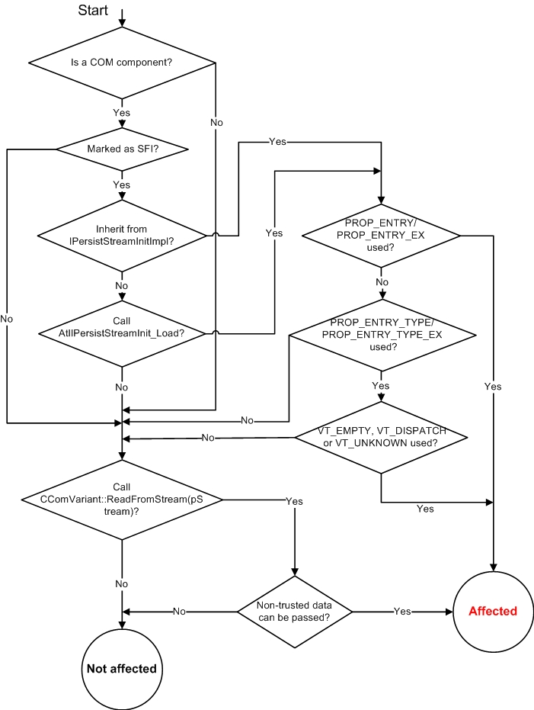
Notes:
ATL used a ton in Windows, e.g. the login screen
The exploit had been present for several releases, several years
Determining if the control is affected
You need to review the source code of your control in order to assess whether your control is impacted. The following is a step-by-step guide for the code review process.
First, while we believe that most affected COM components would be ActiveX controls, we want to emphasize here that this ATL vulnerability applies to any COM component built with ATL if the necessary conditions are present.
The diagram below provides an easy way of identifying vulnerable controls:

Slide 17
Not All Big Names Agree
RMS
“C++ is a badly designed and ugly language. It would be a shame to use it in Emacs.” –posted to emacs-devel July 2010.
Mike Acton, Engine Lead, Insomnia Games @ 2014 CPPCON
Challenges the C++ “World-View”
Challenges Code-centric, design pattern-centric
Promotes data driven development for resource constrained environments

Slide 18
Linus on C++
*YOU* are full of bullshit. C++ is a horrible language. It's made more horrible by the fact that a lot of substandard programmers use it, to the point where it's much much easier to generate total and utter crap with it. Quite frankly, even if the choice of C were to do *nothing* but keep the C++ programmers out, that in itself would be a huge reason to use C.
In other words: the choice of C is the only sane choice. I know Miles Bader jokingly said "to piss you off", but it's actually true. I've come to the conclusion that any programmer that would prefer the project to be in C++ over C is likely a programmer that I really *would* prefer to piss off, so that he doesn't come and screw up any project I'm involved with. C++ leads to really really bad design choices. You invariably start using the "nice" library features of the language like STL and Boost and other total and utter crap, that may "help" you program, but causes:

Slide 19
Linus on C++ Continued
infinite amounts of pain when they don't work (and anybody who tells me that STL and especially Boost are stable and portable is just so full of BS that it's not even funny)
- inefficient abstracted programming models where two years down the road you notice that some abstraction wasn't very efficient, but now all your code depends on all the nice object models around it, and you cannot fix it without rewriting your app. In other words, the only way to do good, efficient, and system-level and portable C++ ends up to limit yourself to all the things that are basically available in C. And limiting your project to C means that people don't screw that up, and also means that you get a lot of programmers that do actually understand low-level issues and don't screw things up with any idiotic "object model" crap. So I'm sorry, but for something like git, where efficiency was a primary objective, the "advantages" of C++ is just a huge mistake. The fact that we also piss off people who cannot see that is just a big additional advantage. If you want a VCS that is written in C++, go play with Monotone. Really. They use a "real database". They use "nice object-oriented libraries". They use "nice C++ abstractions". And quite frankly, as a result of all these design decisions that sound so appealing to some CS people, the end result is a horrible and unmaintainable mess. But I'm sure you'd like it more than git.

Slide 20
Ken Thompson on C++
“It certainly has its good points. But by and large I think it's a bad language. It does a lot of things half well and it's just a garbage heap of ideas that are mutually exclusive. Everybody I know, whether it's personal or corporate, selects a subset and these subsets are different. So it's not a good language to transport an algorithm -- to say, "I wrote it; here, take it." It's way too big, way too complex. And it's obviously built by committee.”
“When Stroustrup read the interview he came screaming into my room about how I was undermining him and what I said mattered and I said it was a bad language.”
-cited in Seibel, Peter (2009). Coders At Work. p. 475.

Slide 21
Recap, Takeways
Recap: Not against C++ NOT: “Don’t use C++” or “C is Better than C++”. Rather: Imperatives like: “C is obsolete” and “Stop Teaching C” have an element of rhetoric, regardless of the status of the speaker. It is self serving to their agenda. They dictate Takeways C++ may very well be your best solution You might decide to use a subset You learn that using C++ has a constant factor overhead that you can incur You may decide to craft your own template or header based code that you can own and control. However: C has a stable ABI, makes you think more like the hardware It is a good language for micro-controllers and for electrical engineers It has a small feature set, a language that you can get a handle on. I assert that just these facts alone, regardless of the other factors, exposes the imperatives such as “C is obsolete” and “Stop Teaching C” as rhetoric. C is a great language to learn for low-level programming

Slide 22
Links
Instructional Videos:
@TODO
https://github.com/stevemac321/whyc
My github, includes instructions
ATL Security Bug: https://msdn.microsoft.com/en-us/vstudio/ee309358.aspx?f=255&MSPPError=-2147217396

