Slide 1
Why C?
C is NOT Obsolete! KEEP Teaching C!
By: Stephen MacKenzie
Former 20 year Member of the Microsoft Visual C++ Team

Slide 2
Premise
I am NOT against C++, but…
C++ “Popes” Anathematize C As Heresy
Bjarne, Kate
The Assertion that C++ Code Bloat is a Myth
They DO have Some Points:
Type safety
RAII
Very Nice Library
Modern Language Features
Notes:
Show youtube Bjorna C is Obsolete
Show youtube Kate Gregory Stop Teaching C
Who died and made these people pope? Do you automatically bow down to people based upon their industry status? Do you allow others to dictate their morality upon you simply because they might have a higher IQ than you? If you do, I am of the opinion that this a sort of idolatry or slave thinking. But maybe that’s just me.

Slide 3
Raising A Fist Against the Inquisition
C Has a Small Feature Set
C is a Great Language for Electrical Engineers
C Has a Stable ABI
C++ breaks ABI by design every major release
C is the language of Unix-style Kernels
C Helps You Think Like a Computer
C++ paradigm: all about the code, real world modeling
C paradigm: about the data
Notes:
Linux Torvalds, Ken Thompson, Richard Stallman
1.) speculation, but informed based up experience
2.) There is something compelling about a small language and feature set that you can master

Slide 4
(continued.)
Popular in the Microcontroller realm
Approved by Mission Critical Standards
Modern C++ is not allowed by MISRA etc.
IAR Embedded Workbench C++98/03
C is able to implement C++ features
Pimpl idiom (interfaces)
Generics, polymorphism
C Libraries for Developers are NOT header based
MS09-035
Active Template Library Security Update for Developers
Attention Customers!!!!

Slide 5
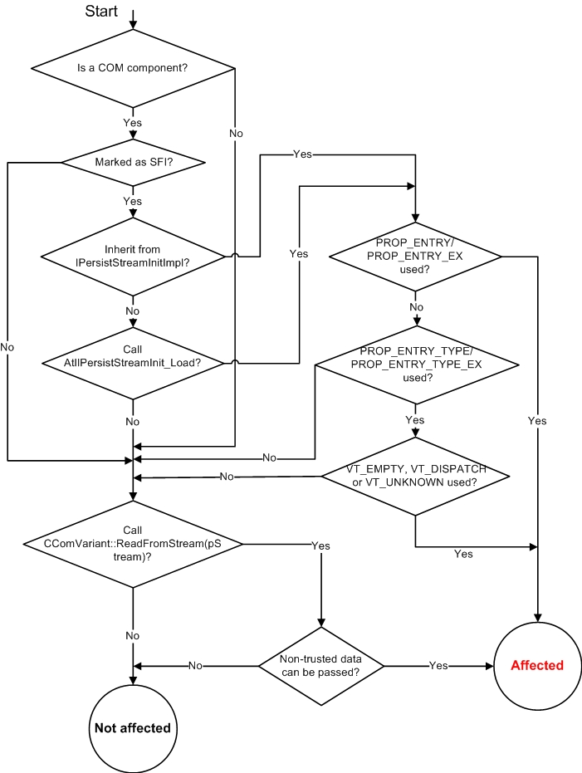
Notes:
ATL used a ton in Windows, e.g. the login screen
The exploit had been present for several releases, several years
Determining if the control is affected
You need to review the source code of your control in order to assess whether your control is impacted. The following is a step-by-step guide for the code review process.
First, while we believe that most affected COM components would be ActiveX controls, we want to emphasize here that this ATL vulnerability applies to any COM component built with ATL if the necessary conditions are present.
The diagram below provides an easy way of identifying vulnerable controls:

Slide 6
Lie: C++ No Longer Bloats Code
Let’s Look at Some Data
Why do the numbers vary from release to release?

Slide 7
Its About the Hardware and Data: Risk Management and Return on Investment
Do we blindly delegate to the C++ Gurus?
They are not “Infallible”
Not All Agree
Linus, Ken, Richard, Acton
Evaluate, Measure, Test, Discuss
Make the Right Decision for Your Context
If You Want to Learn C++:
A Tour of C++, STL Videos on Channel 9
Notes:
Data Driven C++, Mike Acton, Engine Lead, Insomnia Games, find on youtube, CPPCON 2014.

Slide 8
Part II – Programming ST Microcontroller From Linux
Minimal Tools, no IDE
Stlink usb driver, gdbserver deployment
gcc ARM cross tools
Gdb debugging on the host
Semihosting back to the host (printing to screen)
MLibs
C and C++ Libraries, Tests, and Framework
Under GPL2
OK from text only console
To debug one test you need tmux or screen

Slide 9
Recap, Takeways
Recap: Not against C++ NOT: “Don’t use C++” or “C is Better than C++”. Rather: Imperatives like: “C is obsolete” and “Stop Teaching C” have an element of rhetoric, regardless of the status of the speaker. It is self serving to their agenda. They dictate Takeways C++ may very well be your best solution You might decide to use a subset You learn that using C++ has a constant factor overhead that you can incur You may decide to craft your own template or header based code that you can own and control. However: C has a stable ABI, makes you think more like the hardware It is a good language for micro-controllers and for electrical engineers It has a small feature set, a language that you can get a handle on. I assert that just these facts alone, regardless of the other factors, exposes the imperatives such as “C is obsolete” and “Stop Teaching C” as rhetoric. C is a great language to learn for low-level programming

Slide 10
Links
Instructional Videos:
@TODO
https://github.com/stevemac321/whyc
My github, includes instructions
ATL Security Bug: https://msdn.microsoft.com/en-us/vstudio/ee309358.aspx?f=255&MSPPError=-2147217396

