Slide 1
Cryptography
September 23, 2017

Slide 2
About me
BCA 2nd Year Student, from Maharaja Surajmal Institute (GGSIP University)
Oracle Certified Associate in Java SE 8
Android App on Google Play Store that saves Diary logs encrypted in AES/GCM, with 6900+ installs, 300 active users and rating of 4.0 (app id: com.steve.diary.diary)
Contact:
https://www.stevemann.in
@stevemann2705
https://www.linkedin.com/in/stevemann2705/

Slide 3
There are two kinds of cryptography in this world: cryptography that will stop your kid sister from reading your files, and cryptography that will stop major governments from reading your files
-Bruce Schneier (Applied Cryptography)

Slide 4
What is Cryptography?
The art and science of concealing the messages to introduce secrecy in information security is recognized as cryptography*
* There are other things involved in cryptography which will be discussed later.

Slide 5
Need of Cryptography
To store passwords in a secure manner (hashes)
Secure transportation of data
Detect unauthorized tampering with files/data
To ensure sender is the one he claims to be (authentication)

Slide 6
Functions of Cryptography
Confidentiality
Accountability
Authenticity
Availability
Integrity

Slide 7
Terminology
Plaintext/Cleartext
The message
Ciphertext
The encrypted message
Encryption/Enciphering
Process of encrypting plaintext to ciphertext
Decryption/Deciphering
Process of decrypting ciphertext to plaintext

Slide 8
Terminology Returns
Key
The 'shared secret' to keep the message secret
Keyspace
The set of all possible keys
Cryptographic Algorithm/Cipher
Series of steps applied to the message and key for encryption/decryption purposes
Cryptanalysis
Breaking cryptography

Slide 9
Basic Operation
Encryption
Decryption
Plain Text
Cipher Text
Key
Cipher Text
Plain Text
Key

Slide 10
Caesar's Cipher
One of the earliest known and simplest ciphers
Each letter shifted a certain number of places
The number of shifts would be the key
E(x,k) = (x+k) mod 26
D(x,k) = (x-k) mod 26

Slide 11
Caesar's Cipher Example
Plaintext(x): hello world
Key(k): +5
E(x,k) = (x+k) mod 26
Ciphertext: mjqqt btwqi
Encryption
Ciphertext(x): mjqqt btwqi
Key(k): +5
D(x,k) = (x-k) mod 26
Ciphertext: hello world
Decryption

Slide 12
Cryptanalysis
Bruteforce
Keyspace for Caesar’s Cipher only 26
Can be bruteforced easily*
*Bruteforce Demo

Slide 13
Cryptanalysis

Slide 14
Cryptanalysis

Slide 15
Cryptanalysis
Key k can be acquired by frequency analysis of letters of ciphertext
Frequency table shifts a certain number(k) to the right (positive) or to the left (negative)
k is the key used for encryption

Slide 16
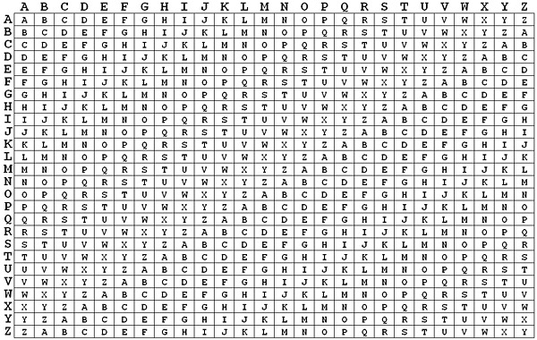
Vigenère Cipher
Simple form of polyalphabetic cipher
Uses Vigenère Square for encryption
Harder Cryptanalysis
Keyspace of 26^{n} (n - key length)
Vigenère Square

Slide 17
Vigenère Cipher Example
Plaintext: this is a secret message
Key: snake
Plaintext
t | h | i | s |  | i | s |  | a |  | s | e | c | r | e | t |  | m | e | s | s | a | g | e
s | n | a | k |  | e | s |  | n |  | a | k | e | s | n | a |  | k | e | s | n | a | k | e
l | u | i | c |  | m | k |  | n |  | s | o | g | j | s | t |  | w | i | k | f | a | q | i
Key
Ciphertext

Slide 18
Cryptanalysis is Difficult
Larger keyspace 26^{n} (n - key length), bruteforce difficult
Simple frequency analysis not possible
Flattens the frequency distribution table
Still prone to frequency analysis attack

Slide 19
Cryptanalysis
Letter frequency table for first 5 chapter of Dan Brown’s novel, The Lost Symbol
Ciphertext encrypted with key: pseudo(6 letters)
Keyspace of 308915776

Slide 20
Cryptanalysis
Find patterns in ciphertext, like ‘aab’ occurance is high in ciphertext.
Find general distance of repetition
Guess key by finding pattern in repitition
Distances b/w consecutive ‘aab’ are 5910, 4830,12404,3336, 4722…..
5910, 4830, 3336, 4722 are all divisible by 6. ‘aab’ repeats itself after certain blocks of 6 chars
So we can assume key length to be 6

Slide 21
Cryptanalysis
Now that we have a key length assumption, we take every 6th character and see its frequency distribution
Starting from first character of plaintext, every 6th character will be encrypted using same key ‘P’
The block similar to Caesar’s Cipher
Prone to frequency analysis and finding the first character of key
Similarly, we can find all the other characters of the key

Slide 22
Modern Cryptography
Operates on binary bit sequences (0 and 1) instead of texts or so
Foundation of computer and communications security
Relies on publically known mathematical algorithms
Cipher Algorithm is publically known

Slide 23
One time pad/Vernam Cipher
Uses binary operator XOR (bitwise), also called bit inverter
Involves use of a sequence of random bits as key
Simplest cipher, yet gives strongest possible security guarantee* (if used correctly)
Key bits should be truly random and pad should be used only once
Attacker learns nothing about the plaintext by looking at ciphertext
* The attacker does know about the length of the message, although it doesn’t matter in most cases

Slide 24
One time Pad
Plaintext
1 | 0 | 1 | 1 | 1 | 0 | 0 | 1
0 | 1 | 0 | 1 | 0 | 0 | 1 | 1
1 | 1 | 1 | 0 | 1 | 0 | 1 | 0
Key
Ciphertext
Attacker will just see 11101010 transmitting and cannot tell anything about the plaintext without the key
The plaintext bit can be either 1 or 0 with equal possibilities because key is truly random
and the key is only used once
This is called perfect security

Slide 25
Randomness of keys
Theoretically, for a key of length 10, 0000000000 is as random as 0101110111
Using 0000000000 or 1111111111….. simply gives same plaintext or just inverts every bit
Using keys that repeat themselves after certain length makes one time pad just like Vigenère Cipher, which can also be cracked
Hence, ‘truly random’ bits are needed for perfect security

Slide 26
Crib dragging
Reusing key poses serious security issues with one time pads
The process uses sequences(cribs) that are expected to occur with high probability
Basic Principle
Cj ⊕ Pj = (Pj ⊕ K) ⊕ P
= K ⊕ Pj ⊕ Pj
= K ⊕ 0
= K
Where
Cj is the ciphertext
Pj is the crib
K is the key

Slide 27
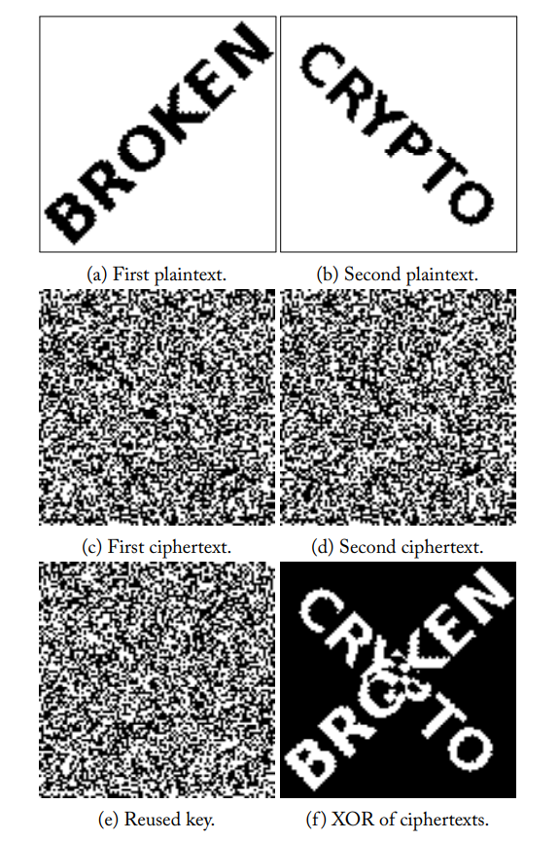
Visual Representation of information leak by reused key

Slide 28
Limitations of One time pad
Truly random key generation is expensive
Key length should be equal to data length, impractical
Key distribution and protection
Reusing keys makes it insecure

Slide 29
Types of Modern Ciphers
Symmetric Ciphers (Private Key Cryptography)
Same key used from encryption and decryption
Both parties need to agree on same key
Asymmetric Ciphers(Public Key Cryptography)
Different keys for encryption and decryption
Private key is never shared, public key is open
Eg: RSA, ElGamal
Eg: AES, DES, Blowfish, Twofish

Slide 30
Types of Modern Ciphers
Stream Ciphers
Block Ciphers
Encrypts block of certain size at once
Same key for each block
Encrypts a stream of bits
Needs to change key continuously based on previous 'state'
Eg: salsa20, SEAL, OTP
Eg: AES, DES, Blowfish

Slide 31
DES
Symmetric key method of data encryption
Designed in 1970s
Outdated
Never use DES/3DES in your systems
Successor: AES

Slide 32
How does DES work
Block Cipher, 64-bits block size
Permutation based, having 2⁶⁴ possible arrangements of 64-bits
Uses key size of 56-bit (stored as 64-bit key, but every 8th bit not used)
Encryption mechanism based on Feistel Structure
Notes:
http://page.math.tu-berlin.de/~kant/teaching/hess/krypto-ws2006/des.htm

Slide 33
How does DES work
Creates 16 subkeys, each 48-bits long
Initial Permutation (IP) on 64-bits data block
Each 64-bit permuted block divided into two 32-bit half-blocks (L and R)
16 iterations using a cipher function f(b,k) where b is block (32-bits) and k is key (48-bit subkey)
L_{n} = R_{n-1} , R_{n} = L_{n-1} + f(R_{n-1},K_{n})
Inverse Permutation (IP⁻¹) on the final 64-bits block of 16 iterations

Slide 34
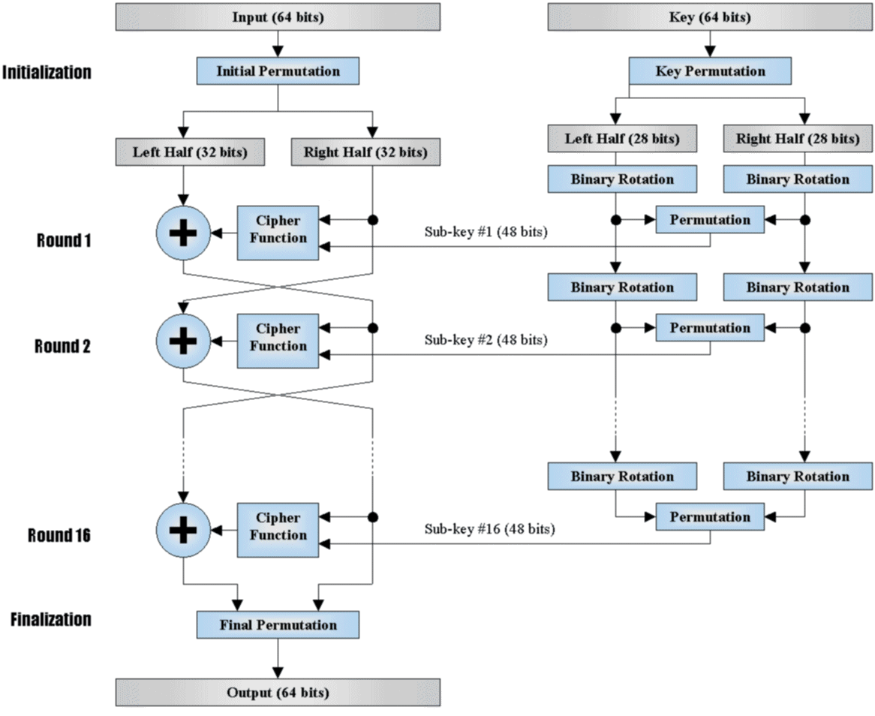

Slide 35
Cracking DES
Before DES was adopted as a national standard, Martin Hellman and Whitfield Diffie, registered some objections to the use of DES as an encryption algorithm.
Early 1998, John Gilmore and team built a machine that could brute force (try all possible 2⁵⁶ keys) in 4.5 days
July 1998, harnessed by thousands of networked computers, they were able to crack DES in 22 hours

Slide 36
3DES
Triple DES was introduced to overcome limitations of DES
3 iterations of the same DES algorithm
Uses two keys (64-bits each), A and B
EK(m)=EA(DB(EA,msg)))
For backward compatibility, A and B should be same
Susceptible to certain chosen-plaintext or known-plaintext attacks, reducing effective key size to 80-bits
80-bits is not enough security, as keyspace can be searched thoroughly by affordable consumer hardware today

Slide 37
AES/Rijndael
Block size 128-bits, key length can be 128, 192 and 256 bits
Based on Substitution-Permutation Network
Faster in both software and hardware
At present, there is no known practical attack that would allow someone without knowledge of the key to read data encrypted by AES when correctly implemented

Slide 38
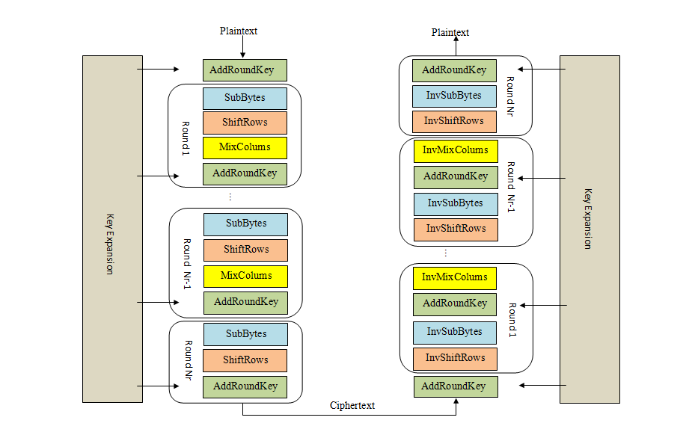
AES Encryption and Decryption

Slide 39
Key Exchange?

Slide 40
Diffie-Hellman Key Exchange
A way, where two people, over insecure channel, agree on a shared key securely
Conceptualized by Ralph Merkle
Introduced in mid 70s by Whitfield Diffie and Martin Hellman

Slide 41
Principle
Alice
Bob
A = gª
B = g^{b}
Bª
=
A^{b}
A^{b} = g^{ab} = g^{ba}= Bª
where
g – base number
A – Alice’s Public Key
B – Bob’s Public Key
a – Alice’s secret key
b – Bob’s secret key

Slide 42
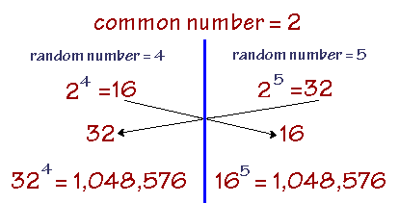
Simple Example
Demo

Slide 43
Problem solved!

Slide 44
Except…

Slide 45
Authentication
Alice
Bob
(Exchanges keys)
(Exchanges keys)
Eve
XKJHDCKSC
CSCKHEDNR
Ceasefire!
Attack!

Slide 46
How to authenticate?
Use GCM(Galcois-Counter Mode)
Use MACs (Message Authentication Codes)
Notes:
Steve

Slide 47
Before that…

Slide 48
Hashing
One way functions
No key used
Cannot be decrypted
Also called Message Digests/Fingerprints/Checksums
Typically used to provide a digital fingerprint of a file's contents
To verify file isn't altered

Slide 49
Properties of a Hash Function
Deterministic
Same message should result in same hash value
Quick
Computation should not take much time
Infeasible
There should be no way to generate a message that corresponds to specific hash value other than brute forcing all possible messages
Unrevealing
Small change to message would completely change the hash value, hence the hash value doesn’t reveal anything about the message
Minimal Collisions
It should be infeasible to compute two different messages with same hash values

Slide 50
Uses of Cryptographic Hashing
Verifying the integrity of files or messages
Password verification
Proof-of-work
File or data identifier
Pseudorandom generation and key derivation
Eg:
MD5
SHA-256
RIPEMD
Whirpool
Notes:
Parush
Verifying the integrity of files or messages[edit]
Main article: File verification
An important application of secure hashes is verification of message integrity. Determining whether any changes have been made to a message (or a file), for example, can be accomplished by comparing message digests calculated before, and after, transmission (or any other event).
For this reason, most digital signature algorithms only confirm the authenticity of a hashed digest of the message to be "signed". Verifying the authenticity of a hashed digest of the message is considered proof that the message itself is authentic.
MD5, SHA1, or SHA2 hashes are sometimes posted along with files on websites or forums to allow verification of integrity.[6] This practice establishes a chain of trust so long as the hashes are posted on a site authenticated by HTTPS.
Password verification[edit]
Main article: password hashing
A related application is password verification (first invented by Roger Needham). Storing all user passwords as cleartext can result in a massive security breach if the password file is compromised. One way to reduce this danger is to only store the hash digest of each password. To authenticate a user, the password presented by the user is hashed and compared with the stored hash. (Note that this approach prevents the original passwords from being retrieved if forgotten or lost, and they have to be replaced with new ones.) The password is often concatenated with a random, non-secret salt value before the hash function is applied. The salt is stored with the password hash. Because users will typically have different salts, it is not feasible to store tables of precomputed hash values for common passwords when salt is employed. On the other hand, standard cryptographic hash functions are designed to be computed quickly, and, as a result, it is possible to try guessed passwords at high rates. Common graphics processing units can try billions of possible passwords each second. Key stretching functions, such as PBKDF2, Bcrypt or Scrypt, typically use repeated invocations of a cryptographic hash to increase the time, and in some cases computer memory, required to perform brute force attacks on stored password digests.
In 2013 a Password Hashing Competition was announced to choose a new, standard algorithm for password hashing.[7] The winner, selected in July 2015, was a new key stretching algorithm, argon2. In June 2017, NIST issued a new revision of their digital authentication guidelines, NIST SP 800-63B-3,[8]:5.1.1.1 stating that: "Verifiers SHALL store memorized secrets [i.e. passwords] in a form that is resistant to offline attacks. Memorized secrets SHALL be salted and hashed using a suitable one-way key derivation function."
Proof-of-work[edit]
Main article: Proof-of-work system
A proof-of-work system (or protocol, or function) is an economic measure to deter denial-of-service attacks and other service abuses such as spam on a network by requiring some work from the service requester, usually meaning processing time by a computer. A key feature of these schemes is their asymmetry: the work must be moderately hard (but feasible) on the requester side but easy to check for the service provider. One popular system – used in Bitcoin mining and Hashcash – uses partial hash inversions to prove that work was done, to unlock a mining reward in Bitcoin and as a good-will token to send an e-mail in Hashcash. The sender is required to find a message whose hash value begins with a number of zero bits. The average work that sender needs to perform in order to find a valid message is exponential in the number of zero bits required in the hash value, while the recipient can verify the validity of the message by executing a single hash function. For instance, in Hashcash, a sender is asked to generate a header whose 160 bit SHA-1 hash value has the first 20 bits as zeros. The sender will on average have to try 219 times to find a valid header.
File or data identifier[edit]
A message digest can also serve as a means of reliably identifying a file; several source code management systems, including Git, Mercurial and Monotone, use the sha1sum of various types of content (file content, directory trees, ancestry information, etc.) to uniquely identify them. Hashes are used to identify files on peer-to-peer filesharing networks. For example, in an ed2k link, an MD4-variant hash is combined with the file size, providing sufficient information for locating file sources, downloading the file and verifying its contents. Magnet links are another example. Such file hashes are often the top hash of a hash list or a hash tree which allows for additional benefits.
One of the main applications of a hash function is to allow the fast look-up of a data in a hash table. Being hash functions of a particular kind, cryptographic hash functions lend themselves well to this application too.
However, compared with standard hash functions, cryptographic hash functions tend to be much more expensive computationally. For this reason, they tend to be used in contexts where it is necessary for users to protect themselves against the possibility of forgery (the creation of data with the same digest as the expected data) by potentially malicious participants.
Pseudorandom generation and key derivation[edit]
Hash functions can also be used in the generation of pseudorandom bits, or to derive new keys or passwords from a single secure key or password.

Slide 51
MAC
Message Authentication Code, slightly different from signatures
Uses a key, as in symmetric cryptography
Integrity + Authentication
HMAC (Hash Based MAC) uses hashing
MAC(k, x)

Slide 52
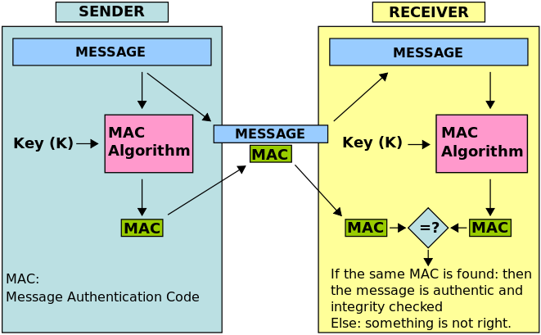

Slide 53
So…
We have safely agreed on a secret key through an unsecure channel
We have encrypted messages, sent over insecure channel
We have decrypted messages using same secret key
We have ensured integrity and authenticity

Slide 54
What’s left
Stream Ciphers
Public Key Encryption
Key Derivation
Passwords Storage

Slide 55
Questions?

Slide 56
Thank You

